Slide 1
Argentina uruguay paraguay
Spanish for Business
Lesson Eight
Los Países de la América Sur:

Slide 2
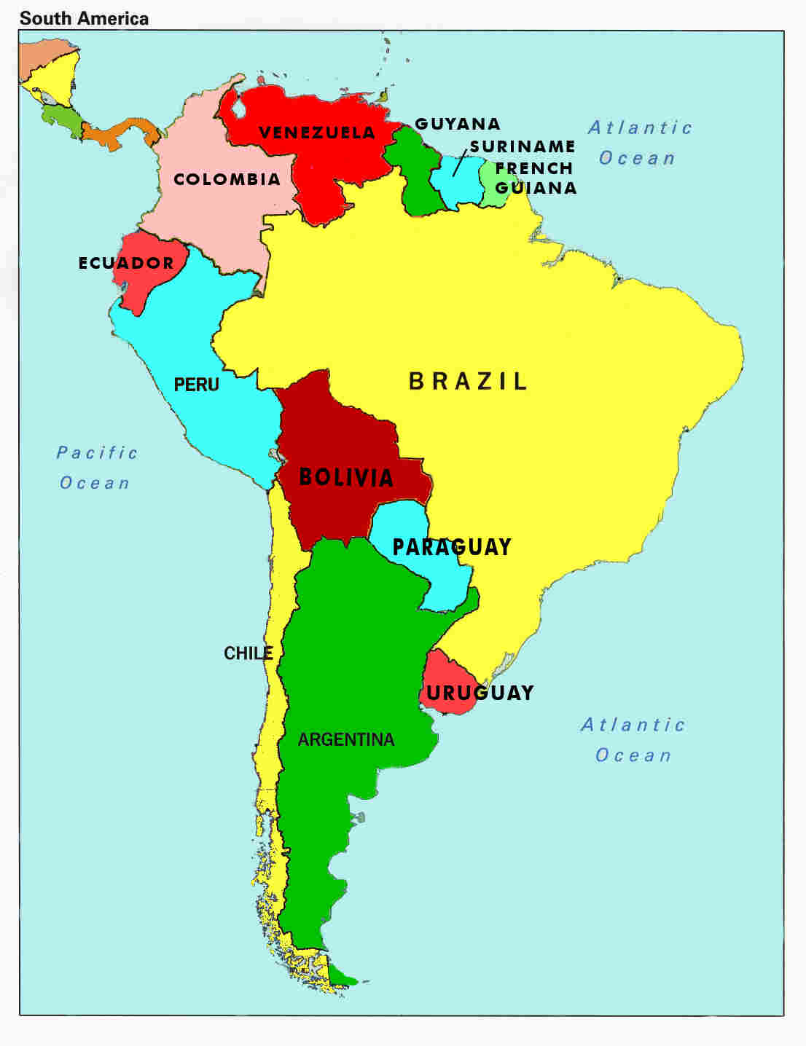
Argentina

Slide 3
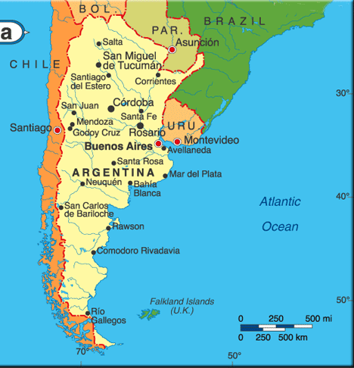
Argentina
Explore Argentina – Patagonia to the Pampas (glaciers)
Part 1 of 4 BBC Documentary 9 min
Part 2 of 4
(Buenos Aires &
Los desaparecidos)
Part 3 of 4
(Los Desaparecidos- under the dictatorship)
Part 4 of 4
(soy trade - poverty)

Slide 4
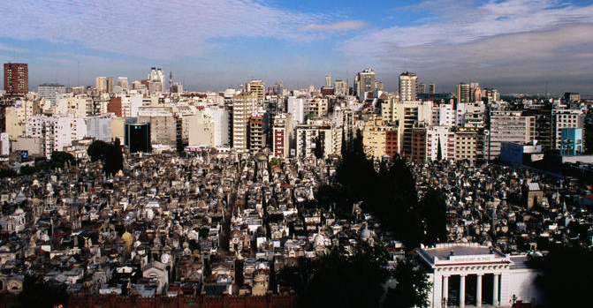
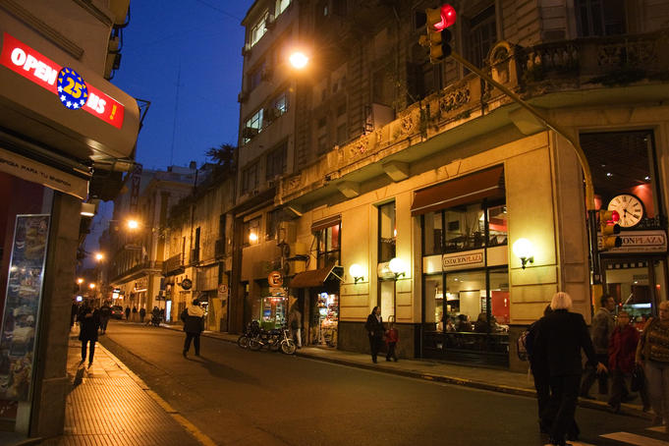
Buenos Aires : La capital
Mix together a beautiful European-like city with attractive residents (call them porteños), gourmet cuisine, awesome shopping, a frenzied nightlife and top-drawer activities, and you get Buenos Aires, a cosmopolitan metropolis with both slick neighborhoods and equally downtrodden areas – but that’s part of the appeal. It’s an elegant, seductive place with a ragged edge, laced with old-world languor and yet full of contemporary attitude. BA is somehow strangely familiar, but unlike any other city in the world.
http://www.lonelyplanet.com/argentina/buenos-aires
Travel Tips for Visiting Buenos Aires- 4 min

Slide 5
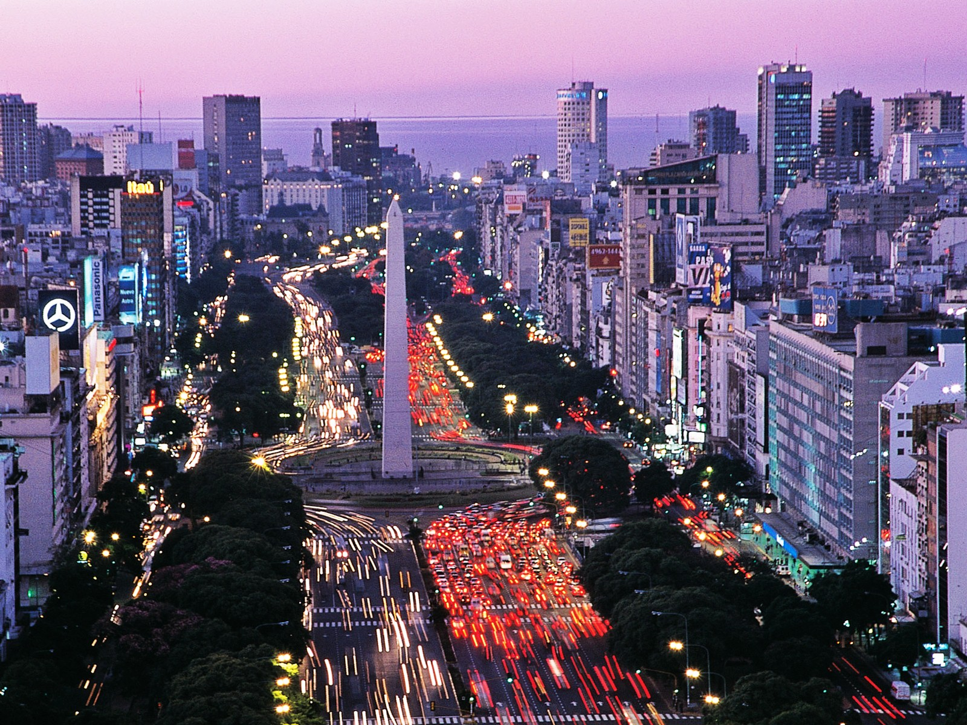
Obelisco - obelisk
Buenos Aires
Top Things to Do
By Livingradically
4 ½ min
The Real Buenos Aires
BBC Documentary
Part 1 of 2
14 min
Buenos Aires
Paris de America
En espaňol – 55 min

Slide 6
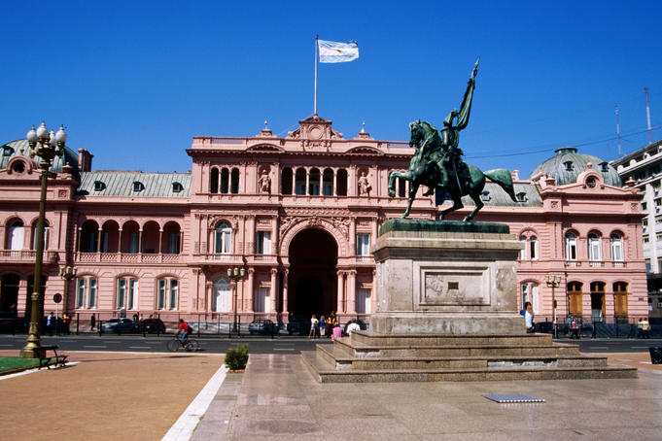
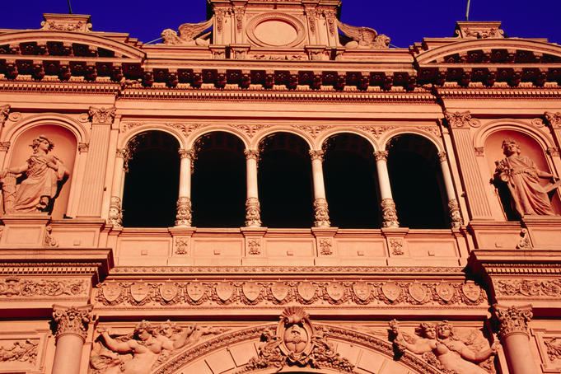
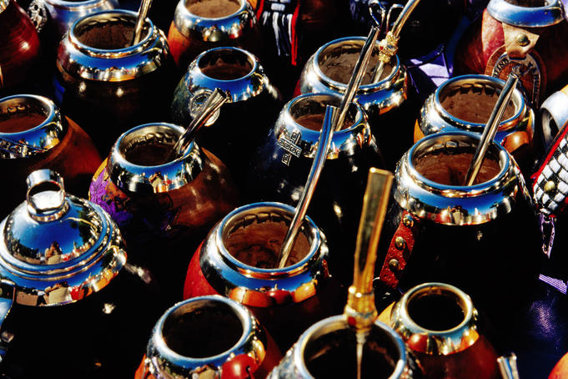
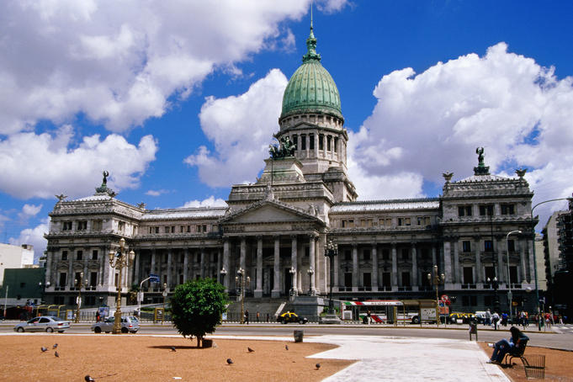
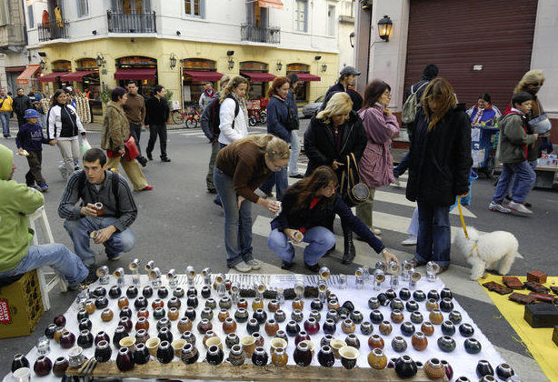
Buenos Aires: la Plaza de Mayo
Casa Rosada – Pink House
– Presidential Palace
Mate gourds for sale
Palacio del Congreso

Slide 7
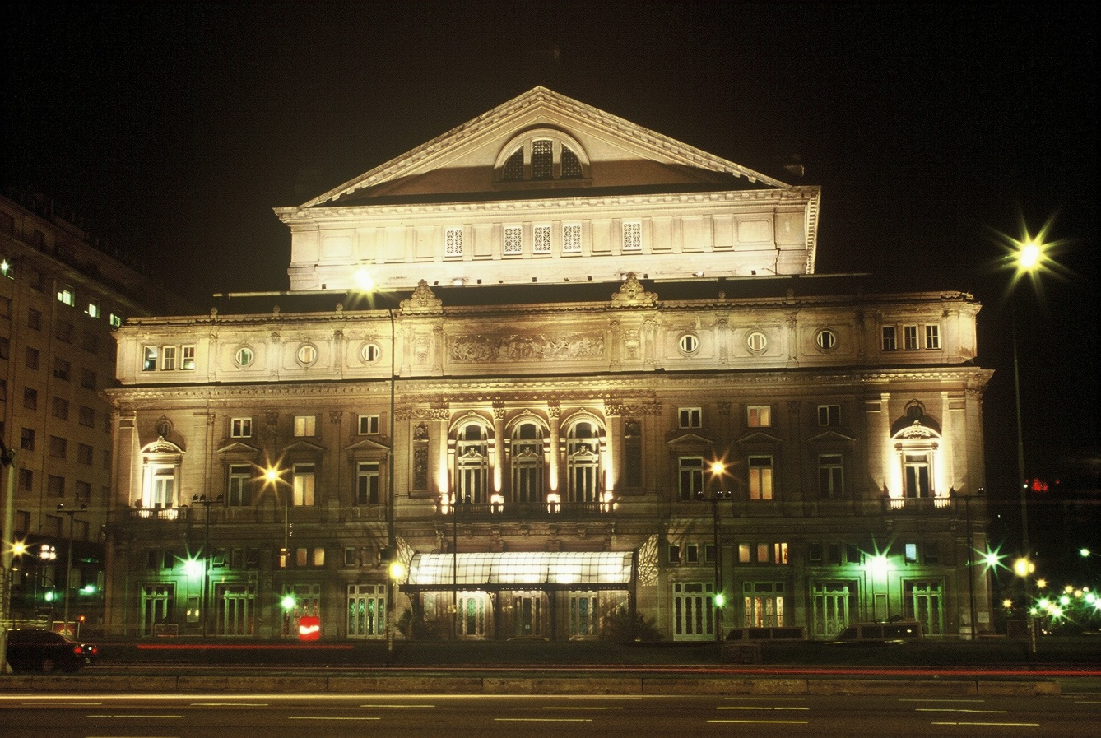
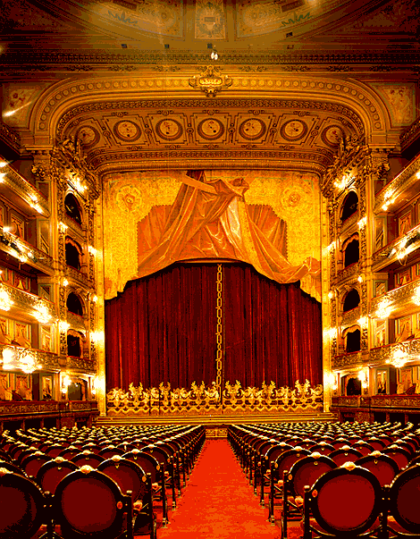
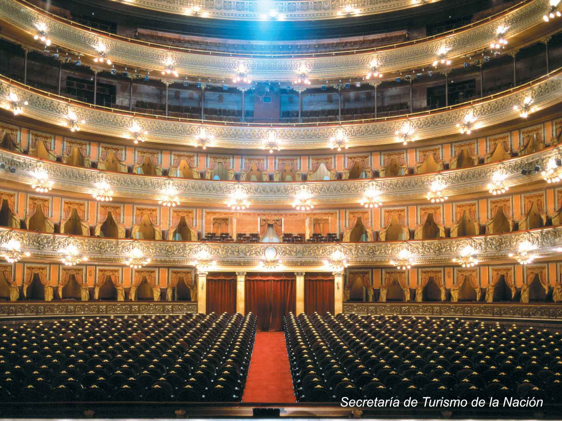
Teatro Colón

Slide 8
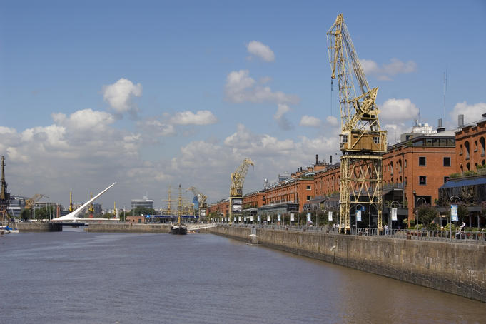
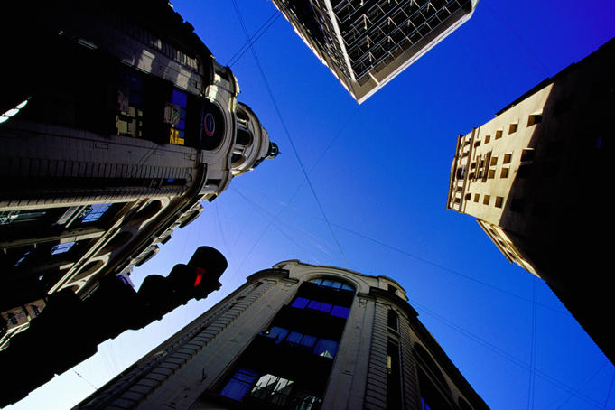
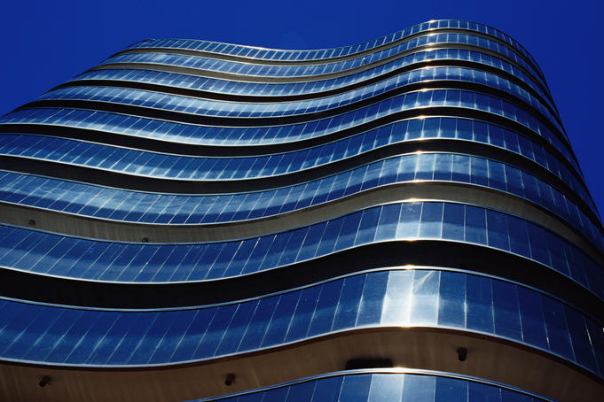
Rio de la Plata con Puerto Madero
http://www.geographia.com/argentina/buenosaires/business.htm
Buenos Aires is one of South America's premier business destinations. It has a modern business infrastructure that corresponds to international standards, and a strong economy. The major local industries are as follows:
Chemical
Mining
Oil & Gas
Automobile
Communications
Infrastructure
Banking
Food & Beverage
Electricity
Agriculture
Interview of
Global Business Experience
in Argentina

Slide 9
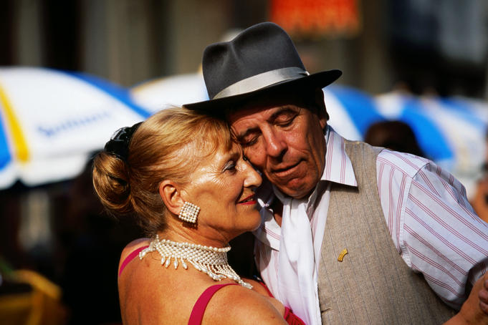
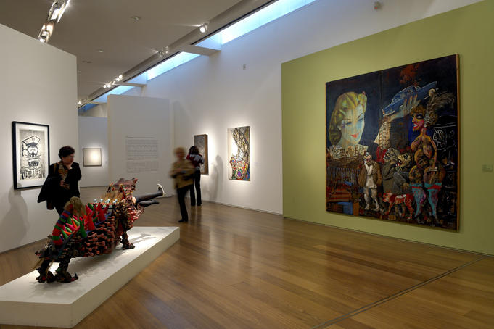
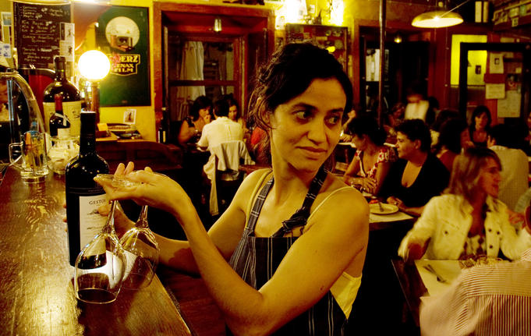
Street Tango
Tango Argentina
MALBA- Museo de Arte Latina
de Buenos Aires – 3 min
Café Tortoni

Slide 10
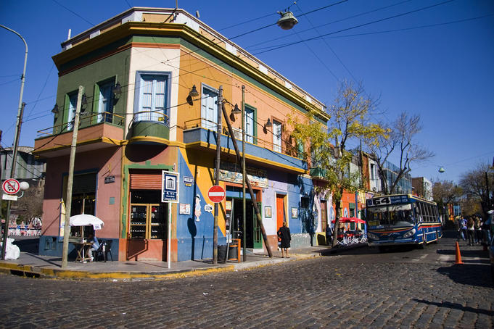
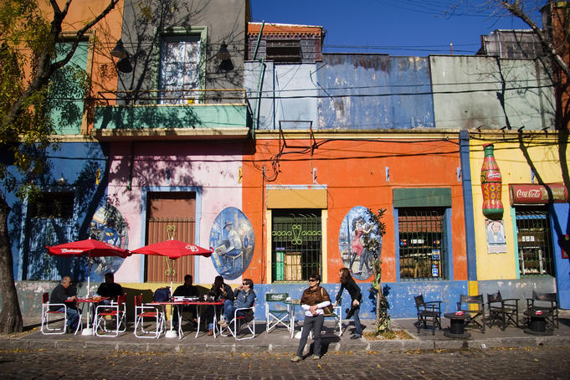
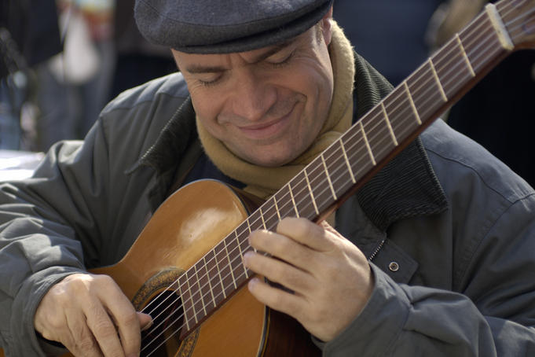
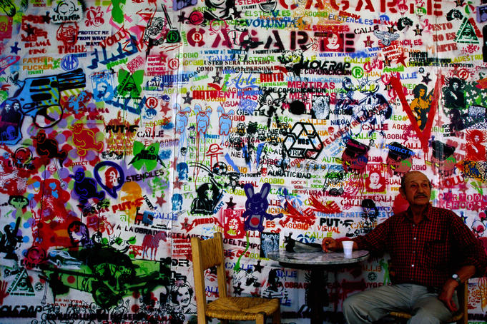
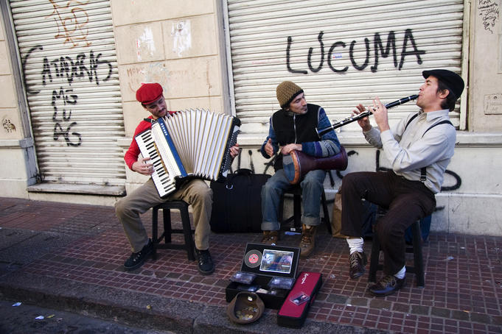
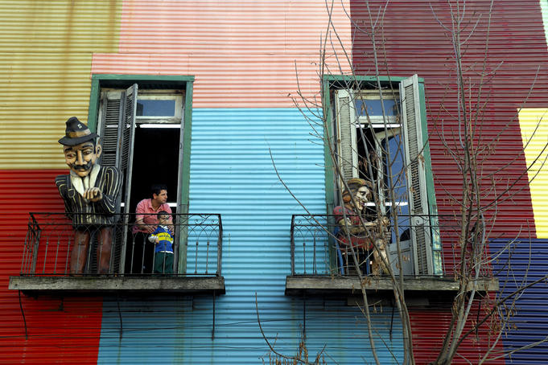
The Real
Buenos Aires
BBC Documentary
Part 2 of 2
7 min.
La Boca district
Guitarist in Plaza Dorrego
Centro Cultural Recoleta- Stencil graffiti
Sunday San Telmo Market
Balconies in el Caminito

Slide 11
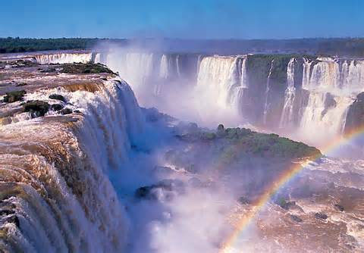
IguazÚ- waterfalls
Taller than Niagara Falls, twice as wide with 275 cascades spread in a horsehoe shape over nearly two miles of the Iguazu River, Iguazú Falls are the result of a volcanic eruption which left yet another large crack in the earth.
During the rainy season of November - March, the rate of flow of water going over the falls may reach 450,000 cubic feet (12,750 cubic m) per second.
The name of the falls comes from the Guaraní word for "great water."
http://gosouthamerica.about.com/cs/southamerica/a/IguazuFalls.htm

Slide 12
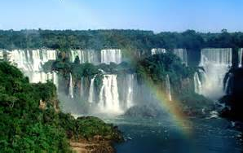
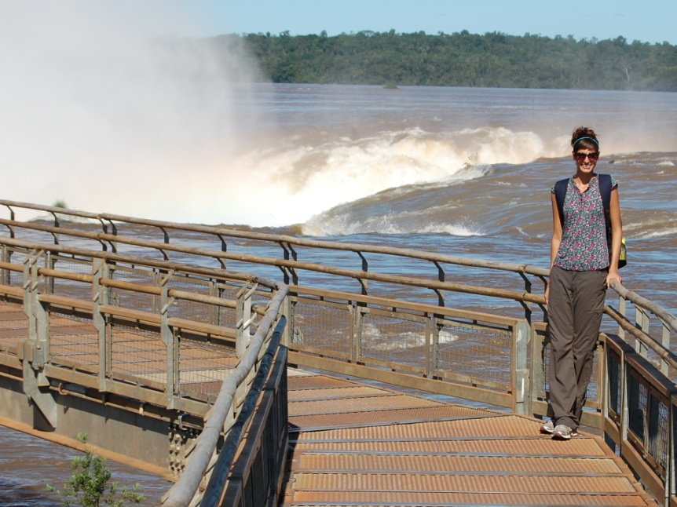
The falls are part of a singular practically virgin jungle ecosystem protected by Argentine and Brazilian national parks on either side of the cascades. Two thirds of the falls are on the Argentinian side of the river where you can also tour Iguazú National Park where there are jungle trails and bird hikes. Plan a full day in the park to fully enjoy the wildlife flora and fauna.
From the Argentine side you can take a series of catwalks over the water rushing into Devil's Gorge. Protective rain suits are provided. There are some areas where it is possible to swim in the spray of the cascades. Ask locally for instructions but be aware that you might have a resulting problem with cuticle parasites.
The best times to see Iguazu Falls are in the spring and fall. Summer is intensely tropically hot and humid, and in winter the water level is considerably lower. There are hotels on both sides of the river and many tour agencies provide sightseeing opportunities around the area

Slide 13
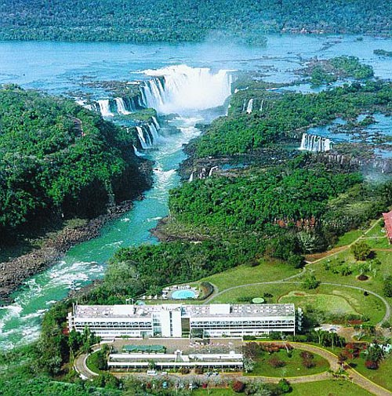
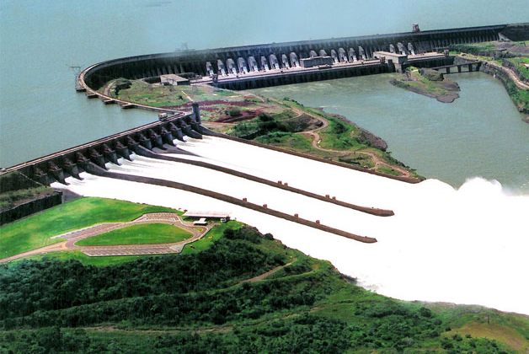
The vast power of the falls was not fully utilized until the construction of the huge Itaipu hydroelectric power plant built jointly by Paraguay and Brazil. Completed in 1991 the dam is open to tours and provides 12,600,000 KW of power satisfying almost 40% of Brazil and Argentine power needs. The dam one of the largest in the world is touted by both countries as a masterpiece of technology.
http://gosouthamerica.about.com/cs/southamerica/a/IguazuFalls.htm

Slide 14
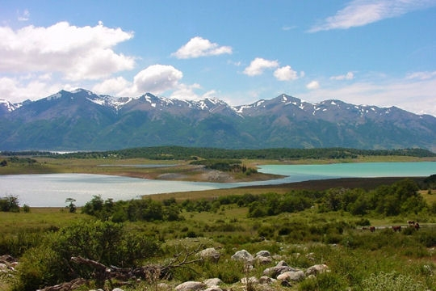
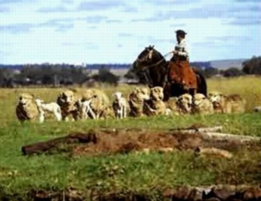
Pampas – grasslands
Explore Argentina: Patagonia to the Pampas BBC Documentary Part 3 of 4 at 6:40
The Pampas of South America are a grassland biome. They are flat, fertile plains that covers an area of 300,000 sq. miles or 777,000 square kilometers, from the Atlantic Ocean to the Andes Mountains. It is found primarily in Argentina and extends into Uruguay. The word Pampas comes from the Guarani Indian word for level plain. The Argentinean Pampas are the home of the 'Gaucho', the original South American cowboy.
http://www.blueplanetbiomes.org/pampas.htm

Slide 15
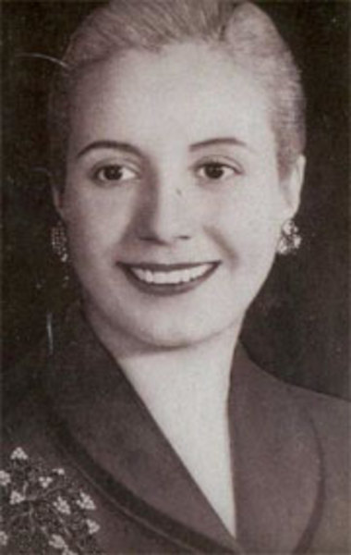
La gente famosa: Eva perón
Eva Perón was born May 7, 1919, in Los Toldos, Argentina. Growing up in small towns with little money, Perón dreamed of becoming actress. She moved to Buenos Aires in 1930s and had some success as a performer. Her life changed dramatically when she married Juan Perón, a colonel and government official, in 1945. He became president of Argentina the following year and she was a powerful political influence on him. Eva Perón used her position as first lady to fight for women's suffrage and improving the lives of the poor, and became a legendary figure in Argentine politics.
http://www.biography.com/people/eva-peron-9437976

Slide 16
Eva Duarte de Perón became a legendary figure in Argentine politics. A skilled speaker, she was adored by the poor she worked hard to help, but she was not without critics and detractors.
She tried to run for vice president with her husband in 1951, but she was opposed by the army.
She died of cancer in Buenos Aires on July 26, 1952. Since her death, her life continues to fascinate people around the world and was the basis for the successful musical Evita (1979).
Don’t Cry for Me Argentina

Slide 17
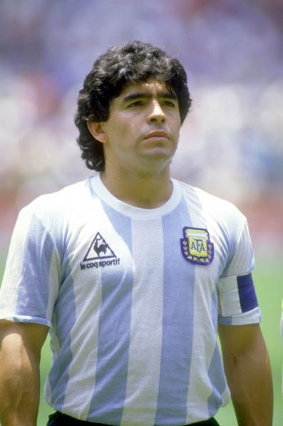
La gente famosa: diego Maradona (1960- )
Soccer player
Diego Armando Maradona was born on October 30, 1960, in Buenos Aires, Argentina. Maradona led club teams to championships in Argentina, Italy and Spain, and famously starred for the Argentinean team that won the 1986 World Cup. However, the soccer legend's career was marred by a pair of high-profile suspensions for drug use, and he has often battled health problems in retirement.
http://www.biography.com/people/diego-maradona-9398176

Slide 18
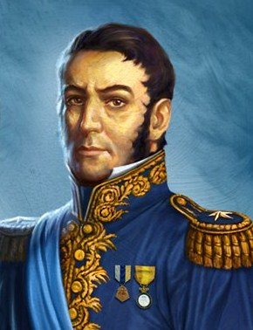
La gente famosa
José de San Martín
1778-1850
Independence leader
Helped lead the revolutions against Spanish rule in Argentina (1812), Chile (1818) and Peru (1821)
For 20 years he was a loyal officer of the Spanish monarch, fighting against the Moors, the British and the Portuguese….In later years, San Martín averred that he had sacrificed his career in Spain because he had responded to the call of his native land, and this is the view taken by Argentinian historians.
http://www.britannica.com/EBchecked/topic/521474/Jose-de-San-Martin

Slide 19
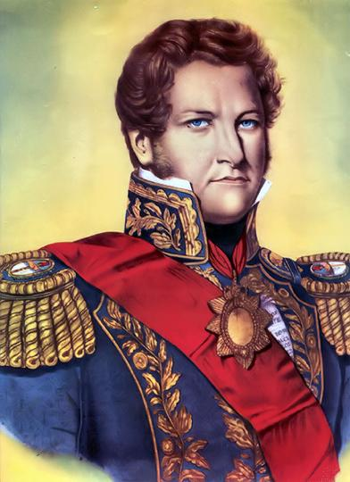
Gente Famosa: Juan Manuel de rosas (1793-1877)
Manuel Dorrego, governor of Buenos Aires, Rosas was appointed head of the provincial militia in 1820 . After Dorrego was overthrown in 1828, Rosas opposed the new governor, Juan Lavalle. Rosas reconvened the former legislature, which elected him governor on Dec. 5, 1829. As head of the Federalist Party, Rosas was opposed by Lavalle’s unitarios (centralists). He left his post to his legal successor at the end of his term but returned to the governorship once again in 1835. He agreed to return only under the condition that he receive dictatorial powers.
Rosas’s 17-year dictatorship was noted for its law and order through tyranny. His spies and the Mazorca, a ruthless secret police force, intimidated all opposition, so that by 1840 few dared to oppose him. He also ordered the display of his portrait in public places and churches as a sign of his supreme command. Finally a coalition of Brazilians, Uruguayans, and native Argentinians, under the leadership of Justo José de Urquiza, overthrew Rosas at the Battle of Caseros (Feb. 3, 1852).
http://www.britannica.com/EBchecked/topic/509675/Juan-Manuel-de-Rosas

Slide 20
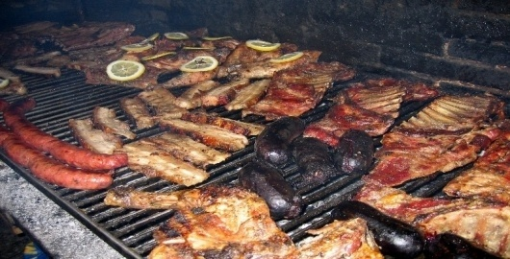
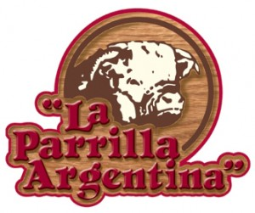
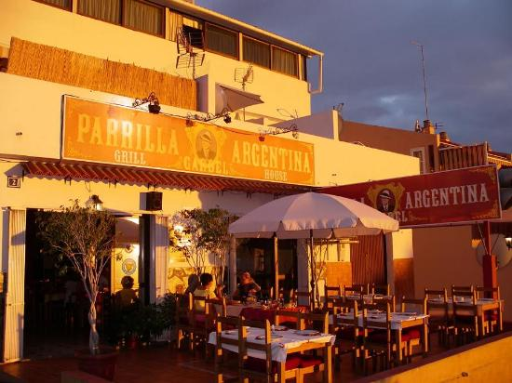
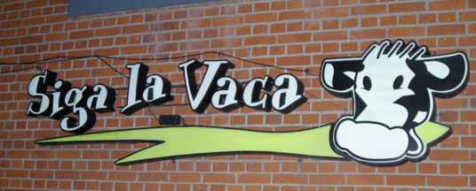
Comida de argentina: parilla

Slide 21
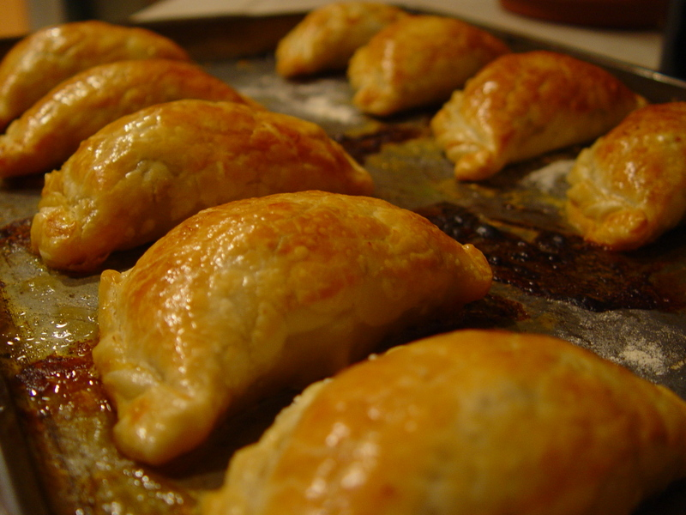
Comida de argentina: empandas
What sets Mendoza-style empanadas apart from others is that they are baked rather than fried. The typical filling is seasoned ground beef with a slice of green olive and a slice of hard-boiled egg. They are sealed with a special technique called 'repulgue', in which the edges of the empanada are folded and pressed over and over again to create a pattern.
Folding Video
http://fromargentinawithlove.typepad.com/from_argentina_with_love/2008/05/empanada-of-the.html

Slide 22
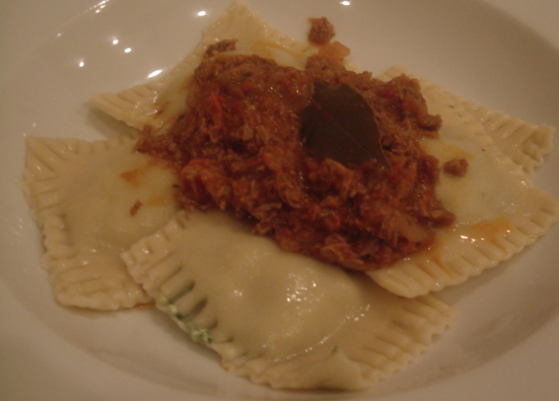
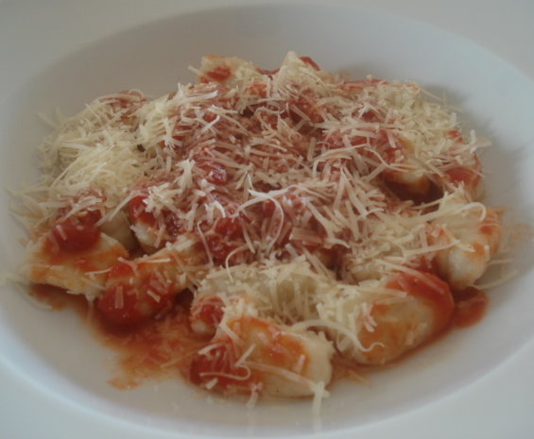
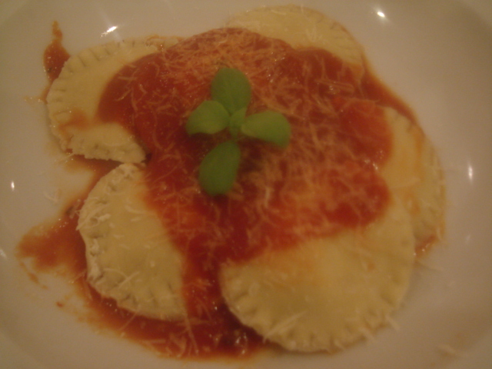
Comida de argentina: Italian pasta dishes
It´s well known that Buenos Aires like New York was flooded with Italians during and after the II World War and with them they bring all their recipes. Argentina is worldwide famous for its quality beef, but also in the cafes and restaurant of Buenos Aires the pizzas and pasta are the also the star dishes at the Argentinian homes..
http://kitchenvoyage.blogspot.com/2012/01/argentina-pasta-recipes.html

Slide 23
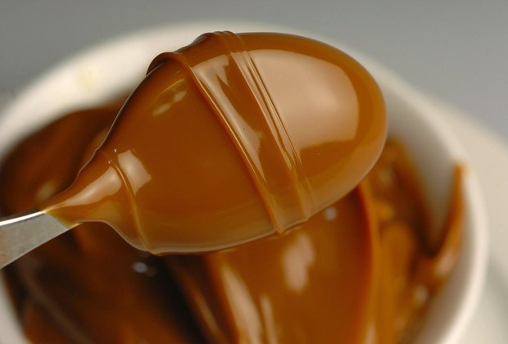
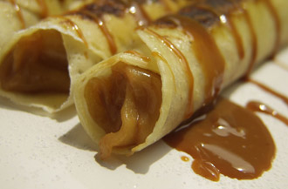
Comida de argentina: dulce de leche
Sweet, caramelized condensed milk
History of Dulce de Leche
Video - How to Make it
Argentines love sweet stuff, they can eat ice cream anytime of the year, even in the freezing winter at 0 degrees Celsius. They can stuff themselves with a whole beef steak and still have room reserved in their stomachs for a caramel custard (flan), or a crepe filled with dulce de leche (panqueque de dulce de leche). It seems this nation never tires of thick, sweet, overly powerful desserts that make your knees go weak after an initially sugar kick.
http://dishbydish.net/2012/08/08/dulce-de-leche-argentinas-favourite-sweet-sauce/

Slide 24
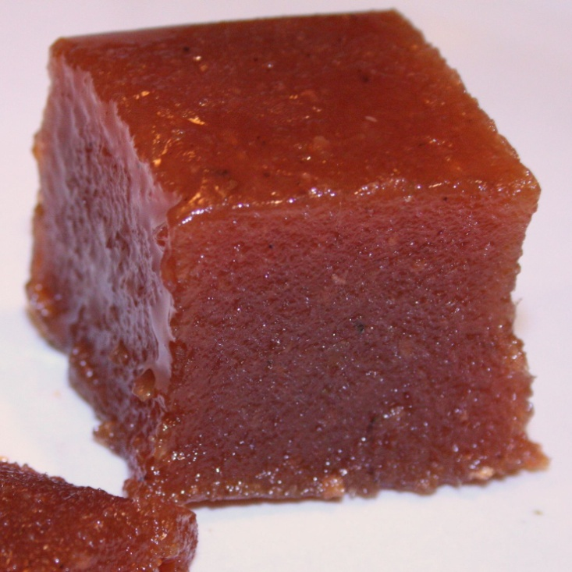
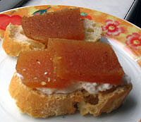
Comida de argentina: dulce de membrillo
Dulce de Membrillo is a sweet, very dense jelly made from the fruit of the quince tree. The quince is a relative of the apple and the pear and is golden yellow and looks like a large lumpy pear. Unlike the jellies we are used to eating in the USA, membrillo is dense enough to hold its shape. So, it is normally sold in squares or “bricks,” then cut into thin slices and spread over plain toast or toast with soft or cream cheese. Some people prefer to serve it with Manchego cheese to have a salty contrast to the sweetness of the membrillo.
http://spanishfood.about.com/od/dessertssweets/a/Membrillo.htm
Cooking Show –
Making Dulce
de Membrillo – pt 1
2
3

Slide 25
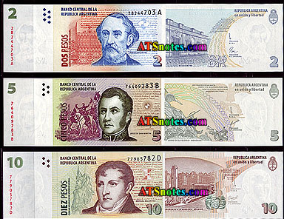
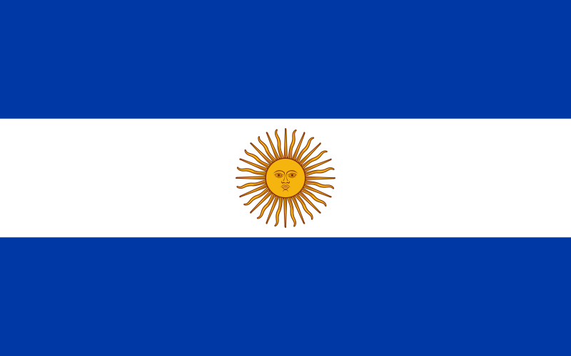
Other facts
Cross Cultural Management Practices:
Argentina - University Presentation
La Moneda Nacional: Peso
El ingreso anual- $6,050 per year
La población –39.5 million

Slide 26
Business Etiquette in Argentina
Make sure to cover your mouth when yawning or coughing
Don’t put your feet up on any furniture
Eating in the street or on public transportation is considered rude
Argentine executives may put in a very long day, often lasting until 10:00 p.m.. An 8:00 p.m. business meeting is not unusual
At a meal, crossing the knife and fork signal "I am finished". When dining, keep your hands on the table, not in your lap
Titles, especially among the elderly, are very important. Address a person directly by using his or her title only. Persons who do not have professional titles should be addressed as Sr., Sra., Srta.
Argentines are tough negotiators. Concessions will not come quickly or easily.
Contracts are lengthy and detailed. A contract is not final until all of its elements are signed. Any portion can be re-negotiated. Get everything in writing.
Be punctual for business appointments, but prepare to wait thirty minutes for your counterpart, especially if you are meeting an important person.
The pace of business in Argentina is slower than in the United States.
Argentines often need several meetings and extensive discussion to make deals.
During business meetings, sustain a relaxed manner, maintain eye contact and restrict the use of gestures. Don’t take a hard sell approach
http://www.cyborlink.com/besite/argentina.htm

Slide 27
uruguay

Slide 28
uruguay
Natural Tourism
Promotional Video 10 min
Narrated Tour of Montevideo, Punta del Este, Colonia
– 11 min

Slide 29
Lugares para visitar: montevideo: La Capital
Uruguay’s capital and by far its largest city, Montevideo is a vibrant, eclectic place with a rich cultural life. The city wears many faces, from its industrial port to the exclusive residential suburb of Carrasco near the airport. In the historic downtown business district, art deco and neoclassical buildings jostle for space alongside grimy, worn-out skyscrapers, while across town the shopping malls and modern high-rises of beach communities like Punta Carretas and Pocitos bear resemblance to Miami or Copacabana.
http://www.lonelyplanet.com/uruguay/montevideo

Slide 30
Montevideo’s polluted air and honking taxis may feel a bit jarring, but stick around. The capital’s active and resurgent urban culture is a palpable force, and locals are justifiably proud to share it with you. In Ciudad Vieja, the heart of historic Montevideo, old buildings are being restored to make room for boldly painted cafés, hostels and galleries, while down by the port the municipal administration has spruced up the Mercado del Puerto to accommodate a new city tourist office and Carnaval museum. Montevideo serves as administrative headquarters for Mercosur, South America’s leading trading bloc, and the capital’s many embassies and foreign cultural centers add to the international flavor. Meanwhile, the city’s music, theater, art and club scenes continue to thrive, from elegant older theaters and cozy little tango bars to modern beachfront discos..
http://www.lonelyplanet.com/uruguay/montevideo

Slide 31
Top Things to Do - 2 min
Uruguay is the most peaceful country in South America with the least crime, violence and insecurity. It has well-educated human resources.
http://www.indembarg.org.ar/en/gbvuy_guide.htm

Slide 32
Montevideo Uruguay is the country’s capital city and main base for visiting tourists. A compact and eclectic place, it well reflects Uruguay’s general prosperity; in fact, the residents of Montevideo were recently listed as enjoying South America’s highest quality of life. Visiting here is just as fun as living here: There are plenty of historical sites to see, excellent accommodation options, and a vibrant shopping and nightlife culture. Uruguay may be a relative newcomer to the international travel market, but Montevideo is way ahead of its time.
The Greeting Man sculpture
http://www.destination360.com/south-america/uruguay/montevideo
Montevideo en espaňol – 4 min

Slide 33
Business
Uruguay is one of the most stable, transparent and efficient markets in Latin America. Government policies and business practices of the private sector are predictable, transparent and rule-based. Corruption is one of the lowest in Latin America..
Uruguay’s competitive advantage is in agriculture. The land is fertile and water is plenty. Seeing the opportunities arising from global food insecurity, Uruguay is focusing on increasing agricultural production.
The agribusiness is well organized in Uruguay with mechanization and outsourcing. Main exports are soy, wheat, rice, cotton, wool, meat, leather and paper pulp.
Uruguay is offering competitive incentives for foreign investors to set up assembly units in the Zona America for exports to the rest of South America.
Montevideo port is developing as a hub for trade with South America. There are bonded warehouses for storage and distribution to the region.
http://www.indembarg.org.ar/en/gbvuy_guide.htm

Slide 34
Colonia de Sacramento
Portón de Campo
Photos and Music
Colonia del Sacramento, in Uruguay's province of Colonia, is steeped in history. It was the only Portuguese settlement along the Rio de la Plata. Founded as Nova Colonia do Sacramento in 1680 by Manuel de Lobo,and as such was the focus of struggle between the Spanish, who founded the settlement at Montevideo in response, and the Portuguese over control of the area. For years it operated as a contraband port, evading the strictures imposed on trade by the Spanish crown. Today it is a resort city, a port, and the trade center for a rich agricultural region.
http://gosouthamerica.about.com/cs/southamerica/a/UruColSacto.htm

Slide 35
Colonia
Built in Portuguese style of houses and cobblestoned streets, the historic portion of Colonia is reminiscent of old Lisbon. Winding streets and colorful houses are laid out in a pattern different from Spanish colonial cities, and a delight to explore. The historic quarter, Barrío Historico, on a small peninsula jutting out into the river, was named a UNESCO heritage site in 1995
http://gosouthamerica.about.com/cs/southamerica/a/UruColSacto.htm

Slide 36
Colonia
Colonia del Sacramento is across the Rio de la Plata from Buenos Aires, and is the main water thoroughfare for visitors from Argentina to access any part of Uruguay. Many travelers stop to enjoy the excellent restaurants, art and craft shops, museums and a large yacht harbor
Explore Colonia
http://gosouthamerica.about.com/cs/southamerica/a/UruColSacto.htm

Slide 37
Calle de los suspiros en Colonia
Probably the most photographed part of Colonia del Sacramento in Uruguay is the Calle de los Suspiros which can be literally translated as the 'Street of Sighs'.
There are different theories about how it got its name. One is that criminals used to get hung at the end of the street (no records to back this up so it can be dismissed). Another is that prostitutes used to line the street to tempt the sailors (where the sighs come in there are best left to your imagination), and a final one about a lover that was killed on this street and with her last breath (sigh) calling her partner (which I suspect was invented to try and romanticize the street).
http://www.southamerica.cl/Uruguay/Calle_de_los_Suspiros_Colonia.htm

Slide 38
Punta del este
Guided Tour
Tourism is an important revenue source. Punta del Este is a famous holiday resort for the rich and famous of Latin America, especially in the period December-February. Argentines are the main tourists and many have holiday homes in Punta del Este.
http://www.indembarg.org.ar/en/gbvuy_guide.htm

Slide 39
Gente famosa de uruguay
José Gervasio Artigas (1764-1850)
Independence Leader against Brazil and Portugal
In 1810 José Gervasio Artigas offered his services to the Buenos Aires junta that was leading an independence movement against Spain. After winning at Las Piedras, he besieged Spanish-held Montevideo for a time. He then became the champion of federalism against the efforts of Buenos Aires to assert centralized control. From 1820 he lived in exile in Paraguay. Uruguay achieved independence in 1828.
http://www.biography.com/people/jos%C3%A9-gervasio-artigas-37105

Slide 40
Gente famosa de uruguay
Virginia Patrone (1950- )
Painter

Slide 41
Gente famosa de uruguay
Natalia Oreiro (1977- )
Singer, actress
Me Muero de Amor- Music Video
Entrevista en espaňol

Slide 42
Comida de uruguay: asado
Asado is the national dish. Uruguay's meat has very good fame because the conditions for cattle growing are ideal in this part of the world.
Typical Asado
Asados are social activities, instead of charcoal the meat is roasted by making a fire from wood, and using the embers to cook the meat. It's a time consuming process, but all for the better, because while someone is preparing the fire (el asador) everyone else gets to eat snacks, and play cards ("truco" typically). It's typical to put some parmesano provolone cheese on the grill, and to serve hot cheese as entrance, along with the snacks. The meat is placed in a big, big grill, called "parrilla", expected to support considerable amounts of meat, and sausages.
http://www.from-uruguay.com/2005/10/food-asado.html

Slide 43
Comida de uruguay : chivito
Chivitos and Groceries In Uraguay
The chivito (whose name translates to "little goat") is a serious sandwich filled with meat. The star ingredient is a slice of churrasco (grilled, thin sliced beef), which is topped with slices of ham, bacon, lettuce and tomato, melted mozzarella cheese, and a fried egg. Optional toppings include cooked onions, olives, peppers, and pickles. Salsa golf, a mixture of ketchep and mayonnaise that is popular in Argentina and Uruguay, is the perfect condiment for this sandwich.

Slide 44
Comida de uruguay : italian pasta dishes
While the food in most South American countries has some Spanish influence, in Uruguay one can find many popular Italian dishes including pizza, sausage and all varieties of pasta.
http://foodspring.com/content/uruguay/
Pasta with Caruso sauce: This famous Uruguyan pasta sauce is named after Enrico Caruso, a well-known opera singer who visited Montevideo in the early 20th century. Italian food (especially pasta) is very popular in Uruguay, but Uruguayans like to add their own touch to traditional Italian dishes - like the beef broth to this creamy ham and cheese sauce. The result is delicious.
http://southamericanfood.about.com/od/maincourses/r/Uruguayan-Pasta-With-Caruso-Sauce.htm

Slide 45
Comida de uruguay: gnocchis
Gnocchi (known as "ñoquis") is traditionally eaten on the 29th day of each month. This was the day before payday, when people were at their poorest. Gnocchi made a cheap and hearty meal. On these occasions, some people leave a coin or a banknote under the plate to attract prosperity
http://www.oocities.org/heartland/7187/food-and-recipes-from-uruguay.html

Slide 46
Comida de uruguay : alfajores
Short bread cookies with dulce de leche in the middle

Slide 47
Other facts
La Moneda Nacional:Peso
El ingreso anual-
$6,380 per year
The majority of the people are middle class; the extremes of wealth and poverty found in most other South American countries don't exist.
Uruguayans stand very close when conversing, both socially and in business. People touch shoulders and hold arms while they talk to each other.
The “ch-ch” sound is used to get someone's attention or to get a bus to stop.
The North American “O.K.” sign is extremely rude.
Meetings are extremely formal, but don't usually start on time. However, be sure to arrive on time.
Hire a local contact to help you in the business community and to navigate you through red tape.
A highly trained and educated businessperson may be working at a low-level position due to exile, imprisonment or political affiliation. Do not ask questions.
It is extremely impolite to use a toothpick in public.
Uruguayans dress conservatively and seldom wear the bright colors popular elsewhere in South America.
Uruguayans are extremely political people. Ask about politics.
A foreign woman will have no problem doing business in Uruguay. It may even be an advantage. Men like to be with and enjoy doing business with women.
http://www.ediplomat.com/np/cultural_etiquette/ce_uy.htm
La población –3.3 million

Slide 48
paraguay

Slide 49
Paraguay Tourism:
You Have to Feel It!
2010 – 8 min
We Feel It – 6 min

Slide 50
Lugares para visitar: La Capital: asunción
It’s hard to get your head around Asunción. At heart she is beautiful, with a sprinkling of original colonial and beaux-arts buildings, international cuisine, shady plazas and friendly people. Her more-recent and modern demeanor boasts new, seemingly endless suburbs, ritzy shopping malls and smart nightclubs.
But her sophistication hides blemishes: the Río Paraguay backdrop and its shanty shacks, dengue fever–carrying mosquitoes, diesel-spewing buses, stark utilitarian architecture and oppressive heat and humidity.
Asunción claims to have 1.2 million people, yet seems to hold many more – her sprawling suburbs have joined with neighboring towns. Despite her flaws, she’s well worth getting to know.
http://www.lonelyplanet.com/paraguay/asuncion

Slide 52
itaipÚ
The world’s largest generator of renewable, clean energy.
The Itaipu Dam is a hydroelectric dam on the Paraná River located on the border between Brazil and Paraguay. The name "Itaipu" was taken from an isle that existed near the construction site and means "the sounding stone".
The dam is the largest operating hydroelectric facility in terms of annual energy generation. It is a binational undertaking run by Brazil and Paraguay at the Paraná River on the border section between the two countries. In 2008 the plant generated a record 94.68 TWh, supplying 90% of the electricity consumed by Paraguay and 19% of that consumed by Brazil.
http://www.itaipu.gov.br/en
Watch the power of the water
http://en.wikipedia.org/wiki/Itaipu_Dam

Slide 53
Gente famosa: Francisco solano lópez
Dictator (1826-1870)
Leader of the War of Triple Alliance against Argentina, Brazil, and Uruguay in which Paraguay lost.

Slide 54
Gente famosa
Alfredo Strossner
(1912- 2000)
Dictator (1954-1989)
.
Under his rule the country became a haven for Nazi war criminals, peaceful opposition was crushed and the indigenous population was persecuted. Stroessner was one of the great strongmen of South American politics. Indeed, during the 20th Century, only Cuba's Fidel Castro served as head of state in the continent for a longer period of time. A violent dictator to many, others saw him as a bulwark against communism
http://news.bbc.co.uk/2/hi/americas/4792281.stm

Slide 55
Gente famosa
Celeste Troche (1981- )
Professional Golfer

Slide 56
Comida de Paraguay: yerba mate tea
Yerba Mate has the “strength of coffee, the health benefits of tea, and the euphoria of chocolate" all in one beverage.
Yerba mate is made from the naturally caffeinated and nourishing leaves of the celebrated South American rainforest holly tree. For centuries, South America’s Aché Guayakí tribe have sipped yerba mate from a traditional mate gourd for its rejuvenative effects. These rainforest people find tremendous invigoration, focus, and nourishment in yerba mate.
The leaves of the rainforest mate tree naturally contain 24 vitamins and minerals, 15 amino acids, abundant antioxidants. In fact, The Pasteur Institute and the Paris Scientific society in 1964 concluded "it is difficult to find a plant in any area of the world equal to mate in nutritional value" and that yerba mate contains "practically all of the vitamins necessary to sustain life."
http://guayaki.com/mate/130/Yerba-Mate.html

Slide 57
Comida de paraguay: sopa paraguaya
Cornbread of smashed corn, cheese, milk, and onions
Sopa Paraguaya is a rich and tasty cornbread. There are several explanations for why the name of this cornbread translates to "Paraguayan soup." One theory is that the recipe resulted from a long ago failed corn soup experiment. Another says it's because it's often served with soup. The name may not make sense, but sopa paraguaya is a wonderful accompaniment to many dishes (including soup!).

Slide 58
Other facts
La Moneda
Nacional:
Guaraní
El ingreso anual- $1,670 per year
La población –6.1 million

