Slide 1
Artists of Mexico
José Guadalupe Posada(1852-1913)
Diego Rivera (1886-1957)
José Clemente Orozco (1862-1949)
David Alfaro Siqueiros (1896-1974)
Frida Kahlo (1907-1954)

Slide 2
Posada 1852- 1913
José Guadalupe Posada was born in the state of Aguascalientes, Mexico. In his early life he worked as a teacher of lithography and in 1887, he moved to Mexico City where he became a newspaper illustrator.
His graphic work is well recognized and he often dealt with political, social and moral themes. Posada's "calaveras" (skeletons) are images often associated with the the Day of the Dead, but their original intent was more satirical. "La Catrina or the Female Dandy was originally intended to poke fun at the upper class, during the autocratic rule of Porfirio Diaz.

Slide 3
La calavera catrina
The calavera of the fashionable lady Zinc relief etching

Slide 4
Gran fandango y francachela de todas las calaveras
Happy dance and wild party of all the skeletons metal engraving

Slide 5
Calavera depicting contemporary newspapers as skeleton cyclists
c. 1889-1895 metal engraving

Slide 6
Calavera of Don Quijote
metal engraving

Slide 7
Calavera Zapatista

Slide 8
Calavera Huertista
Calavera de la Adelita

Slide 9
Calavera de Artistas y Artesanos

Slide 10
Calavera de Catrín
Calavera de Don Juan Tenorio

Slide 11
Calavera del Gato Marrón

Slide 12
Calavera de la Intervención

Slide 13
Posada is a popular artist in the deepest and highest sense of the word; popular because of his humble origin; popular, because of the definite class feeling he brings into each of his works; popular, because he was not an artist without antecedents, a phenomenon foreign to the world in which he lived, but rather the outburst of the feelings of a striving people; popular, because of the way he studied and lived in direct contact with life and the way in which he conscientiously listened to the demands of Mexico.

Slide 14
Posada la Primera
Posada represents in Mexico the beginnings of a social tendency in art. His work was produced in a moment of crisis, at a decisive moment of Mexican history, and just as the great pre-Hispanic and Colonial became creative in intensely religious periods, his marks the hour of economic independence which Juárez accomplished in the political sense with the defeat of feudalism. His art was the living weapon which contributed to the decline of that social order, at the same time making Mexican art truly human. With Posada there appears in the field of professional art the first feeling of nationalism.

Slide 15
Los Tres Grandes
Diego Rivera (1886-1957)
Jose Clemente Orozco (1862-1949)
David Alfaro Siqueiros (1896-1974)

Slide 16
Mexican Muralism
History – intellectual community emerged in response to the tyranny of President Porfirio Diaz under whom 2/3 of people lived in poverty; inspired by Posada and Dr. Atl
1920’s – 1960’s movement took place
emphasized Mexico’s indigenous people and culture
known for the political undertones of the social and political situation of post-revolutionary Mexico
art used as a teaching method
murals were painted as frescoes on public buildings in Mexico, D.F. and Guadalajara
commissioned by government-Jose Vasconcelos created the Ministry of Public Education
Inspired the art movement that was a part of the WPA in the U.S. in 1940’s

Slide 17
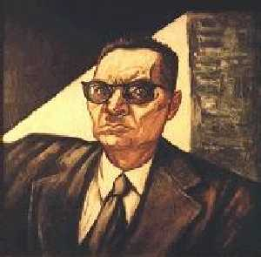
Jose Clemente Orozco (1862-1949)
studied art at the San Carlos Academy for Fine Arts in Mexico, D.F.
influenced by Jose Posada and Symbolism
“He painted like a camera took pictures, clear and detailed.”
in school - lost his right hand and partial sight in one of his eyes - joined the student strikes initiated by the painting students to over throw the strict Director
very active politically throughout the Mexican revolution and witnessed its horrors first hand
became a political cartoonist, publishing most of his work in local newspapers before becoming a muralist
http://www.wfu.edu/history/StudentWork/fysprojects/kmason/Orozco.htm

Slide 18
His Murals
considered by some as the most complex of the Mexican muralists
dedicated to depicting the truth and had a greater sense of realism that Diego Rivera.
murals contain violent displays of conflict and chaos and misery
realized the enormous gap between social ideals and social realities
focused on showing personal suffering in a pessimistic, skeptical, yet sympathetic way
http://www.wfu.edu/history/StudentWork/fysprojects/kmason/Orozco.htm

Slide 19
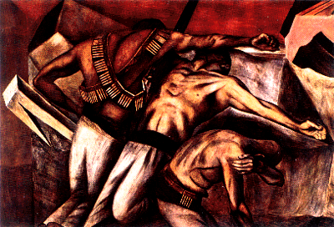
The Trench
1926
National Preparatory School
“Orozco illustrates the power of his painting in a clear depiction of the death soldiers during the revolution. The eerie stillness of the soldiers is implicit of the violent movements of war frozen in time. This piece is a realistic portrayal of the war without overriding emotion.” http://www.wfu.edu/history/StudentWork/fysprojects/kmason/Orozco.htm

Slide 20
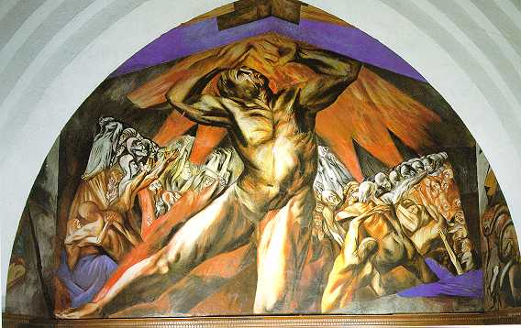
Prometheus, 1930, Pomona College, California
“This was his first mural in the United States. It illustrates Orozco's belief that all the events of history are in a never ending circular sequence.”

Slide 21
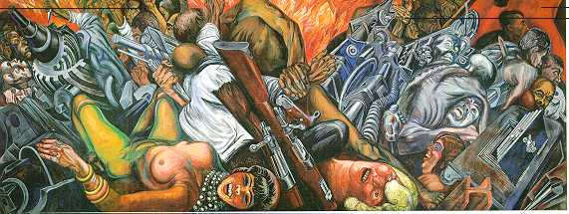
Catharis, 1934, Palace of Fine Arts, Mexico City
“Catharis shows the never ending cycle of Humanity's self destruction and moral decay in a frightening manor. It explores the theme of man being obsessed the modern advances in technology and machinery. In front of a fiery background, humans are being sucked into mechanical quicksand.”

Slide 22
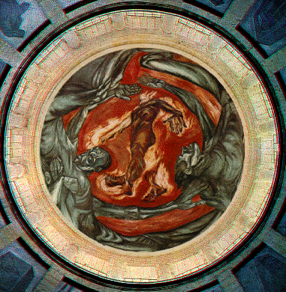
Man of Fire 1938-9 Hospicio Cabanas, Guadalajara
“Man of Fire is arguably Orozco's greatest achievement. The image is a metaphor for the theme of social struggle with a combination of the essence of the ideal. Orozco is successful in depicting an accurate account of man's personal suffering”

Slide 23
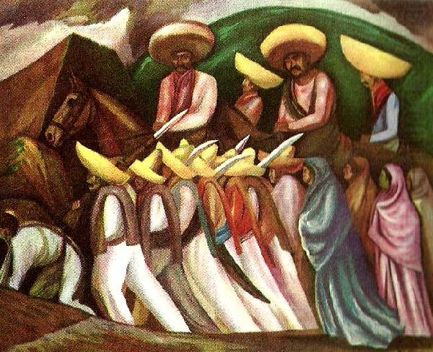
Zapatistas

Slide 24
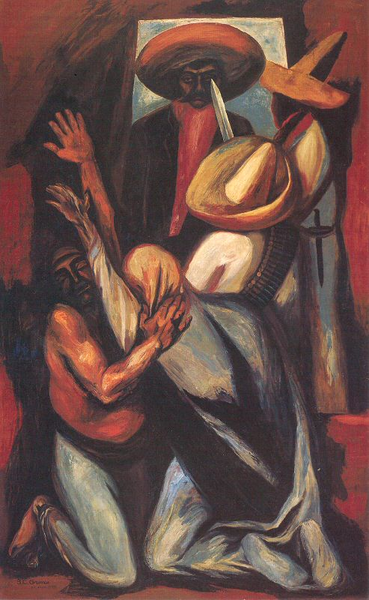
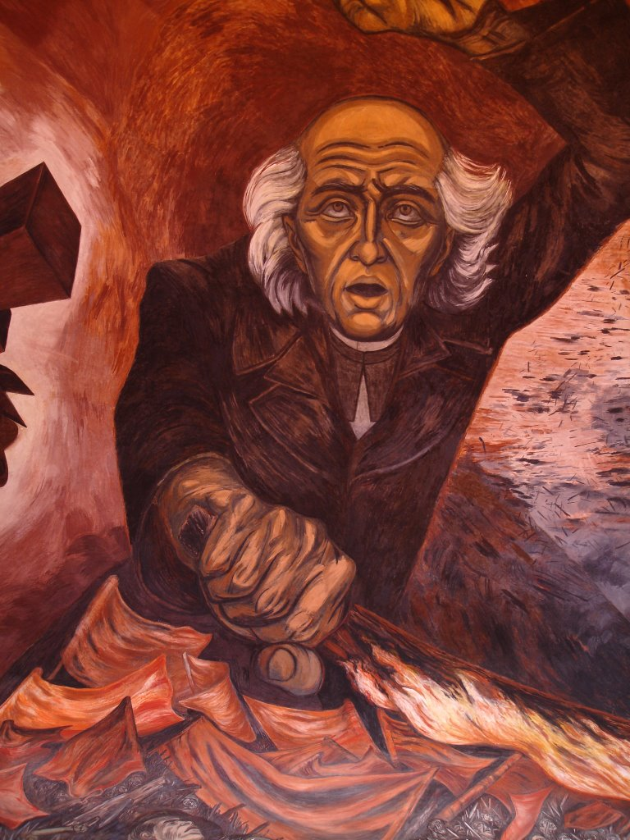

Slide 25
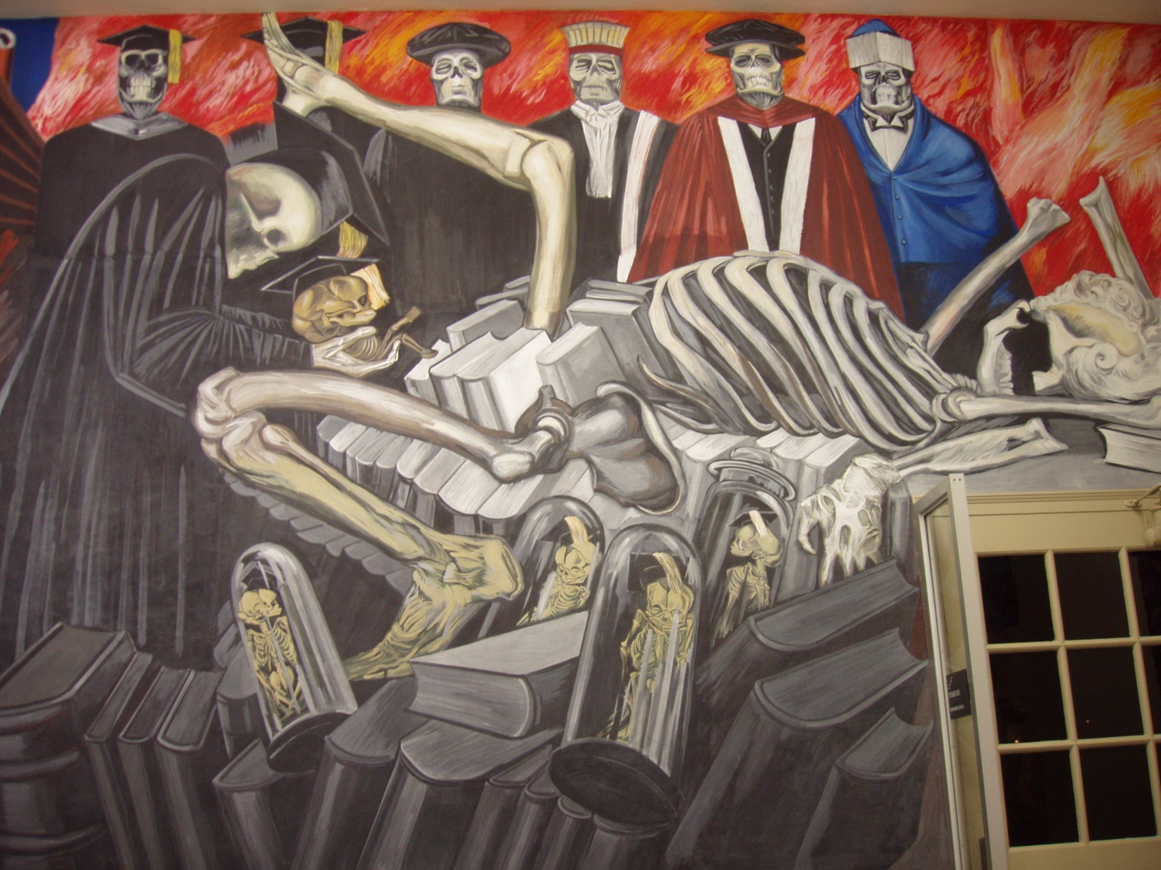
Mural at Dartmouth College

Slide 26
David Alfaro Siqueiros
His style of experimentation with the integration of traditional Mexican art and modern art is unique
His revolutionary art work paralleled the radical changes taking place in Mexico
His style was influenced by Michelangelo during his studies in Europe. His work contains the “powerful, foreshortened figures characteristic of Michelangelo and the bold perspective of Baroque art.
He was influenced by Boccioni who gave him his love of the modern age which is why he “began to incorporate machinery, speed, science, and technology into his art”
His art contained the message of social issues to the common people
Early murals showed his modern/traditional style
While in U.S. (1923-38) he changed his mediums and materials. He experimented with acrylics, resins, asbestos, airbrush, pyroxlene, projector and camera. In 1936 he worked with Jackson Pollock. http://staff.esuhsd.org/~balochie/studentprojects/mexmuralists/index.html

Slide 27
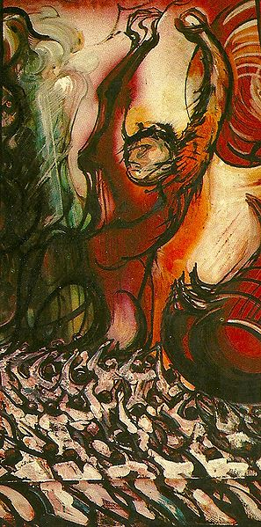
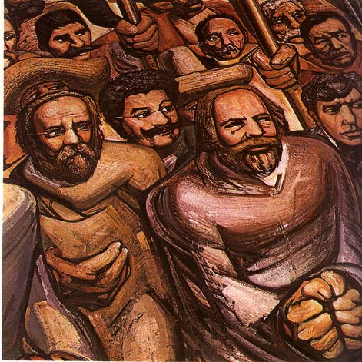
“Del porfirismo a la Revolución" (1957-1966) de David Alfaro Siqueiros conservado en el Museo Nacional de Historia en la Ciudad de México

Slide 28
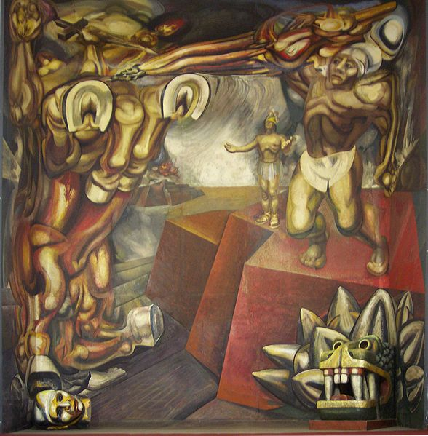
1944 in Tecpan

Slide 29
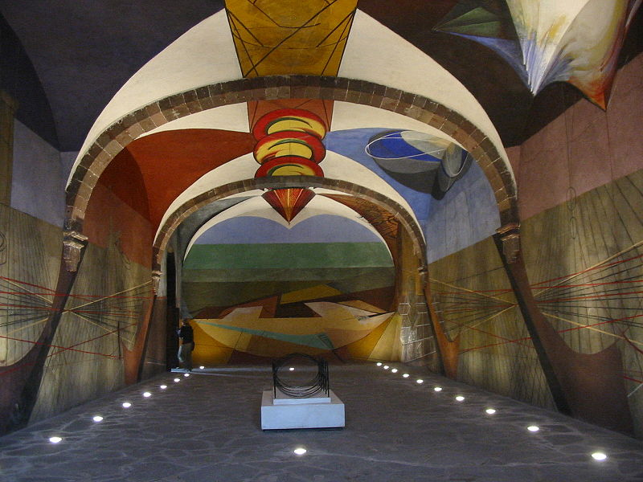
Unfinished mural at the in Escuela de Bellas Artes, a cultural center in San Miguel de Allende, Mexico

Slide 30
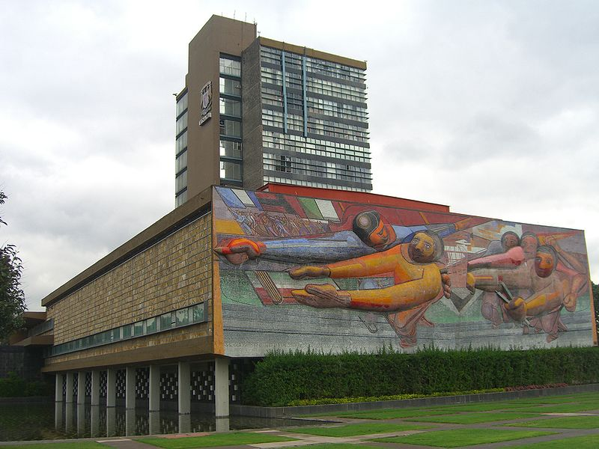
"El pueblo a la universidad, la universidad al pueblo", National Autonomous University of Mexico, 1952-6

Slide 31
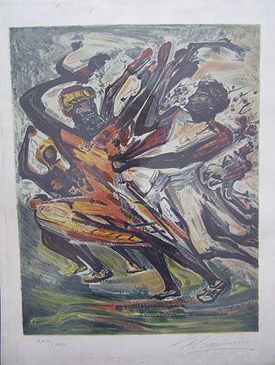
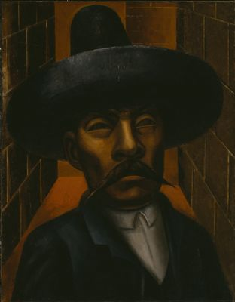
Zapata 1931, Hirshhorn Museum and Sculpture Garden, Smithsonian, Washington, D.C
self portrait

Slide 32
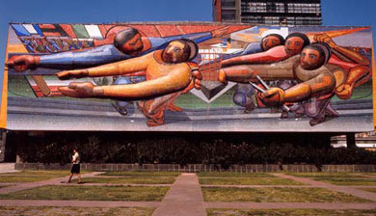

Slide 33
La Nueva Democracia 1954, Palacio de Bellas Artes

Slide 34
Diego Rivera 1886- 1957
http://www.diegorivera.com/

Slide 35
His life – His art- His politics
Began as a cubist
But he is known as a muralist
He painted frescoes on important buildings in Mexico and in America. He believed that this made his art accessible to the common man. Many of his works were commissioned by public officials.
Believed in social revolution. Became a communist.
Believed that art has a social function : “If it isn’t propaganda it isn’t art.”
His works glorified the life and culture of the common man, peasants, laborers, indigenous peoples.

Slide 36
His life – His art- His politics- Cont.
His works often contained images of recognizable historical and political figures. His mural in Detroit was destroyed because he included a painting of Lenon.
He married Lupe Marín and had children with her. His second wife was Frida Kahlo. And he was repeatedly unfaithful to both of them.
He was criticized by other artists and politicians because he liked to socialize with the upper class while he was painting murals and talking about the plight of the lower, common working class.

Slide 37
La Era, 1904 Oil on canvas Diego Rivera Museum, Guanajuato, Mex

Slide 38
Fiesta Tehuana
Dance in Tehuantepec,
1928 Oil on canvas New York, IBM Corporation

Slide 39
Vendedor de Flores
The flower carrier,
1935
Oil and tempera on masonite
San Francisco Museum of Modern Art

Slide 40
Common scenes
Las Sandias, 1957
Vendedora de Flores
1949

Slide 41
The Murals
Diego is most known for his murals

Slide 42
Historia de México - El antiguo Mundo Indígena, 1929-1935 -Fresco Muro Norte, Palacio Nacional, Ciudad de México

Slide 43
Hombre en una Encrucijada, 1934 Fresco Museo del Palacio de Bellas Artes, Ciudad de México Man at the Crossroads, 1934
This is his reproduction of the mural he started in Detroit that was destroyed before it was complete.

Slide 44
Industria de Detroit o Hombre y Máquina, Frente 1932-1933 Fresco Instituto de Artes de Detroit, Detroit, Michigan Detroit Industry or Man and Machine, Front Wall 1932-1933

Slide 45
PanAmerican Unity panels 1-3 1940 City College of San Francisco

Slide 46
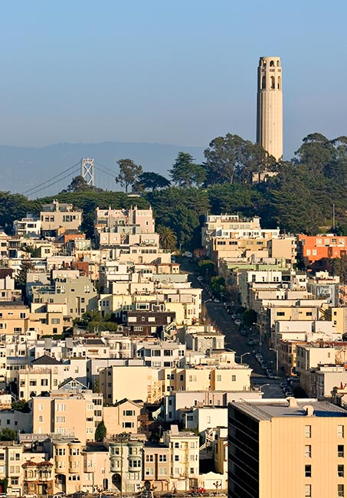
Coit Tower
Built in San Francisco in 1933
In 1934 they commissioned 26 artists under the Public Works of Art Project (WPA) to create a series of fresco paintings on the interior walls with the theme of “Aspects of California Life” and depicted the struggles of working class Americans

Slide 47
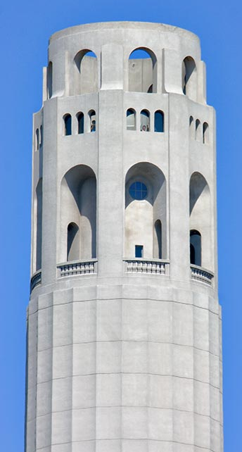
Inspired by Rivera
Rivera had recently completed two frescos in San Francisco— Making a Fresco, at the California School of Fine Arts (now San Francisco Art Institute) and another at the San Francisco Stock Exchange.
Several of the Coit Tower artists had worked with or assisted Rivera. Another Rivera Mural, Pan American Unity a 22 by 74-foot masterpiece produced on Treasure Island for the 1940 Golden Gate International Exposition, is on display at City College of San Francisco.
The Coit Tower murals were painted during a particularly disruptive period in U.S. History. Depression related economic challenges led to much discussion about alternate forms of government. A four day general strike accompanied by widespread rioting in San Francisco triggered an eighty-three day strike .
Coit Tower muralists protested and picketed at the tower when Rivera's mural commissioned for Rockefeler in New York City was destroyed after he refused to change an image of Lenin in the painting.
The opening of Coit Tower and the display of its murals was delayed several months because of the controversial content of some of the paintings. Clifford Wight's mural, which contained a hammer and sickle as one of a series of medallions illustrating the range of political philosophies existing in America, was removed before the opening.
http://www.inetours.com/Pages/SFNbrhds/Coit_Tower.html

Slide 48
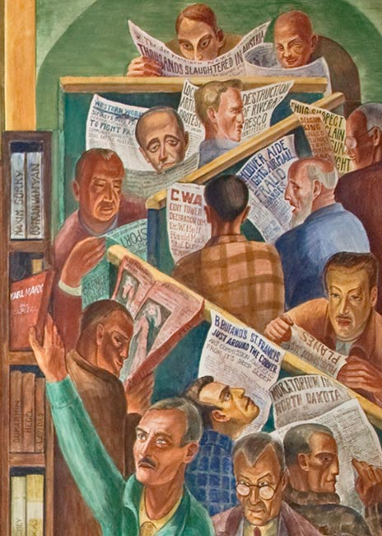
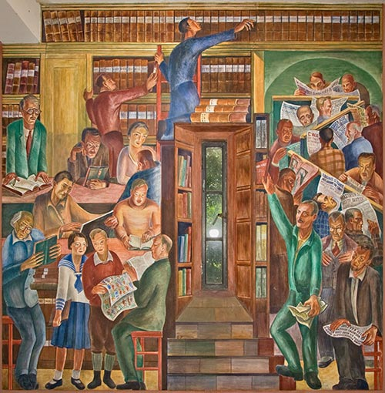

Slide 49
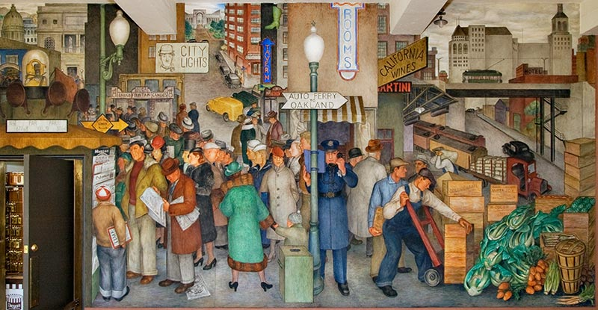
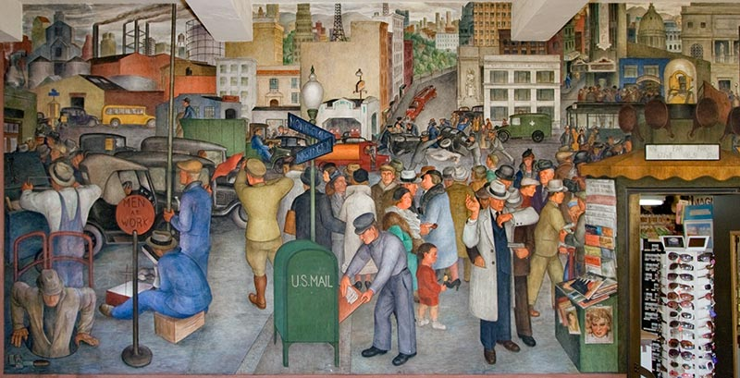

Slide 50
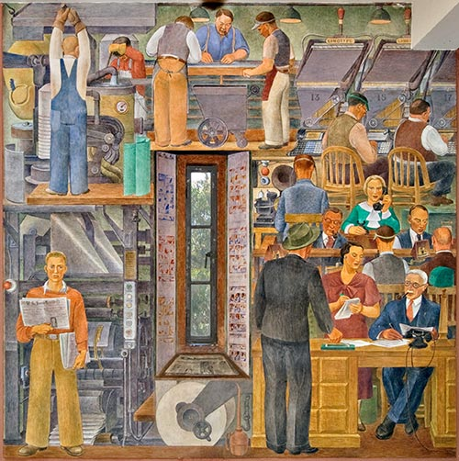

Slide 51
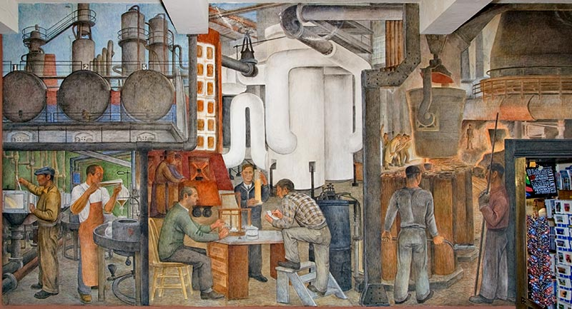
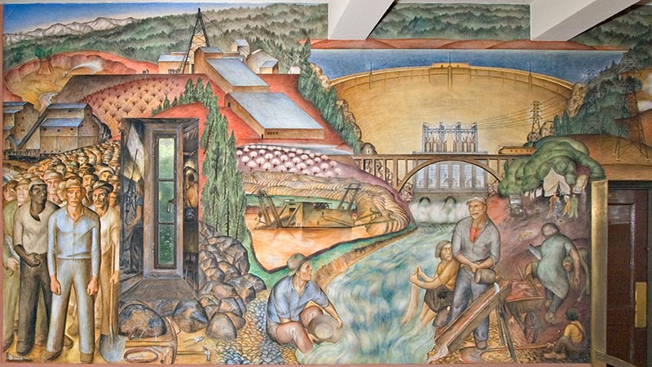

Slide 52
Frida Kahlo- Her Life
She says that her life and art were shaped by two accidents:
First, her bus crashed into a trolley and she was gravely injured – her spinal column, her hip, and her leg were fractured. She was trapped in huge casts for months, had to relearn to walk, and had immense pain and numerous surgeries and medical procedures throughout her life.

Slide 53
Second, she married Diego Rivera when she was only 19 and he was 43. Through him she was introduced to the artists of the day and to the political ideas and people of communism. She was hurt by his infidelities and they divorced years later. But their lives continued to be intertwined. She was a non- conformist.

Slide 54
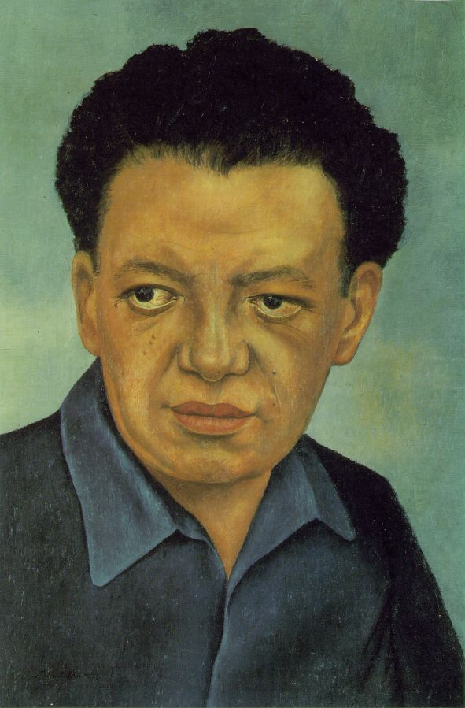
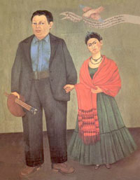

Slide 55
Frida’s ethnic heritage
The Jewish Museum will present Frida Kahlo's Intimate Family Picture from September 5, 2003 through January 4, 2004. The exhibition focuses on Frida Kahlo's 1936 painting, entitled My Grandparents, My Parents, and I and presents a new perspective on the renowned Mexican artist. In addition to the original painting and a detailed preparatory sketch, exhibition visitors will be able to see documentary materials that influenced the painting's imagery such as reproductions of Kahlo's parents' wedding picture, Henri Rousseau's The Present and the Past, a Nazi genealogical chart, and a medical illustration from Kahlo's library. The show provides insights into Kahlo's work and reveals important aspects of her hybrid and multicultural identity, as the daughter of a European Jew and a Mexican Catholic mestiza (a woman of mixed European and Mexican Indian descent). A selection of seven vintage photographs of Frida Kahlo taken by her father, Wilhelm (Guillermo) Kahlo, a German-Jewish immigrant to Mexico, will illuminate the father and daughter relationship.

Slide 56
My grandparents, my parents and I 1936

Slide 57
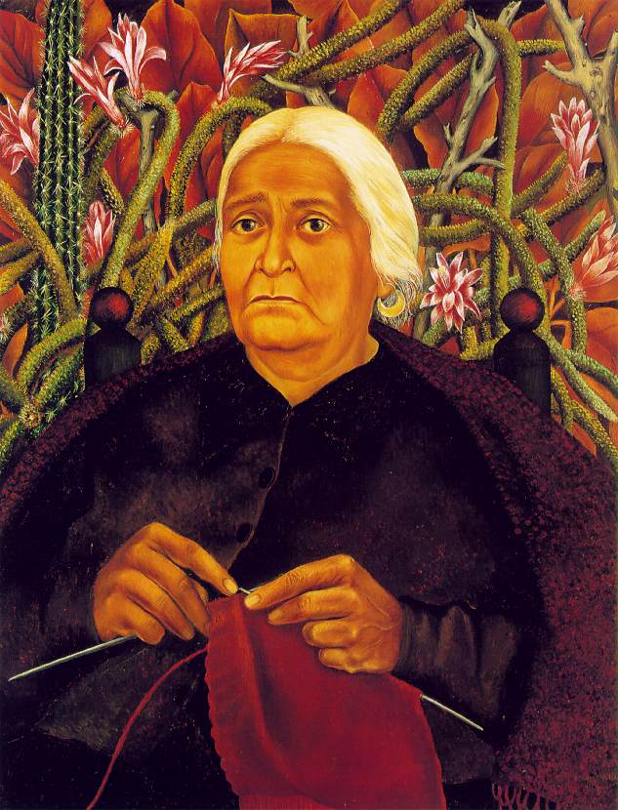

Slide 58
Frida Kahlo – Her Art
Her art blended images of catholic background of her mother, the pre-Columbian Indians, and popular Mexican art, and “avante guard” modern art of Europe.
She was a surrealist.
Frida's works reveal her as a forerunner of modern (or even better postmodern) extreme cultural tendencies. These images include:
the vacillating limit between visible and invisible
the strong attraction for transmutation, transformation, mutations of several kinds
invasion of body by external objects
the breaking of traditional separations such as body/mind, outside/inside. She “ let the outside show the inside eliminating physical barriers such as skin, to exhibit outside the inside of her life.”
Her art was not political it was emotional. It was personal.

Slide 59
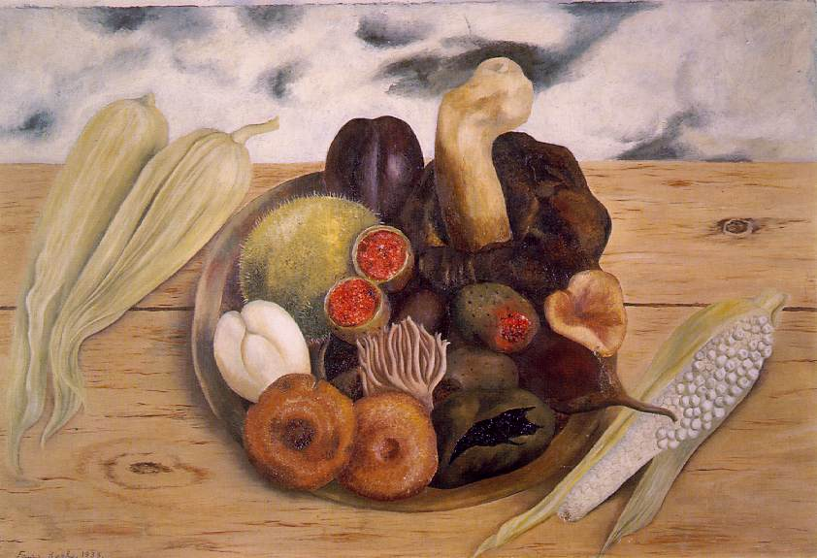

Slide 60
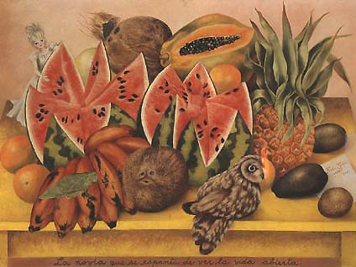
Frida Kahlo / La Novia que se Espanta de Ver la Vida Abierta / 1943 / Oleo sobre tela / 63 x 81,5 cm Colección J. y N. Gelman

Slide 61
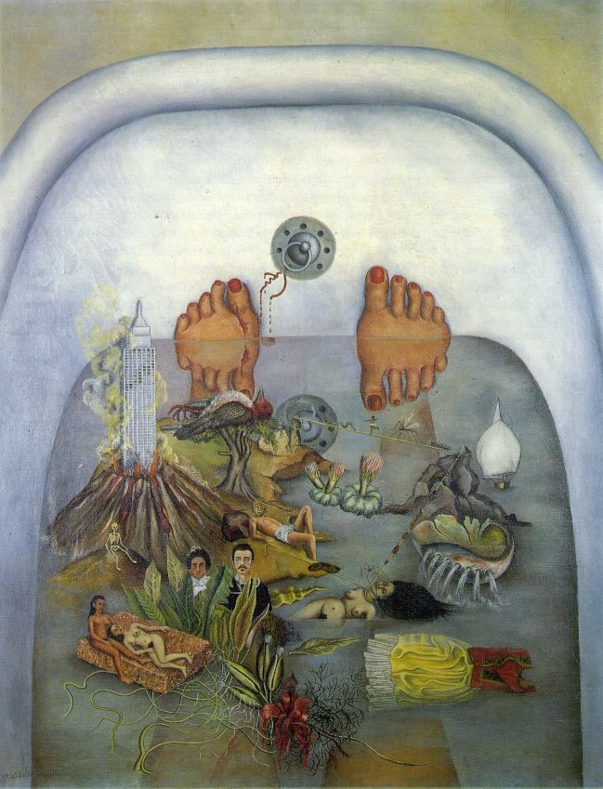

Slide 62
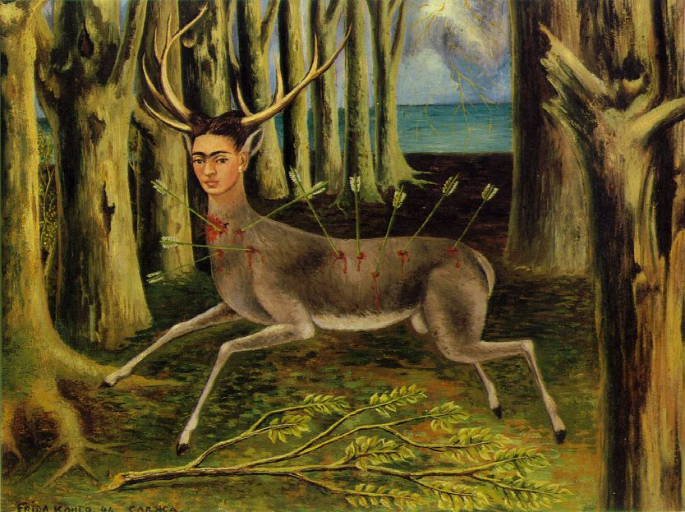

Slide 63
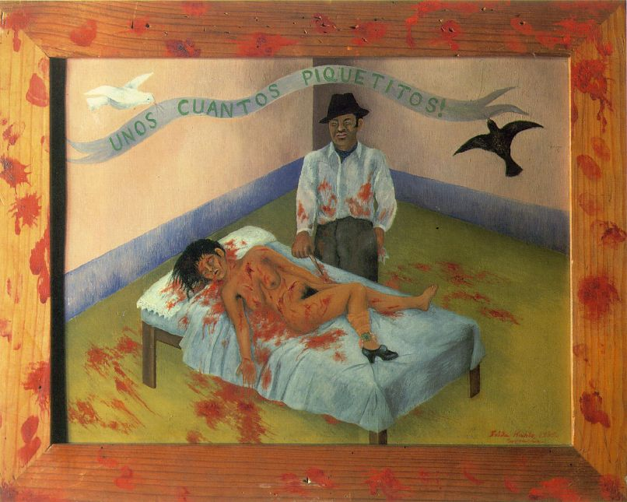

Slide 64
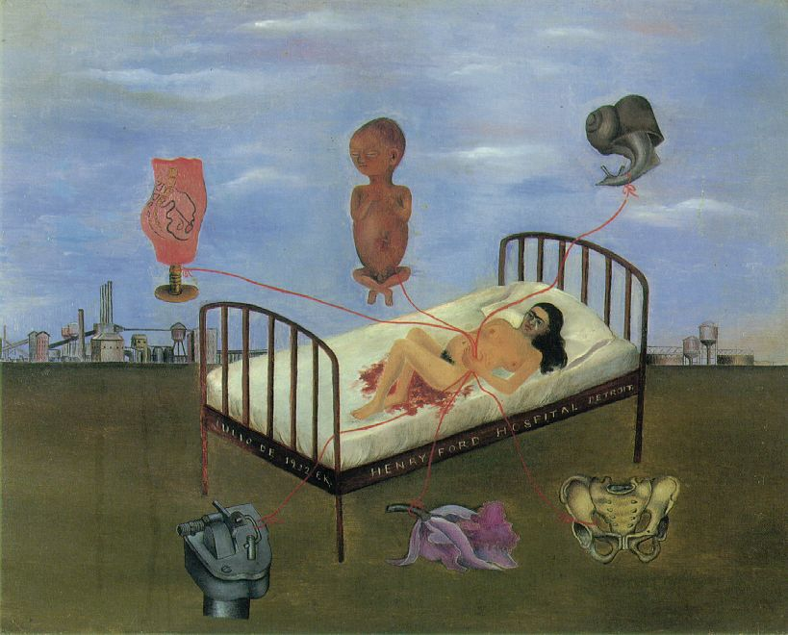

Slide 65
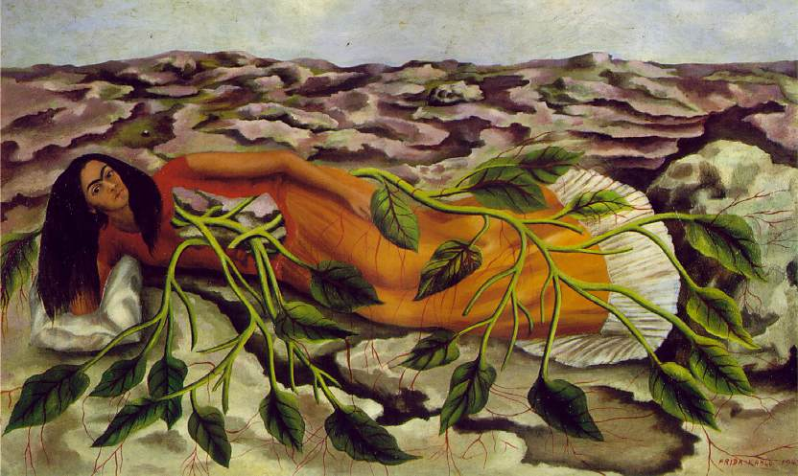

Slide 66
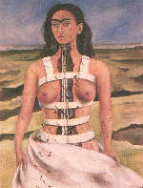

Slide 67
Frida – Her Self Portraits
Lots of people have defined Frida' s mania for self-portaits (about 1/3 of her works) as a sort of therapy to survive, an alienation of suffering and physical pain from herself, a kind of repression of the ravaging action inflicted by external events on her body (bus accident, surgeries and "weird" medical treatments of her age).
The body surely was for Frida the centre of any kind of thought, both about her internal self (as women and artist) and about her external environment (cultural, political and social aspects of her time). Certainly her body, wounded, pierced, distorted by technology (bus) and by the medical treatments of her age, was the ideal place for eliminating all self/world barriers:
“When the external world pierces you from the stomach to the pelvis your body becomes a privileged place of understanding, passage and metabolization of any event. Representing oneself becomes representing the world.”

Slide 68
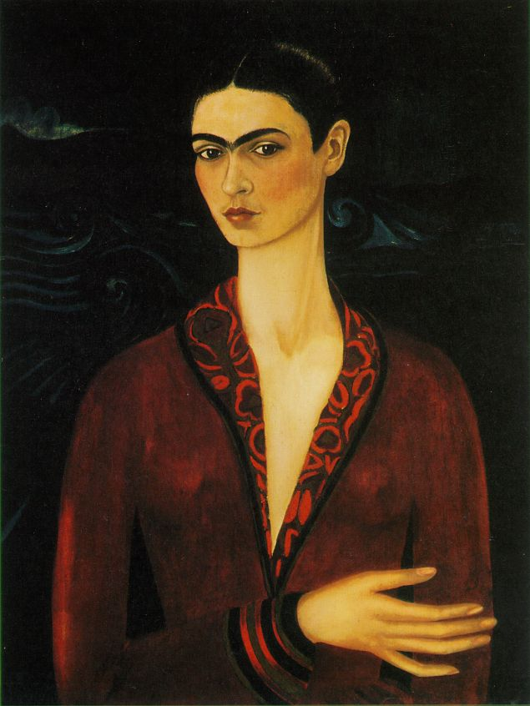

Slide 69
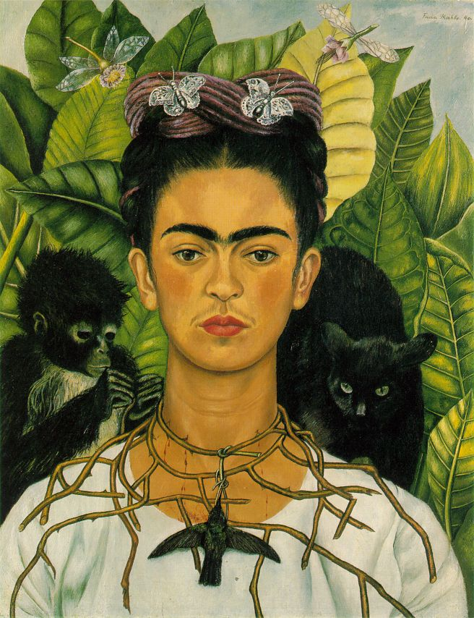

Slide 70
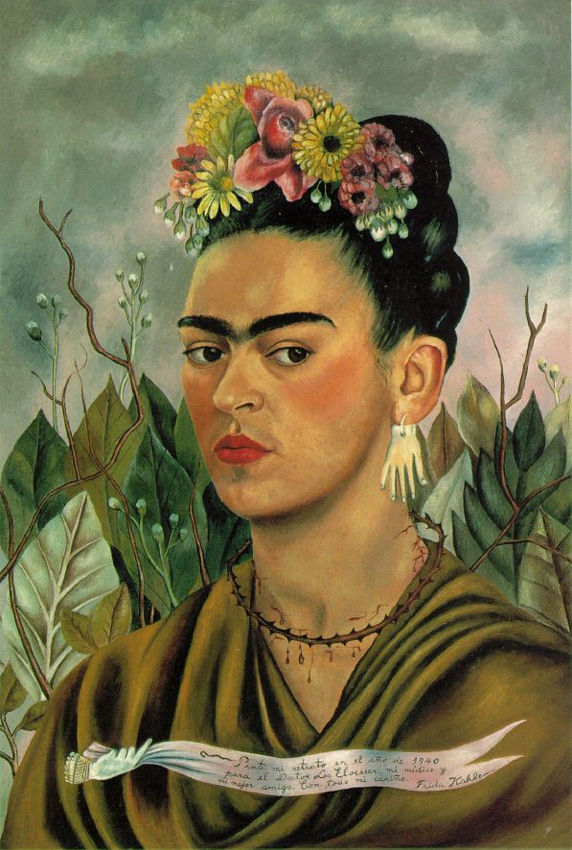

Slide 71
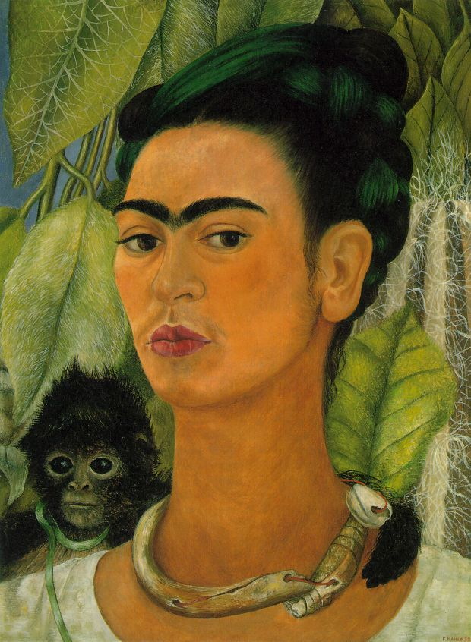

Slide 72
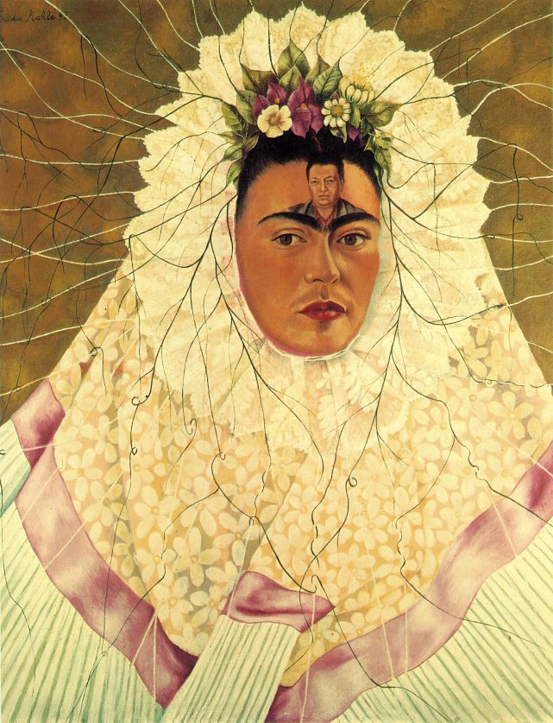

Slide 73
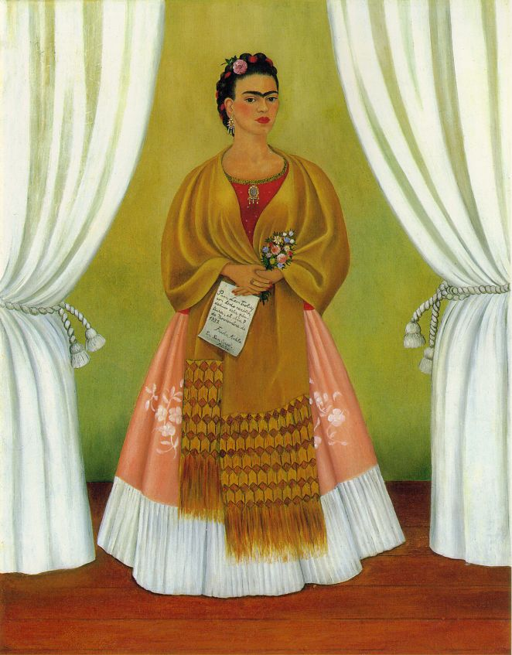

Slide 74
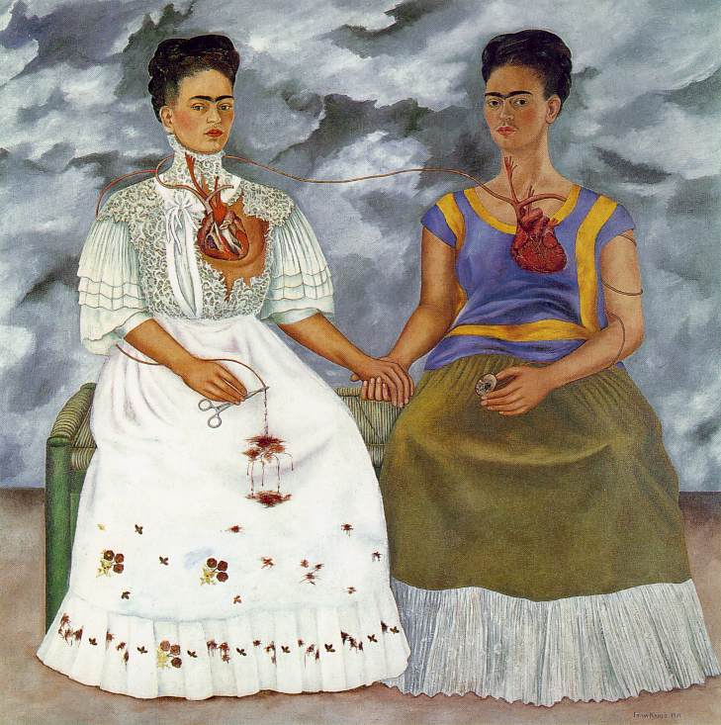

Slide 75
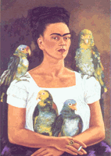

Slide 76
http://www.fridakahlo.it/

