Slide 1
Bolivia perÚ
Chile
Spanish for Business
Lesson Seven
Los Países de la América Sur:

Slide 2
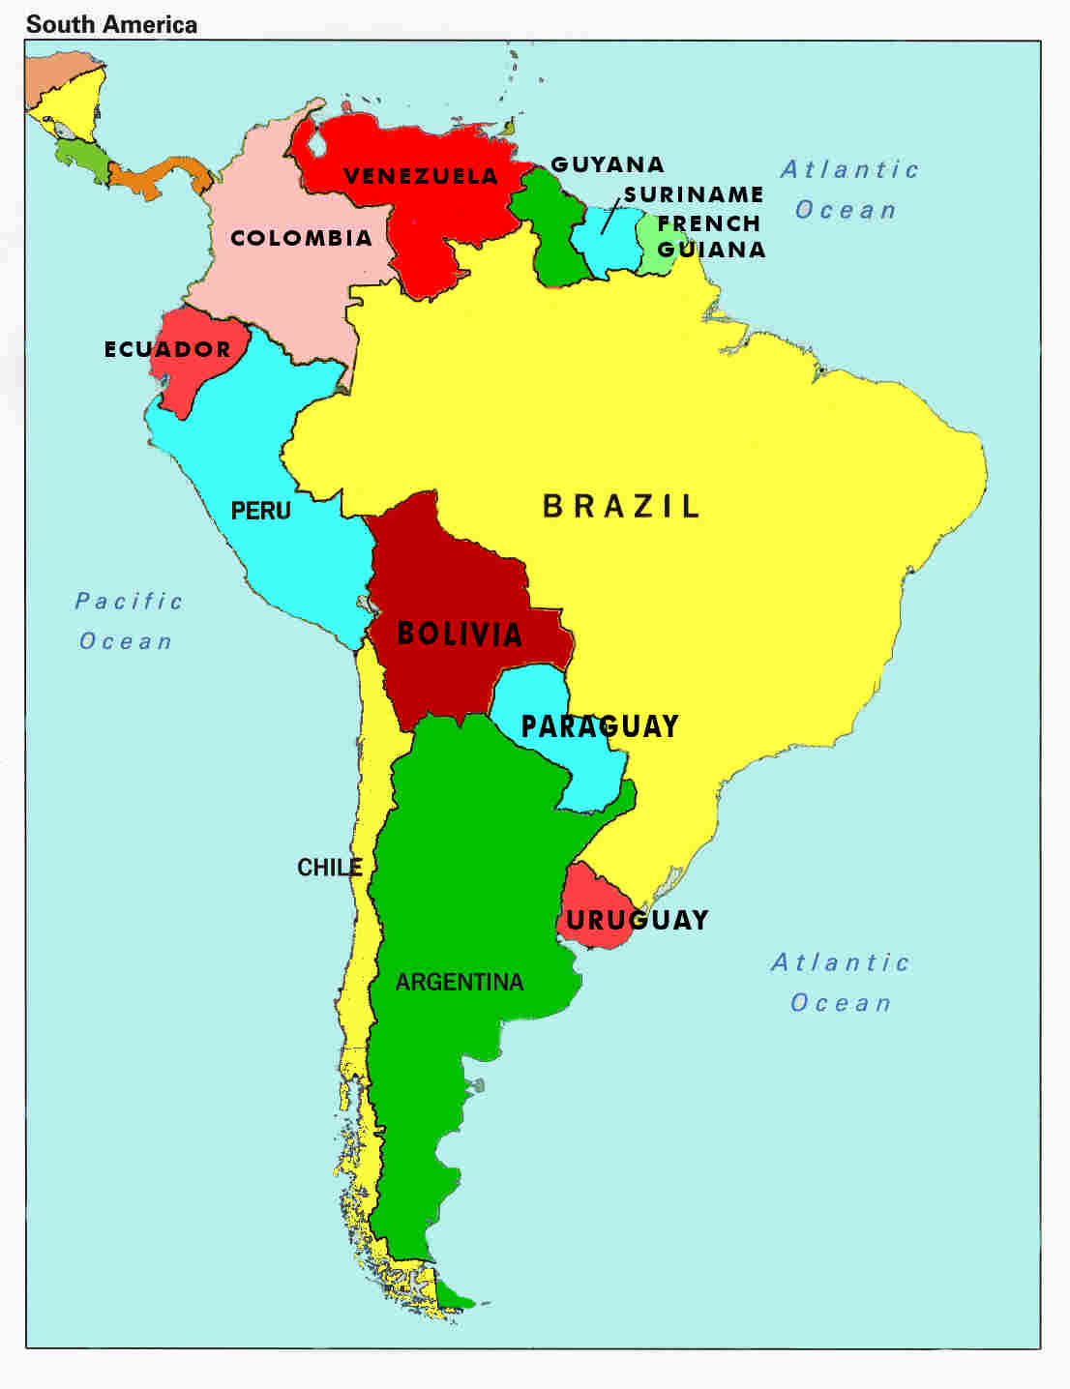
bolivia

Slide 3
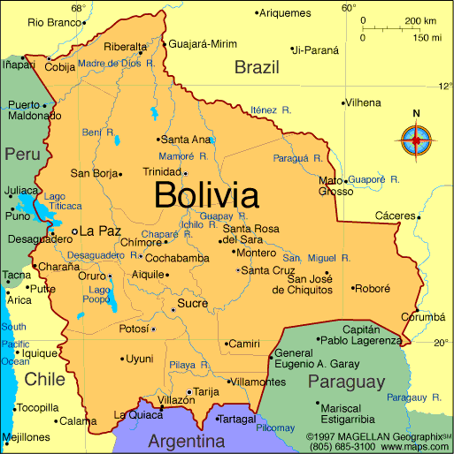
Bolivia

Slide 4
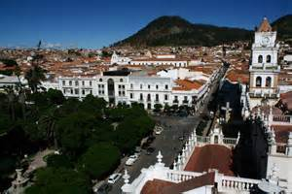
La Capital oficial: Sucre
The city with 4 names :
Sucre, La Plata, Charcas, or Ciudad Blanca
Bolivia has 2 capital cities:
La Paz and Sucre. Sucre is the constitutional capital and home of the Supreme Court.
Amateur Tour of Sucre and Southern La Paz – 12 min

Slide 5
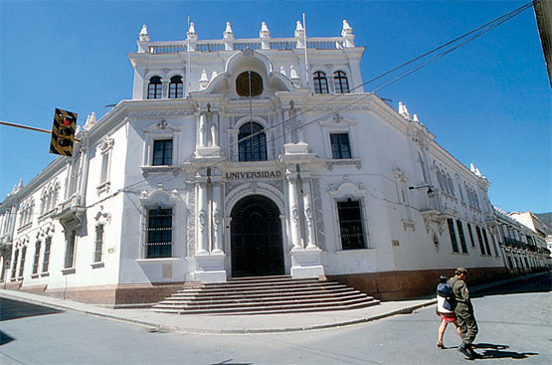
Sucre has a rich, varied history and a wealth of historical architecture deserving of the selection as a World Heritage Site by UNESCO.
Sucre is also a university city, with many cultural attractions, museums, shops, restaurants.
San Francisco Xavier university was founded in 1625, one of the oldest universities in the Americas, and specializes in law.

Slide 6
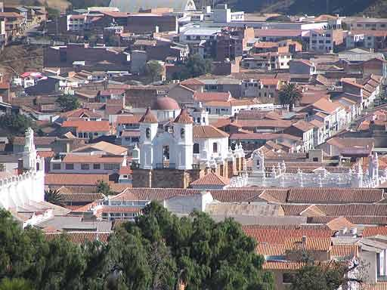
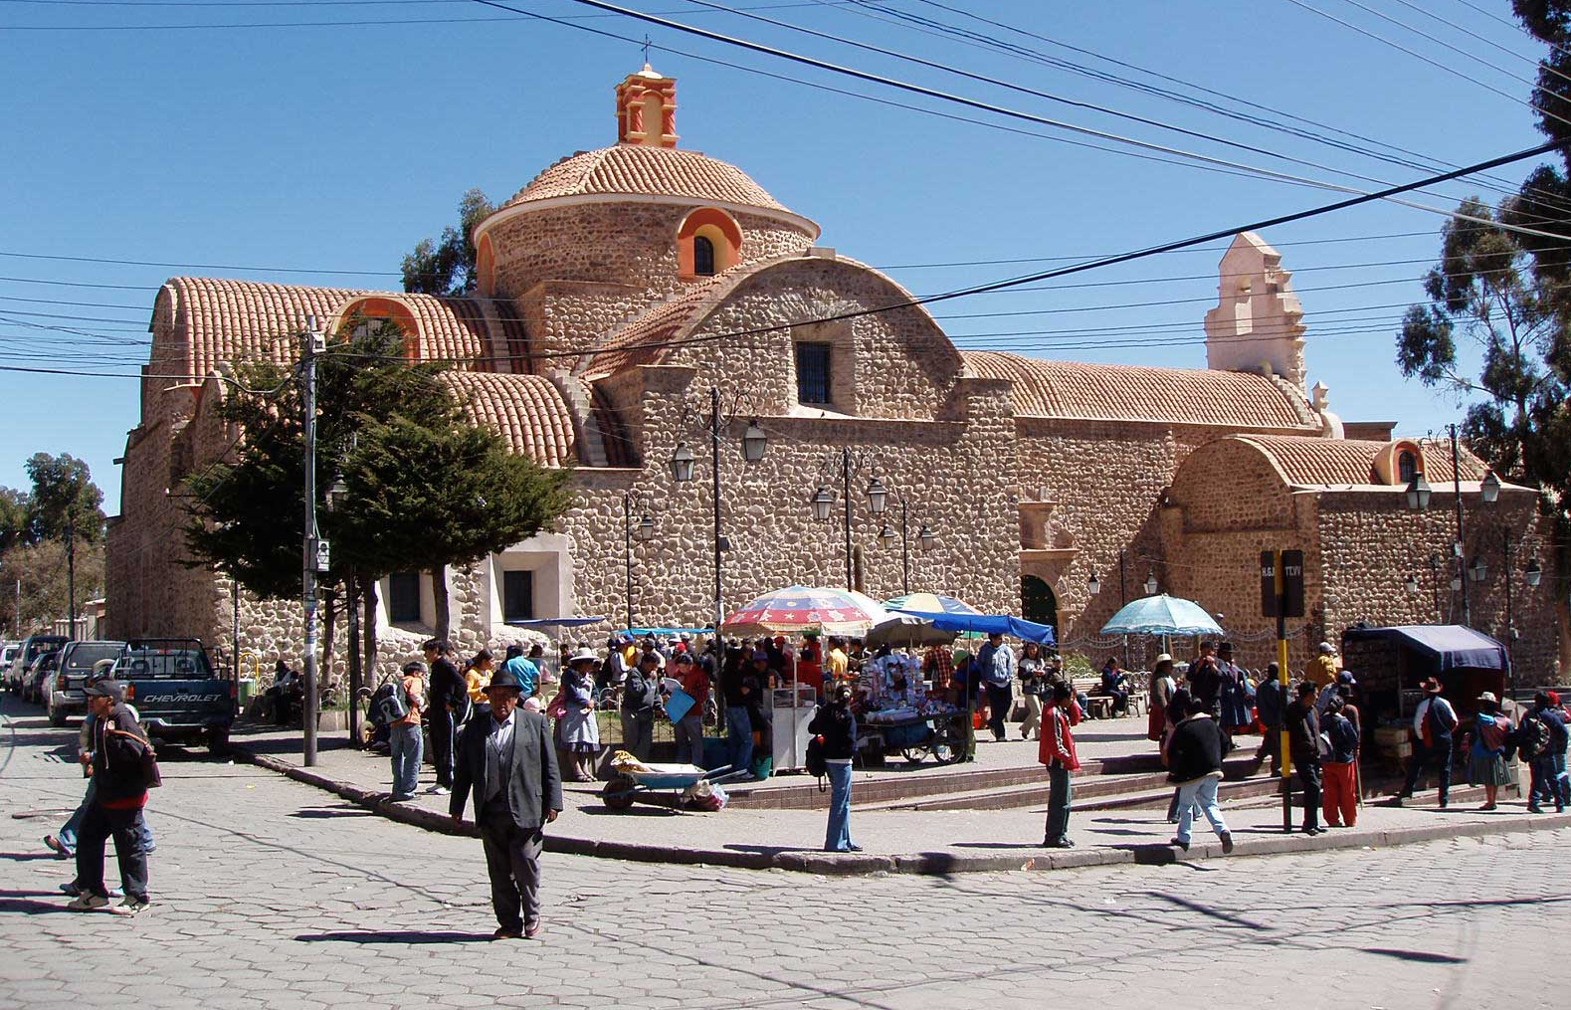
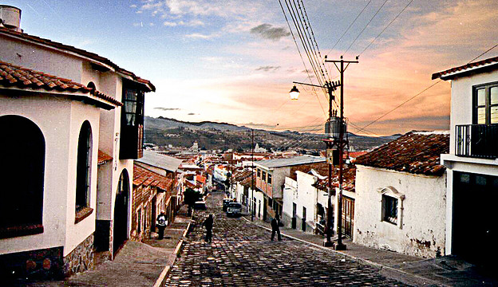
“Sucre is an easily walkable city and the older sections, with the white colonial buildings with their distinctive red-tiled roofs and distinctive balconies offer nooks and crannies to explore. “
Sucre Tours – 7 min
http://gosouthamerica.about.com/od/bolsucre/a/Sucre.htm

Slide 7
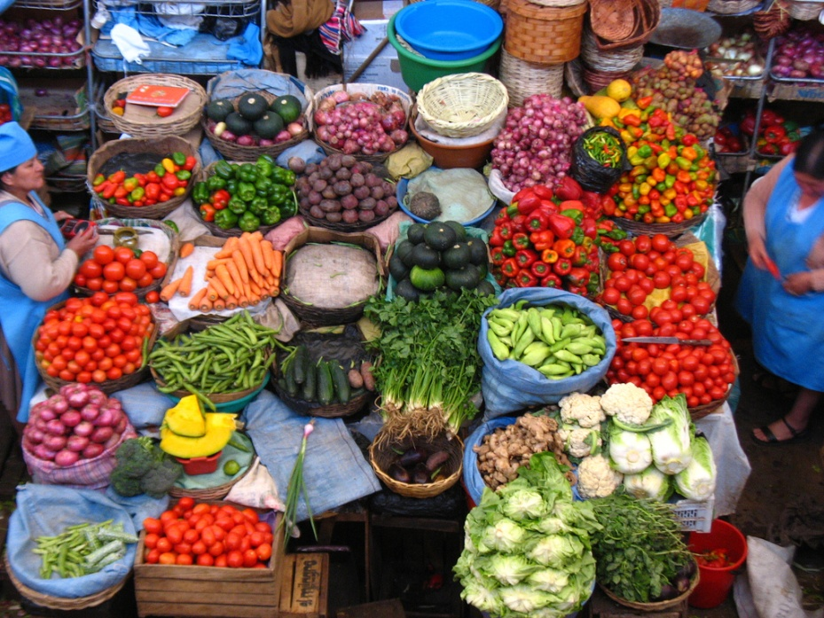
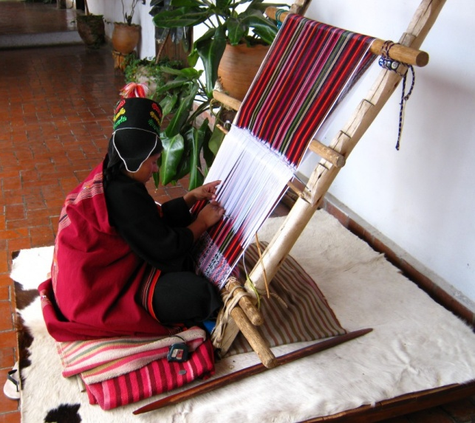
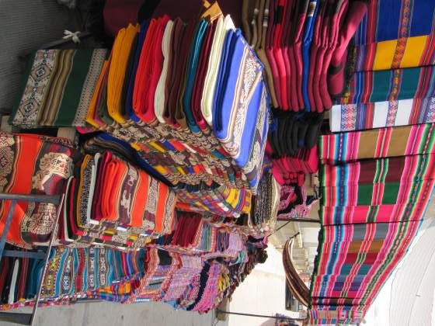
The large indigenous population, mainly Quechua, maintains their traditional clothing and customs, and sell their crafts and goods available in the markets and fairs
It is also a major agricultural center and supplies the mining communities of the barren altiplano. It has an oil refinery and a cement plant
http://gosouthamerica.about.com/od/bolsucre/a/Sucre.htm

Slide 8
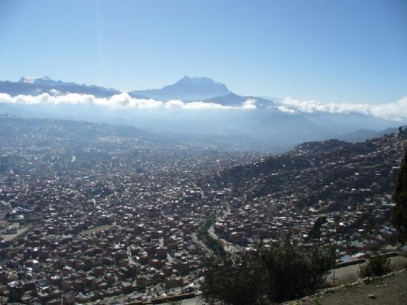
La Capital administrativa: la paz
“The city that touches the Sky”
The highest capital city in the world at 3300-4100 feet above sea level
The largest city in Bolivia and centre for commerce, finance and industry- the governmental (some say ‘de facto’) capital
Tourist Guide
Video Tour
The Two Bolivias
4 min Bus Tour

Slide 9
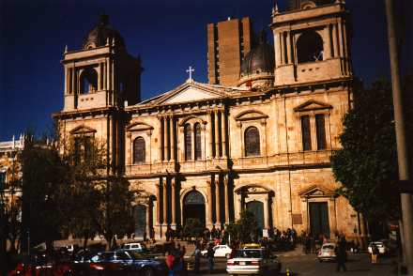
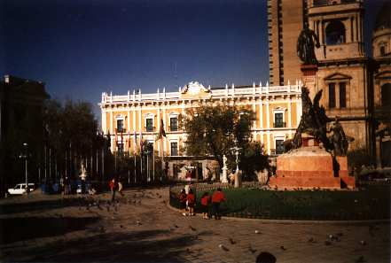
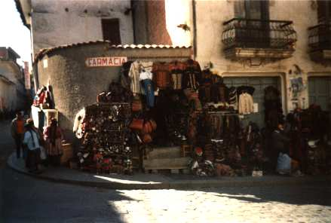
Sitios de interÉs en la paz
El Palacio Quemado – Presedential Palace
El Catedral en la Plaza Murillo, 1835
El Mercado de Las Brujas- (Witches' Market): Merchandise sold here includes herbs, remedies as well as other ingredients used in Aymara traditions.
http://www.boliviaweb.com/cities/lapaz.htm

Slide 10
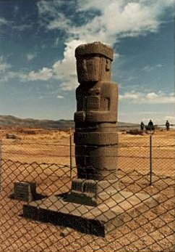
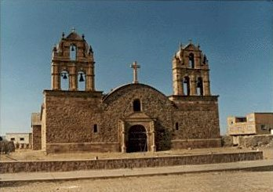
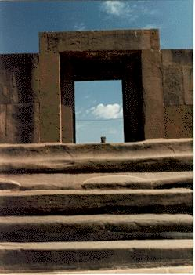
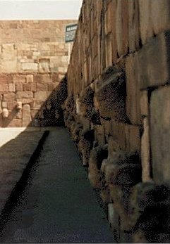
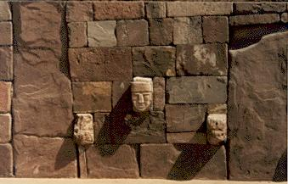
la paz: TIahuanaco
BBC – Video Clip
Ruins of an ancient city built over 1,000 years ago
by the Tiahuancu people
Puma Pumku
7 min History Channel

Slide 11
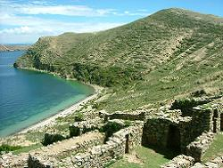
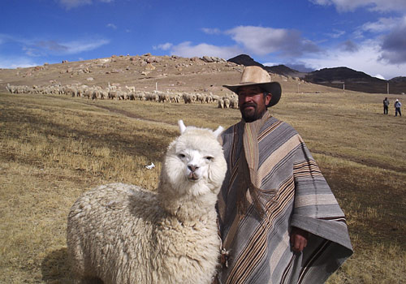
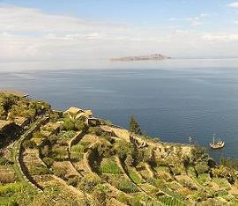
Isla del sol
Isla del Sol is one of the most sacred places in Bolivia. According to Inca legend it is where the sun god's children, Manco Capac and Mama Ocllo, emerged from the depths of Lake Titicaca and found the Inca civilization.
Isla del Sol is the largest island on Lake Titicaca. The island contains few small villages, home to about 5,000 mostly indigenous people who farm the lands, fish or raise alpaca.

Slide 12
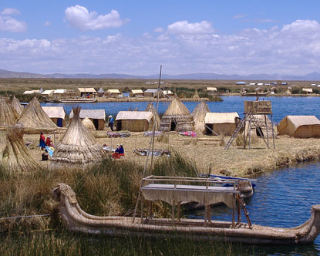
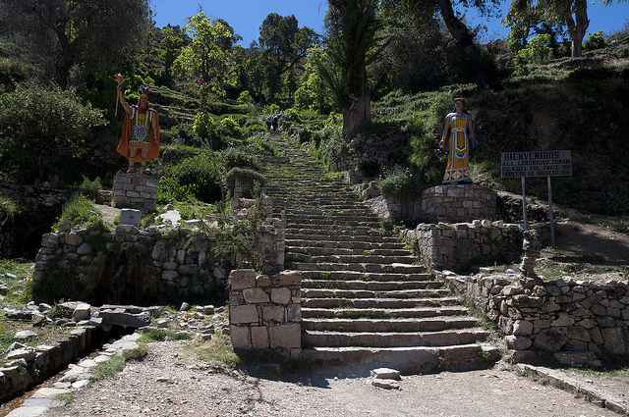
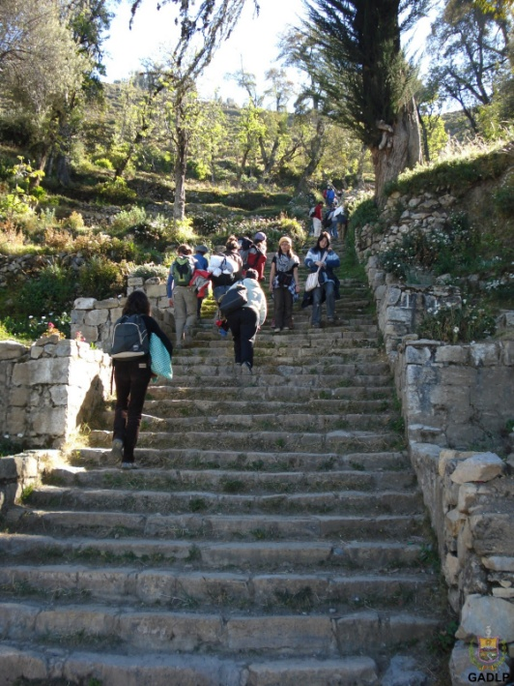
Isla del sol
The island is about a 90 minute boat ride from Copacabana. Boats usually arrive at the one of the main villages called Yumani in the southern part where you'll find some of the islands famous ruins, such as the 200 Inca steps the climb up the steep terrain. These steps are the original Inca construction and they lead to a sacred spring fountain.

Slide 13
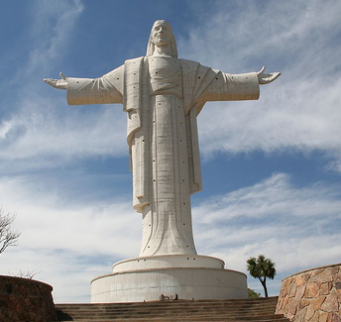
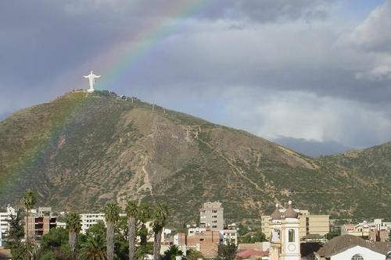
Cristo de la concordia en Cochabamba
As the world's tallest statue of Christ, it stands 33m high, one meter for every year of Christ's life and when you add its base it reaches a final height of 42 meters
http://www.boliviafacts.net/cristo-de-la-concordia.html
The statue towers over Cochabamba, with its outstretched arms in a welcoming embrace and is located atop the huge San Pedro hilltop, that overlooks Cochabamba about 265 meters above the city.
Video de Cristo de La Concordia

Slide 14
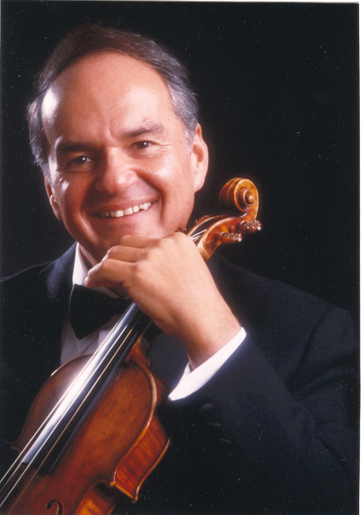
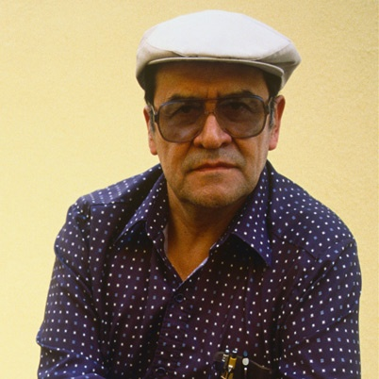
La gente famosa
Jaime Laredo (1941- )
  Violinist and conductor
  Began his musical career at age 5
  Currently conductor of the Vermont Symphony Orchestra
Jaime Escalante (1930- )
  Teacher that the movie Stand and Deliver was based on

Slide 15
La gente famosa:
Evo Morales (1959- )
  President since 2006
  Democratic Socialist
  His administration has focused on the implementation of leftist reform, poverty reduction and combating the influence of the United States and transnational corporations in Bolivia
  Morales has received international acclaim for his support of indigenous rights and anti-imperialism, and has been named "World Hero of Mother Earth" by the General Assembly of the United Nations. Critics have accused him of autocratic tendencies and protecting the cocaine trade.
http://en.wikipedia.org/wiki/Evo_Morales

Slide 16
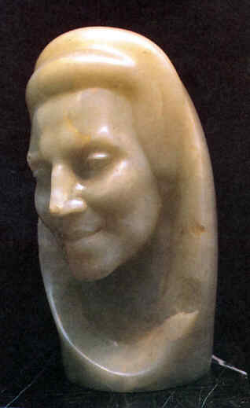
La gente famosa
Marina Nuñez del Prado (1959- )
Sculptress
  Casa Museo Marina Nuñez del Prado is a museum in La Paz in which much of her work is displayed.
  Her work is characterized by rolling curves and bulk and by the use of such spectacular materials as black granite, alabaster, basalt and white onyx, as well a different native Bolivian woods. Among her outstanding sculptures White Venus (1960), a stylized female body in white onyx, is among her most admired works. Another famous work is Mother and Child, sculpted in white onyx. She was inspired by Indian themes
  http://www.boliviaweb.com/hallfame/nunez.htm

Slide 17
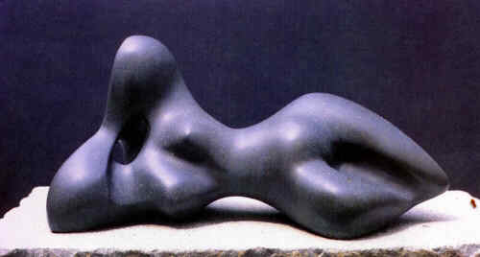
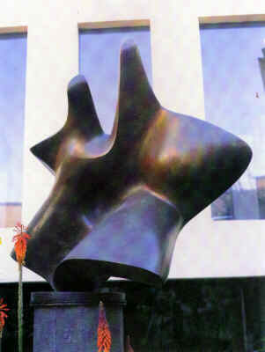
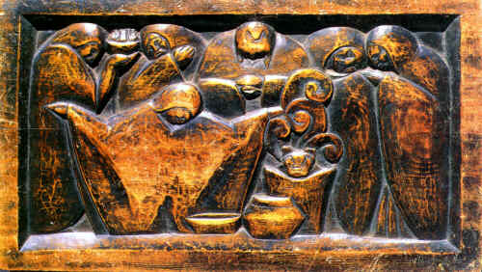
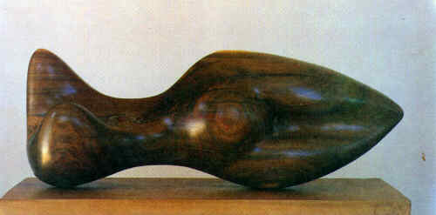

Slide 18
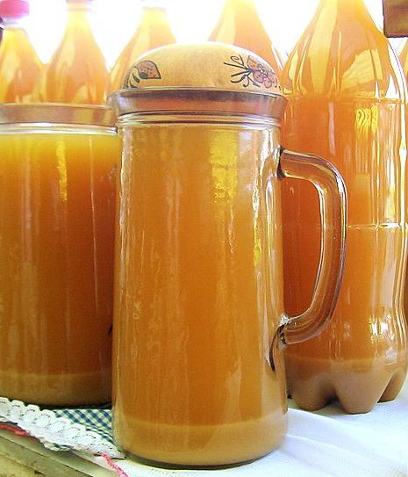
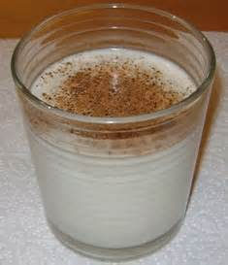
Comida de Bolivia: chicha
Alcoholic drink
made from purple corn

Slide 19
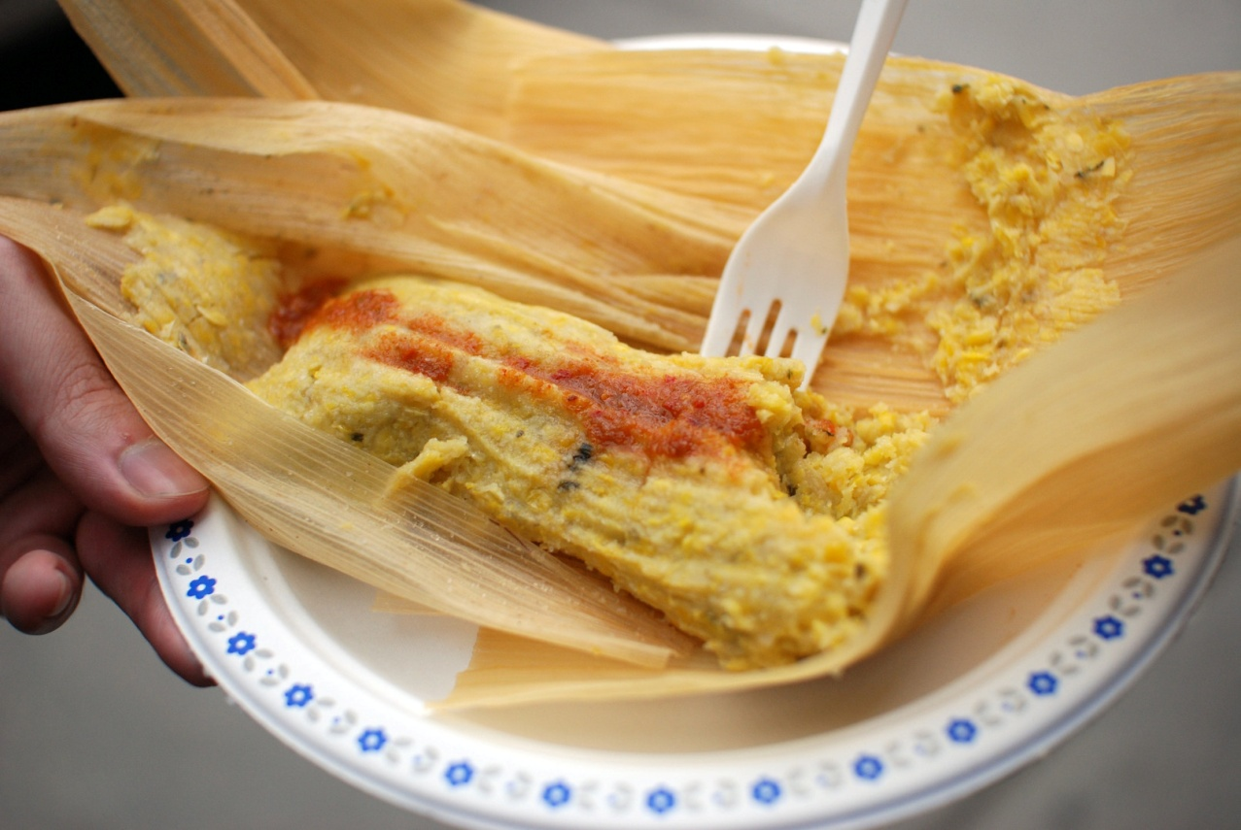
Comida de bolivia: Humitas
Sweet tamale:
pureed corn, queso fresco, sugar, cinnamon and raisins all cooked in achiote oil and steamed in corn husks

Slide 20
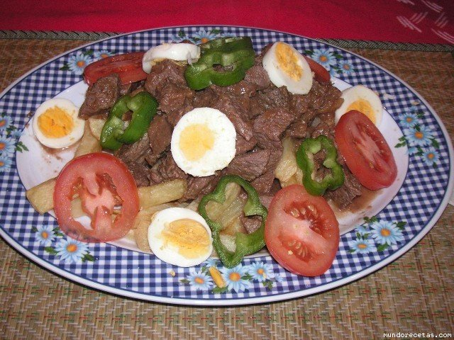
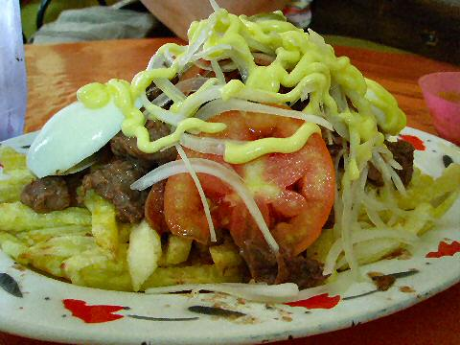
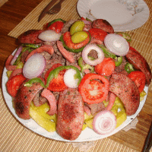
Comida de bolivia:
Pique macho
Beef, sausage, fries, boiled eggs, peppers

Slide 21
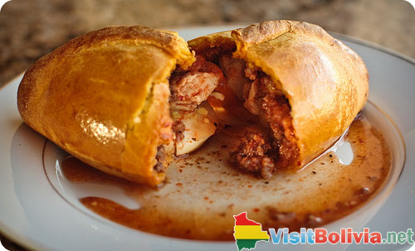
Comida de bolivia: salteÑA
Empanadas salteñas are stuffed with diced meat or chicken, chives, raisins, potatoes, hot sauce and peppers

Slide 22
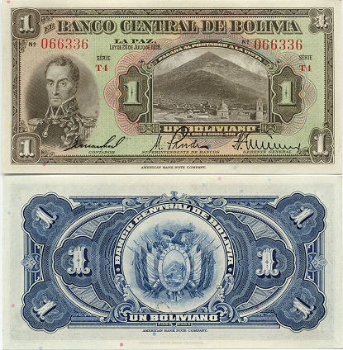
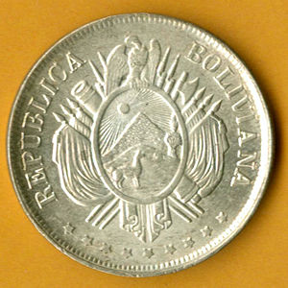
Other facts
La Moneda Nacional:
Boliviano
El ingreso anual- $1,260 per year
La población –9.5 million

Slide 23
Perú

Slide 24
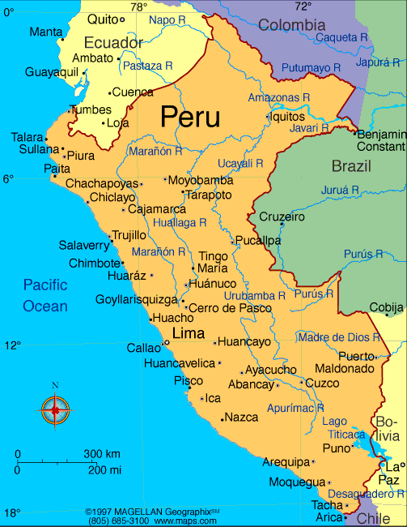
Peru
Peruvian Rain Forest

Slide 25
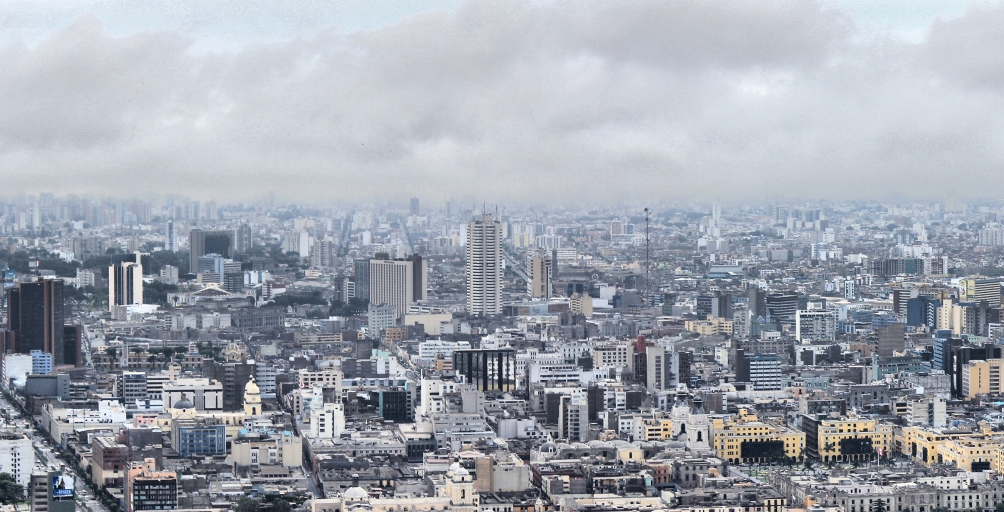
Lugares para visitar:
La Capital: Lima
“City of the Kings”
“Lima…is large, noisy, polluted and shrouded in a misty coastal fog for much of the year.”
“Despite the unimpressive landscape; the friendly people, important historical sites, quality museums, and variety of dining and entertainment establishments make Lima a very interesting place to visit.”
http://www.peru-travel-adventures.com/lima-peru.html/

Slide 26
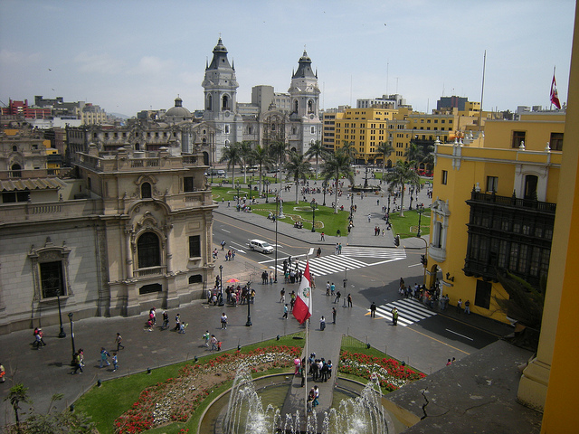
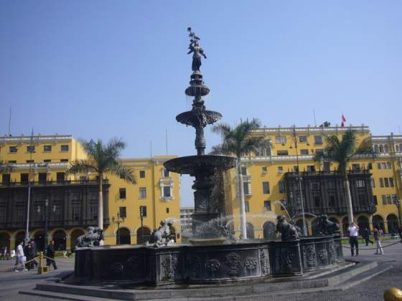
Exploring Lima
The Plaza de Armas is a great starting point for exploring Lima. Stand in the middle of this spacious and handsome square, by the 17th-centruy bronze fountain, and you are at the historic heart of the city.
On the north side is the Government Palace, which was completed in 1938, and suffers from the past of Peru's dictators of the time for grandiose French baroque. On weekdays at 12:45 pm, you can see the changing of the guard.
http://www.peru-travel-adventures.com/lima-peru.html/

Slide 27
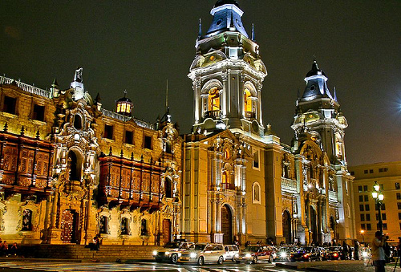
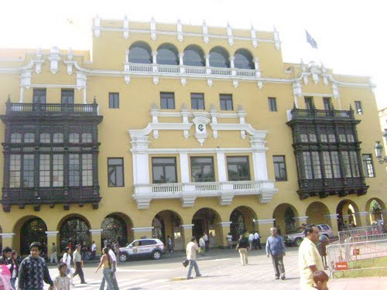
Exploring Lima
The eastern side of the square is dominated by the cathedral, which was reconstructed many times due to earthquakes.
Opposite the cathedral is the Municiplidad de Lima, or town hall. The pleasant interior includes a fine library. Next to it on the square is the headquarters of the Club de la Union, a lunchtime mixture of politicians and professionals.
http://www.peru-travel-adventures.com/lima-peru.html/

Slide 28
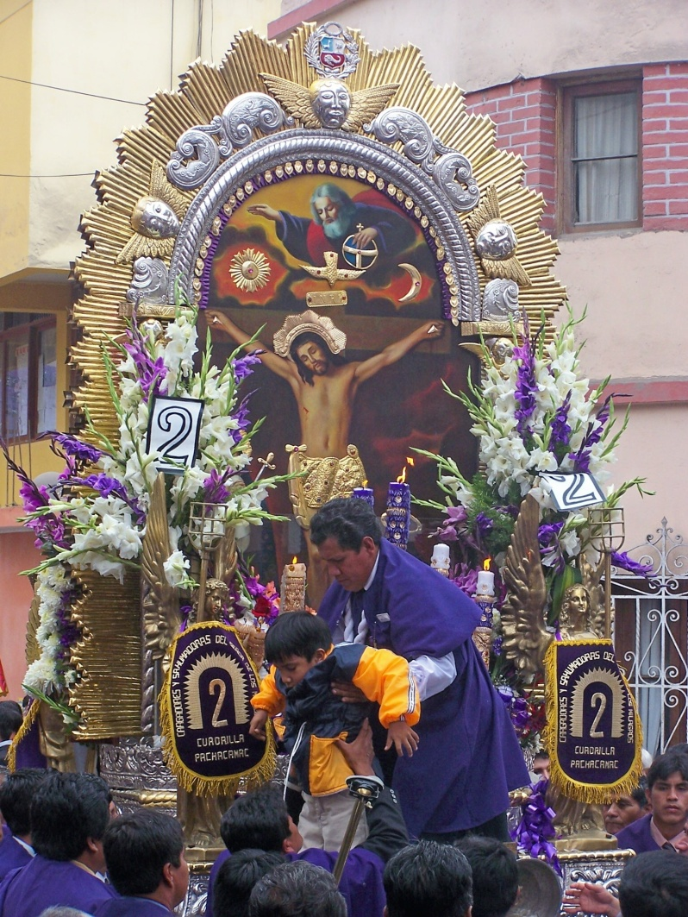

Festivities in lima:
SeÑor de los milagros
The Lord of the Miracles, the patron saint of Lima, is celebrated in October with a series of street parades that include a life-size replica of Jesus carried on an elaborate adorned altar. The faithful followers are adorned in purple robes and the entire reverent, yet festive, occasion is accompanied by music, singing, the ringing of ceremonial bells and the burning of incense.
http://www.peru-travel-adventures.com/lima-peru.html/

Slide 29


Festivities in lima
October is also the month when the bullfighting season begins. The best bullfighters of the world come to compete for the Escapulario de Oro (the gold epaulet) in the Plaza de Acho ring.
Other celebrations throughout the year include a wine harvest festival in March, and the Feria del Pacifico international fair in November.
http://www.peru-travel-adventures.com/lima-peru.html/

Slide 30

Museums
The Museum of Anthropology and Archaeology in the Plaza Bolivar is one of the most interesting museums in South America, with a superb collection of pottery and textiles from all the main cultures of ancient Peru.
The Museum of the Republic, contains exhibits from the colonial and independence periods. The National Museum, opened in 1990, in a neo-brutalist mausoleum on Av Javier Prado Oeste in San Borja. The museum contains impressive mock-ups of pre-Columbian archaeological sites, and an ingenious replica of the Chavin stela, a massive carved stone idol.
The Gold Museum contains a private collection with some fine items and artifacts.
The Museum of the Inquisition, next to the Congress in the city center, is in the building where generations of supposed heretics were tortured and tied. The stocks in the underground dungeons and torture chambers are originals.
http://www.peru-travel-adventures.com/lima-peru.html/

Slide 31

Business distrit :
San Isidro and Miraflores
At the top end of Av. Larco is the Parque Kennedy, where artists sell paintings during the weekend.
Next to the Pacifico Cinima is the Café Haiti, a prime spot for people-watching.
Around the corner in Ricardo Palma, is the more upmarket Vivaldi Café.
Walking down Diagonal you will find firstly great imported export-quality Peruvian coffee in the highly trendy Café Café and a little further on is a side street crammed with pizzerias with open-air tables. A cobbled road leads down a gully to the Costa Verde, as the sweep of beaches is called.
http://www.peru-travel-adventures.com/lima-peru.html/
Peru: Nation with healthy economy
And Stable Democracy 10 min

Slide 32


islas flotantes
Floating Islands on Lake Titicaca – 6 min en espaňol
Creating the Floating Islands
The Aymaras that have settled there today construct their floors and rafts with bulrush (reedy plant). They are dedicated to fishing and especially welcoming tourists.
http://pe.gotolatin.com/eng/Attr/htm/Peru-Islas-Flotantes-Uros.asp

Slide 33


Machu picchÚ
7,000 feet above sea level and nestled on a small hilltop between the Andean Mountain Range, the majestic city soars above the Urabamba Valley below. The Incan built structure has been deemed the “Lost Cities”, unknown until its relatively recent discovery in 1911. Archaeologists estimate that approximately 1200 people could have lived in the area, though many theorize it was most likely a retreat for Incan rulers. Due to it’s isolation from the rest of Peru, living in the area full time would require traveling great distances just to reach the nearest village.
http://www.peru-machu-picchu.com/
National Geographic : Machu Piccu Decoded
Virtual Tour

Slide 34

Cusco-Inti raymi fesital
4 min video
Every year on the 24th of June Cusco celebrates the festival of Inti Raymi. This festival was celebrated by the Incas as the Festival of the Sun where the God of the Sun Wiracocha is honored. The Inti Raymi symbolizes the eternal consecration of marriage between the Sun and his sons, the human beings.
During the ceremony the Inca is toasted with chicha (a fermented drink) poured into gold containers, one for the Inca, one for the Sun, and the third one for the mother land, mentioning also the Apus or gods of the earth. As a fitting finale, the Inca gives a speech in the native language quechua.
http://www.perupicchu.com/cusco/inti-raymi.php

Slide 35




Nazca Lines
http://www.sacred-destinations.com/peru/nazca-lines
The Nazca Lines are giant sketches drawn in the desert of western Peru by ancient peoples. The drawings were created on such a large scale is such that the shapes can be readily discerned only from the air, leading to a variety of theories about their purpose.
Mystery of the Nazca Lines
Smithsonian Channel 46 min

Slide 36




Arequipa- colca canyon
The Colca Valley is a colorful Andean valley with pre-Inca roots, and towns founded in Spanish colonial times, still inhabited by people of the Collagua and the Cabana cultures. The local people maintain their ancestral traditions and continue to cultivate the pre-Inca stepped terraces.
Colca Canyon is a canyon of the Colca River in southern Peru, located about 100 miles (160 kilometers) northwest of Arequipa. It is more than twice as deep as the Grand Canyon in the United States at 13,650 ft depth.
Tour Advertisement
en.wikipedia.org/wiki/Colca_Canyon

Slide 37


Gente famosa
Atahualpa (c 1500)
Last Inca Emperor
Tupac Amaru II (1742-1781-)
Leader of indigenous uprising against the Spanish

Slide 38


Gente famosa
Pachamama
An Andes, Incan goddess meaning “Mother Earth

Slide 39

Gente famosa
Alberto Fujimori (1938-)
President (1990-2000)
Currently serving a 6-25 year prison sentence for abuses of power including:
  ordering an illegal search and seizure
  human rights violations
  and a role in killings and kidnappings by the Grupo Colina death squad during his government's battle against leftist guerrillas in the 1990s

Slide 40

Comida de perÚ:
CUY
Roasted guinea pig

Slide 41


Comida de perÚ : inca cola
known as "the Golden Kola" in international advertising) is a soft drink that was created in Peru in 1935.
yellowish-gold in color, and is sold in glass and plastic bottles of various sizes and cans of the same color with an Inca motif.
has an unusual sweet fruity flavor that resembles a little of its main ingredient, lemon verbena. Americans compare its flavor to bubblegum or cream soda
is a source of national pride and patriotism in Peru, a national icon
The Coca-Cola Company owns the Inca Kola trademark everywhere but in Peru. In Peru, the Inca Kola trademark is owned by Corporación Inca Kola Perú S.A
http://en.wikipedia.org/wiki/Inca_Kola

Slide 42

Comida de perÚ : mazamorra morada
Purple corn pudding
Mazamorra morada is a popular Peruvian dessert made from purple corn and fruit. It's thickened into a pudding-like texture with potato flour or corn starch, and spiced with cinnamon and cloves. It tastes a bit like blackberry pie filling, but more exotic. Mazamorra has a beautiful deep purple (morada) color, and is usually served cold.
http://southamericanfood.about.com/od/desserts/r/mazamorramorada.htm

Slide 43

Comida de perÚ : papas a la huancaÍna
Potatoes in an ají pepper, creamy sauce
Papa a la Huancai­na, (potatoes Huancayo style) are boiled yellow potatoes covered with an even yellower spicy and creamy cheese sauce, and accompanied by hard-boiled eggs and black olives.
This easy recipe is so popular that you can find the Huancai­na sauce everywhere: as a dip for crudites, quails eggs, corn, or fried yucca, as a sauce for spaghetti or risotto (surprisingly good), with steak, etc.

Slide 44




Comida de perÚ : quinoa
Quinoa, an ancient grain known as the “Mother Grain” to the Incas, is a delightful ingredient that is used in drinks, desserts, salads, and soups, to name just a few. Eaten for breakfast, lunch and dinner, this Andes-grown grain is the most protein-packed of all the grains.
http://www.earthyfamily.com/PU-recipe.htm
Quinoa Wisdom from Peru –
Cooking with Quinoa
http://renegadehealth.com/blog/2011/10/24/quinoa-wisdom

Slide 45


Other facts
Members of the national police, or the armed forces may not vote in the national elections.
There are almost seven times more unpaved roads in Peru than paved roads. Transportation is particularly interesting in the wet season- where it has been known to rain more than 16 days per month
Peru contains only 205,000 Internet hosts. (That’s about 1.05% of the Unites States' Internet hosts). However, 4.57 million users are able to access information from the Internet in Peru. This means that for every Internet host, there are almost 23 people using that computer.
http://www.perufacts.org/perufacts.html
La Moneda
Nacional:
Nuevo Sol
El ingreso
anual-
$3,450 per year
La población –27.9 million

Slide 46
chile

Slide 47

A Trip through Chile- 8 min
Chile Travel Promotional Video –
3 min – Pictures and Music only

Slide 48


Lugares para visitar:
La Capital: santiago
Chile's capital city is cosmopolitan, the financial, cultural, and political center of the country. It's graced with tree-lined streets, parks, distinctive neighborhoods, ample assortment of restaurants and hotels.
http://gosouthamerica.about.com/od/chisantiago/Santiago.htm
Santiago Travel Tips- 5 min
Discover Santiago – 1 min

Slide 49


Cerro san cristobÁl
http://en.wikipedia.org/wiki/Cerro_San_Crist%C3%B3bal
Cerro San Cristóbal (San Cristóbal Hill) is a hill in central - northern Santiago which rises 300 m above the rest of Santiago; the peak is the second highest point in the city. Although it’s original name is Tupahue "place of god,” the San Cristóbal family held a quarry on the hills south side, close to the Mapocho river and that’s the reason why it is called San Cristóbal even if it has a statue of Virgin Mary on the top.

Slide 50

San pedro de Atacama
Tiny San Pedro de Atacama (elevation 2440m) is a precordillera oasis village turned into a tourist boomtown, and is also the gringo gathering point of northern Chile..
San Pedro itself seems hardly big enough to absorb the hordes of travelers that arrive; it's little more than a handful of picturesque adobe streets clustering around a pretty tree-lined plaza and postcard-perfect church. However the last decade has seen a proliferation of guesthouses, restaurants, Internet cafés and tour agencies wedging their way into its dusty streets.
http://www.lonelyplanet.com/chile/northern-chile/san-pedro-de-atacama

Slide 51




San pedro de Atacama
Pictorial
Video
Close by is the country's largest salt flat, spotted pink with flamingos and its edges crinkled by volcanoes, fields of steaming geysers, a host of otherworldly rock formations and weird layer-cake landscapes
http://www.lonelyplanet.com/chile/northern-chile/san-pedro-de-atacama

Slide 52


Chuquicamata copper mine
Copper
Production
In Chile
The Chuquicamata (Chuqui) mine is a large open pit copper mine located 1,650km north of Santiago, which has been operating since 1910. The mine produced 29 million tons of copper by the end of 2007. The Chuquicamata site is expected to be closed by 2013.
A new underground mine will be developed in addition to the present open pit mine and will begin operations in 2018. Four subterranean tunnels extending 1,500km will be constructed under the surface of the mine. The tunnels will deepen the mine by nearly 787m by the end of production in 2060. The underground mine will be developed at an estimated cost of $2bn and will produce an estimated 120,000t/d. The mine is owned and operated by Codelco.
http://www.mining-technology.com/projects/chuquicamata-copper/

Slide 53

Easter island- moai stone figures
One of the world's most famous yet least visited archaeological sites, Easter Island is a small, hilly, now treeless island of volcanic origin. Located in the Pacific off the coast of Chile, it is considered to be the world’s most remote inhabited island. Sixty-three square miles in size and with three extinct volcanoes (the tallest rising to 1674 feet), the island is, technically speaking, a single massive volcano rising over ten thousand feet from the Pacific Ocean floor. The oldest known traditional name of the island is Te Pito o Te Henua, meaning ‘The Center (or Navel) of the World.’ The island received its most well known current name, from the Dutch sea captain Jacob Roggeveen who became the first European to visit on Easter Sunday, April 5, 1722.
The most famous features are its enormous stone statues called moai, at least 288 of which once stood upon massive stone platforms called ahu.
There are some 250 of these ahu platforms spaced approximately one half mile apart and creating an almost unbroken line around the perimeter of the island.
http://sacredsites.com/americas/chile/easter_island.html

Slide 54


Easter island- moai stone figures
Another 600 moai statues are scattered around the island, either in quarries or along ancient roads between the quarries and the coastal areas where the statues were most often erected.
Nearly all the moai are carved from the tough stone of the Rano Raraku volcano.
The average statue is 14 feet, 6 inches tall and weighs 14 tons. Some moai were as large as 33 feet and weighed more than 80 tons (one statue only partially quarried from the bedrock was 65 feet long and would have weighed an estimated 270 tons).
Depending upon the size of the statues, it has been estimated that between 50 and 150 people were needed to drag them across the countryside on sleds and rollers made from the island's trees.
BBC Documentary 50 min
Short Video

Slide 55



ValparaÍso beach
The best beaches in Chile include the five beaches of Valparaiso. This is Chile’s major seaport, and with its close proximity to Santiago, it is also a popular destination on a Chile vacation.
Similar to other areas of the coastline, restaurants are known for serving fresh seafood. A Chile beach will offer a range of accommodation options as well, with everything from camping to five-star resorts on offer to visitors.
http://www.destination360.com/south-america/chile/beaches

Slide 56


ViÑa del mar
Vina del Mar is one of Chile’s most famous beaches and has been attracting the upper classes of the country since the 1870s. Many consider this area to be Chile’s prime seaside resort, and it is sometimes referred to as the Chilean Riviera.
Located just five miles north of Valparaiso, Vina del Mar is easily accessible. Santiago is only 75 miles away, increasingly the popularity of this Chile beach. The President of Chile has a summer home here, and a variety of beach resorts and restaurants draw tourists from around the world.
http://www.destination360.com/south-america/chile/beaches

Slide 57





Patagonia Region- rainforest
Patagonia is a large land area comprising the southernmost region of South America. Situated in Chile and Argentina, Patagonia connecting the Andes Mountains to Argentina's Colorado River. Many plants and animals live in this geographic region; some are indigenous only to this area.
Travel Video – Pictures and Music

Slide 58

Patagonia Region- glaciers
Covering more than two thousand square miles, more than 350 stunning Patagonia glaciers are located in famous Los Glaciers National Park.
The undeniable beauty of crystallized blue ice combined with the overwhelming natural beauty of the area’s mountainous backdrop creates a vision unlike any other. It is one of the top things to do in the country.
Reaching the Patagonia glaciers requires transportation via boating, hiking, 4x4 driving, or even horseback riding.
Glacier Grey – Puerto Natales
Patagonia Chile
Pictures and Music
http://www.destination360.com/south-america/argentina/patagonia-glaciers

Slide 59


Gente famosa
Michelle Bachelet (1951- )
President 2006-2010
Head of UN Women’s Agency 2011-2012
Announced her candidacy for November’s elections, saying “her goal would be ending the inequality that plagues Chile, which has one of the world's largest gaps between rich and poor despite its economic successes.”
http://www.huffingtonpost.com/2013/03/28/michelle-bachelet-announc_n_2970707.html
Bernaro O’Higgins (1778-1842)
Chilean landowner and one of the leaders of its struggle for Independence.
Although he had no formal military training, O'Higgins took charge of the ragged rebel army and fought the Spanish from 1810 to 1818 when Chile finally achieved its Independence.
Today, he is revered as the liberator of Chile and the father of the nation.
http://latinamericanhistory.about.com/od/thehistoryofchile/a/10bernardoohiggins.htm

Slide 60

Gente famosa:
Augusto Pinochet (1915-2006
Dictator (1973-1990)
After Salvador Allende was overthrown by the 11 September 1973 coup d'état, Chile was ruled by a military dictatorship that lasted up until 1990. The regime, led by General Augusto Pinochet, was characterized by the systematic suppression of political parties and the persecution of dissidents to an extent that was unprecedented in the history of Chile. Scholars now consider it an example of a police state.
Indicted for human rights violations in 1998
http://en.wikipedia.org/wiki/Augusto_Pinochet

Slide 61


Gente famosa
Pablo Neruda (1904-1973 )
Poet
Nobel prize in Literature 1971
Isabel Allende (1942- )
Novelist
Her best-known works, which include the novels The House of the Spirits and City of the Beasts, are written in the style of magic realism, which uses fantasy and myth to override time and place.
http://www.biography.com/people/isabel-allende-9181801

Slide 62


Comida de chile: empanadas
Usually filled with hamburger, olive and hard boiled egg pieces

Slide 63


Comida de chile:
Pastel de choclo
“Chilean Sheppard’s Pie” : Ground beef (and sometimes chicken) casserole with corn batter topping

Slide 64



Comida de chile:
LÚcuma /chirimoya fruits

Slide 65

Other facts
Business Etiquette in Chile
Prior appointments are necessary
In business, punctuality respected. Meetings should start and end on time
Have business cards printed with English on one side and Spanish on the other. Present cards to everyone in a meeting except secretaries
Business entertaining generally is done at major hotels and restaurants
Light conversation is customary before business discussions
Don’t serve wine with your left hand. Wines, especially white wines, are a national treasure
Proper table manners are important
Women have advanced in professions in Chile, more so than in most other Latin countries. However, they will be at a slight disadvantage because of the machismo ethnic that continues to exist
Gifts are not expected in business until the relationship is a close one
Chileans do not bargain in either stores or street markets. It is illegal to sell something and not issue a receipt
La Moneda
Nacional:
Peso
El ingreso anual- $8,350 per year
La población –16.6 million
http://www.cyborlink.com/besite/chile.htm

