Slide 1
Colombia Ecuador Venezuela
Spanish for Business
Lesson Six
Los Países de la América Sur:

Slide 2
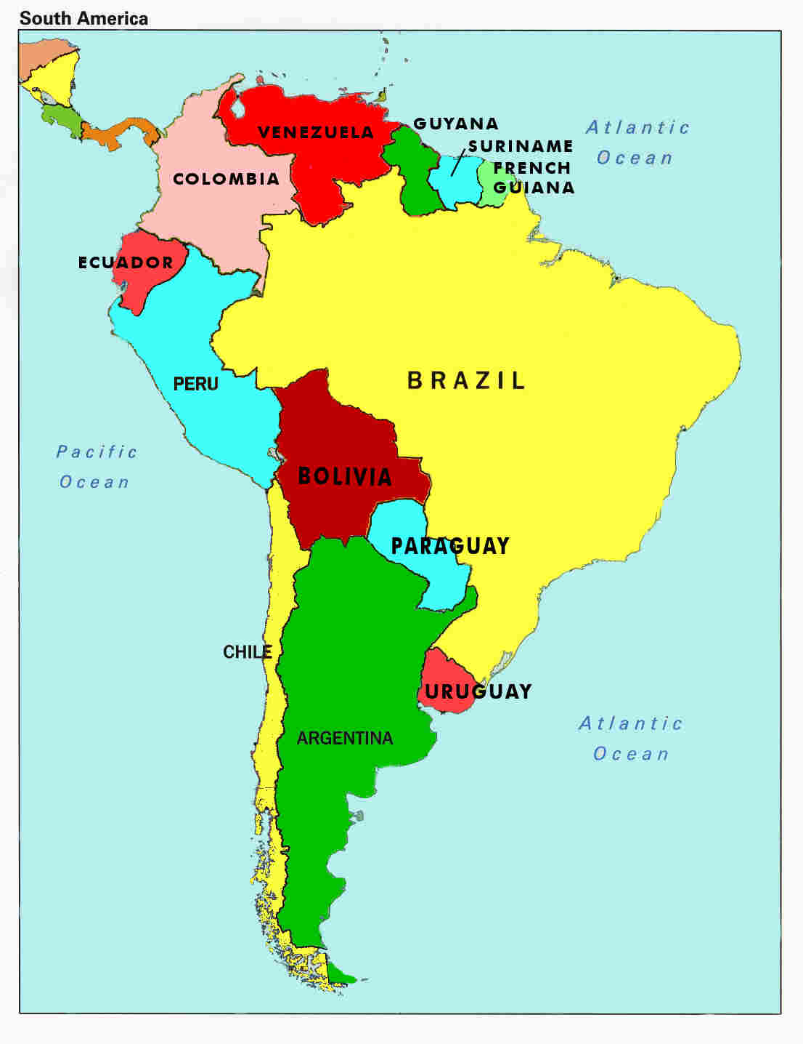
Colombia

Slide 3
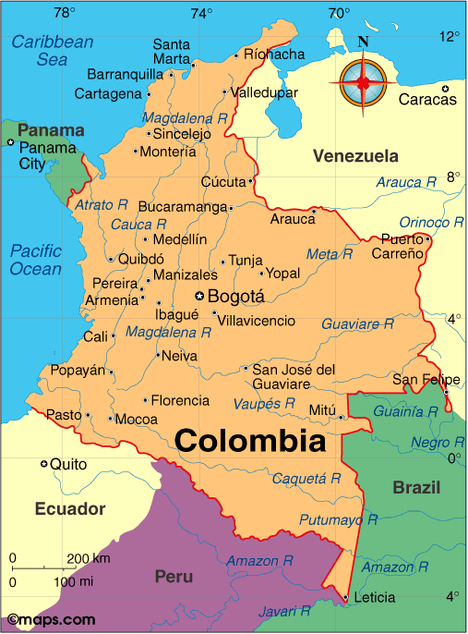
Colombia
Colombia:
La Experiencia
De Tu Vida – Bogotá- Part 1
Colombia : Friendly, Beautiful and Troubled

Slide 4
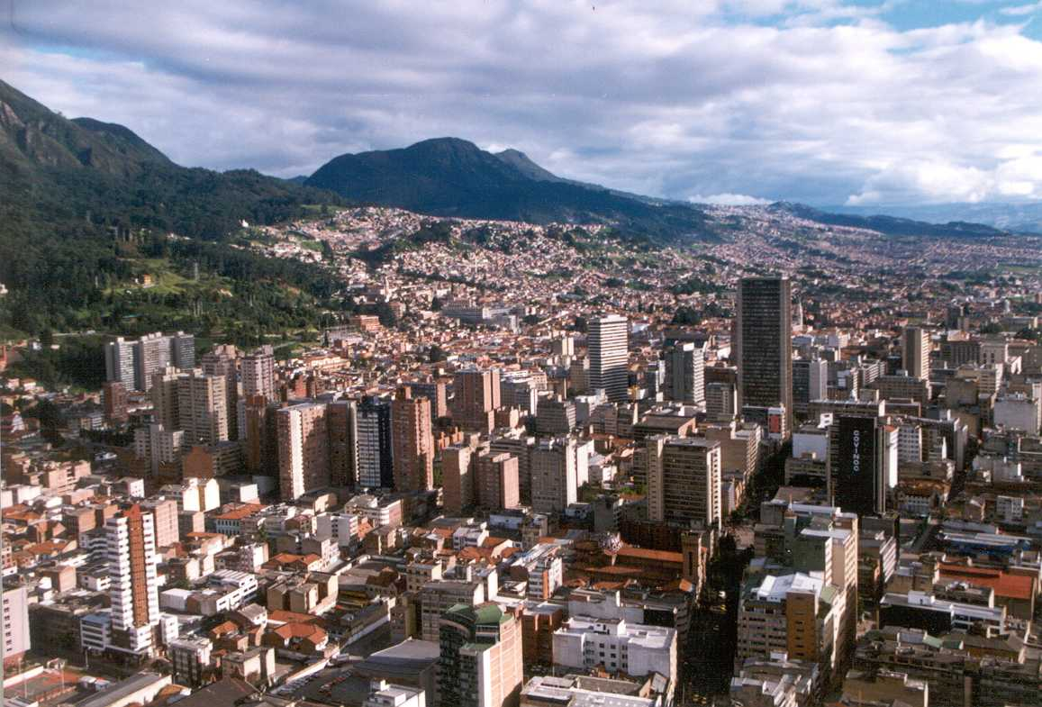
Colobia: Los lugares para visitar
Travel Guide to Bogota
lA Capital: SantafÉ DE BOGOTÁ
population of around 8 million in 2010
one of the 30 largest cities of the world
the third-highest capital city in South America[2] With its many universities and libraries
known as "The Athens of South America" because of the many libraries and universities
one of the most stable democracies in Latin America
the political and financial center of Colombia
listed as a global city and ranked 54th in the 2010 Global Cities Index
http://www.aimac2013.org//bogota.html

Slide 5
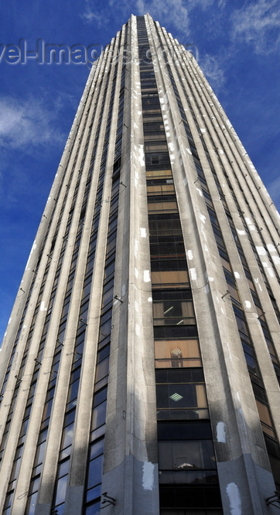
SantafÉ DE BOGOTÁ- A Global city
http://en.wikipedia.org/wiki/Global_city
“A global city is considered to be an important node in the global economic system.…the linkages binding a city have a direct and tangible effect on global affairs through socio-economic means.”
Economic characteristics :corporate headquarter sites for multinational corporations, international financial institutions, law firms, conglomerates, and stock exchanges that influence the world economy; contribute significant financial output; house the major stock market indices; provide a variety of international financial services; appear near the top of cost of living.
Political characteristics: active influence on international events and world affairs; headquarters for international organizations; a large metropolitan area; expatriate communities

Slide 6
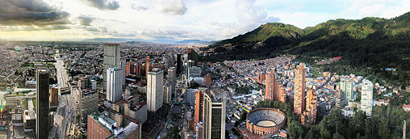
SantafÉ DE BOGOTÁ- A Global city (cont.)
http://en.wikipedia.org/wiki/Global_city
Cultural characteristics: renowned cultural institutions such as important museums, opera/ballet companies, orchestras, film/theater centers; lively cultural scene, including film festivals, thriving music scene, nightlife, art galleries, street performers, annual parades, influential international media organizations; major sports facilities, home teams in major league sports, and the ability to host international sporting events
Infrastructural characteristics: advanced transportation system including significant highways, large mass transit network; major seaports; major international airport with significant number of passengers or cargo; advanced communications infrastructure including fiber optics, Wi-Fi, cellular service; health facilities; prominent skylines/skyscrapers
Educational characteristics: well known universities with international student attendance, research facilities important religious sites, World Heritage Sites of historical and cultural significance; significant tourism; subject in arts and media

Slide 7
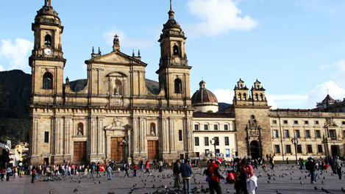
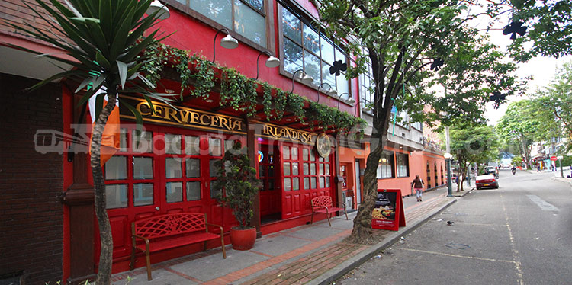
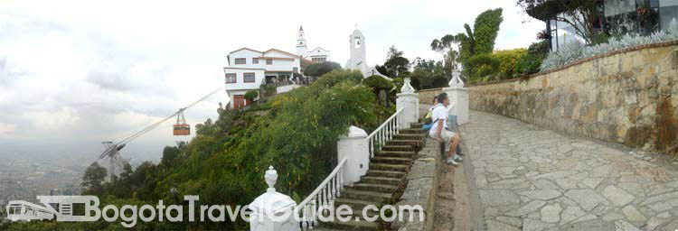
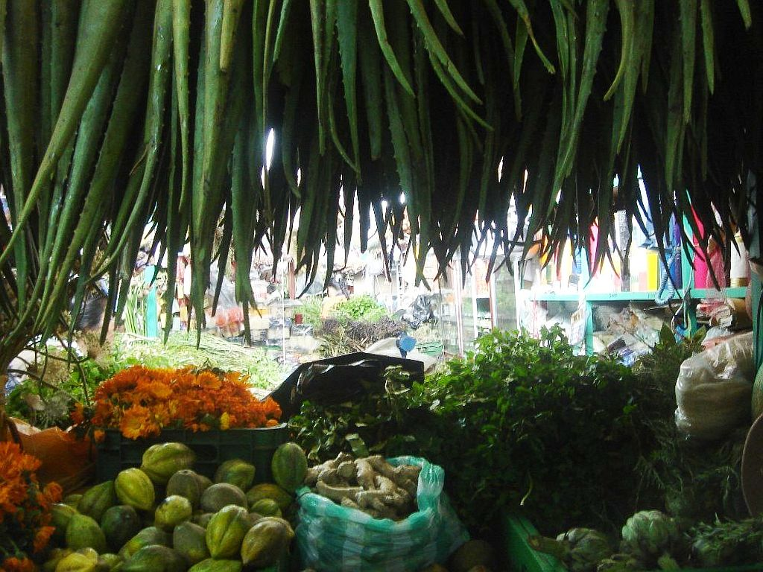
SantafÉ DE BOGOTÁ
Lugares para Visitar
http://bogotatravelguide.com/index_en.html
http://www.travel-images.com/colombia2.html

Slide 8
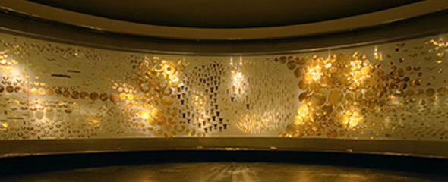
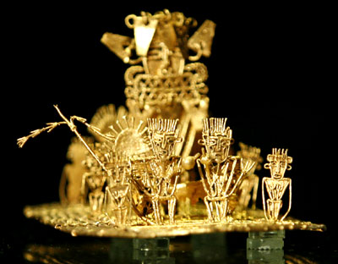
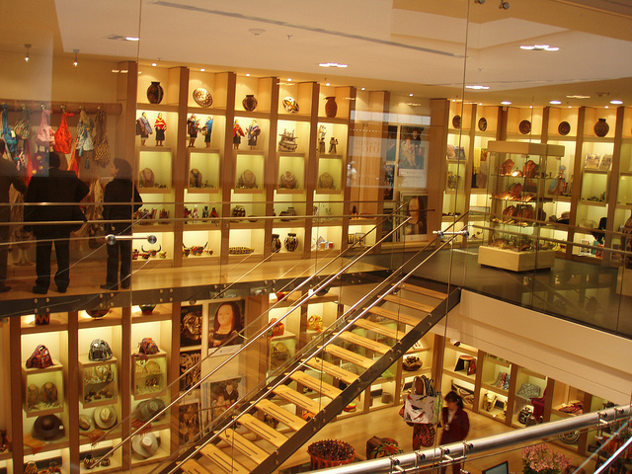
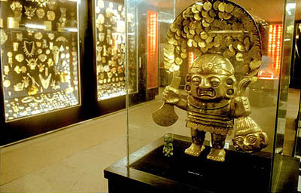
Gold Musem- SantafÉ DE BOGOTÁ
La experiencia
de la Vida :Part 2
El Museo y otros

Slide 9
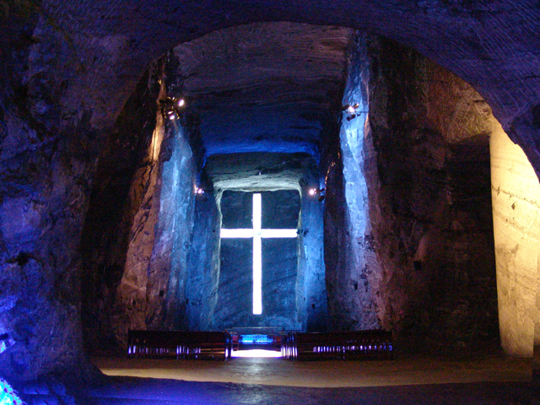
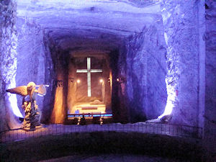
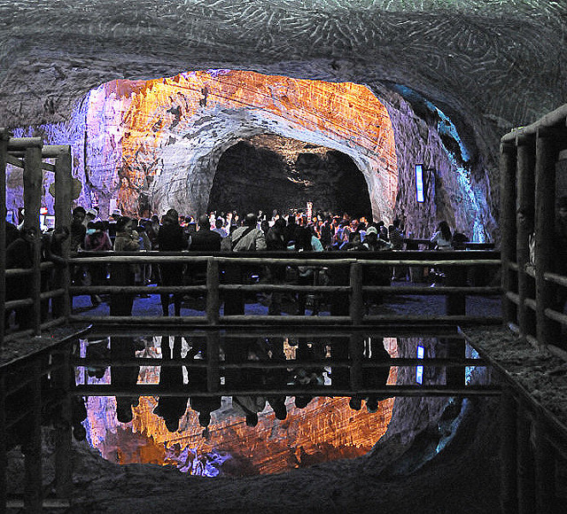
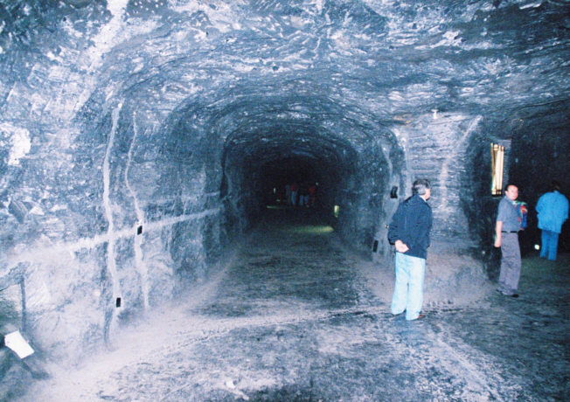
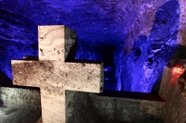
zipaquirÁ-Salt mine- SantafÉ DE BOGOTÁ?
The tour inside the Zipaquirá Salt Cathedral lasts 60 minutes. Weddings are also held in the cathedral.
The miner's route is a guided tour during which tourists can experience life as a miner, with staff and security teams. It lasts 30 minutes.
http://www.colombia.travel/

Slide 10
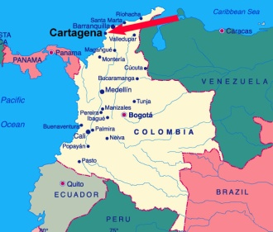
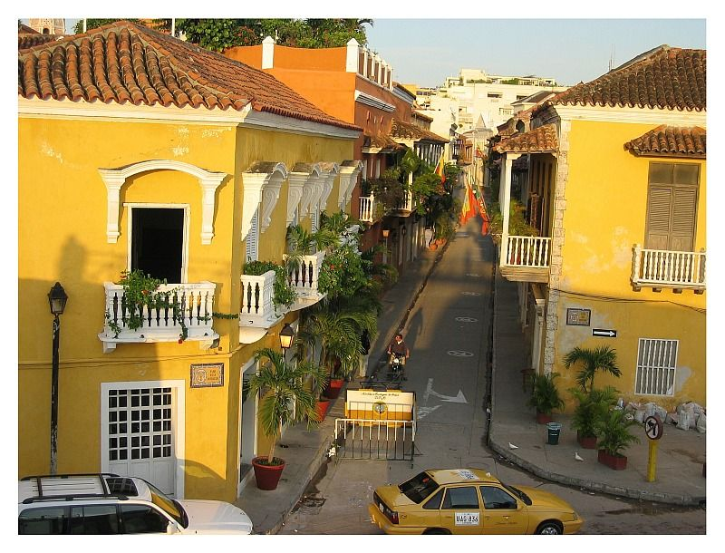
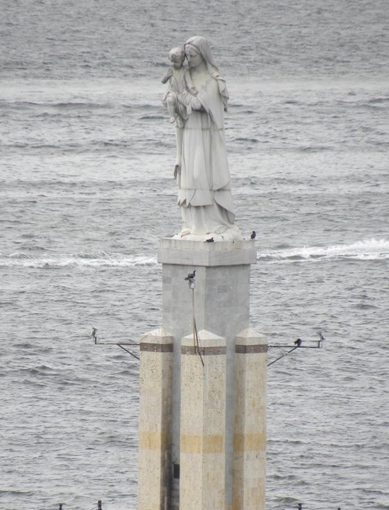
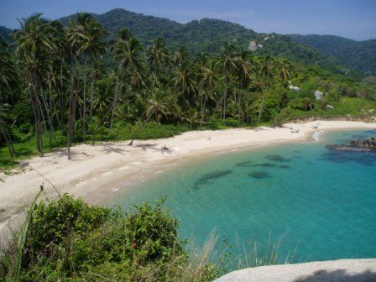
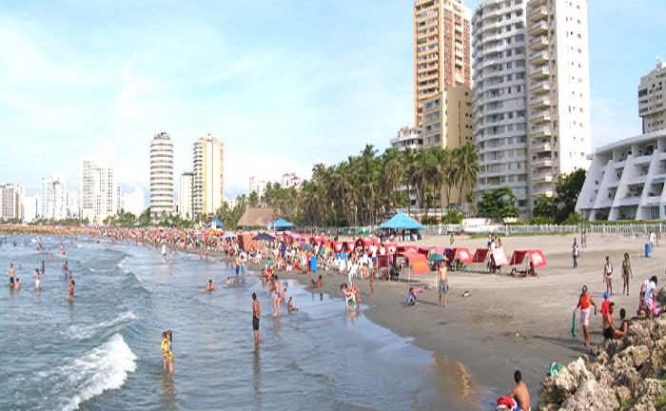
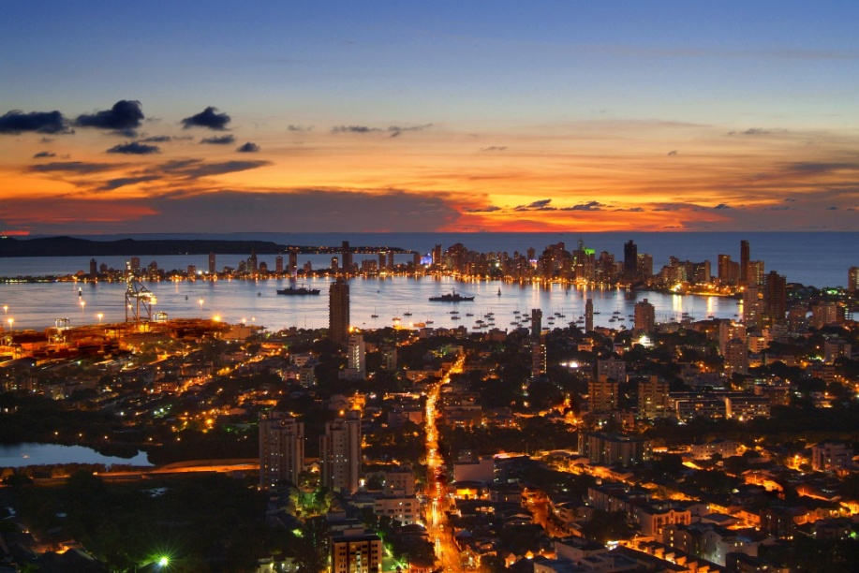
CArtagena
Travel Guide
To Cartagena

Slide 11
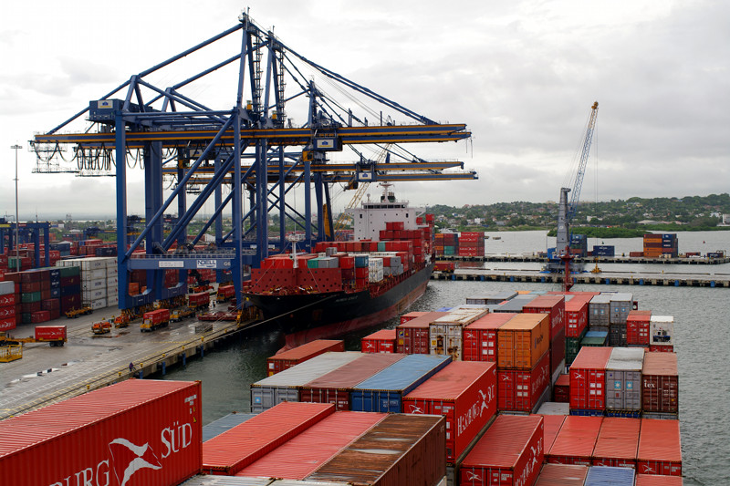
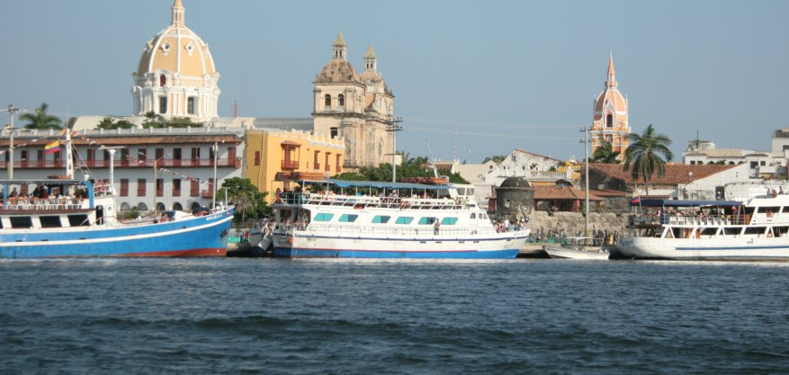
CArtagena – Port
Video of Port and Ships
Once the port that all the wealth from South America traveled through to Spain
Now a busy cruise ship port at a historic city
And the biggest container port in Colombia
www.cartagenainfo.net/cruise/indexeng.html

Slide 12
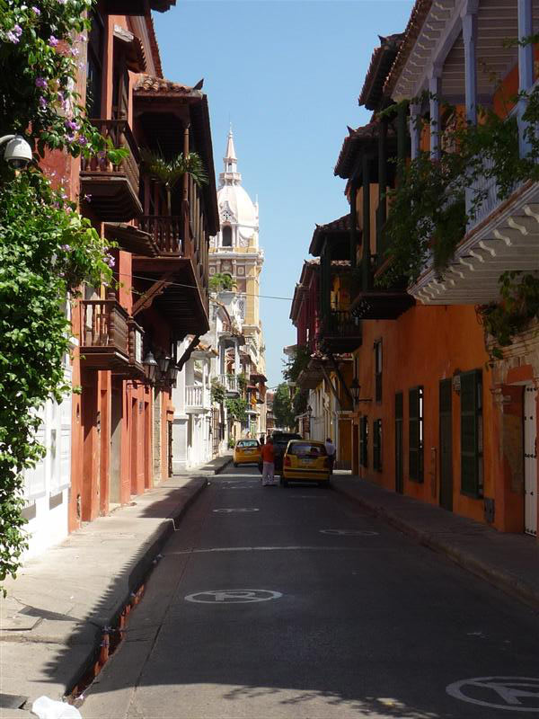
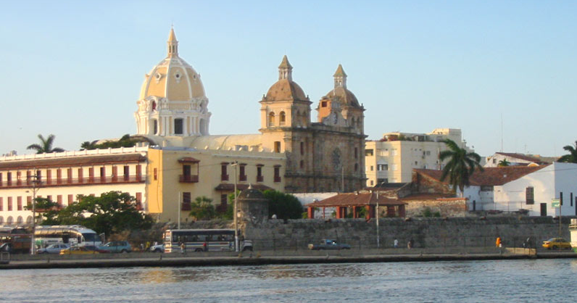
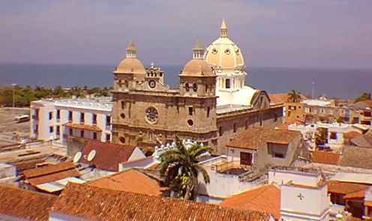
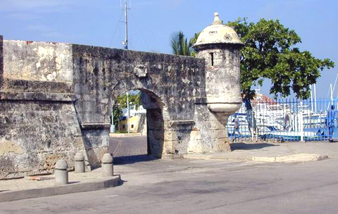
Cartagena- Colonial WALLED cITY

Slide 13
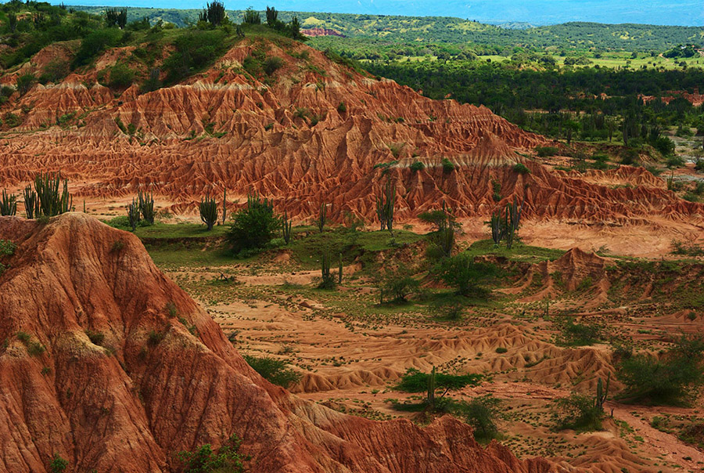
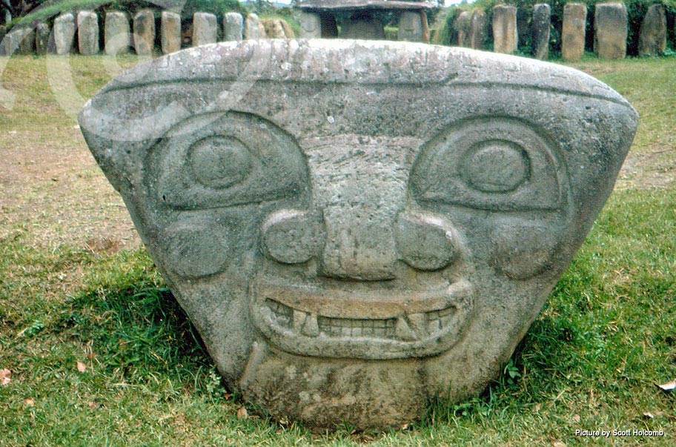
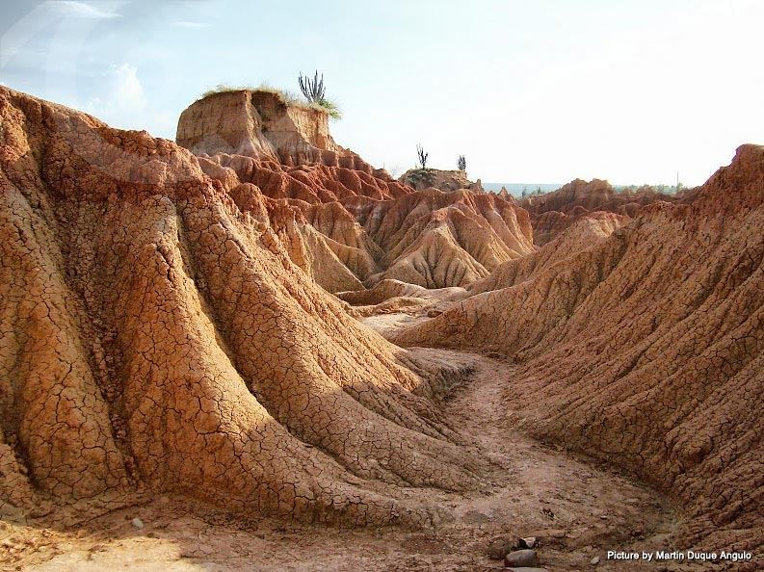
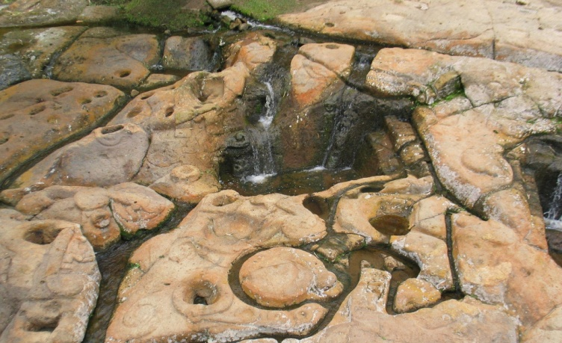
Tatacoa desert & San Agustin
Quick Look
Desierto de
La Tatacoa
Misterio de
San Agustin

Slide 14
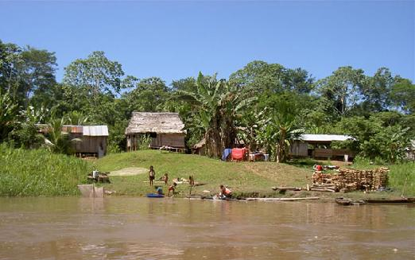
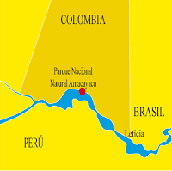
Leticia & Amazon jungle
Part 4 :
La Experiencia de la Vida-Tyronaca
Leticia is a remote jungle town, capital of the Colombian Amazonas state, gateway to the Amazon rainforest and near the small village of Puerto Narino which is a good place to spot dolphins.
You have to catch a flight to Leticia or take a very long journey by boat
Is it safe? Yes, hundreds of miles from any guerilla activity.
There are jungle lodges and rainforest tours
If traveling across to Brazil you need your passport stamped and a yellow fever certificate
Slide Show Leticia & the Amazon
30% of Colombia is Amazon Rainforest
http://www.paisatours.com/leticia.htm

Slide 15
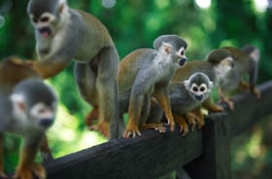
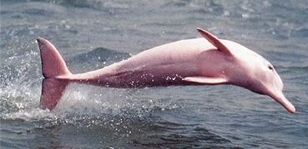
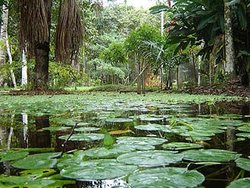
Amacayacu National Park
90 minute boat trip from Leticia
The word "Amacayacu" means "River of the Hamocs" in Quechua
Visitors to the park could see tropical birds -including 11 species of herons, 150 kinds of aquatic mammals- including manatee and river dolphins, various types of retiles- including 4 types of crocodiles, monkeys, sloths and other mammals.
Within the park there are two Tikuna Indican communities. Fourteen different tribes inhabit the Amazonian region.
Quellevar Travel Tour of Amacayacu National Park
http://www.theworldwonders.com/southamerica/amacayacu.html

Slide 16
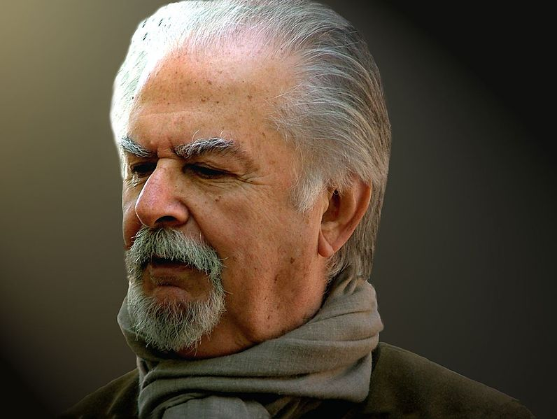
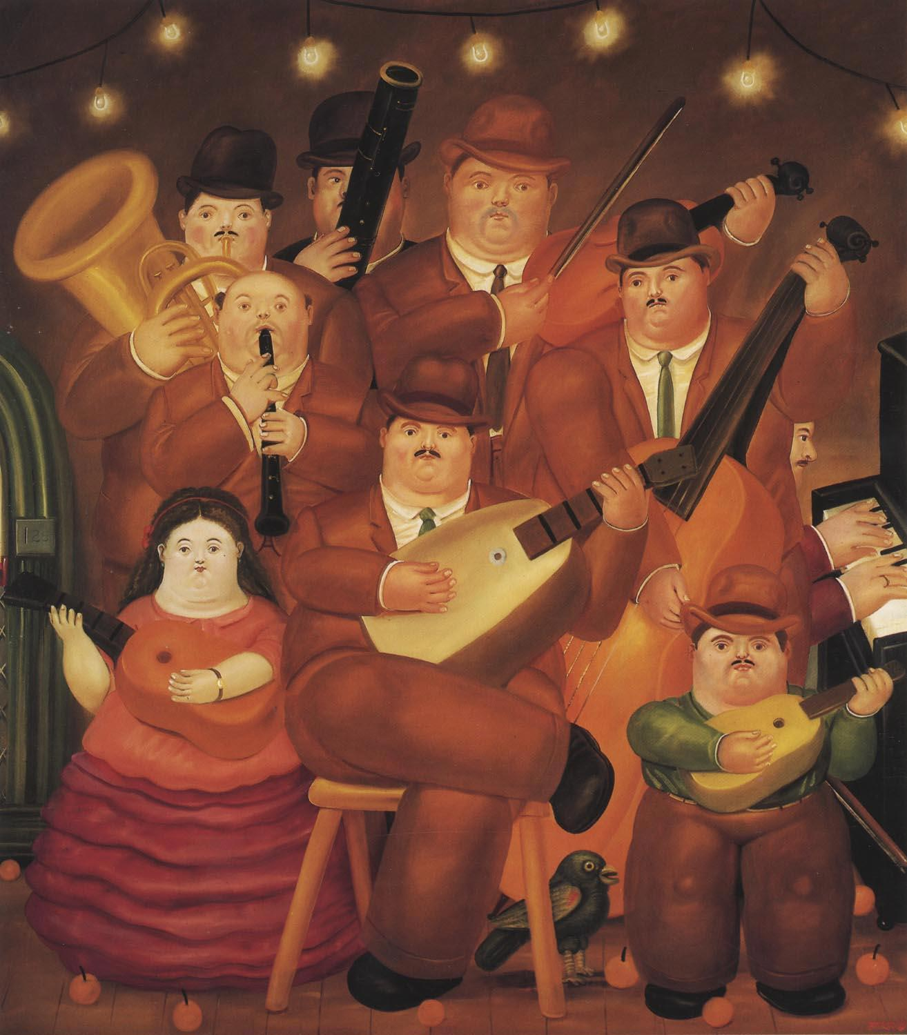
La gente famosa
Fernando
Botero
(1932- )
Artist
His works feature a figurative style, called by some
"Boterismo", which gives them an unmistakable identity. Botero depicts women, men, daily life, historical events and characters, milestones of art, still-life, animals and the natural world in general, with exaggerated and disproportionate volumetry, accompanied by fine details of scathing criticism, irony, humor, and ingenuity. http://en.wikipedia.org/wiki/Fernando_Botero

Slide 17
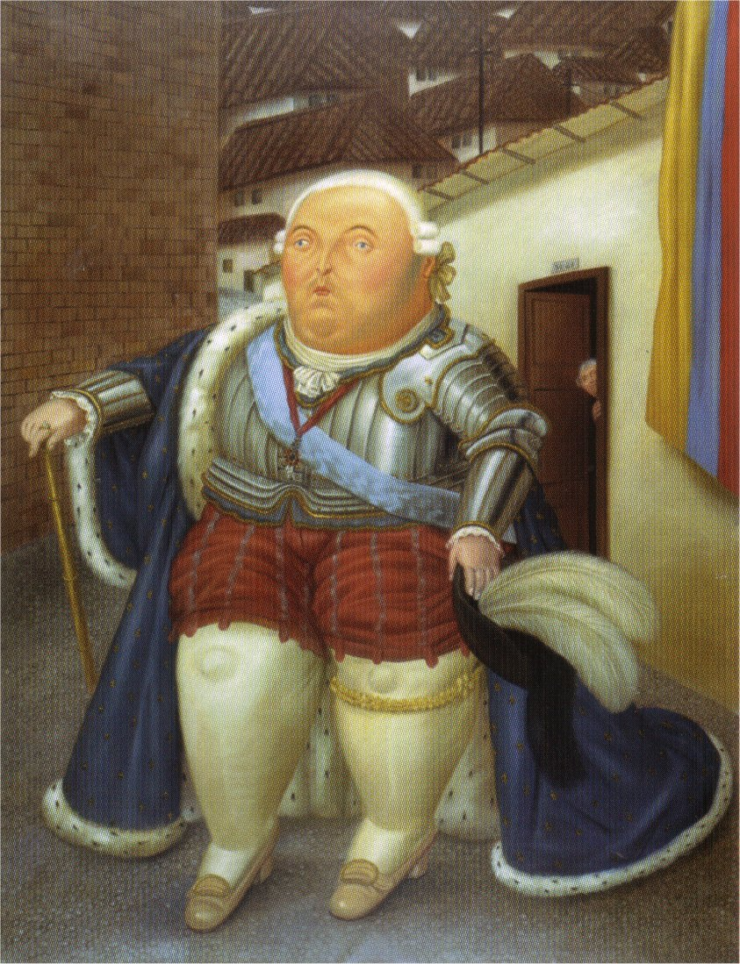
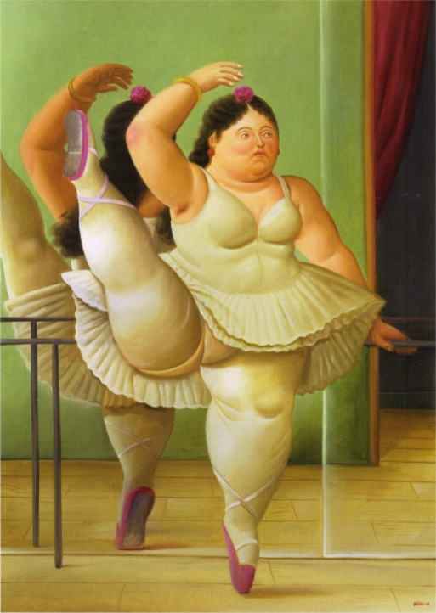
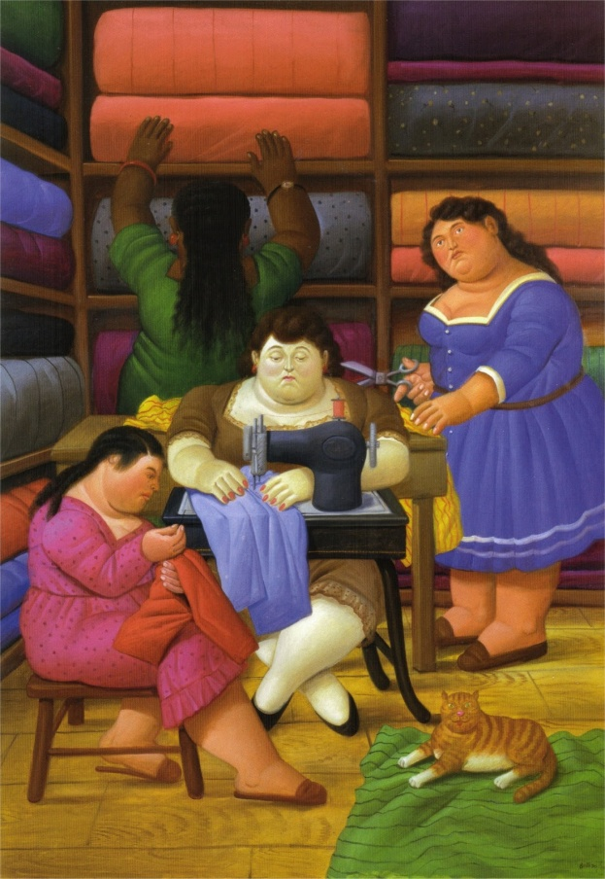
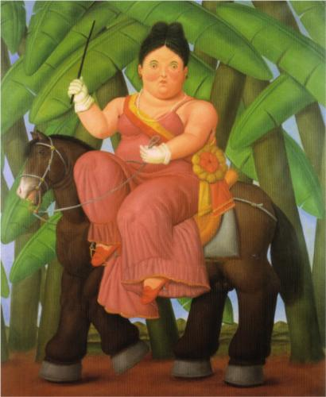
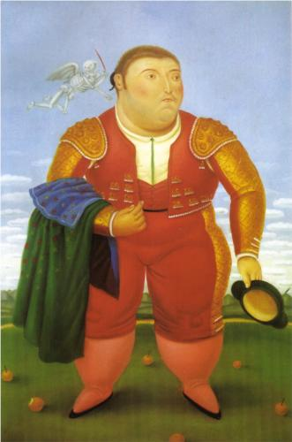
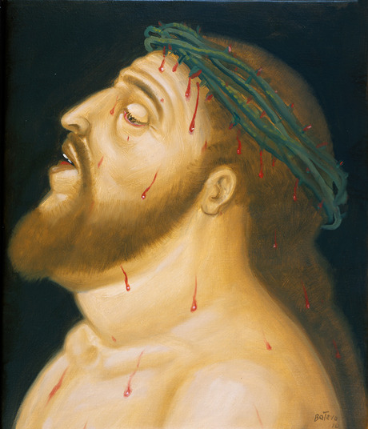

Slide 18
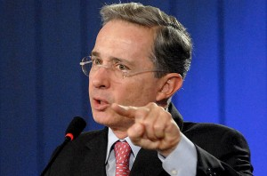
La gente famosa
Shakira (1977- )
Singer
Video de LOCA en español
Álvara Uribe (1952- )
President (2002- 2010)

Slide 19
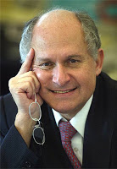
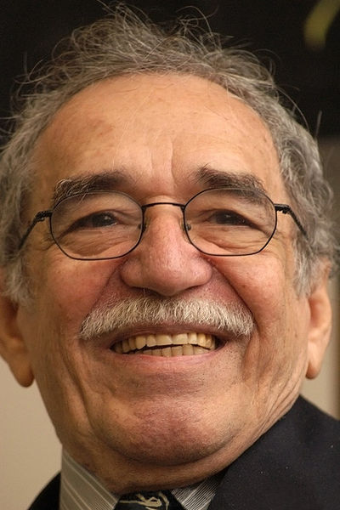
La gente famosa
Elkin Patarroyo (1947-)
Nobel prize for science
Discovered a vaccine for malaria and donated the rights to the WHO (World Health Organization) rather than accept payment from drug companies who offered $68 million
Vaccine later proved ineffective in clinical trials
Gabriel García Márquez (1928- )
Nobel prize for literature
One Hundred Years of Soliltude
Knicknamed “Gabo”

Slide 20
Comida de Colombia: Arepa y CarimaÑola
Arepas are made from corn meal and
Carimañolas are made from yucca
Making these two
Colombian Specialties

Slide 21
Comida de Colombia: Sancocho
Receta de Sancocho Colombiano
Otra Receta
En inglés

Slide 22
Comida de Colombia: CafÉ
La Experiencia de la Vida
Part 3 con Juan Valdez
Café Colombiano
Juan Valdez Home Site

Slide 23
Comida de colombia: fritanga
popular meal throughout Colombia, from the coast to the highlands.
heaping plate of meat, which may include chorizo sausage, blood sausage, ribs, chops, steaks, organs such as heart or kidneys and more.
generally served with potatoes and/or fried bananas.
fried in oil in a deep saucepan (not grilled like the parrillada of Ecuador) http://suite101.com/article/traditional-colombian-food-a49469

Slide 24
Other facts
El ingreso anual- $3,250 per year
La Moneda Nacional:
Peso
La población –46.1 million
Perceptions and Realities
Of Doing Business in Colombia
La Experiencia de la Vida
Part 5 – Foods in the market
Doing Business in Colombia
March 2013 Presentation
Behavior Tips for Colombian Business Trips
Part 6- Carnaval

Slide 25
ecuador

Slide 27
Lugares para visitar: La Capital: Quito
the political and cultural hub of a highly centralized country, where power is wielded by an elite class of politicians, bankers and company directors
where Quechua-speaking women queue for buses in traditional clothing with beads for sale strung tightly around their necks… and babies carried on their mothers' backs in securely wrapped blankets
And the proliferation of ragged shoeshine boys and desperate hawkers selling miracle products is a sobering reminder of the levels of poverty in the city, and its considerable social inequalities.
Discovery Channel :
Passport to Latin America
Quito Ecuador :Part 1
http://travel.yahoo.com/p-travelguide-191502072-quito_vacations-i

Slide 28
Lugares para visitar: La Capital: Quito
At the southern end is the old town… the Plaza de la Independencia, Plaza San Francisco and Plaza Santo Domingo…hill of El Panecillo (the Little Bread Roll), crowned by a large statue of the Virgen de Quito.
Passport to Latin America:
Quito, EcuadorPart 2
http://travel.yahoo.com/p-travelguide-191502072-quito_vacations-i

Slide 29
Lugares para visitar: La Capital: Quito
At the northern end is the new town, El Norte as the Quiteños call it, stretching to the airport with the central areas of La Mariscal, where most hotels and tourist facilities are located, and the business district further north, around Parque La Carolina.
http://travel.yahoo.com/p-travelguide-191502072-quito_vacations-i

Slide 30
Guayaquil
Largest city
Most population
Main port
Turismo Guayaquil
Malecon 2000:
Waterfront promenade with contemporary art museum, large garden and a shopping mall

Slide 31
Cuenca- La concepcion cathedral & monastery
Cuenca Ecuador Video Turístico Part 1
Cuenca Ecuador Video Turístico Part 2

Slide 32
Cuenca
Why We Chose Cuenca
Feria Libre
To Live in Cuenca Ecuador
La Casa Cuencana
Help for Ecuadorian Business Owners
From the DIY Cuenca Landing Guide
http://www.discovercuencaecuador.com/

Slide 33
Islas galÁpagos
Exploring
the Galapagos
4 min
Wonders of the
Galapagos
Documentary
54 min

Slide 34
Amazon jungle
Yusani
National
Park
Tours

Slide 35
Gente famosa
Gerardo (1965-)
Singer -“Rico Suave” 1990
Gerardo Mejía, is a Latin rapper and singer who later became a recording industry executive. Born in﻿ Guayaquil, Ecuador, he and his family moved to Glendale, California, when he was 12 years old.
Music Video “Rico Suave

Slide 36
Gente famosa
Luis Miranda
Painter (1932- )
"Mi pintura es de carácter rural. Yo pinto al hombre en su medio, la gente que veo. Siempre he dicho: en la vida todo es bello, la cuestión es plasmarlo plásticamente", refiere el artista. “Yo no puedo estar sin pintar. El día que no pinte, me muero.”
http://www.eluniverso.com/2012/07/17/1/1380/luis-miranda-expone-sus-ultimas-obras-acuarela.html

Slide 37
Gente famosa
Fanny Carrión de Fierro (1939- )
Poet -
Essayist - political, cultural and social issues, gender issues, human rights, children's rights, the indigenous movement, and linguistics.
Noralma Vera Arrata (1936-)
Prima ballerina
Choreographer

Slide 38
Gente famosa
Rafael Correa (1963- )
President 2007- current
In 2008- he declared Ecuador's national debt illegitimate & succeeded in reducing the price of outstanding bonds by more than 60%
He has reduced the high levels of poverty, indigence, and unemployment in Ecuador
Correa was re-elected in 2013 for a third term with over 57% of the vote. Former President Osvaldo Hurtado, said that Correa has conjured "a perfect dictatorship" by manipulating democratic institutions much as many say Chavez has in Venezuela
http://en.wikipedia.org/wiki/Rafael_Correa
Presidentes de Lationamerica:
Rafael Correa
Rosalía Arteaga (1956-)
President of Ecuador for 3 days in 1997
http://en.wikipedia.org/wiki/Rosal%C3%ADa_Arteaga

Slide 39
Comida de ecuador: ceviche

Slide 40
Comida de ecuador : Cassava Cheese Bread Yuca Fritters
Yuca root

Slide 41
Comida de ecuador : Cuy
A cuy is a South American guinea pig. The tiny animal is revered in Ecuador culture and is utilized in several ways, primarily as a food source. It is also used in spiritual practices and healing ceremonies, performed on the patient by a healer or shaman, also known as a yachak.
http://www.pro-ecuador.com/cuy.html

Slide 42
Other facts
“President Obama announced the National Export Initiative (NEI) two years ago, with the goal of doubling exports by 2014. U.S. embassies are committed to supporting U.S. companies to start exporting or grow their exports to Ecuador.”
http://ecuador.usembassy.gov/doing-business-local.html
La Moneda
Nacional:
US Dollar
Ecuador is one of only two countries in South America that do not share a border with Brazil.
La población –13.3 million
El ingreso anual- $3,080 per year

Slide 43
venezuela

Slide 45
Lugares para visitar: La Capital: Caracas
Not one of the top touristic destinations in Venezuela…
But the capitol city has excellent art, good and bustling night life
The “staggering inequalities of wealth in Venezuela” range from the very poor “barrios” in the west to the modern business district of El Rosal
Streets are always crowded and gas is the cheapest in the world 12 cents per gallon
One of the most dangerous cities of the world – visitors need to be very careful
http://wikitravel.org/en/Caracas
Photo Journey Through Caracas

Slide 46
Lugares para visitar: La Capital: Caracas
La Casa Natal de Simon Bolivar
Plaza Bolivar
Brief Tour of Caracas
By InterContinental
Concierge

Slide 47
Lugares para visitar: La Capital: Caracas
Centro de Arte La Estancia
Parque del Este
Teleférico up the Avila

Slide 48
Lugares para visitar: La Capital: Caracas
Centro Comercial Sambil
El Rosal
Venezuela
Reaches
For New
Tourism
Heights
Caracas :
The Informal City
Part 1
Part 2
3

Slide 49
Canaima national park
Brief
Video
Intro
Canaima National Park, located in southeastern Venezuela, is truly one of the world’s most beautiful places.
In 1994, Canaima National Park became a UNESCO World Heritage Site because of its natural wonders.
At 30,000 square kilometers, it is the second largest park in Venezuela.
Transportation within the park is very primitive and usually involves small aircraft, hiking, or canoeing.
The main residents within the park’s borders are all members of the Pemon Indian tribe.
If you find yourself traveling to Venezuela, Canaima National Park is a must-see on your itinerary. www.canaima.co.uk/

Slide 50
Salto Ángel - waterfall
Angel Falls, the highest waterfall in the world, is located in the Guayana highlands. The water comes in a free fall of 979 meters from the Churum river hovering of the edge of the "Auyantepuy" Table mountain.
http://salto-angel.com/en/angel-falls-venezuela
2 min
Video

Slide 51
Salto Ángel – cloud forest
25,000 species of orchids

Slide 52
iSla margarita
Pictorial
Video

Slide 53
iSla margarita
The largest city of the island is Porlamar, which is considered the economic center of Margarita. The town center has narrow streets and alleys with small shops. The most elegant shops are located in the main streets running parallel to each other, “General Santiago Mariño” and “4 de Mayo”.

Slide 54
Gente famosa
Simon Bolivar (1783-1830)
The Great Liberator
Simon Bolivar was one of South America's greatest generals. His victories over the Spaniards won independence for Bolivia, Panama, Colombia, Ecuador, Peru, and Venezuela. He is called El Liberator and the "George Washington of South America."
http://www.bolivarmo.com/history.htm

Slide 55
Gente famosa
Hugo Chavez (1954- )
President (1999- 2013)
"The left is back, and it's the only path we have to get out of the spot to which the right has sunken us. Socialism builds and capitalism destroys.“ – Hugo Chávez
Participated in failed coup attempt to overthrow Perez in 1992
Created new constitution
Gained control of state run oil company
Survived coup attempt against him in 2002
Strained relations with US by resisting efforts to curb narcotics trafficking, selling oil to Cuba, and objecting to US war in Iraq
Called President George W Bush and imperialist
Presidentes de Latinoamerica:
Hugo Chavez Part 1
Part 2
http://www.biography.com/people/hugo-ch%C3%A1vez-193225

Slide 56
Gente famosa
Luis Aparicio (1934- )
Baseball Hall of Fame 1984
Shortstop for White Sox, Orioles and Red Sox
Irene Sáez (1961- )
Miss Universe 1981
Politician-
Mayor of Chaco 1992
Ran for president 1998
Govenor of Nueva Esparta 1999-2000

Slide 57
Gente famosa
Carolina Herrera (1939- )
Fashion Designer
Fragrance designer

Slide 58
Comida de venezuela: Arepa

Slide 59
Comida de venezuela: PabellÓN Criollo
Pabellón Criollo is the quintessential Venezuelan meal. The various components of the dish are a balance of flavors and colors that make a Venezuelan's heart sing: shredded beef, simmered black beans, fried plantains and hot rice. Sometimes a fried egg is thrown on the top for good measure.
3 min How To Video

Slide 60
Comida de venezuela: Pescado y marisco
The coast of the country offers a host of quality seafood such as shellfish, crayfish, and all manner of fish in general. The pargo or red snapper is a delicacy in the country as well as the dorado

Slide 61
Other facts
La población –27.7 million
El ingreso anual- $7,320 per year
La Moneda Nacional:
Bolivar
1000 VEB= 16 cents US

