Slide 1
Costa rica panama
Spanish for Business
Lesson Five
Los Países de la América Central:

Slide 2
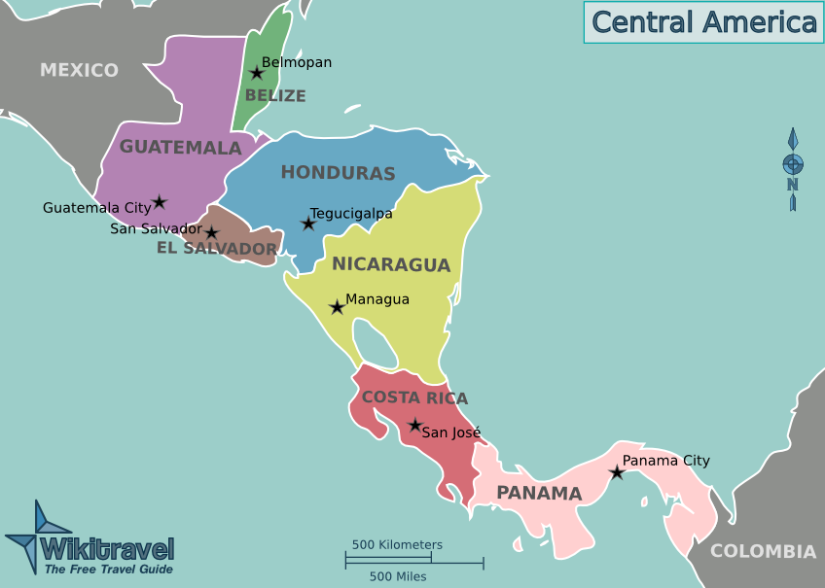
Costa Rica

Slide 3
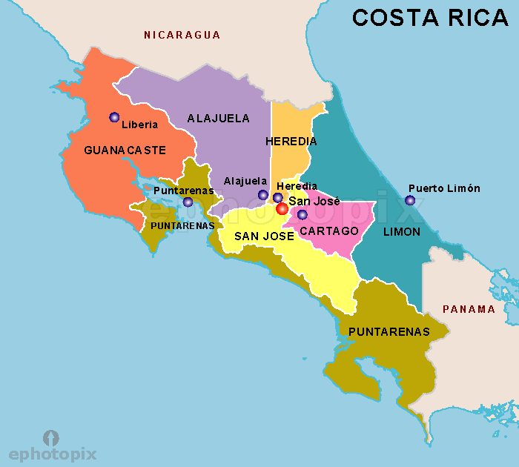
Costa Rica Pura Vida
18 min

Slide 4
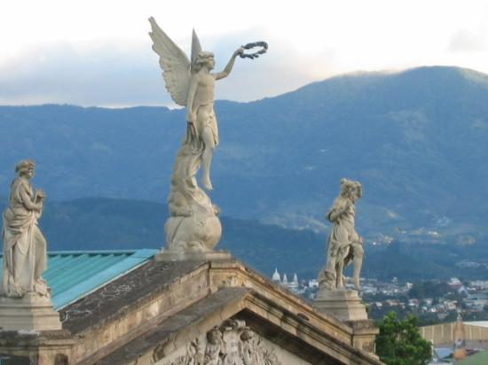
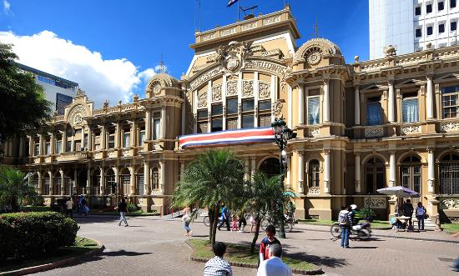
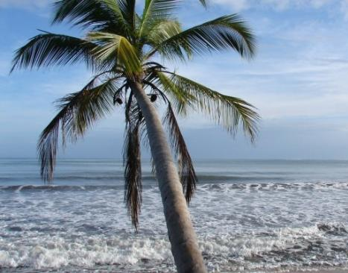
Costa Rica: Los lugares para visitar
El Capital: San josé
San Jose Highlights – Frog TV
Walking Tour
Review of Hostal in San Jose

Slide 5
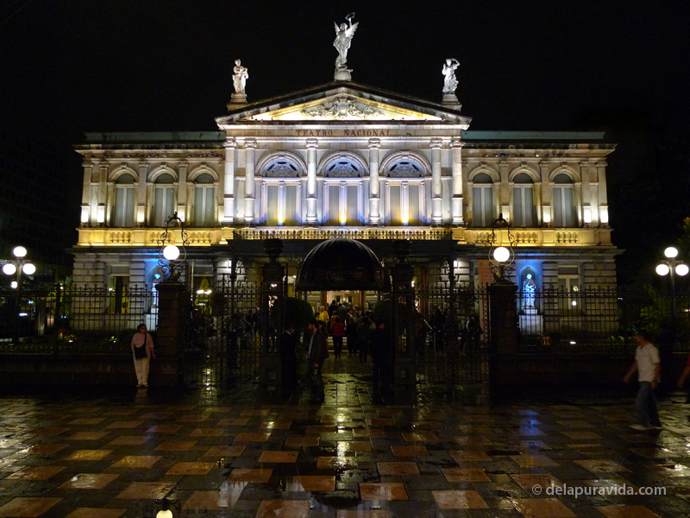
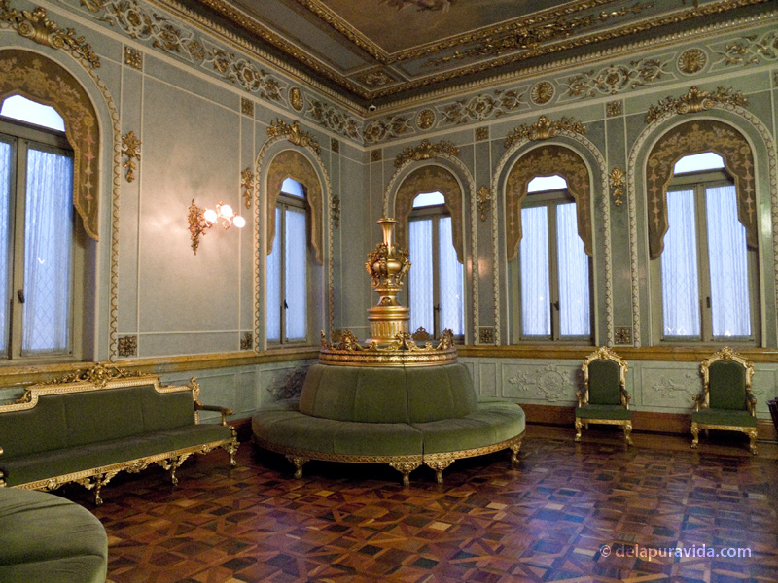
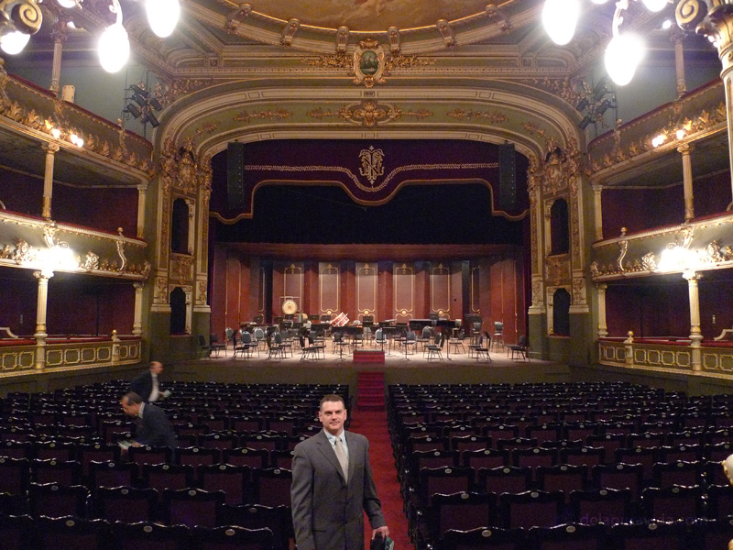
Teatro nacional
Magnificent neo classical building from late 1800s
To see the inside of the theater, you must attend a performance or pay for a guided tour ($7). Many different types of performances are held here and some afternoon performances are as cheap as $5
http://www.delapuravida.com/2010/costa-ricas-national-theatre-in-san-jose/

Slide 6
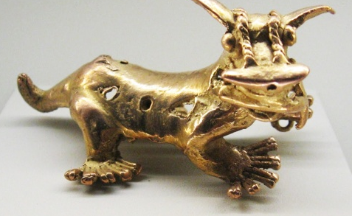
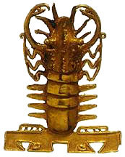
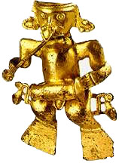
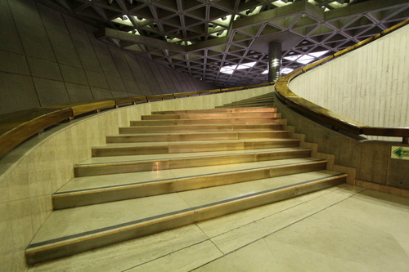
San josÉ- Gold museum
Gold was scarce and extremely important in the religious ceremonies of the native
In the 1950's the Central Bank of Costa Rica began collecting archeological objects as an attempt on the part of the Costa Rican people to preserve and protect their cultural heritage, but it s not until 1982 that the collection had a permanent home
The collection contains thousands of different examples of Pre-Colombian gold artifacts from 500 BE to 1600 AD rangiing from simple round earrings to intricately worked representations of local animals.
The museum building extends down three stories below the Plaza de Cultura. The long sweeping spiral staircase that connects the different levels is the architectural center piece.
http://www.worldheadquarters.com/cr/museums/gold/

Slide 7
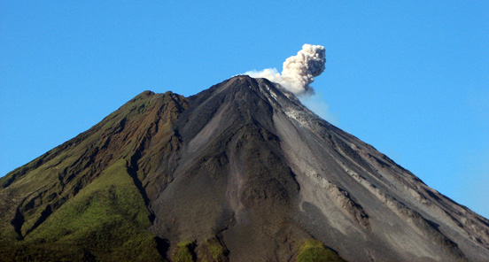
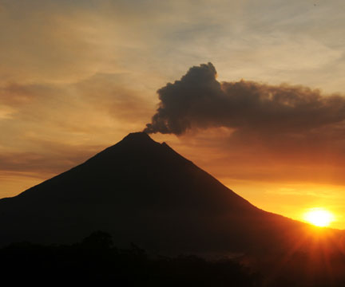
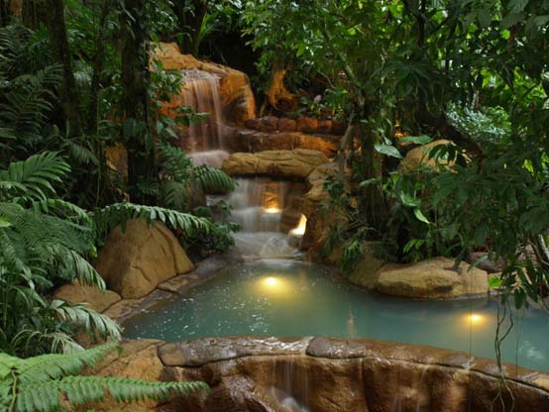
Arenal –
Arenal.net
volcano & Hot Springs
Active (2010)
CBS short video

Slide 8
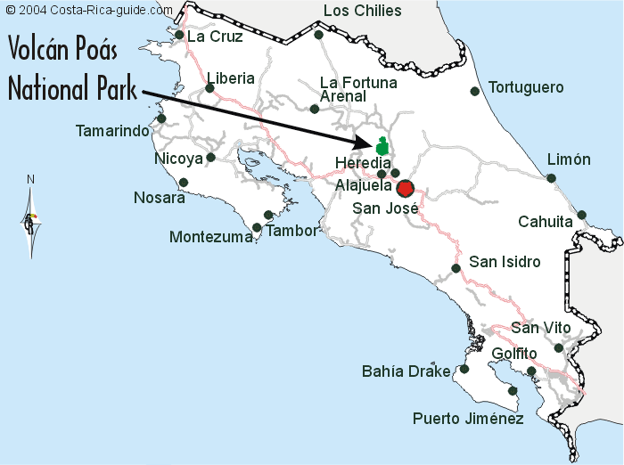
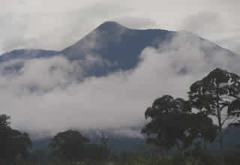
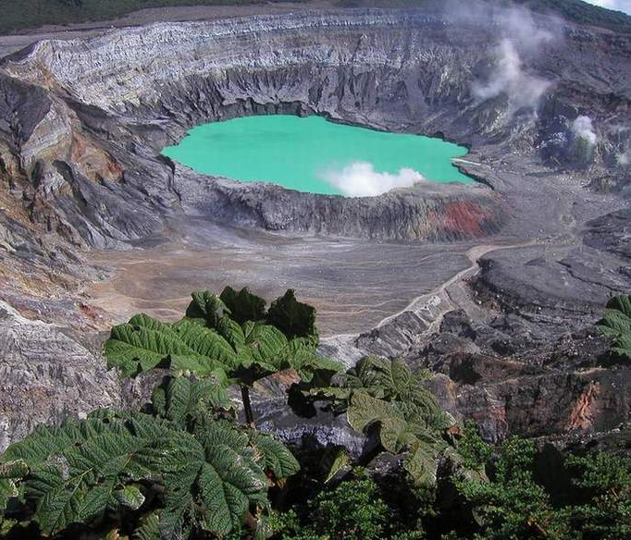
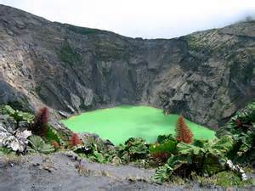
Volcan poÁs National Park
Volcanoes & craters
The last time Volcán Irazú awoke was in the 1960's, when, for four years it showered the residents of Cartago and San José with ash, clogged the air with smoke, and sent glowing boulders rolling down its sides. The next eruption can't be predicted with much accuracy, but currently the only activity in the crater is from fumaroles releasing toxic steam.
irazÚ
National Park

Slide 9
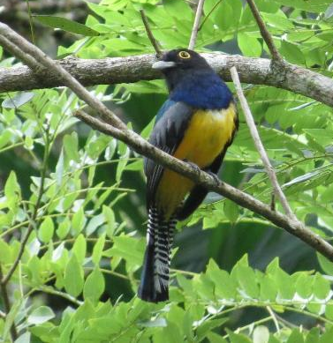
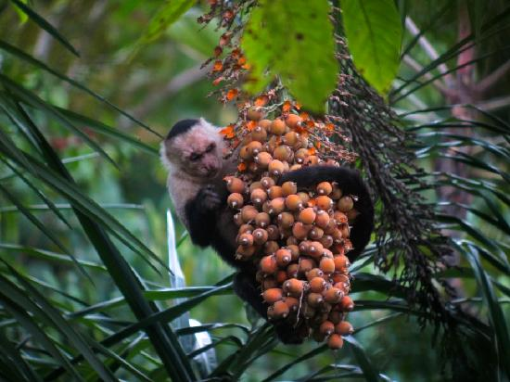
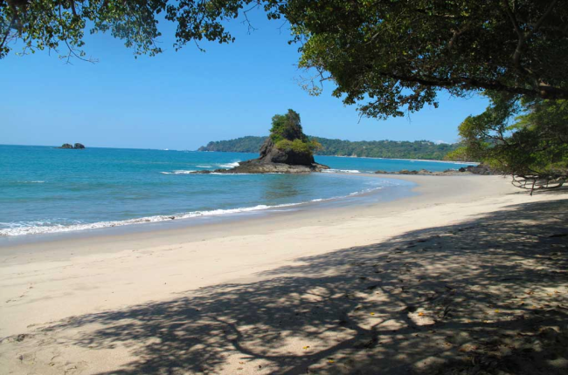
Manuel anotonio national park
Review of Park
This small national park epitomizes everything tourists flock to Costa Rica to see: stunning beaches, a magnificent setting with islands offshore (bird sanctuaries for marine species), lush rainforest laced with a network of welcoming trails, wildlife galore, and all within walking distance of your hotel. You are guaranteed close-up encounters with monkeys, sloths, coatimundis, and scarlet macaws.
http://centralamerica.com/cr/parks/momanuelantonio.htm

Slide 10
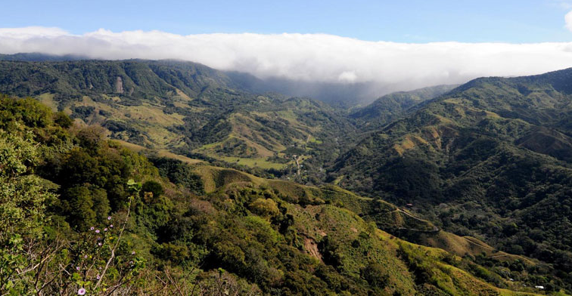
Monteverde cloud forest
Monteverde is a world above the coastal towns that dot the country's famous shoreline. It is a place of cloud forests and coffee plantations, monkeys, mist, and friendly locals.
Due to its high altitude Monteverde is privileged to receive a steady supply of clouds and the life-giving moisture that they contain. This moisture, often in the form of fog, catches on the branches of the tallest trees and drips down to the other organisms below, helping to support a complex ecosystem with over 100 species of mammals, 400 species of birds, tens of thousands of insect species, and over 2,500 varieties of plants, 420 of which are orchids alone.
http://www.monteverdeinfo.com/index.html

Slide 11
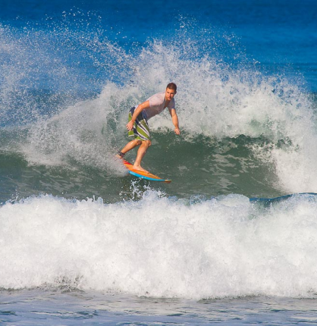
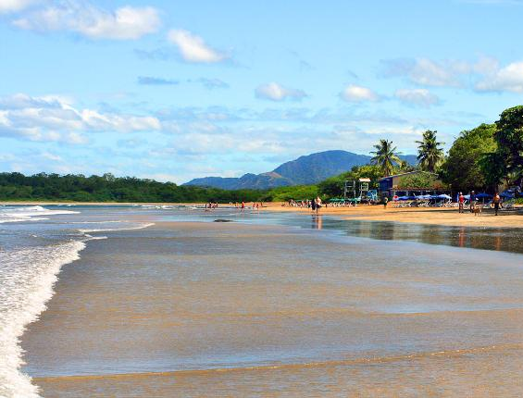
Tamarindo
Tamarindo lies at the heart of the region’s Gold Coast Beaches. Brimming with modern technology it is a unique combination of city meets nature.
Pumping surf, myriad adventure tours and lively nightlife lure thousands of tourists to Tamarindo, as well as a slew of expats who now call it home.
With warm waters and steady sets complementing Tamarindo's golden beaches, the town has attracted die-hard surfers for years

Slide 12
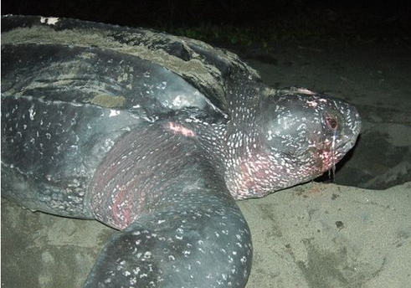
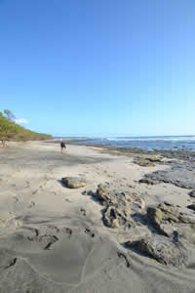
playa grande y langosta
Playa Grande is known for hosting protected nesting sites for the endangered leatherback sea turtle. From October through March, you can catch an evening tour to observe the rare sight of female leatherbacks nesting on the beach - a one-of-a-kind activity just a few miles from Tamarindo

Slide 13
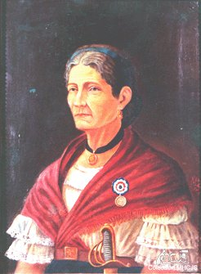
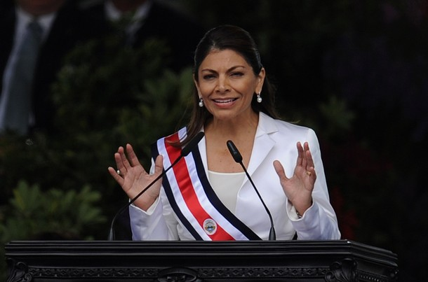
La gente famosa
Laura Chinchilla(1959-)
Elected President 2010
“A social conservative, she opposes gay marriage, abortion and the legalization of the morning-after pill. She has pledged to continue the pro-business policies of her predecessor by courting international investment and expanding free trade.”
Pancha Carrasco (1826-1890)
In 1856 (age 40), when William Walker and his filibusteros invaded Costa Rica, Carrasco volunteered as a cook and a medic. She is most famous for filling her apron pockets with bullets, grabbing a rifle, and joining the defending forces at the Battle of Rivas, becoming Costa Rica's first woman in the military
http://goshycab.com/2010/09/19/top-10-female-leaders/

Slide 14
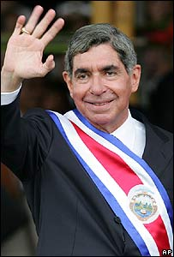
La gente famosa
Óscar Arias (1941-)
Nobel Peace Prize 1985
Helped to end civil wars in several Central American countries
President 1986-1990, 2006-2010
“Dr. Arias drew up the peace plan which was used as a basis for negotiations to end the Central American conflict. During a 1987 Central American summit, Dr. Arias presented his peace plan which called for an immediate cease fire in all guerrilla wars, a suspension of outside military aid, general amnesty and negotiations between conflicting parties, as well as long-term measures such as free elections and general reductions in armed forces. The Arias plan was a great stride toward peace and a base for future progress.” http://www.infocostarica.com/people/oscar.html

Slide 15
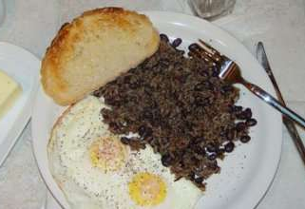
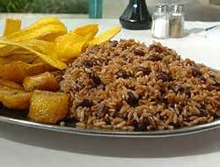
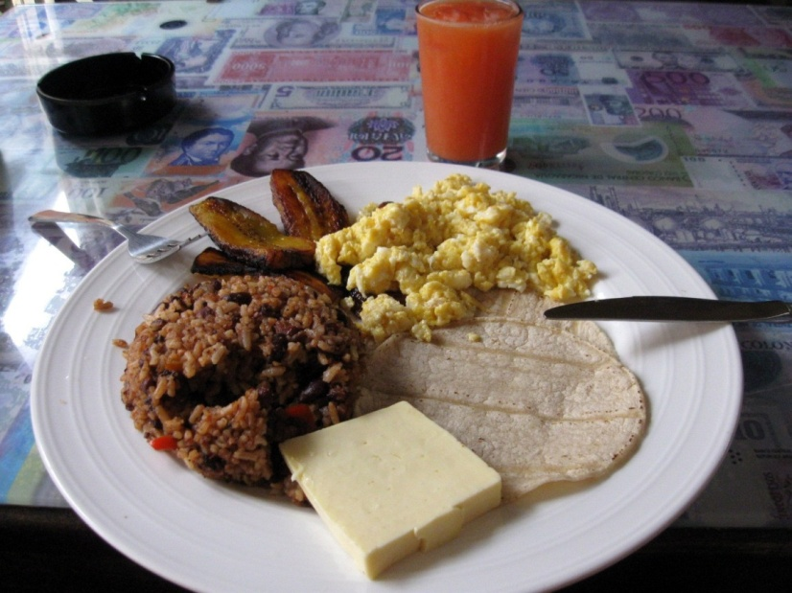
Comida de Costa Rica: Gallo Pinto
Black beans and rice

Slide 16
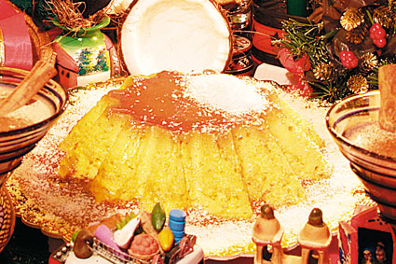
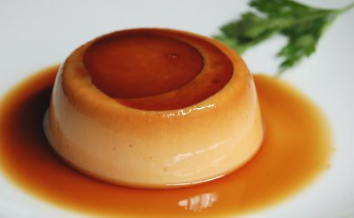
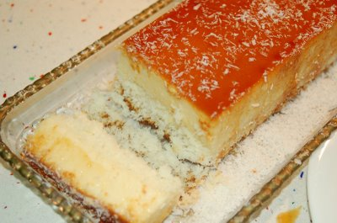
Comida de Costa Rica: Flan de Coco
Coconut Flan
1 can condensed milk
1 can evaporated milk
½ cup sugar
½ cup milk
½ cup shredded coconut
6 eggs

Slide 17
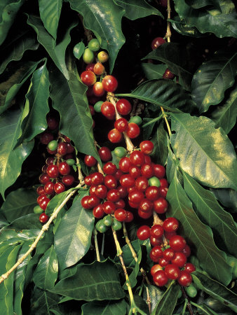
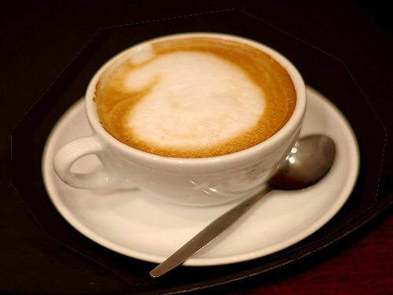
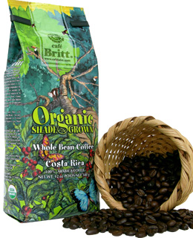
Comida de Costa Rica: CafÉ con leche
Hot steamed milk mixed equally with strong black coffee

Slide 18
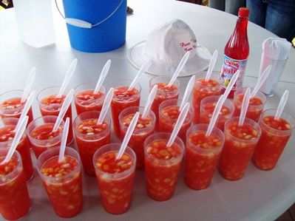
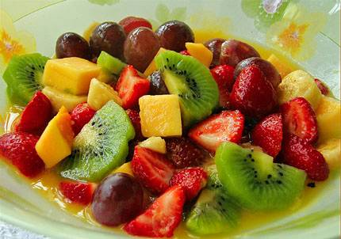
Comida de Costa Rica: Fresco de fruta

Slide 19
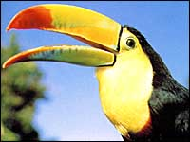
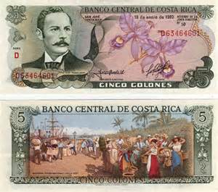
Other facts
El ingreso anual- $5,560 per year
La Moneda Nacional:
Colón
La población –4.5million
Why Gringo Businesses Fail in Costa Rica
Retiring in Costa Rica
Bizarre Fact: Toilet paper goes in the trash can next to the toilet due to plumbing issues
Video on Living in Costa Rica as American

Slide 20
Panama

Slide 21
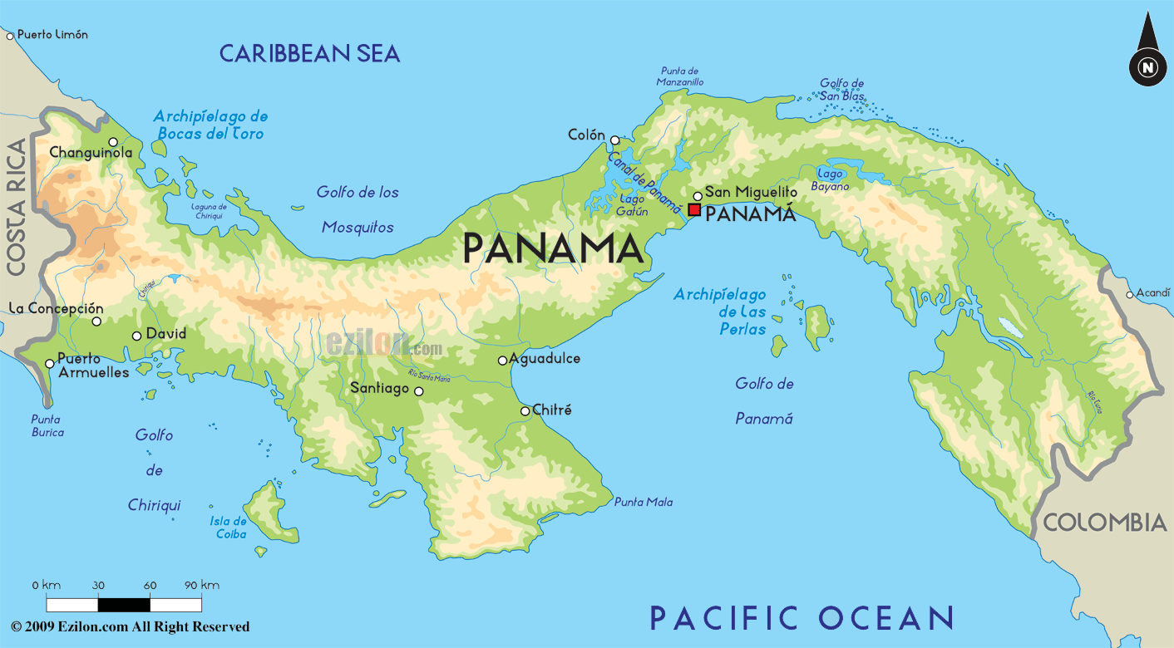
Welcome to Panama:
Perfect tropical paradise for retirement, investment, and tourism
BBC’s Howard Stableford Welcomes Us to Panama

Slide 22
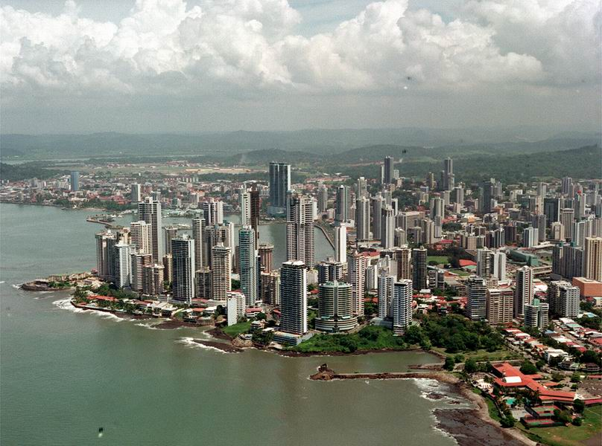
Lugares para visitar: PanamÁ : La Capital
Panama City, is a modern, sophisticated metropolis that resembles Miami and has established commerce, arts, fashion and dining.
Panama's government has strong ties to the United States and strongly supports business, development and tourism. The International Monetary Fund applauds the country's diversified economy and predicts it to have one of the strongest GDP growth rates in the world for the next several years. Panama is known for its highly developed international banking sector, with about 80 banks from several. http://wikitravel.org/en/Panama
Panama City and Canal Explosion Video 2008
First half focuses on business growth

Slide 23
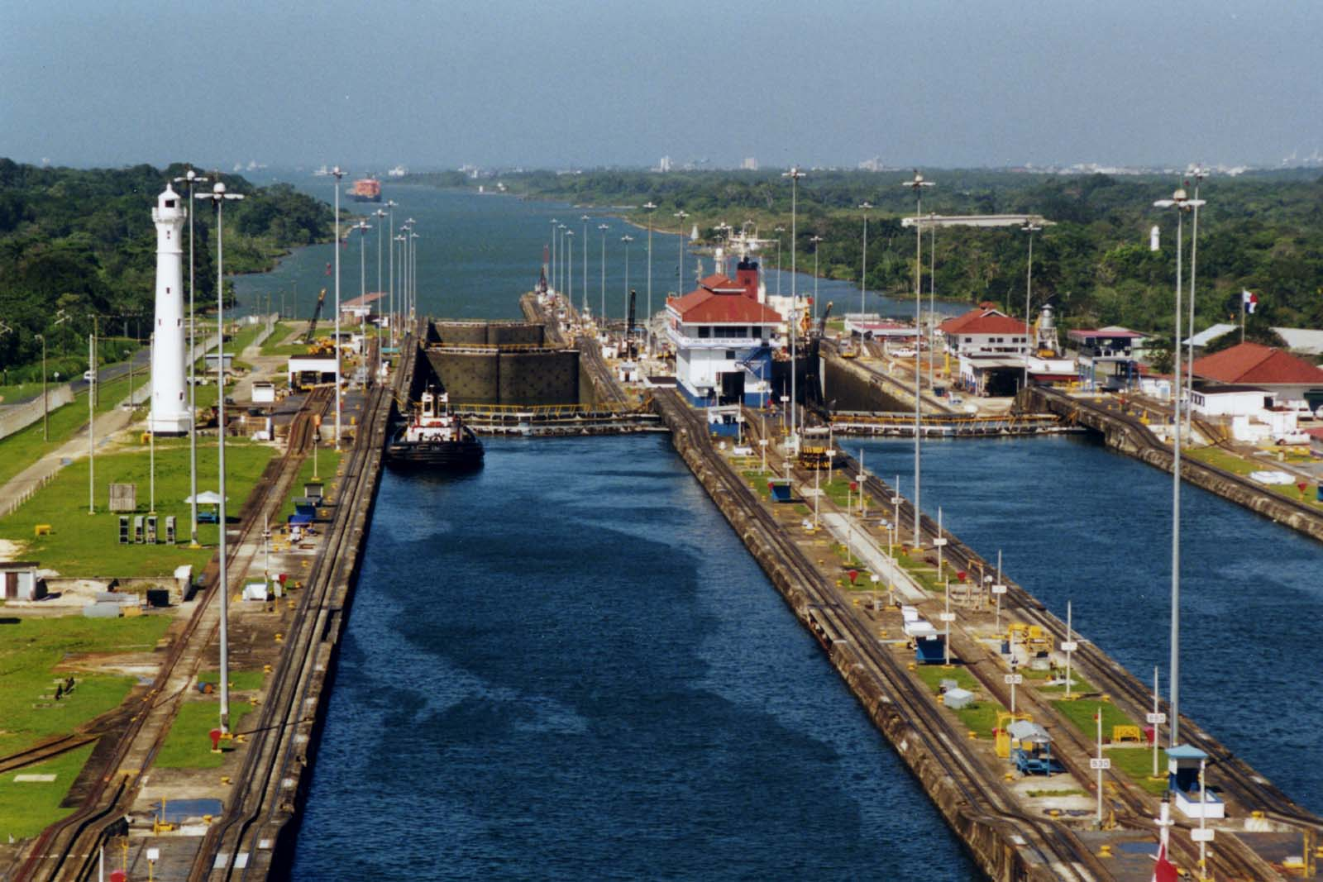
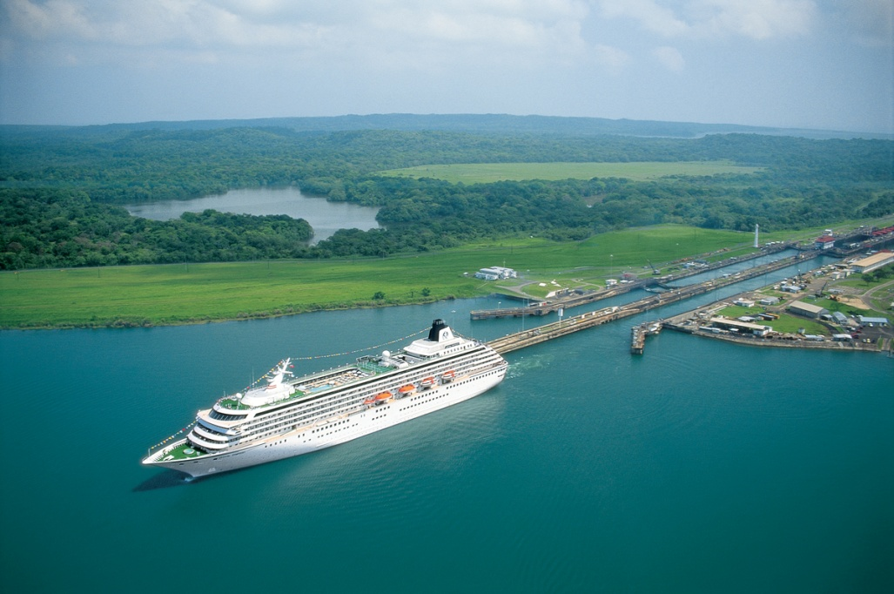
Panama canal- miraflores locks
Currently undergoing expansion, the Canal continues to drive Panama's service-based economy and remains one of the most important transportation links in the world.
In addition to the country's strong economic base, Panama's physical infrastructure, including modern hospitals, airports and roads, is more highly developed than its Central American neighbors.
Canal was US controlled until 2000
http://www.pancanal.com/eng/

Slide 24
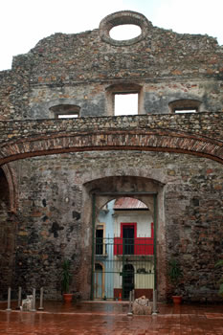
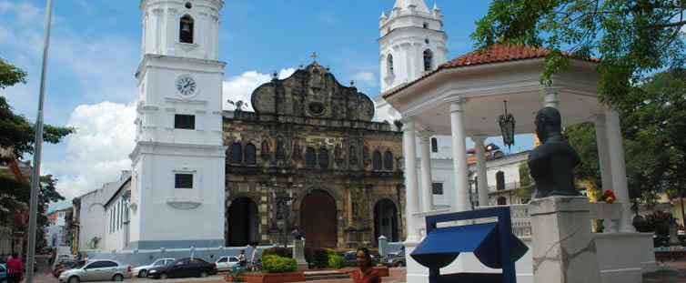
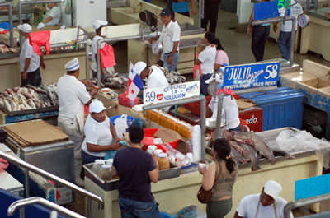
Casco viejo – world heritage site
Travel Casco Viejo
http://cascoviejo.com/attractions/

Slide 25
San blÁS- islands
Home of the Kunas
The islands of the San Blas Archipelago are strung out along the Caribbean coast of Panama from the Golfo de San Blas nearly all the way to the Colombian border.
San Blas is a series of 378 islands of which only 49 are inhabited by the fiercely independent Kuna Indians.
Slide show of the San Blás Islands

Slide 26
Molas by the Kuna
Explanation of the mola tradition
Slideshow of Molas
A Kuna Woman explains learning to make molas

Slide 27
Las perlas – pearl islands
Archipélago de las Perlas
“Because of the archipelago's proximity to the mainland and the capital city, as well as its largely pristine state and wealth of natural attractions, the Panamanian government, in conjunction with the United Nations Development Program (UNEP), set out to convert the area into a prominent tourist destination, with an emphasis on sustainable environmental and social development. In December 2006, a law was passed to declare Las Perlas as a 'special management zone', with strict regulations to ensure the development of the archipelago is carried out with a minimum of impact to its wildlife, ecosystems, and to the islands' inhabitants.”
http://www.neworldrealtygroup.com/panama/regions/las-perlas/
Whale Watching at Contadora Island

Slide 28
BocÁs del toro – rainforest and Beach
Video Slide Show- Turismo Comentario de AAMVECONA (Asociación de Amigos y Vecinos de la Costa y la Naturaleza)
Tourism in the Bocas del Toro Islands is true ecotourism with rain forests, islands, beaches, coral reefs in crystal clear water, mangrove islets in a lake-like scenery, a national marine park.
Activities include: scuba diving, snorkeling, surfing, water skiing, jungle adventurism, coral reefs, surfing beaches, hiking trails, etc.
Bocas del Toro is a mix of cultures :Ngobe Indian communities, Afroantillean traditions, Spanish dances from the conquest time, and modern Caribbean music. http://www.bocas.com/indexing.htm
Los Diablos de Carnaval 2012
Rainy Season in Panama

Slide 29
Colón – Caribbean port
Journal of Commerce
Tour of Port of Colón 2012
the second largest city in Panama, at the Caribbean end of the Panama Canal.
an important port, commercial center, and tourist destination
a free trade zone and the world's second largest duty-free port.
http://coloncity.com/

Slide 30
chiriquÍ Boquete volcÁn barÚ
Real Estate Review of the Chiriquí Region
At about 1,100 meters (3,600 feet) above sea level the air is cool and crisp without the extreme heat and humidity found in most of the country. At around 20c to 28c (68F -80F) some describe this as the World’s Best Climate.
http://learnaboutpanama.com/letters-from-panama/boquete-panama/
Panamas highest peak
A Gringo’s Life in Panama : Filmed in Boquete

Slide 31
Gente famosa
Manuel Noriega (1934-)
Dictator of Panamá (1983-9)
Operation Just Cause – 1989 Bush Speech
In 1989 he started serving jail time in Florida for cocaine trafficking, racketeering and money laundering.
He was extradited back to Panama for further jail time in 2011. (Link)
The Rise and Fall of Manuel Noriega

Slide 32
Gente famosa
Rod Carew (1945-)
Baseball hall of fame 1991
Creo en Tí
Rubén Blades (1948-)
Singer
Songwriter
Actor – Safe House (2002), Predator 2 (1990), Once Upon a Time in Mexico (2003)

Slide 33
Gente famosa
Gloria Guardia (1948-)
Novelist
Journalist –ABC news correspondent in Panamá and syndicated news columnist (1975-1995)

Slide 34
Comida de PanamÁ : tamales - Nacatamales
TAMALES PANAMEÑOS
A nacatamal is made up of mostly corn masa. This base is ladled onto plantain leaves used for wrapping into large individual portions.
How to Make Nacatamales
Before a nacatamal can be wrapped and brought to the last stage of the cooking process, it must be filled. Generally, this filling consists of seasoned pork meat, rice, a slice of potato, bell pepper, tomato, onion, olives, cilantro and/or spearmint sprigs.

Slide 35
Comida de PanamÁ : Patacones de plÁtanos
Fried plantains
Patacones
Rellenos
Making Patacones Panameños

Slide 36
Comida de PanamÁ : Sancocho
Chicken stew
Foodie in Panama:
Making Sancocho on Fogón
Part two

Slide 37
Comida de PanamÁ ceviche
Ingredients:
1 lb. boneless fish, preferably Corvina
(use White Sea Bass, alternatively)
1½ cups finely chopped onion
1⅓ cups fresh lemon juice
½ cup finely chopped celery
¼ cup finely chopped fresh cilantro
½ hot pepper finely minced
salt to taste
1. Cut the fish into bite-size pieces and place in a glass bowl or container of at least 2 inches
high. Add all the other ingredients, mixing well. The lemon juice should cover the fish. Cover
with plastic wrap and place in the refrigerator.
2. Allow at least 4 hours for the fish to 'cook' in the lemon juice and onions. Serve with crackers or tortilla chips.

Slide 38
Comida de PanamÁ : empanadas

Slide 39
Other facts
La Moneda
Nacional:
US Dollar
Balboa
Panama:
Business Opportunities
Making the Move to Panama – BBC’s Howard Stableford Interviews Ex-Pats
El ingreso anual- $5,510 per year
La población –3.3 million

