Slide 1
Family Life in Venezuela

Slide 2
Lifestyle

Slide 3
What do they do during the day?
School
Work
Hang out with friends
Eat dinner around 8pm
Go to bed usually between 12am and 1 am
Wake up around 7am

Slide 4
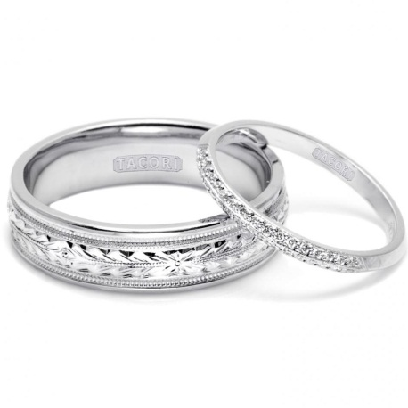
Marriage
Man and woman
The man has to be at least 16 years old
The woman has to be at least 14 years old
They both have to want to be married to each other
You can not marry a relative or ancestor
A judge can approve exceptions

Slide 5
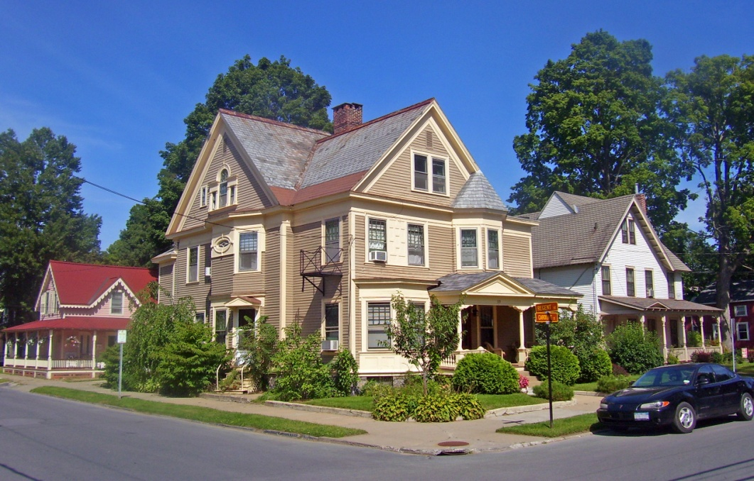
Housing

Slide 6
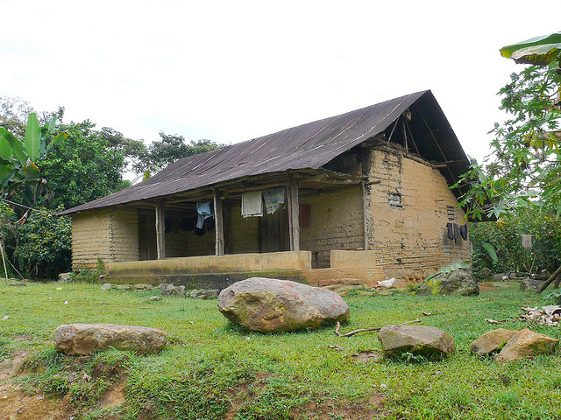
Traditional houses are made from mud and straw called bahareque
Modern houses are made from wood
Live in nuclear families- average of 5
Extended family lives close by

Slide 7
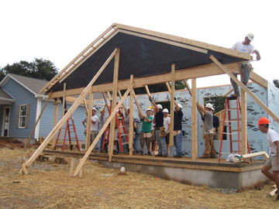
Shortfall of a million homes
Government plans to build 1,700 apartments
They plan to build on abandoned land
They plan to build 2 million homes between 2011 and 2017
http://www.youtube.com/watch?v=FUh9yS0MA_k

Slide 8
Poverty and population
½ of population is living in poverty
Poverty is increasing
In the past, they wanted to evict all poor urban settlers
Venezuelans are experiencing rapid population growth

Slide 9
Population in Venezuela

Slide 10
Vocabulary
Bahareque- mixture of mud and straw
Pobreza- poverty
Pobladores urbanos- urban settlers
Población- population

Slide 11
Health and Medicine

Slide 12
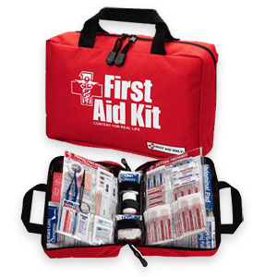
Free universal health care system
Lack of sanitation
Water is not safe to drink
Fruits and vegetables are not safe without treatment
Food at room temperature can often be dangerous
You should pack a personal medical kit for yourself when you travel

Slide 13
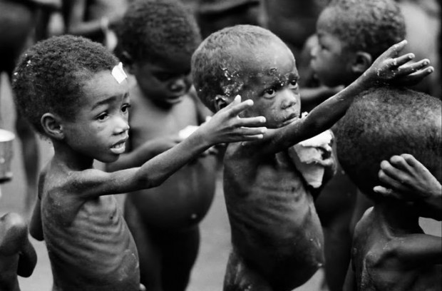
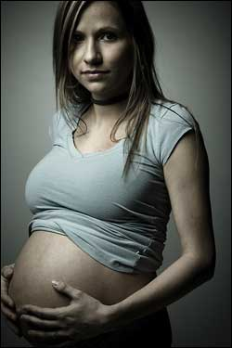
Problem with teen pregnancy
17% of children suffer malnutrition
Average life span is 60 years old

Slide 14
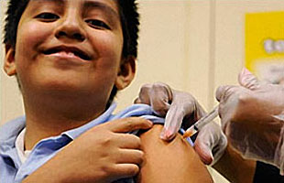
Diseases and Vaccines
Typhoid, Hepatitis A,B, and D, and Yellow Fever
Tetanus-diphtheria, mumps, polio, and varicella immunizations are required to travel to Venezuela
Hepatitis vaccines are recommended for tourists in Venzuela

Slide 15
Vocabulary
Botiquín- medical kit
Vacunas- vaccines
Riesgo- risk

Slide 16
Income

Slide 17
Trading
Important to Venezuelans
Exports mostly oil and petroleum
¾ of export earnings
United States is an important trading partner
They import auto parts, medical instruments, and organic chemicals from the United States

Slide 18
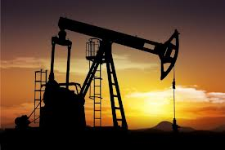
The wealthy Venezuelans mainly got their money from oil in the 1980’s

Slide 19
Economic downturn
Between 1950’s and 1980’s
Everybody was enjoying the wealth
The oil prices ended up collapsing
Venezuelans suffered a bank crisis

Slide 20
Vocabulary
Petróleo- petroleum
Ingresos- income
Comercio- trade

Slide 21
Citations
http://www.flickr.com/photos/jlcrucif/1794584563/
http://en.wikipedia.org/wiki/File:Houses_at_Regent_and_Caroline_streets,_Saratoga_Springs,_NY.jpg
http://www.fpif.org/articles/the_great_oil_swindle
http://www.dreamstime.com/royalty-free-stock-photos-team-happy-business-people-working-together-image8814598
http://www.embavenez-uk.org/pdf/fs_housing_in_venezuela.pdf.
http://www.everyculture.com/To-Z/Venezuela.html
http://answers.yahoo.com/question/index?qid=20070130155514AAaOUxW
http://wiki.answers.com/Q/What_are_Houses_in_Venezuela_like.
http://www.youtube.com/watch?v=FUh9yS0MA_k

Slide 22
Citations
http://arabiangazette.com/billion-children-risk-malnutrition-report/
http://pregnantoncampus.studentsforlife.org/2012/09/07/report-schools-lack-programs-for-pregnant-students/
http://en.wikipedia.org/wiki/Economy_of_Venezuela#1922_-_1964
http://statinfo.biz/HTML/M435F1532A64L2.aspx
http://en.wikipedia.org/wiki/Venezuela
livemocha.com - Jorge ”OliCaRS“, Berliz Pava
http://www.britannica.com/EBchecked/topic/625197/Venezuela/32732/Cultural-life
http://www.embavenez-uk.org/pdf/fs_housing_in_venezuela.pdf
http://www.guide2.co.nz/money/news/home-loans/nz-building-consents-up-in-february/11/15342
http://l2lgroup.com/_blog/L2L_Group/post/The_Power_of_Strategy_in_an_Economic_Downturn/
http://www.thekooza.com/venezuela-denounces-obama-outrageous-remarks-on-chavez/

Slide 23
Citations
http://www.unesco.org/most/guic/guicvenmain.htm.
http://en.wikipedia.org/wiki/Economy_of_Venezuela#1922_-_1964.
http://www.state.gov/r/pa/ei/bgn/35766.htm
http://www.mdtravelhealth.com/destinations/samerica/venezuela.php.
http://ukinvenezuela.fco.gov.uk/en/help-for-british-nationals/living-in-venezuela/marriage-venezuela/
http://www.britannica.com/EBchecked/topic/625197/Venezuela/219050/Trade
http://en.wikipedia.org/wiki/History_of_the_Venezuelan_oil_industry.
http://weddingpic.info/expensive-diamond-wedding-rings-wallpaper/
http://www.utk.edu/tntoday/2009/10/21/tomba-habitat-house/

