Slide 1
Venezuelan Government, History, and religion
By Frank Cardamone

Slide 2
Government

Slide 3
Government:
Venezuela currently has a democratic government, with an elected president and elected representatives, who appoint the leaders of the other branches of government. They have 5 branches of government, established the newly adopted constitution of 1999, Constitución Bolivariana. These branches are: executive, legislative, judicial, citizens, and electoral.

Slide 4
Executive
Led by a president, currently Hugo Chávez.
Elected for a 6 year term.
They can have unlimited amount of terms.
Appoints cabinet members, and the vice president. The current one is Nicolas Maduro.

Slide 5
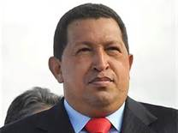
Hugo Chávez

Slide 6
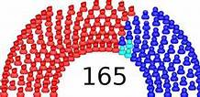
Legislative
Unicameral
It’s called Asamblea Nacional, The National Assembly.
It has 165 seats.
Members serve for 5 years.
Each state gets 3 members, plus some for the population (state population divided by 1.1% national population)
3 seats are reserved for indigenous people, however those seats are elected by everyone, not just indigenous peoples.

Slide 7
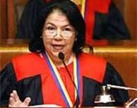
Judicial
Headed by Supreme Tribunal of Justice
It has 6 branches: constitutional, electoral, civil, criminal, social, and political
Each branch has 5 judges, except for the constitutional branch, which has 7
This makes 32 judges total.
The judges can serve for just one term, that lasts 12 years.
Luisa Estela Morales
is the current head of the
Judicial Branch.

Slide 8
Electoral
Controls all election processes
This 5 man group is known as the National Electoral Council
All the members are elected by the National Assembly
They all serve 7 year terms
The current head of this branch is Tibisay Lucena.

Slide 9
Citzens
This branch is made of only 3 people: the comptroller general, the defender of the people, and the attorney general.
It’s job is to make sure the other branches follow the law.

Slide 10
Global Impact
Venezuela has a strong global presence. It has great relations in Latin America, and with the middle east. It is the worlds 5th biggest exporter of oil. It has been known to take in refugees from wars. The president Hugo Chavez has great relations with Cuba and Puerto Rico, but not so great with the USA. We probably shouldn’t have recognized Pedro Carmona as president after a coup d'état in 2002.

Slide 11
History

Slide 12
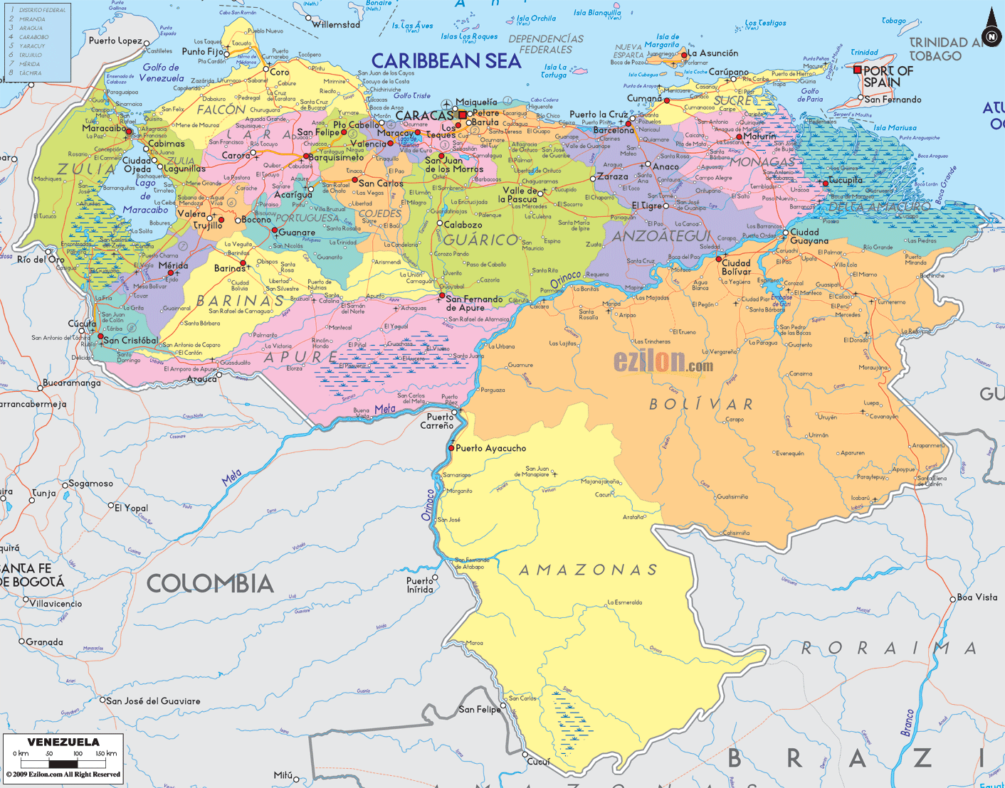
Precolumbian
There isn’t really too much to know. There were a few hunter-gatherer tribes. They had polytheistic religions. There wasn’t any big empire, like the Incas.

Slide 13
Spanish Invasion
The few tribes were enslaved or killed off when the Spanish came. The area was named Venezuela, meaning ‘little Venice’. The settlers lived near the coast, exploiting the area of pearls. Then Los Llanos, or The Plains were discovered, as was the agricultural capabilities. Venezuela became a farming powerhouse, but wasn’t largely controlled because of it’s central location between the empires capitals, Peru and Mexico.

Slide 14
Freedom!
The long and hard road to independence began on July 5th, 1811. The first brief war was won by Venezuela, but the first republic was quickly retaken after a devastating earthquake.
One more year went by, until Simón Bolívar lead the Campaña Admirable, “The admirable campaign”, to free the country a second time. Internal revolts brought this republic down.
Once again led by Simón Bolívar in 1819, the last war lasted 2 years, and half of the population in causalities, but independence was secured for good.
Venezuela joined Bolivar’s Gran Columbia in 1921.

Slide 15
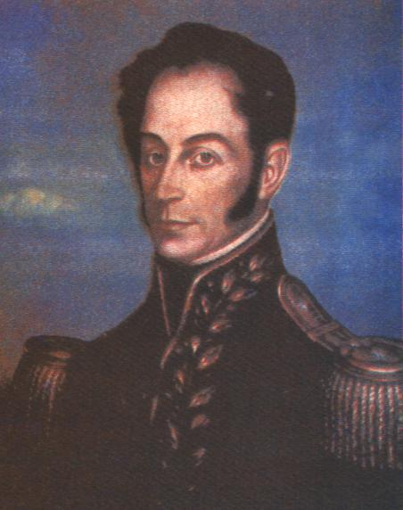
Simón Bolívar

Slide 16
Caudillos
Venezuela left Gran Columbia in 1830. For the next 120 years, a plethora of military strongmen, Caudillos, ruled.
There were a ridiculous amount of coup d'état's as well.
José Antonio Páez was a notable caudillo, kind of starting things off.

Slide 17
Democracy
Although Venezuela was, on paper, a ‘democracy’, it wasn’t until Rómulo Betancourt ascended to power in 1945 through his coup did democracy become a reality. Under Betancourt, oil became the national export, Europeans were accepted as refugees, and universal suffrage was passed. Although more dictators would rise after Betancourt, he was the one who made democracy a real possibility, and for so he is heralded as “The father of Venezuelan democracy.”

Slide 18
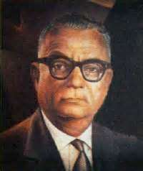
Rómulo Betancourt

Slide 19
Hugo Chávez Era
Was elected in 1998 for his “5th republic” idea.
In 1999, he passed a new constitution, Constitución Bolivariana. The idea was to go back to Simón Bolívar’s ideologies. The new constitution has completely reworked the Venezuelan government.
With assistance from Chávez, OPEC has once again become a leading power on oil.

Slide 20
Religion

Slide 21
By Percentages
96% Roman Catholic
2% Protestant
2% other, including:
13,000 Jews in Caracas
100,000 Muslims in Caracas, Punto Fijo, and Nueva Esparta. (.4%)

Slide 22
Syncretism
The religions listed on the last page are pretty well known. However, Venezuela is known for it’s mixing of religions, or Syncretism. Two of the biggest, and growing, syncretic religions of the country are Santeria, and María Lionza.

Slide 23
Santeria
A mix of Yoruba (African), Roman Catholicism, and aboriginal traditions.
They put a large focus on rituals, including initiations, animal sacrifices, and spiritual cleansing.
The main priests are called Santeros (as) or Olorishas. ‘Olorishas’ is more common.
The original religion came from Cuba, but has spread to Puerto Rico, panama, Dominican Republic, Columbia, and of course Venezuela.

Slide 24
María Lionza
Akin to Santeria, it’s based on African and native religions, as well as Roman Catholicism.
The central figure is María Lionza, a goddess of nature, love, peace, and harmony.
People pay homage to her, by visiting a statue of her in Caracas. They also travel to the mountain where she was claimed to live, Mt. Sorte. This mountain has become a national park because of the frequent visitors.
She is famed for ruling over savage beasts. She’s often depicted riding a Tapir.
Her name is a contraction of Santa María de la Onza, or Saint Mary of the Jaguar.

Slide 25
Maria Lionza
This is the statue of Maria
Lionza in Caracas. She’s seen
here riding a Tapir, and holding
a human pelvis to symbolize
Fertility. An interesting note:
this statue is in between highway
lanes, and people must brave
traffic to visit it.

Slide 26
Cites (Government)
http://en.wikipedia.org/wiki/Venezuela#Government
http://venezuelanalysis.com/basicfacts
http://www.indexmundi.com/venezuela/government_profile.html

Slide 27
Cites (History)
http://en.wikipedia.org/wiki/History_of_Venezuela
http://en.wikipedia.org/wiki/R%C3%B3mulo_Betancourt
http://www.history-timelines.org.uk/places-timelines/42-venezuela-timeline.htm
http://www.infoplease.com/ipa/A0108140.html

Slide 28
Cites (Religion)
http://en.wikipedia.org/wiki/Religion_in_Venezuela
http://www.spainexchange.com/guide/VE-religion.htm
http://en.wikipedia.org/wiki/Santeria
http://en.wikipedia.org/wiki/Mar%C3%ADa_Lionza
http://www.nationmaster.com/country/ve-venezuela/rel-religion

Slide 29
Pictures
http://www.ezilon.com/maps/images/southamerica/map-of-Venezuela.gif
http://4.bp.blogspot.com/-5KEcsq50-VM/TnS5F0BM3oI/AAAAAAAACcc/JICI-ZTsgL8/s1600/SIMON+BOLIVAR.jpg
http://www.bing.com/images/search?q=romulo+betancourt&FORM=HDRSC2&adlt=strict#view=detail&id=C41CB731CAE7E23703F19214B9681C2222532836&selectedIndex=5
http://www.bing.com/images/search?q=maria+lionza+caracas+statue&FORM=HDRSC2&adlt=strict#view=detail&id=C22E9CBA850A8677F7EEBE4B4E81D795E86F79BF&selectedIndex=0

