Slide 1
GuATEMALA, El SALVADOR, HONDURAS y nicaragua
Spanish Countries and Cultures
2014
Los Países de la América Central:

Slide 2
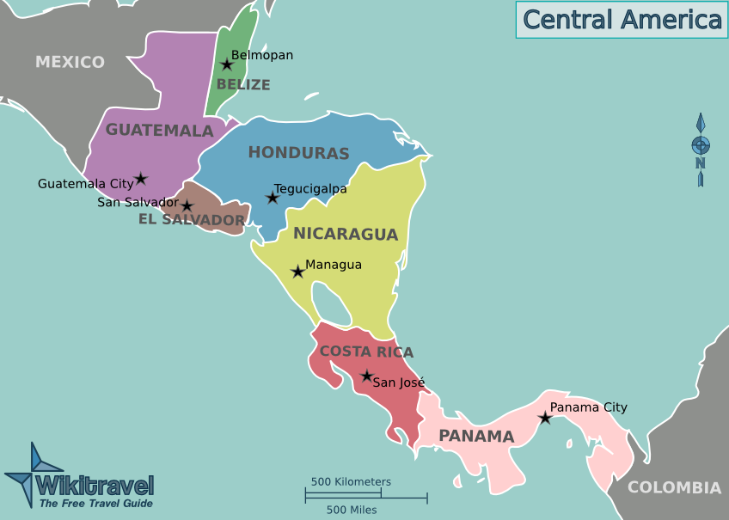
guatemala

Slide 3
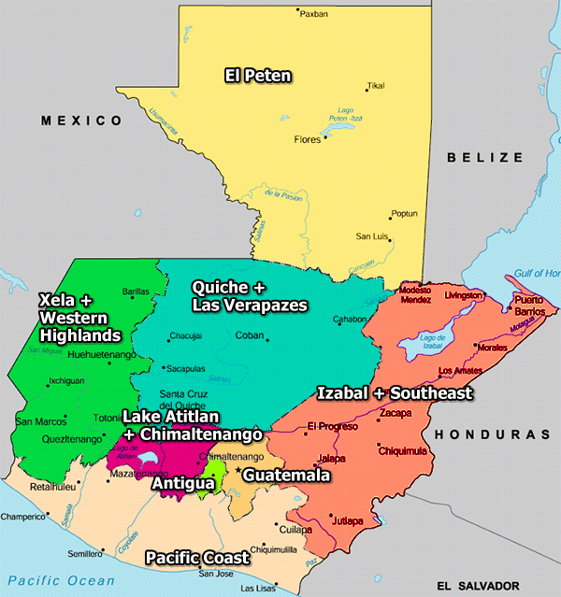

Slide 4
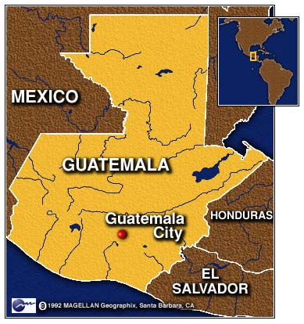
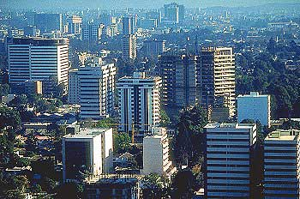
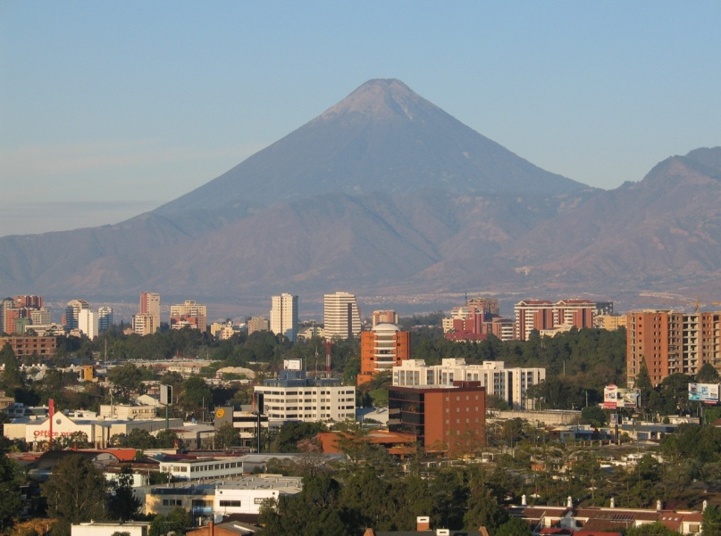
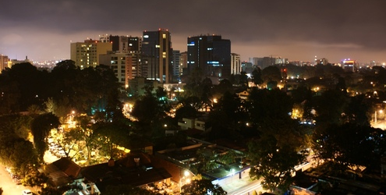
Guatemala: Los lugares para visitar
Guatemala City
Zona Viva (business district)
Video tour of city

Slide 5
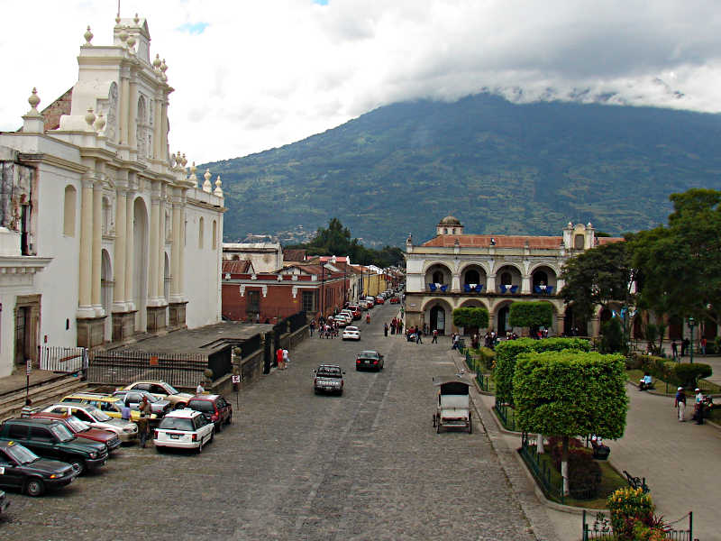
Antigua
situated in a sweeping highland valley between two volcanoes
was once one of the great cities of the Spanish empire
is known for cobbled streets and grand Baroque-style colonial buildings with superb choice of restaurants adding to the city's appeal.
has some of the best language schools in all Latin America
Semana Santa (Holy Week) celebrations are perhaps the most extravagant and impressive in all Latin America
City Tour
Semana Santa , Good Friday Processions 2011
Alfombras of Semana Santa

Slide 6
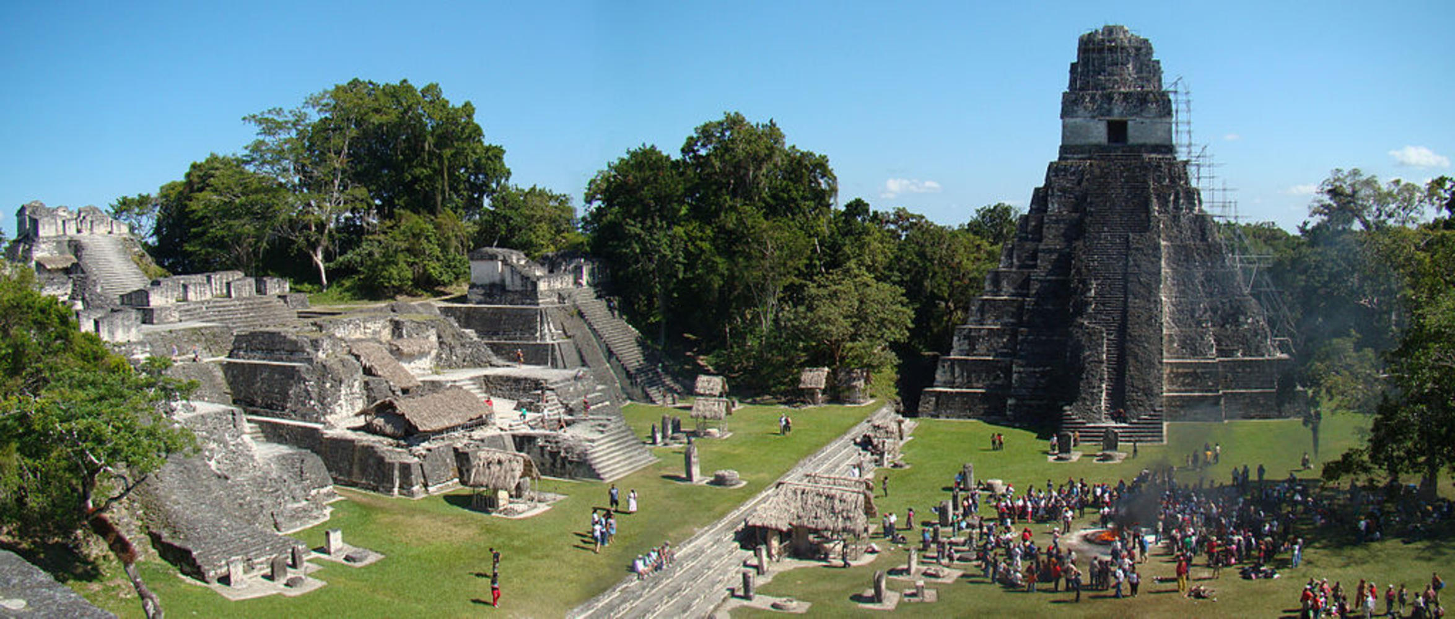
Tikal National Park – Mayan Ruins
Virtual tour
Tikal was the capital of one of the most powerful kingdoms of the ancient Maya. Located in northern Guatemala it is one of the largest archaeological sites of the pre-Columbian Maya civilization, and in 1979, it was declared a UNESCO World Heritage Site.

Slide 7
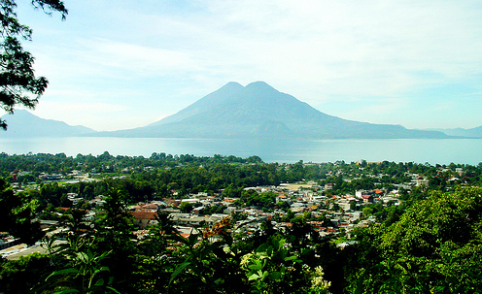
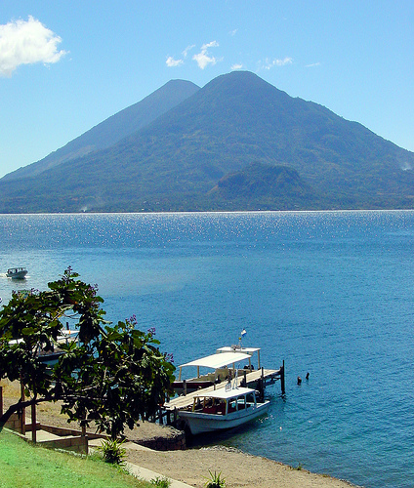
Lake atilan
Short tour
Video Guidebook – 22 min.
The word Atitlan is a Mayan word that translates as "the place where the rainbow gets its colors".
The main tourist center is Panajachel, an 800 year old pueblo of about 14000, mostly Cakchiquel Mayas and some foreigners from every corner of the globe, living inside that rainbow.
The Maya are known for being friendly, funny, welcoming of strangers, and also shy. Living among them is an enchanting experience.
http://www.atitlan.net/

Slide 8
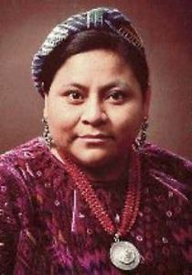
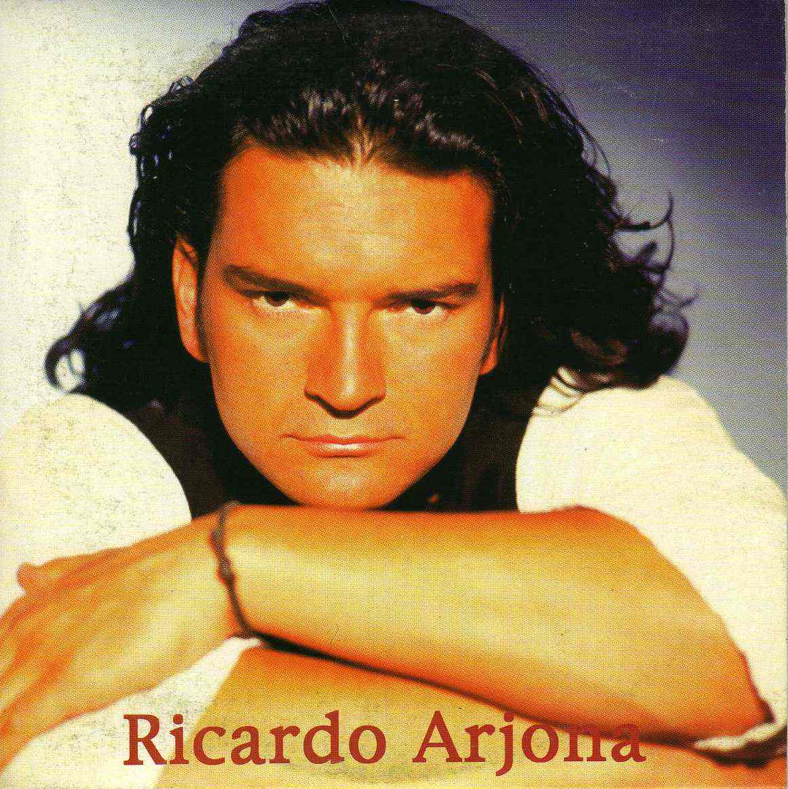
La gente famosa
Comprehensive Interview
Rigoberta Menchu Tum
Human Rights Activist
Nobel Prize Winner, 1992
Ricardo Arjona
Singer
Born 1964
“As an indigenous Guatemalan, of the K'iche' ethnic group, Menchú has dedicated her life to publicizing the plight of Guatemala's indigenous peoples during and after the Guatemalan Civil War (1960--1996), and to promoting indigenous rights in the country. “
Historia del taxi
Cuándo

Slide 9
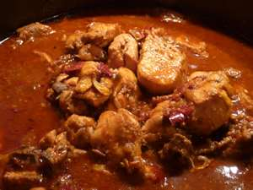
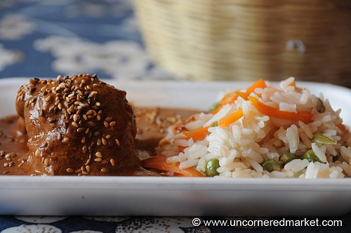
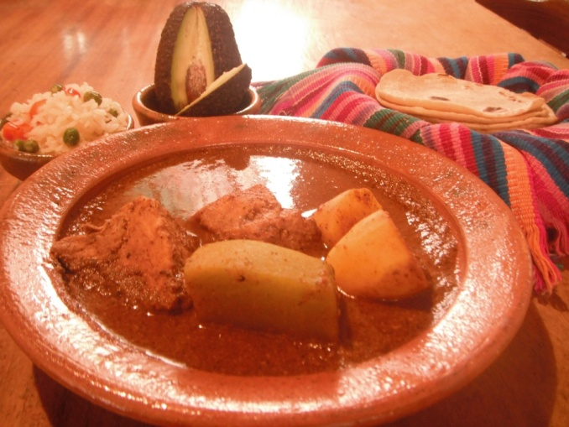
Comida de guatemala
pepián
Chicken (boiled then lightly fried)
Served in a recado – a rich, blended sauce composed of various roasted ingredients. (sesame and squash seeds)
Guatemalans often reserve this dish for special occasions (e.g., weddings, birthdays, holidays

Slide 10
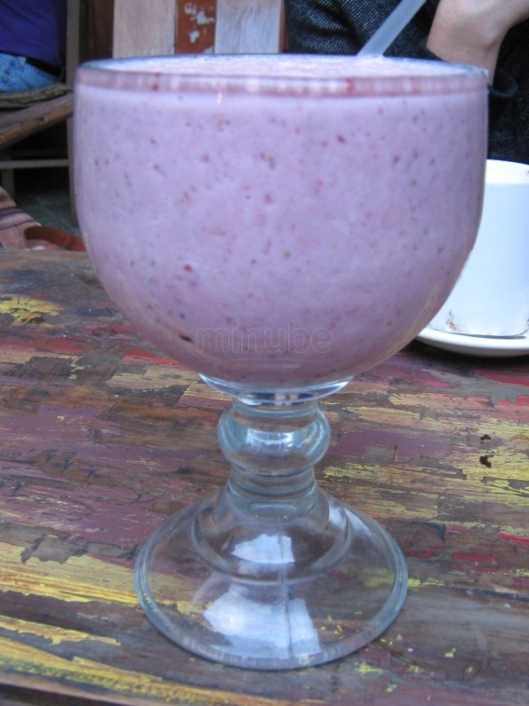
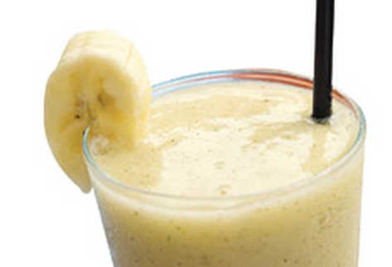
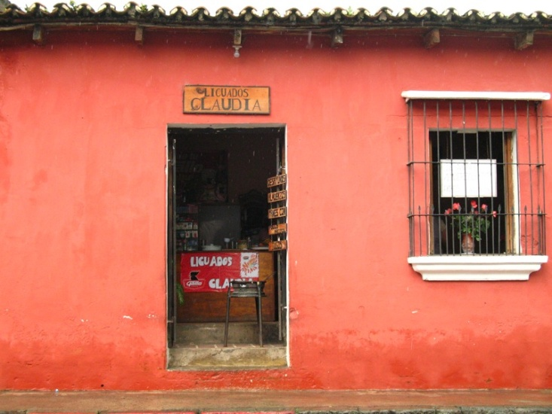
licuados
Comida de guatemala
de melón
de fresa con leche
El lugar para licuados en Antigua

Slide 11
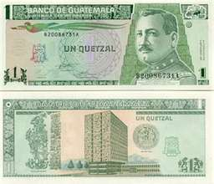
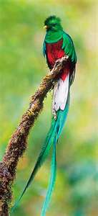
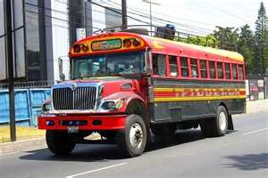
Other facts
El ingreso anual- $2,400 per year
La Moneda Nacional:
El Quetzal
La población – 13.4 million
Camioneta - “Chicken bus”
Want to know more? Click here

Slide 12
El salvador

Slide 13
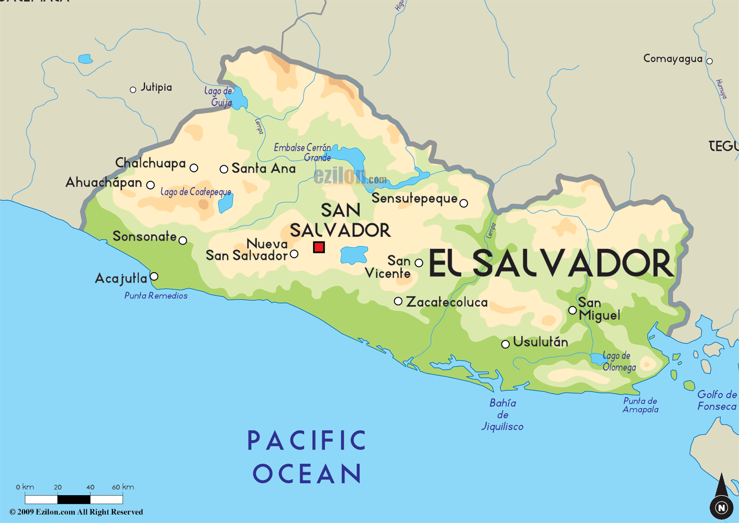
El Salvador
Pictorial Tour- 8 min

Slide 14
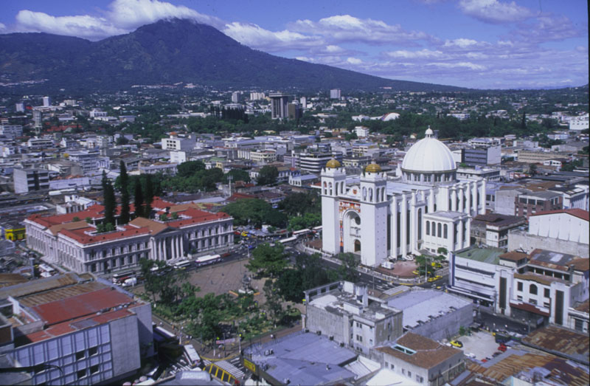
San salvador- La Capital
San Salvador lies at the base of a volcano.
It is home to one-third of El Salvador's population (nearly 2 million) and one-half of the country's wealth.
The downtown area is filled with shops and modern buildings, but unfortunately earthquakes have damaged or destroyed many of the city's historic buildings.
San Salvador's climate is tropical, although the weather can vary; the nights may be cool (especially in December

Slide 15
Business in San salvador
.
Feria Internacional de El Salvador is the largest convention center in Central America.
El Salvador is rated the third best place for investment in Latin America by Moody's.
Some of the very wealthy business families in San Salvador and throughout El Salvador are Siman (owners of the largest department store chain in Central America), Poma (owners of Grupo Roble and Grupo Poma), Quiros (owners of Grupo Q in Central America), Kriete (owners of TACA Airlines), Dueñas (owners of La Gran Via), the family that owns Biggest, Pops, Nash and Mister Donut, and a lot of other important families.
The wealthy live in exclusive suburbs behind tall security walls or luxury condominium buildings. Wealthier areas such as San Benito, Colonia Escalon, Colonia San Francisco, Colonia Maquilishuat, Santa Elena (where the US embassy is located) and Ciudad Merliot have tree-lined avenues, the biggest malls in Central America, bars, clubs, gyms, restaurants, luxury hotels, modern high-rise buildings, plazas, boutiques, cafes, luxury salons, jewelry stores, etc.

Slide 16
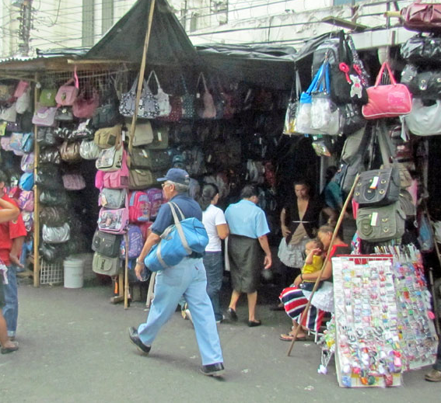
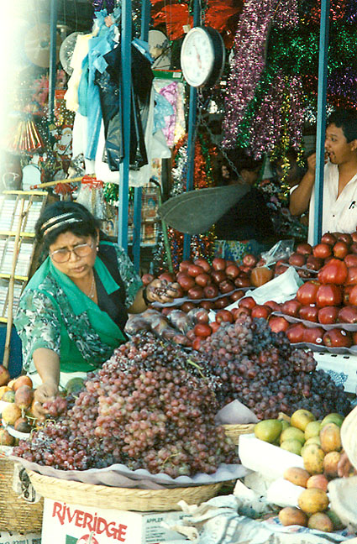
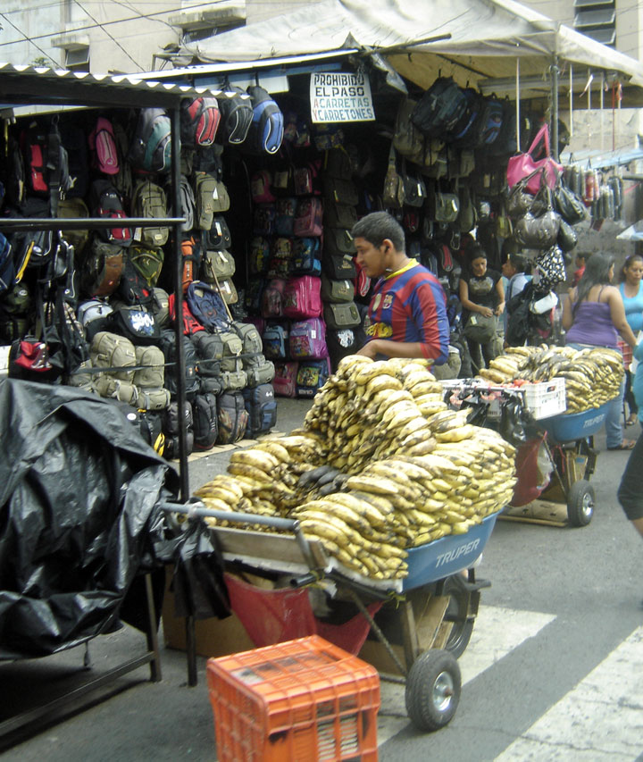
Llopango market
East of the city visit the Llopango markets. The best buys here are local crafts including hammocks which are hand-made and very cheap. Other items include carved figures, a lot based on the Pipil deities and leather work.

Slide 17
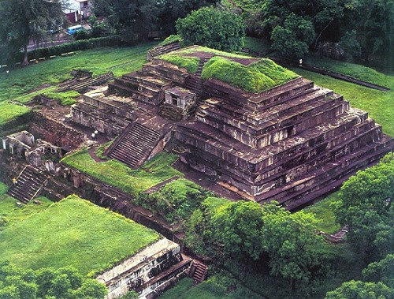
Tazumal
El Salvador Unplugged: #7 Tazumal Video
The excavated remains of Tazumal span a period of over 1000 years, from around 100 AD to 1200 AD. It’s believed that the city functioned as an important trading center, and that much of its ruins still remain unexcavated. Most of the construction took place around 400 to 680 AD with building made of adobe, or stone set in adobe, and a facing of lime plaster. The site was abandoned around AD 1200.

Slide 18
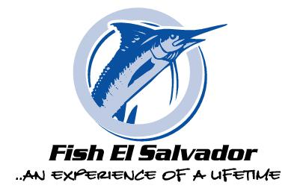
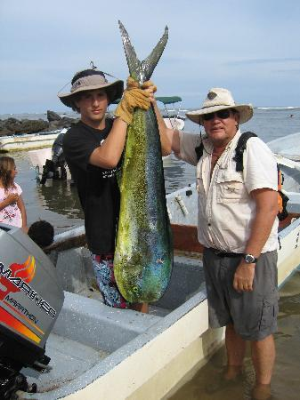
Los cobanos - fishing
Los Cobanos is a protected national reserve where you can expect to find anything but a sophisticated marina and no yachts. The reef is the largest in the Americas Pacific anywhere between Los Cabos and Tierra del Fuego. It is estimated that the corals at the reef are more than 150 years old and some of them near 2 meters in height
The biodiversity observed daily at the reef accounts for some of the best fishing attracting massive amounts of baitfish and giving fishing enthusiasts priceless experiences with amazing fish.

Slide 19
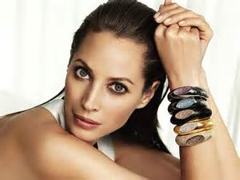
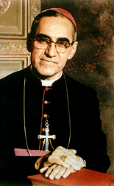
Gente famosa
Oscar Romero
1917-1980
Archibishop
Murdered during Civil War
Christy Turlington
Born 1969
Half Salvadoran
Supermodel
Criticized the government and spoke out against poverty, social injustice, assassinations and torture.
Trailer : Romero 1989
Tribute

Slide 20
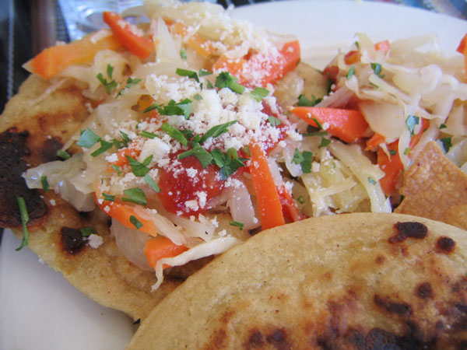
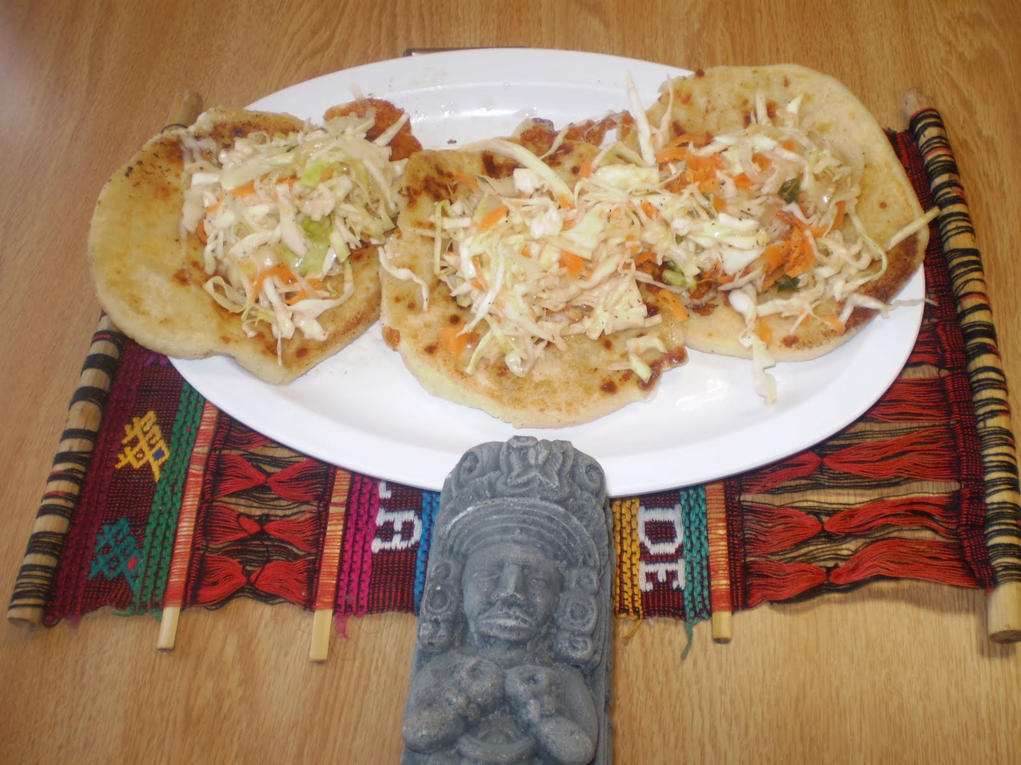
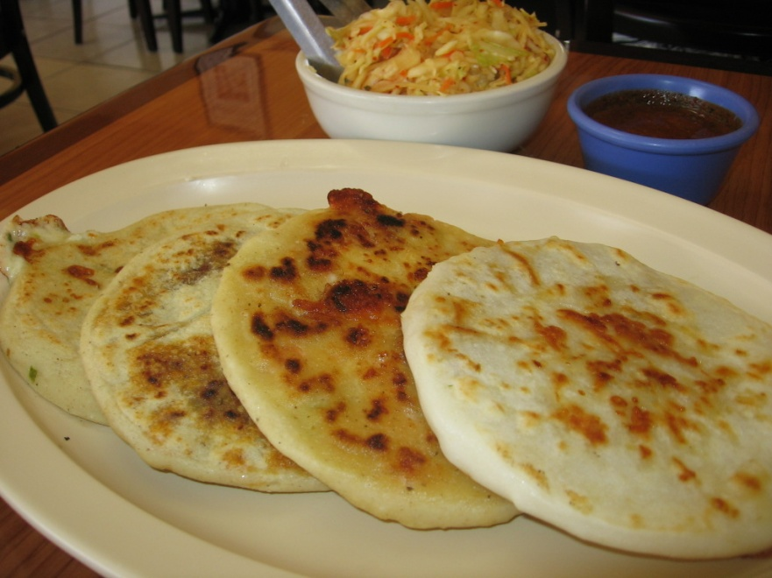
Comida salvadoreÑa
pupusas
thick , corn tortillas
Como se prepara
La ensalada de repollo

Slide 21
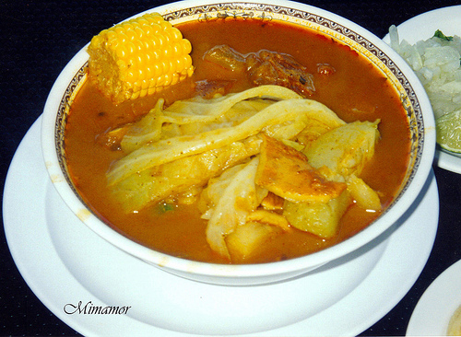
Comida salvadoreÑa
Sopa de pata
Sopa de pata is a traditional El Salvador soup, famous outside El Salvador for a few choice ingredients. Besides fruits and veggies like plantains, green beans, corn and yuca, sopa de pata contains tripe (cow's stomach) and cow's feet. Sopa de pata is also flavored with lemon juice, chile and cilantro.

Slide 22
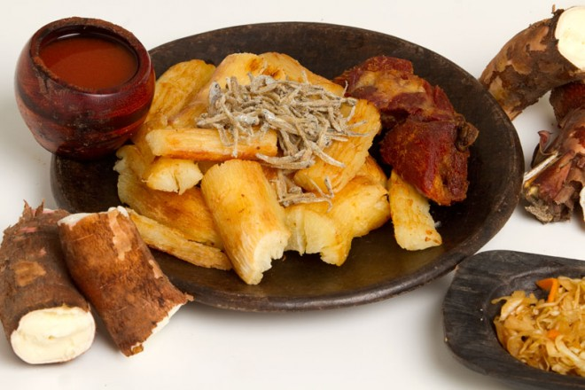
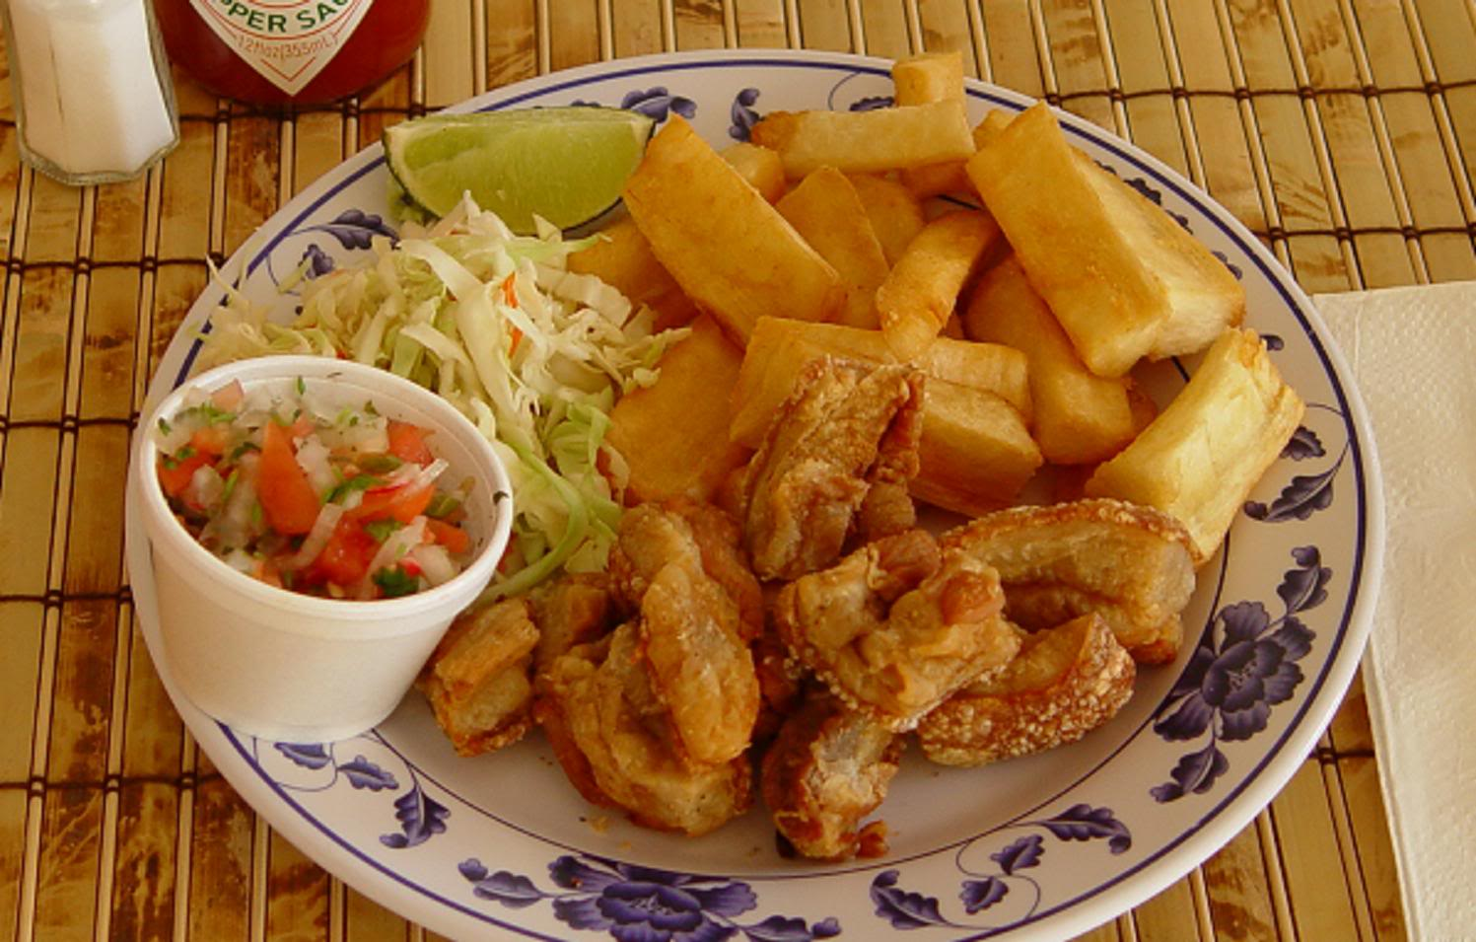
Comida salvadoreÑa
Yuca frita
Deep fried cassava root
Often served with chicharones – deep fried pork cracklings

Slide 23
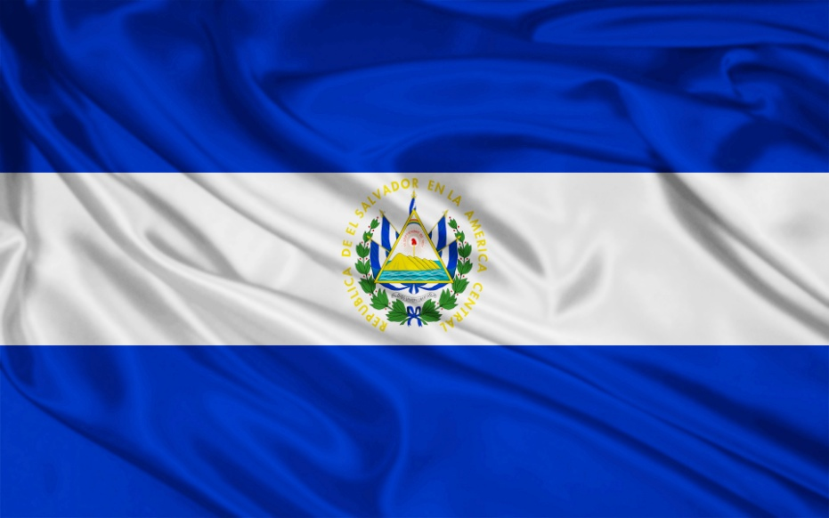
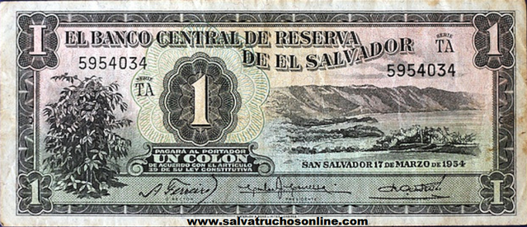
Other facts
El ingreso anual- $2,850 per year
La Moneda Nacional:
U.S. Dollar replaced
Colón in 2001
La población –6.9 million

Slide 24
honduras

Slide 25
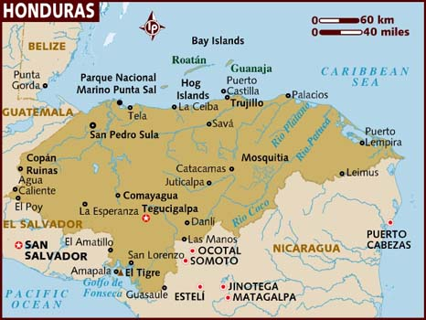
Honduras: Tourism and Investment 2008

Slide 26
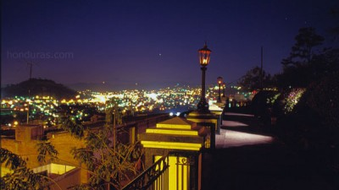
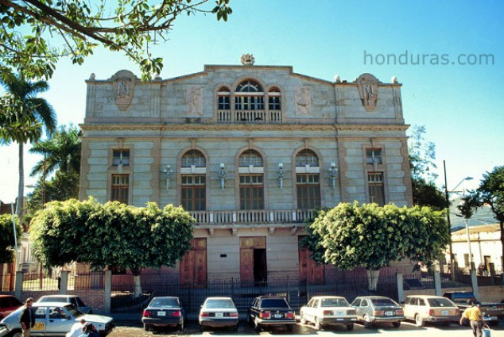
Tegucigalpa – la capital
Travel Tegucigulpa Resorts
Tegucigalpa is the capital of Honduras, founded in 1536, with a gold and silver mining center which winds around a valley and over the mountains.
Along the Boulevard Morazán is a busy commercial area with restaurants, and shopping for tourists and busy working individuals during their lunch breaks. Hotels here are only steps away to the hottest nightclub spots.
Travel Tips on Tegucigulpa

Slide 27
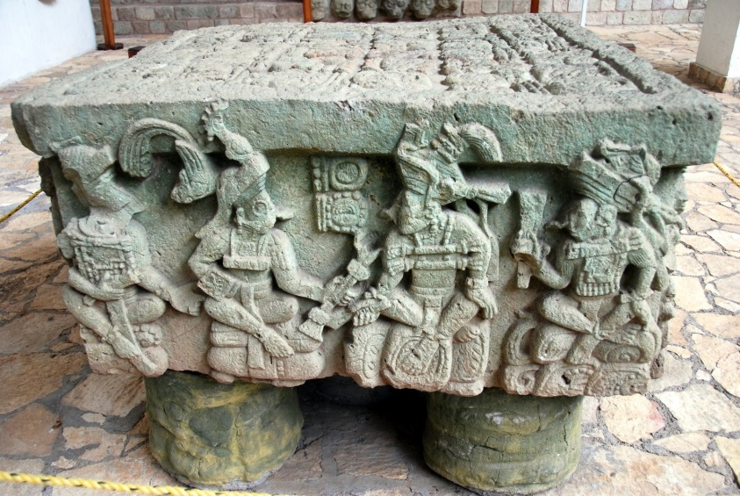
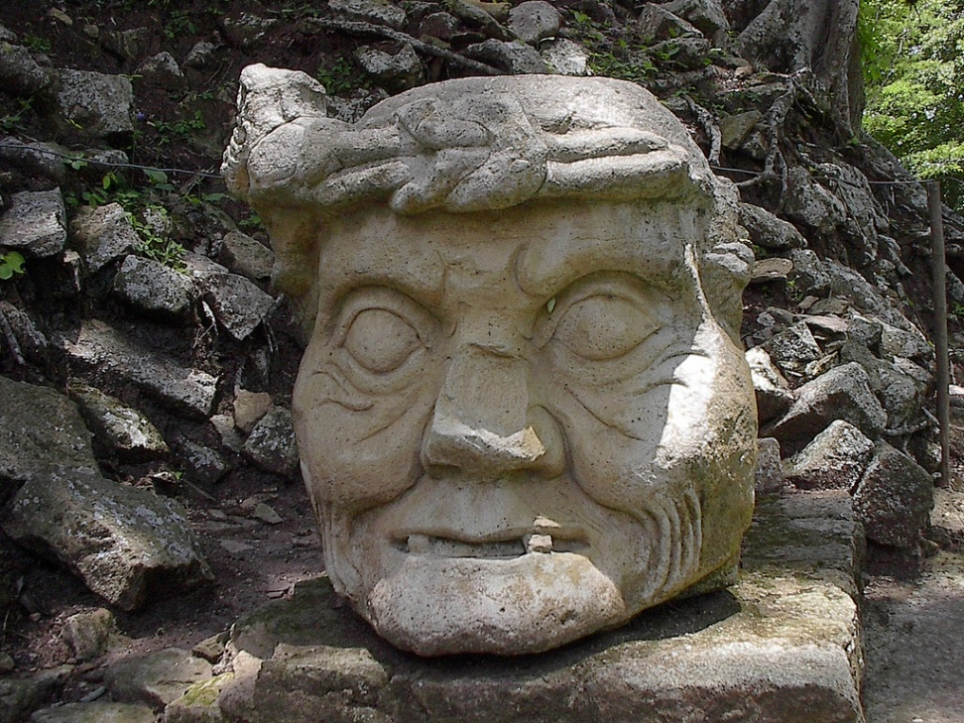
Copán ruinas – mayan ruins
Brief Introductory Tour
The Copan Ruins are located in the western part of Honduras, about 60 kilometers from the border with Guatemala..
Copan - known as Xukpi to the Maya - was the dominant Mayan city in the south of their territory. Its known for its rich stone sculptures and intricate hieroglyphs

Slide 28
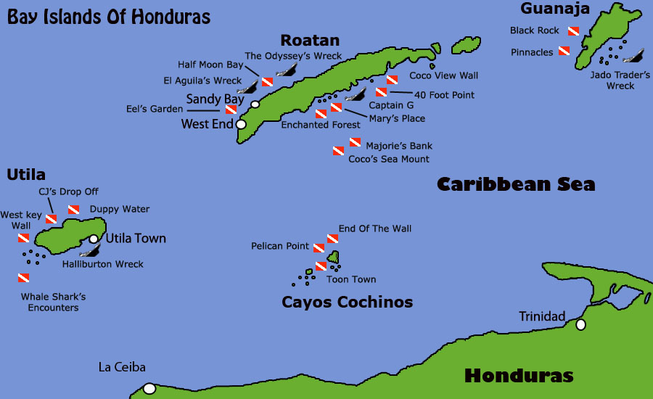
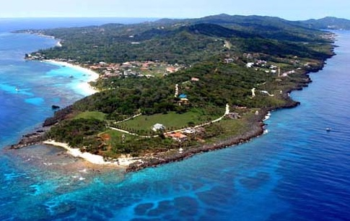
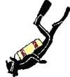
Bay islands
Roatan, Utila and Guanaja are the three largest of several islands known as the Bay Islands of Honduras.
Diving is the main travel attraction and is considered amongst the best in the Caribbean.
Real Estate in the Bay Islands is amongst the most affordable in the Caribbean and many foreigners have established themselves here
Chamber of Commerce Video

Slide 29
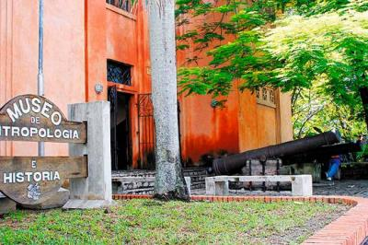
San Pedro Sula
“The best arrival and departure point within Honduras.”
San Pedro Sula offers more flights to Roatan than does Tegucigalpa.
San Pedro Sula is considered the economic capital of Honduras. It sits squarely in the center of the Sula valley. Most of Honduras' commerce and traffic travel through the Sula valley.
Land travel within Honduras is much easier if you begin in San Pedro Sula.. San Pedro Sula sits equidistant between Copan Ruinas and La Ceiba (and on to the Bay Islands).
Museum of anthropology and History
This museum has a selection of pre-Columbian pottery, grinders and other items up through colonial times. Some Spanish would be helpful since few items have English labels.

Slide 30
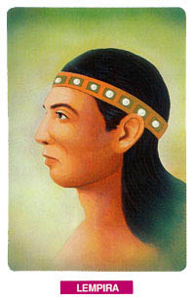
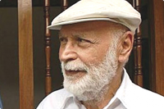
Gente famosa
Robert Sosa (1930-2011)
Considered the national poet of Honduras.
Published Los Pobres, his first book, in 1969, which won the Adonais Prize in Spain.
Lempira
Died 1537
War captain of the Lencas who unified over 200 tribes and fought against the Spanish conquerors.

Slide 31
Gente famosa
Neida Sandoval and Satcha Pretto
Univisión Television

Slide 32
tostones
Comida de Honduras
Twice fried plantains
Video recipe

Slide 33
anafres
Comida de Honduras
A refried black bean and cheese fondue, served hot over coals in a clay pot as an appetizer. Often, peppers and/or chorizo can be added. Tortilla chips accompany the anafres for dipping.

Slide 34
Other facts
La Moneda Nacional:
Lempira
El ingreso anual- $1,600 per year
La población –7.1 million

Slide 35
nicaragua

Slide 37
Managua- la capital
Managua has no “downtown” because it was destroyed by an earthquake in 1972.
If you view Managua from the neighboring hills, you won't see much, because the majority of its buildings are of one story and are obscured by Managua's abundant vegetation; only a few buildings rise above the trees, notably the Bank of America building, the tallest in Managua

Slide 38
Managua- la capital
Getting around in Managua can be tricky. Some streets have names, but no one knows them. They navigate by the points of the compass from a known point of reference: 'from where the small tree was, one block toward the Lake, and 25 leagues up (up is east, down is west, to the Lake is toward the north, and only for south is the habitual word used).
Travel Tips for Managua
Zona rosa
Business and entertainment district

Slide 39
Granada
National tourism hub
Center of commerce in timber, gold and silver as well as production of organic coffee and cacao, cattle, plantain and bananas occurs within its boundaries.
A real estate boom had been underway for several years, with many European and Americans purchasing and renovating the area's homes for retirement or holiday homes and several foreign realtors establishing offices, but that boom slowed in 2007.
Travel with Kate
City Tour en Español

Slide 40
León
The region of leon has one of the most impressive colonial cities in the country. Here, tourists will find hotels, restaurants, bars, tour operators, museums, cultural centers, several colonial churches and the largest cathedral in Central America. Leon also has a couple of famous beaches: Poneloya and Las Peñitas. The Juan Venado Island Natural Reserve is located close to the last beach, featuring abundant marine life and mangrove vegetation. The municipality is also famous for the festivities held in honor of Virgin Mary (December) and the colorful sawdust carpets than can be seen during Holy Week (Easter).
Review of International Living in the city of Leon
Photographic tour

Slide 41
momotombo volcano
Although its most recent eruption was in 1905, volcanic activity at Momotombo has been measured as recently as April 2000. As the temperatures of certain parts of the volcano continually exceed 500°C a geothermal plant has been created at the base of the volcano, producing energy from the volcano's heat.
Climbing the Momotombo is a challenging task. The first step is obtaining a permit from the company that runs the geothermal plant as the plant also serves as the staging area for the beginning of the hike. Due to the fact that this it is a classic cone-shaped volcano, the trails and paths that lead up to the summit are oftentimes very steep. Volcanic sand and rocks coat most of the upper portion of the volcano so good physical shape is necessary to navigate these difficult surfaces

Slide 42
Lake nicaragua
A volcanic chain cuts right through Lake Nicaragua, and this has resulted in the creation of many beautiful islands and groups of islets. Probably the most famous island is Ometepe, a 276 km² tropical island located 10 kilometers off the mainland at the western side of the lake. The island is composed of two volcanoes: Maderas and Concepción. These two impressive volcanoes are surrounded by fertile soil where nature abounds. For sport and adventure the island offers a great array of possibilities, including volcano hiking, biking, surfing, fishing, kayaking, and swimming. The tropical forests and natural reserves make it furthermore a great place for hikers and nature lovers.

Slide 43
La gente famosa
Rubén Darío (1867-1916)
Poet who is known for starting the Spanish modernist literary movement
Monument to him in Nicaragua
Daniel Ortega
Leader in the socialist Sandinista National Liberation Front
President 1985-1990 and reelected 2007

Slide 44
La gente famosa
Giocanda Belli (1948- )
Novelist and poet
Involved in the Sandinista revolution
Works have been translated in America and throughout Europe
Violeta Chamorro (1929-)
President of Nicaragua (1990-7)
Head of anti Sandinista alliance
First female president in Latin America

Slide 45
Gallo pinto
Comida de nicaragua
This hearty, healthy and filling dish is your basic rice and beans. The beans in this case are red, and the color of the beans on the rice gives gallo pinto, or "painted rooster," its name.

Slide 46
Pan de Coco
Comida de nicaragua
Ingredients: yeast, sugar , warm water, flour, shortening , coconut milk, salt, pure coconut oil
Pan de Coco is a delicious coconut bread that originated among the Garifuna people (a cultural mix of West Indies Indians and Africans) who inhabit the coasts of Belize and Honduras. The Garifuna were escaped slaves off a boat from Africa who originally lived on the island of St. Vincent. Their recipes are unwritten and mostly passed down orally from mother to daughter. Pan de Coco has the appearance of dinner rolls.

Slide 47
Mondongo
Comida de nicaragua
Sopa de mondongo is a stew made from diced tripe (the stomach of a cow) slow-cooked with vegetables such as bell peppers, onions, carrots, cabbage, celery, tomatoes, cilantro, garlic or root vegetables.

Slide 48
Other facts
El ingreso anual- $980 per year
La Moneda Nacional: Córdoba
La población –5.6 million

