Slide 1
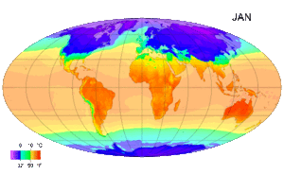
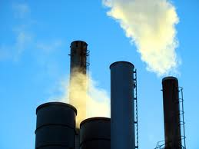
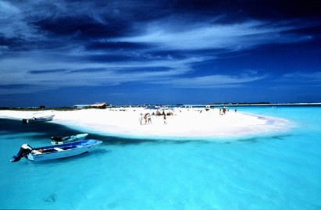
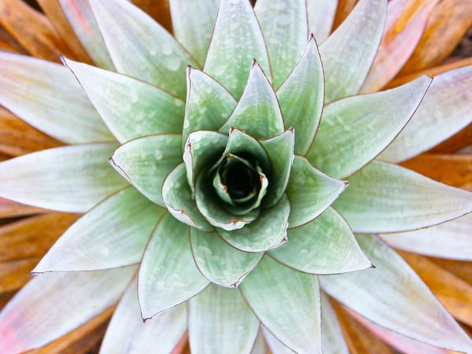
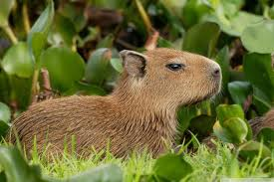
Industry, Vacation Spots, Climate, and Plants and Animals of Venezuela
By: Taylor Williams

Slide 2
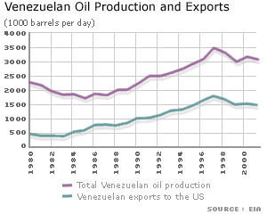
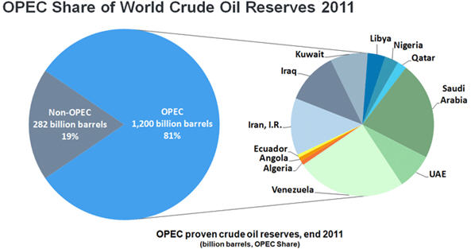
Industry of Venezuela
Do Venezuelan industry sectors play a significant role in the nation’s economy? The answer to that question is yes, they most definitely do. They play a vital role in the nation’s economy, accounting for employment of about 23% of its 12.67 million labor force in 2009. The statuses of some major players in the Venezuela industry sector include oil and gas, electric power generation, and mining.

Slide 3
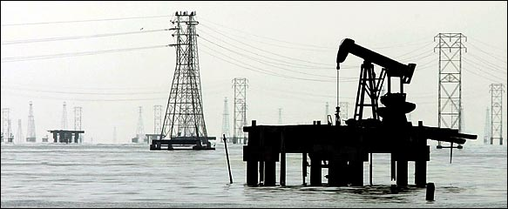
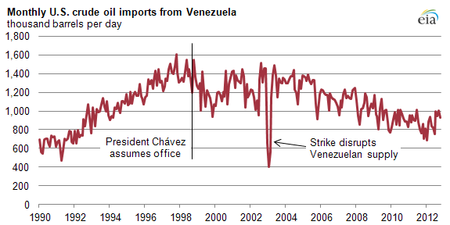
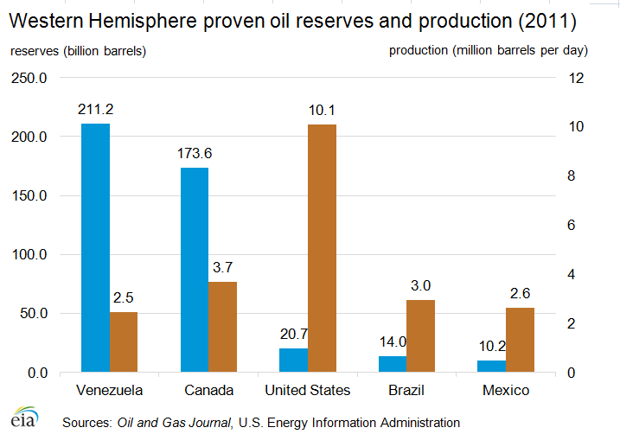
Oil
Oil contributes about one third of Venezuela’s Gross Domestic Product. Venezuela’s oil and gas sector averaged 2.2 million barrels/day in crude oil production in 2009, according to EIA reports. Venezuela’s oil industry was nationalized, leading to the formation of Petroleos de Venezuela.

Slide 4
Video on Oil In Venezuela
http://www.youtube.com/watch?v=QlxNR02xEVA

Slide 5

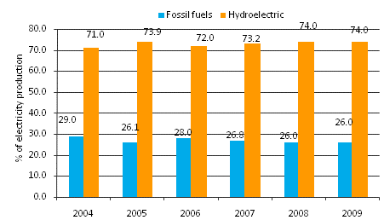
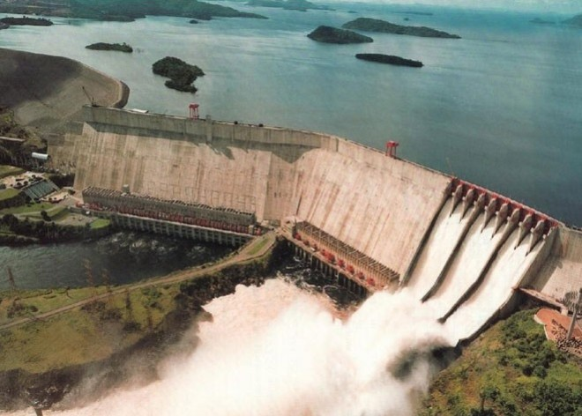
Electricity
Their electricity sector has been facing a lot of criticism due to a significant shortage in electricity production. There has been a national shortage, prompting the Chavez administration to create the Electricity Ministry in December 2009. They have sanctioned the construction of about three dozen thermoelectric and hydroelectric plants to help reduce Venezuela’s reliance on its largest dam.

Slide 6
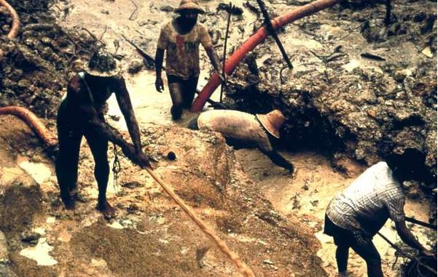
Mining
For mining, the Corporación Venezolana de Guayana is the nation’s state-run mining company. They are involved in many joint ventures throughout the nation. Due to the unique geology of Venezuela, it has become a thriving mining industry, with several extraction plants of nickel, gold, bauxite and coal. Did you know that Venezuela is in fact a key coal producer in Latin America, along with Columbia?

Slide 7
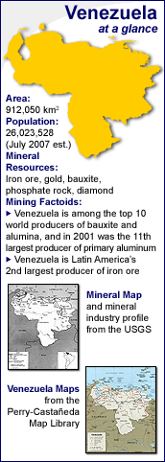
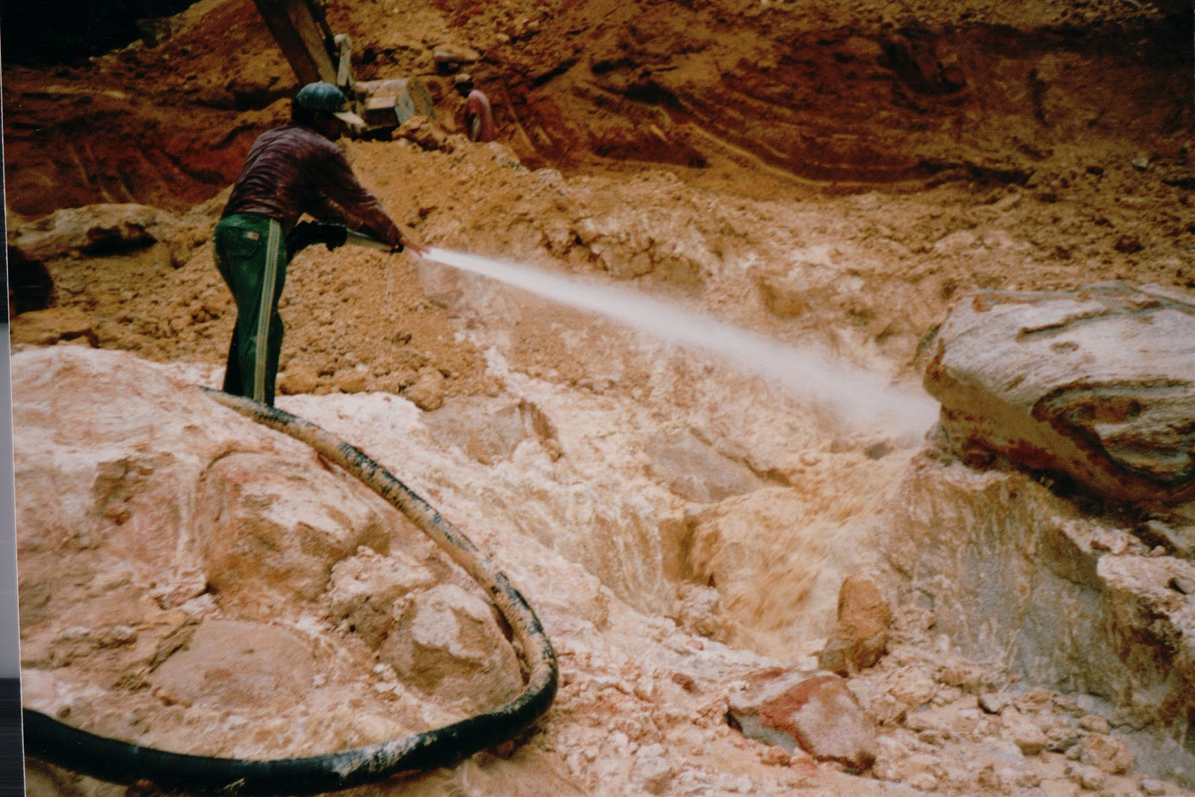

Slide 8
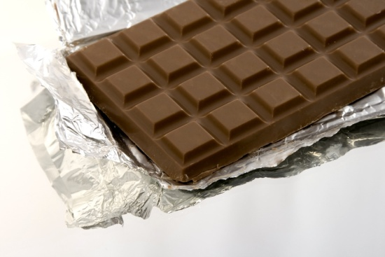


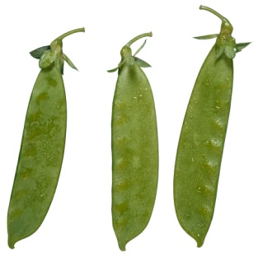
What else do they have?
I also had the opportunity to chat with Asne Brit, a girl from Venezuela on the website www.Livemocha.com. I asked her what the main imports and exports were in Venezuela besides oil. She told me, “Besides oil, we have chocolate, coffee, rubber, plastic, articles of glass, snuff, and animal and vegetable products.”

Slide 9
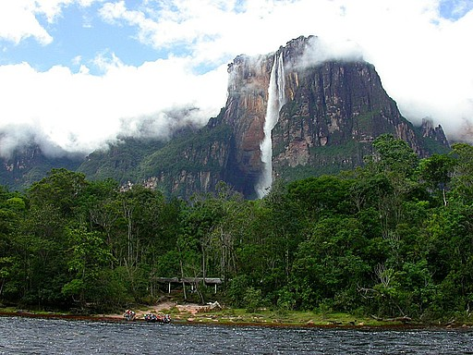
Vacation Spots
Ranked at number one on the best vacation spot list is Canaima National Park. The park is the second largest in the country and is actually bigger than the state of Maryland. The park also features Angel Falls, which is the largest waterfall in the world.

Slide 10
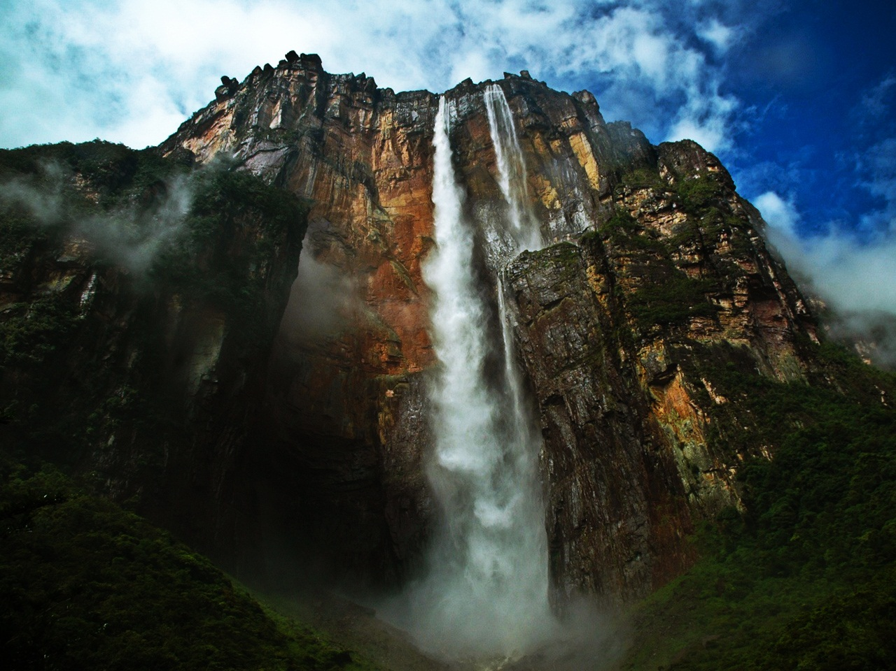
Angel Falls- Did you know it is named after American pilot Jimmy Angel who discovered the falls while searching for gold?

Slide 11
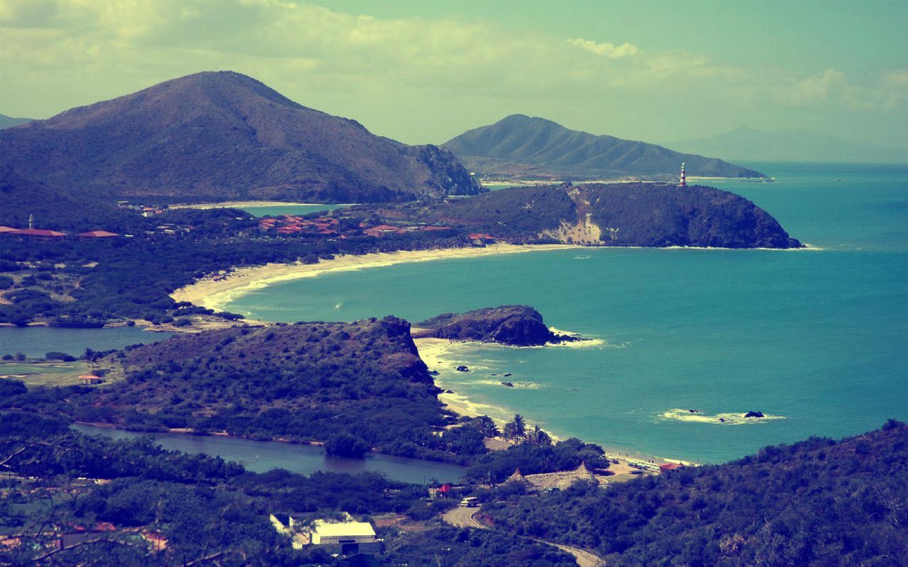
Margarita Island
Margarita Island is the largest island in Venezuela. The island is known for its pristine Mediterranean beaches and tranquil blue waters

Slide 12
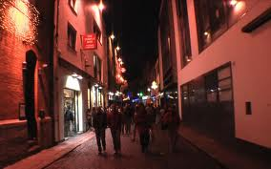
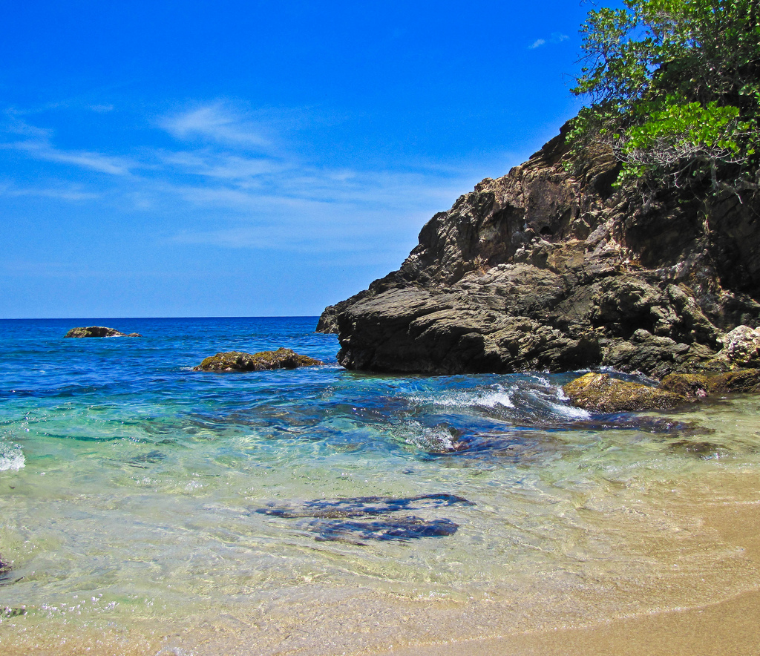
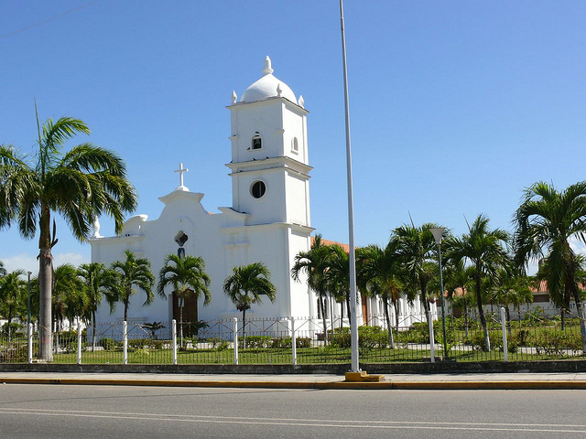
Higuerote
The city is known for its rica historia (rich history) and great vida nocturna. (nightlife).
Iglesia de Higuerote , Estado Miranda - Venezuela

Slide 13
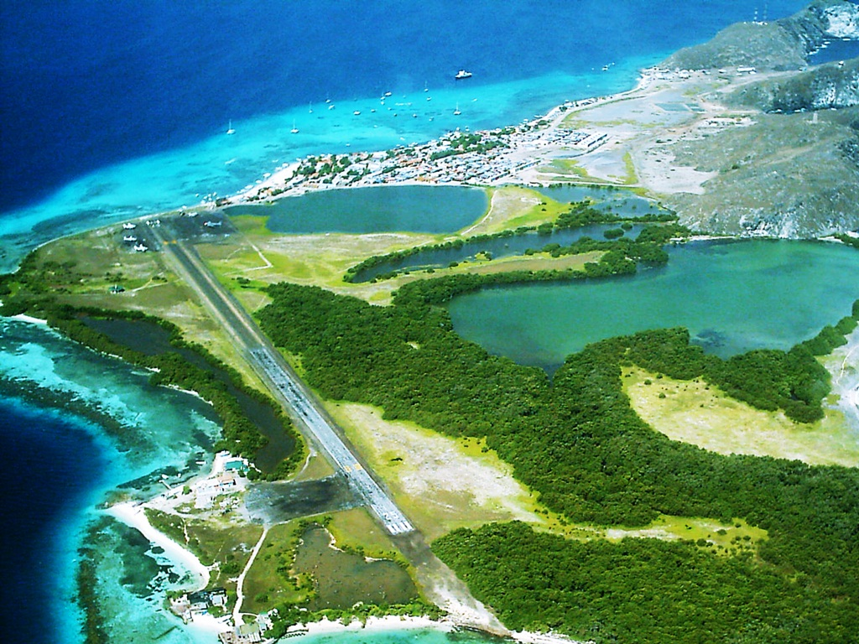
Los Roques National Park.
Los Roques National Park is a great place for day trips, windsurfers, fishermen, and beach combers.

Slide 14
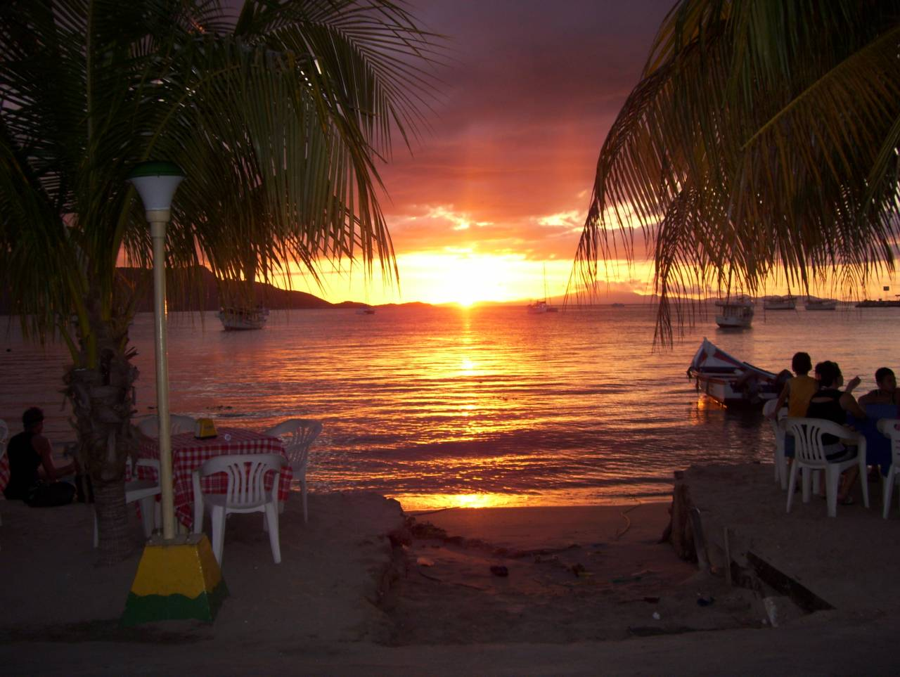
Juan Griego
Juan Griego has excellent beaches with great activities and pristine waters. It is a great place for relaxing and active vacationers.

Slide 15
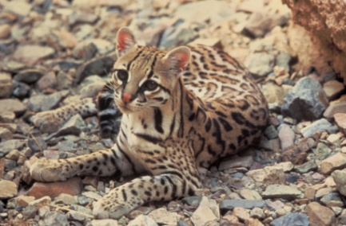
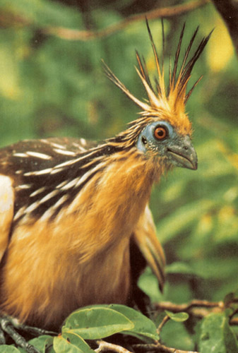
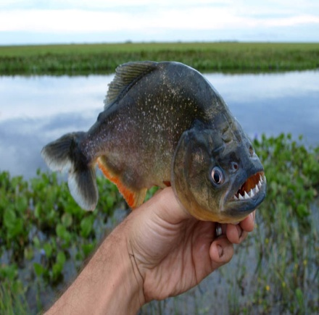
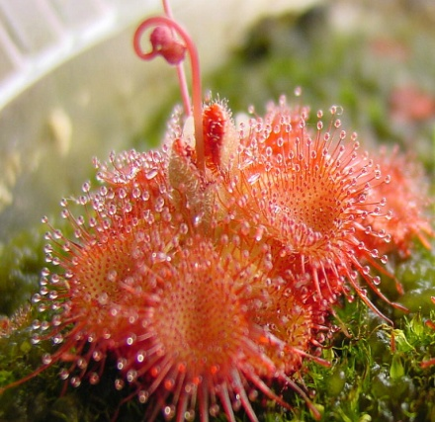
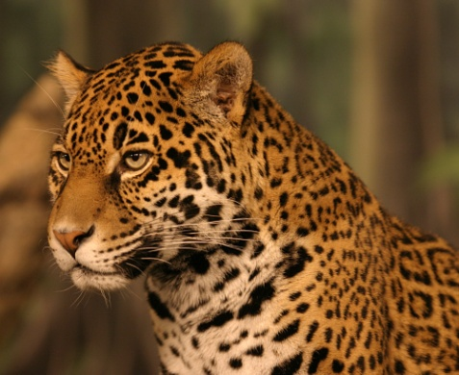
Plants and Animals
Venezuela is a beautiful tropical country with diverse geography, supporting a wide variety of exotic plants and animals, including the fearsome piranha, primitive hoatzin birds, jaguars, ocelots, tapirs, armadillos, and anteaters. In general, Venezuela’s flora is stratified by thermal zones, causing some particular plants to being restricted to certain altitudes and cannot be founded elsewhere.

Slide 16
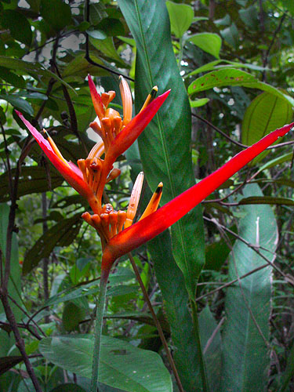
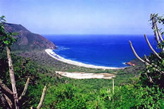
Henri Pittier National Park
Did you know a quarter of the country Venezuela is covered in tropical forest? Over 30,000 species of named tropical plants occupy the mountainous cloud forest of the Henri Pittier National Park. There you can find the beautiful bird of paradise plant called the Heliconia acuminata, primitive tree ferns, and epiphytic plants (plants that derive moisture and nutrients from the air and rain) which are part of the beautiful scenery.
Henri Pittier National Park
Heliconia acuminata

Slide 17

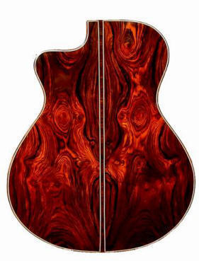

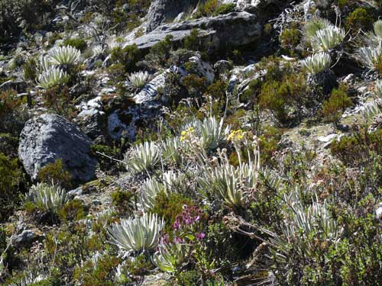
Woods and Plants
Being very abundant in the more diversified cloud forest and rainforest, are noble woods like ebony, rosewood and mahogany, and magnificent and scented flowers such as lilies and orchids. A specific type of plant, the espeletia (frailejón), is described as having long cream-green leaves arranged in a rosette pattern, and can be found in the páramos (tropical moors), blooming between August and December.
Ebony
Rosewood
Mahogany
Espeletia

Slide 18
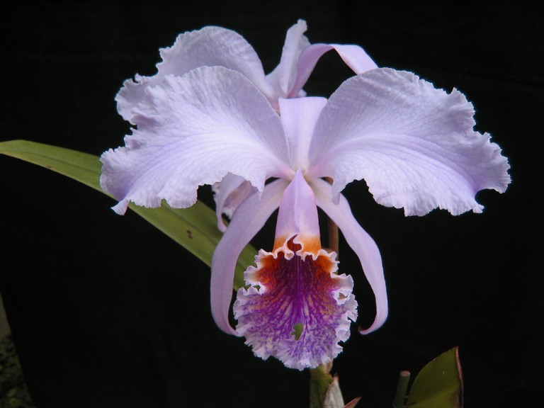
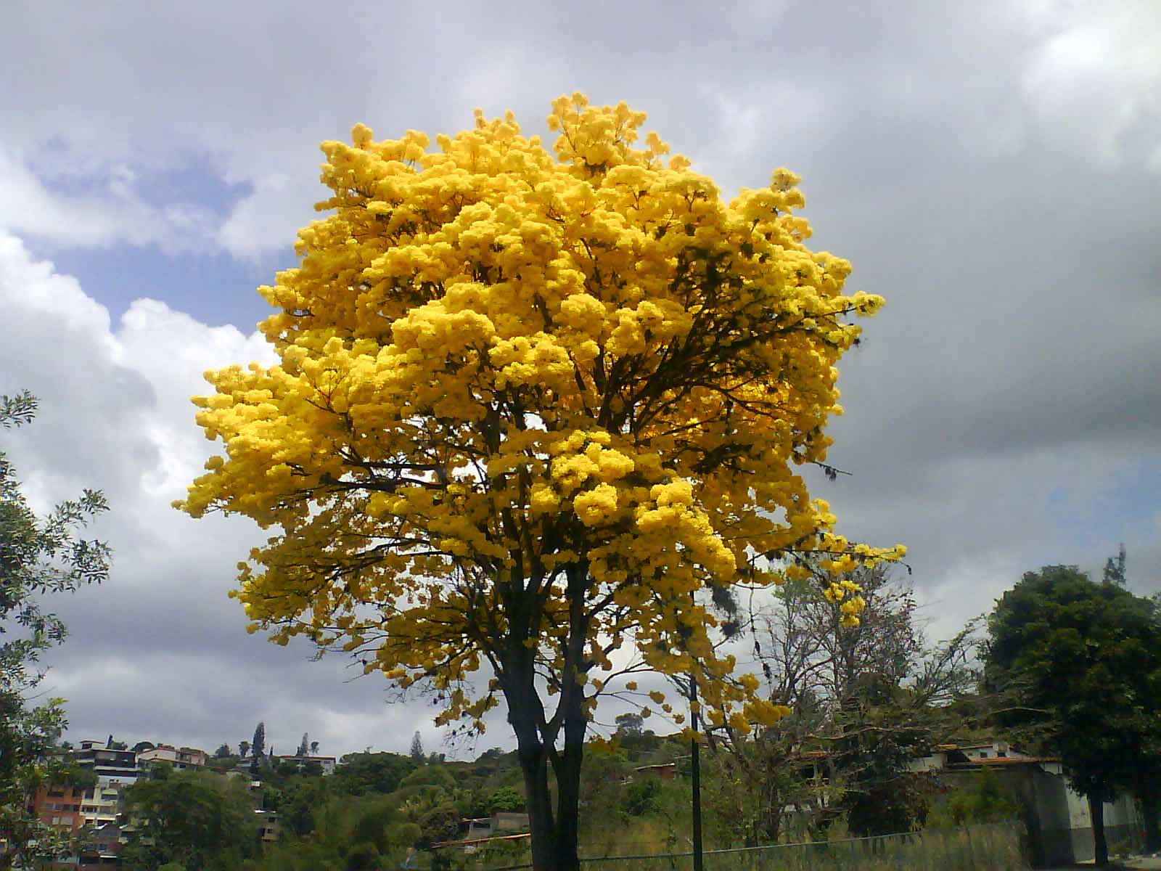
National Flower and Tree
You are probably wondering what the national flower and tree are of Venezuela? Well, the “flor de mayo” (Cattleya Mossiae), is the national flower and is one of several 3,000 species of Venezuelan orchids, the national tree is known in England as the "trumpet tree" and is called the “araguaney”, in Venezuela. This tree is spectacular, from April to June, when it is covered with bright yellow blossoms.
Cattleya Mossiae),
Araguaney

Slide 19
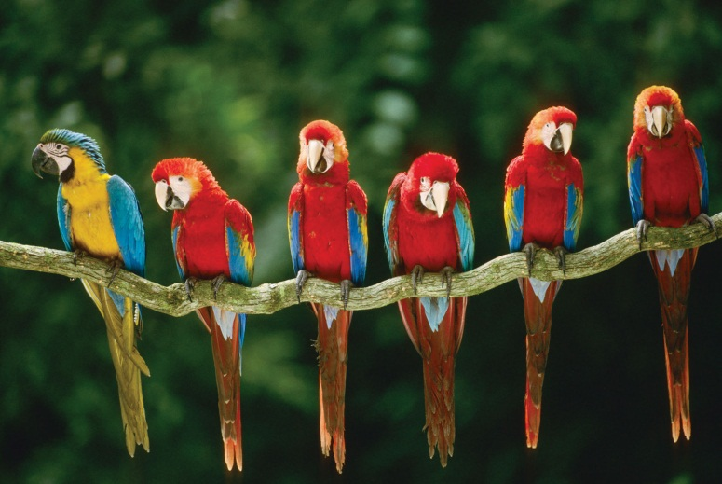
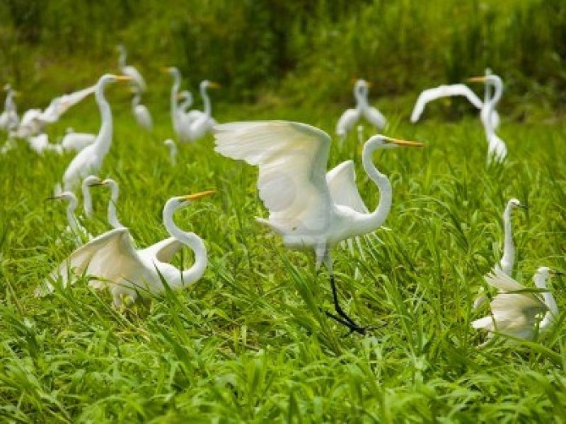
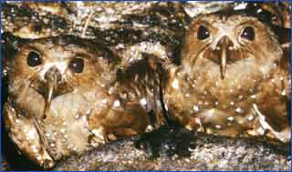
Birds in Venezuela
For the bird range in Venezuela, there are almost 1,400 different species, and Venezuela actually has a number of excellent bird-watching areas. In the tropical forests, birds commonly found are macaws, parrots, toucans, ibises, herons, pelican’s flamingos, hummingbirds, condors, gavials, and oilbirds, as well as a number of singing species like blue jays, orioles and cardinals.
Macaws Herons Oilbirds

Slide 20
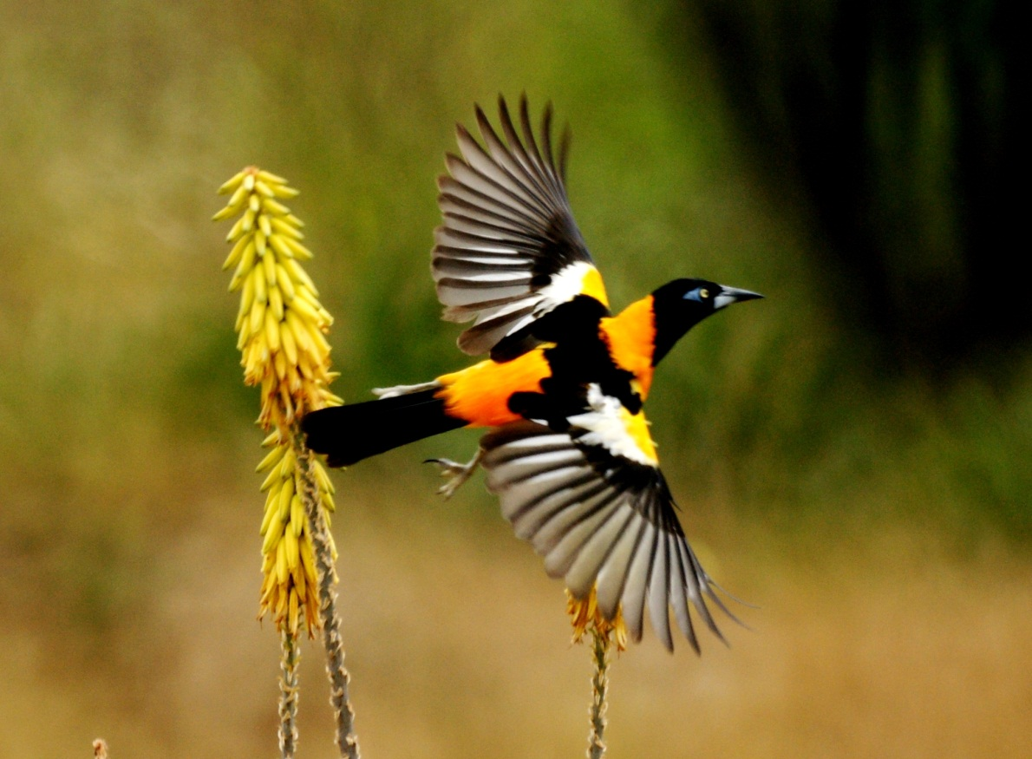
National Bird
The national bird is the “turpial”, which is an oriole noted for its magnificent yellow, black and white plumage and melodic birdsong. .

Slide 21
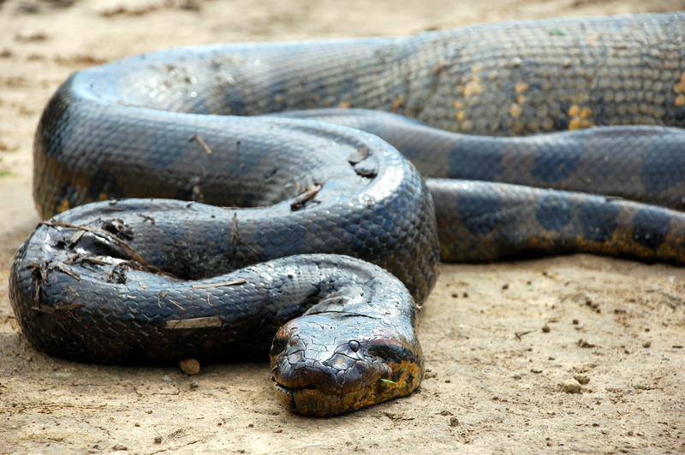
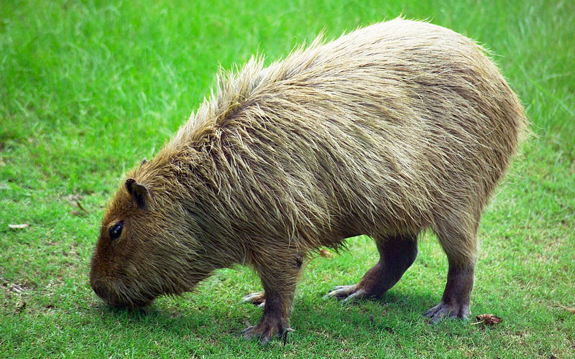
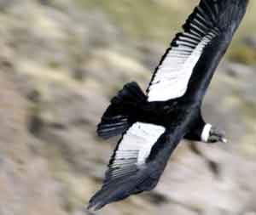
Longest Snake? Largest Rodent? Largest Flying Bird?
Venezuela is unique because it is home to the longest snake in the world, the anaconda; the largest rodent in the world, the capybara, and the world's largest flying bird, the Andean Condor.

Slide 22
Nature and Scenery Slideshow
http://www.youtube.com/watch?v=VwBWmfJzv8Y

Slide 23
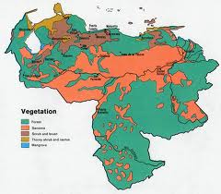
Climate of Venezuela
Although Venezuela lies wholly within the tropics, its climate differs depending on the elevation, topography, and the direction and force of prevailing winds from tropical humid to alpine. Seasonal variations are marked less by temperature than by rainfall. Most of the country has a distinct rainy season. The main rain period is May through November. It is generally referred to as winter and the remainder of the year as summer.

Slide 24
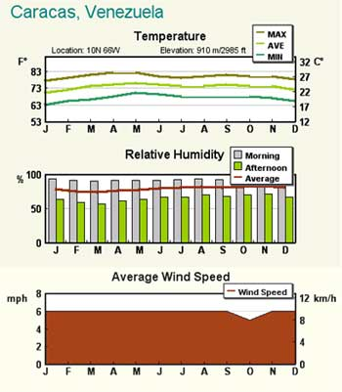
Temperature zones
Based primarily on elevation, Venezuela falls into four horizontal temperature zones. In the tropical zone temperatures are hot, with yearly averages ranging between 79 and 82 °F. The temperate zone ranges from 53.6 to 77 °F. Did you know that many of Venezuela's cities, including the capital, lie in this region? Colder conditions with temperatures from 48 to 52 °F are found in the cool zone. High mountain areas known as the páramos are located in pastureland and permanent snowfield and have yearly averages below 46 °F.

Slide 25
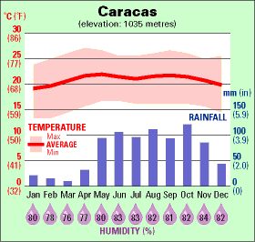
Rainfall
Ranging from 17 in. in the western part of the Caribbean coastal areas to around 39 in. in the Orinoco Delta is the average yearly rainfall for the lowlands and plains. Rainfall in mountainous areas varies considerably. The sheltered valleys receive little rain, but slopes exposed to the northeast trade winds experience heavy rainfall. Caracas averages 30 in of precipitation annually, more than half of it falling from June through August.

Slide 26


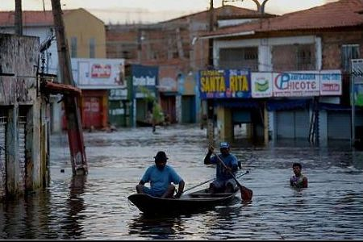
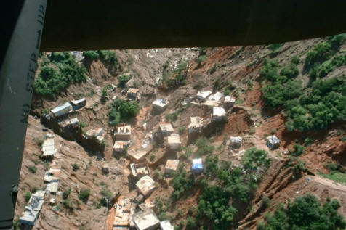
Natural Disasters
Venezuela experiences a lot of natural disasters including devastating earthquakes, floods, hurricanes, mudslides, and cyclones. Venezuela is also home to torrential rains, causing landslides. The country has suffered exceptionally heavy rains in late 2010, affecting wide areas of the country, and road conditions. As far as hurricanes go, the Atlantic hurricane season runs from June 1st to November 30th and can affect portions of northern Venezuela. Venezuela is not usually prone to tropical cyclones but its costal region can occasionally be hit with torrential rain, powerful winds, high waves and storm surges. Cyclones are not such an issue in Caracas as it is sheltered by the Avila mountain range.

Slide 27
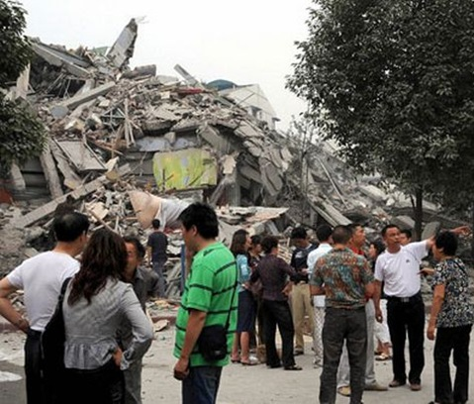
Earthquake
In 1812, a famously devastating earthquake occurred, completely destroying the capital Caracas, and killing 20,000 people.

Slide 28
Citations
http://www.eia.gov/countries/cab.cfm?fips=VE
http://www.savingwater.co.za/2010/02/09/08/venezuela-declares-energy-emergency/
http://www.economywatch.com/world_economy/venezuela/industry-sector-industries.htm
http://www.caligo.com/wbtrs/history.html
http://www.ize2belize.com/venezuela/facts/animals.html
http://celestebehe.blogspot.com/2012/01/putting-capybara-on-lenten-abstinence.html
http://www.voyagesphotosmanu.com/plants_animals_venezuela.html
http://pinoytutorial.com/lifebytes/venezuela-earthquake-news/
http://safety.worldnomads.com/Venezuela/75215/Weather-and-Natural-Hazards-Venezuela.
http://www.youtube.com/watch?v=VwBWmfJzv8Y

