Slide 1
More specialties of Spanish Speaking World
Realidades 7B

Slide 2
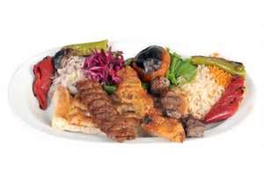
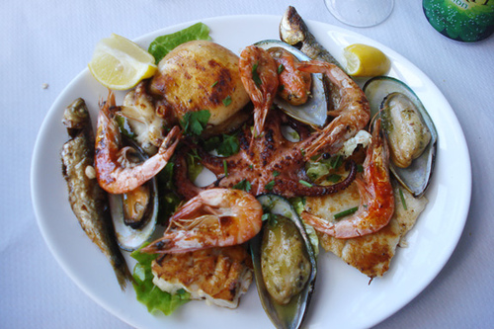
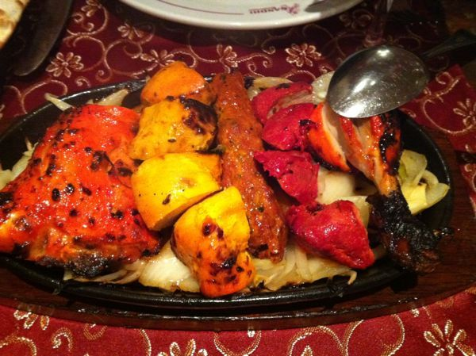
la parrillada mixta
CLICK HERE

Slide 3
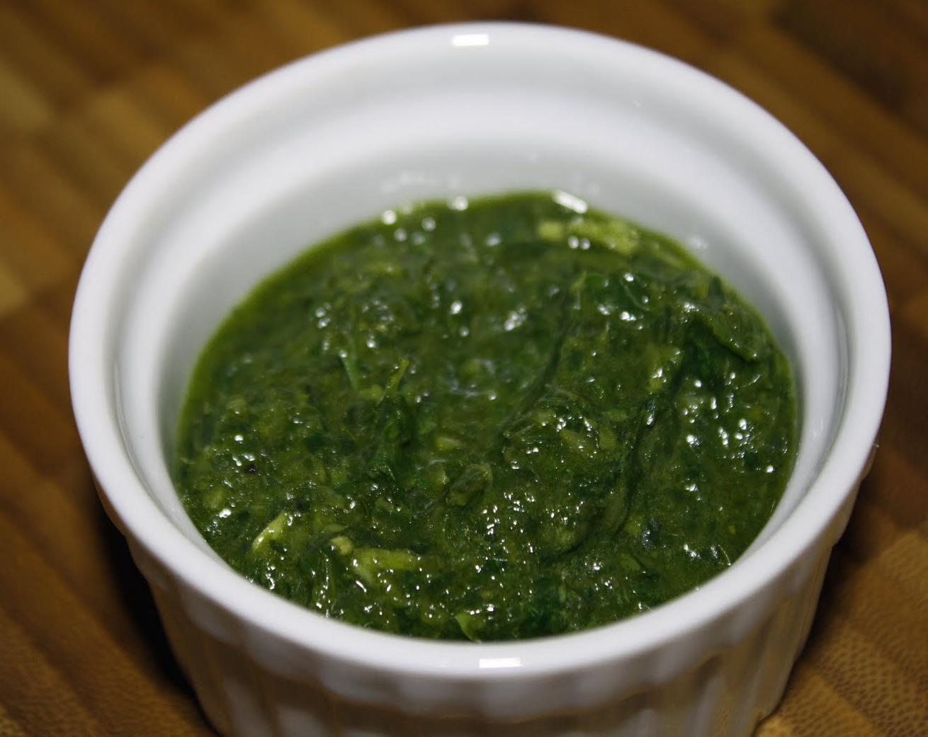
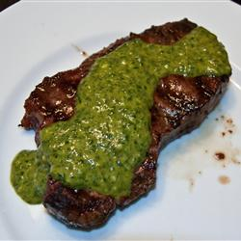
chimichurri
Sauce often served with parrillada mixta
Made of parsely, oregano, garlic, olive oil, vinegar, sometimes cumin and hot sauce

Slide 4
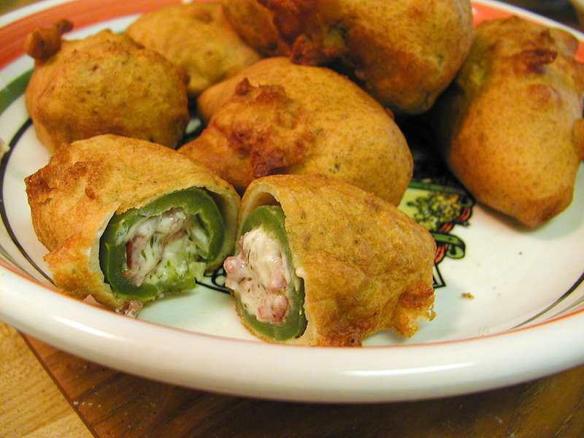
chile relleno
Pepper stuffed with cheese and battered and fried

Slide 5
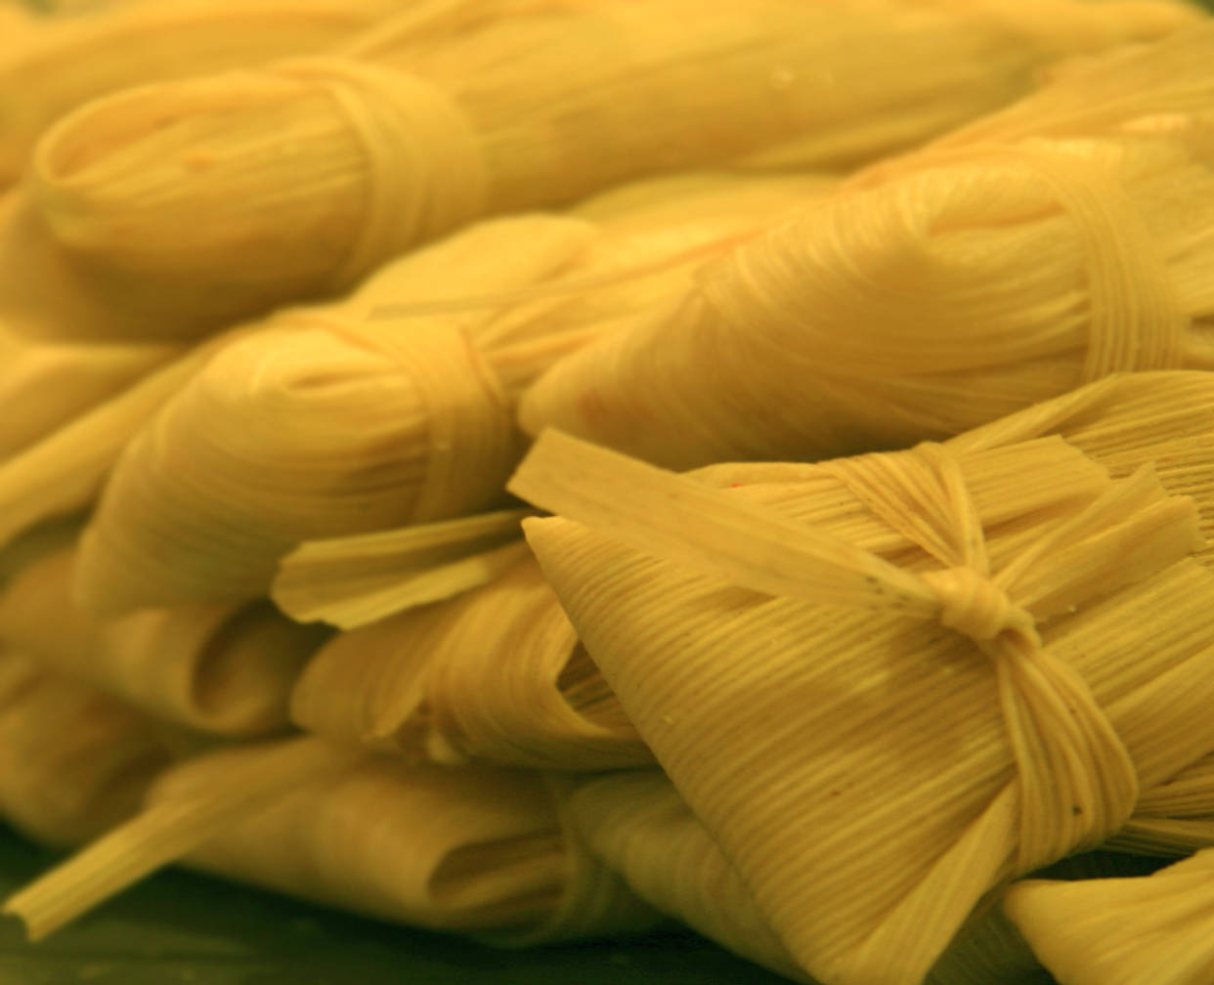
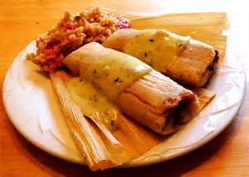
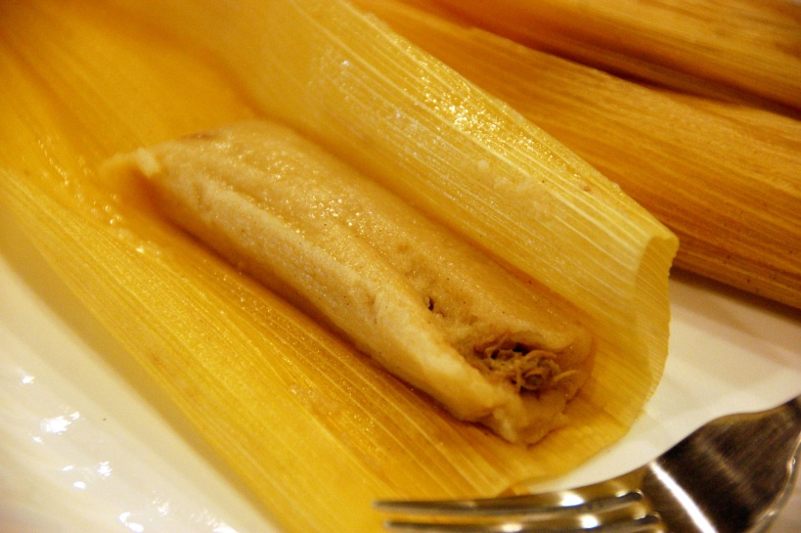
los tamales
dough made of corn meal filled with meats and spices, rolled inside a corn husk or banana leaves and grilled or baked or boiled

Slide 6
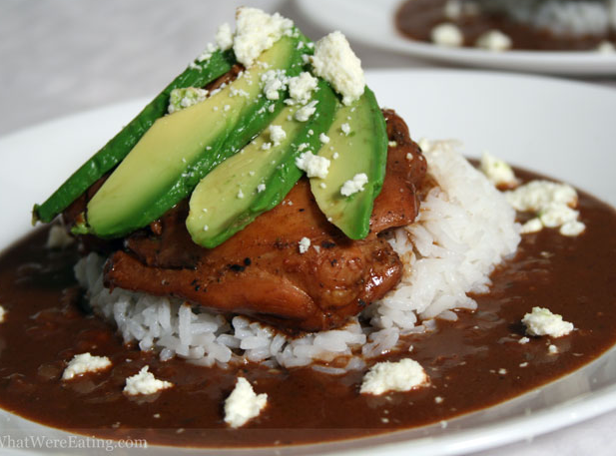
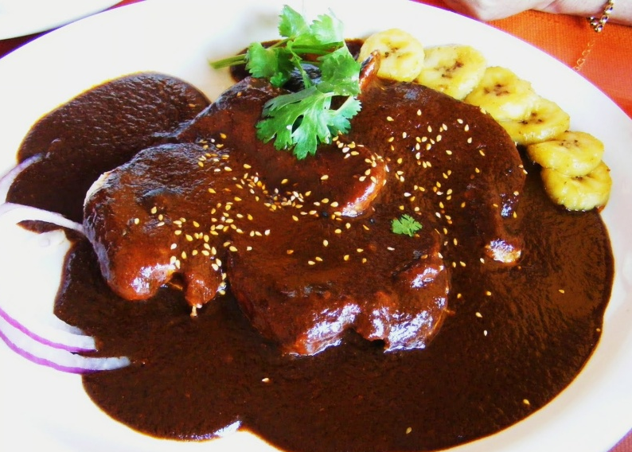
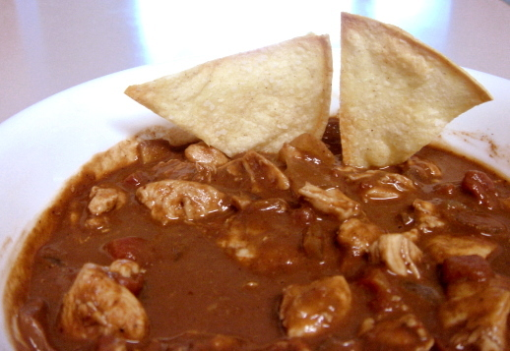
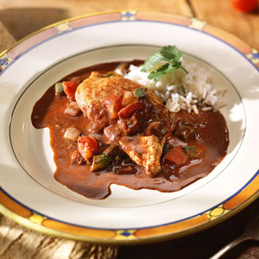
mole
sauce made of ground dried chili peppers, chocolate and cinnamon (Mexico), served over meats or as sauce in stew
How to make traditional mole sauce

Slide 7
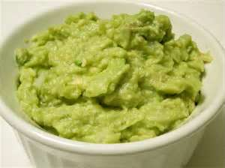
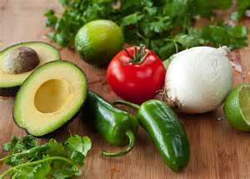
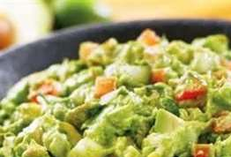
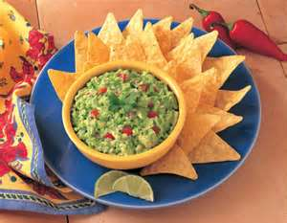
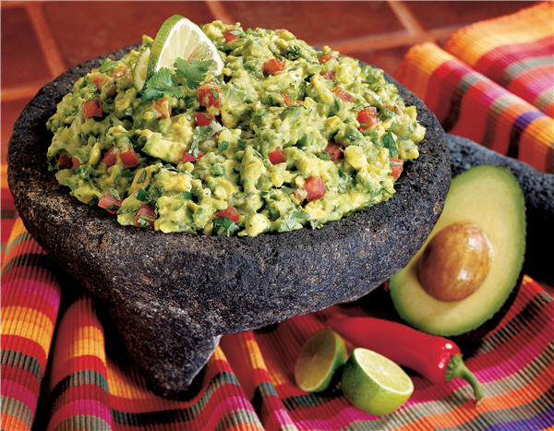
guacamole
green sauce made of uncooked avocado, tomatoes, garlic, onions, lemon juice

