Slide 1
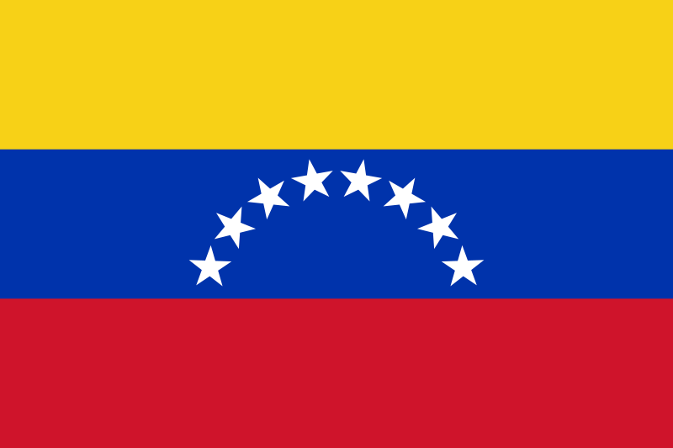
Popular Culture in Venezuela
By: Aamina Haykal

Slide 2
Intro- Venezuelan Popular Culture
Venezuelan pop culture is thriving, and they have a broad range of music, fine art, movies, and clothing.
I will be bringing Venezuela’s pop culture to life through audio samples of their music, video clips, and many pictures of their fine arts.

Slide 3
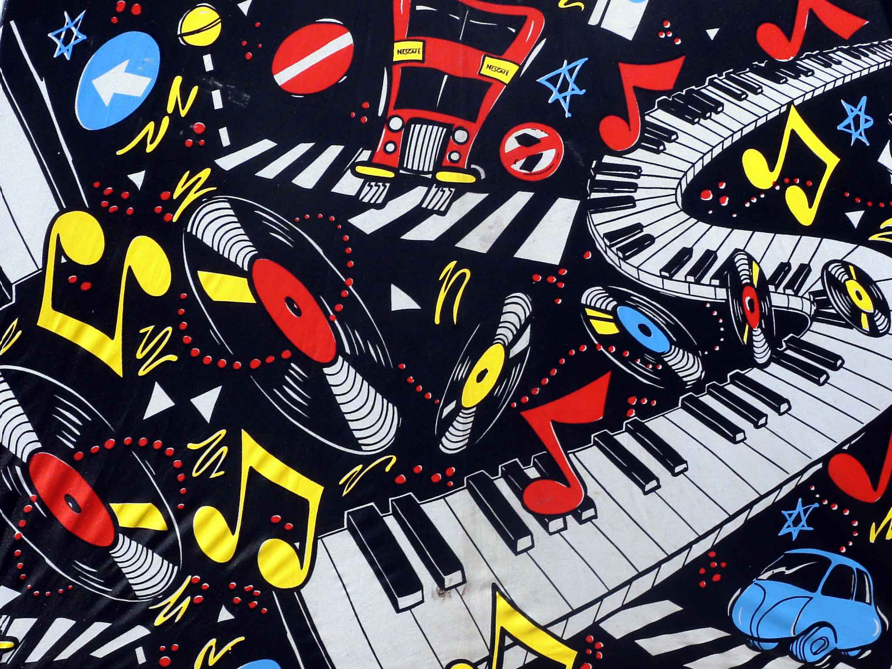
Popular Music
Venezuela

Slide 4

Popular Music
Venezuela’s different styles of music comes from their mixture of different ethnicities/cultures ranging from: African, Native Indigenous, Spanish, and even American and Caribbean.
Music is how Venezuelans express their culture. They have many genres of music ranging from their native Joropo music, to modern pop music.

Slide 5
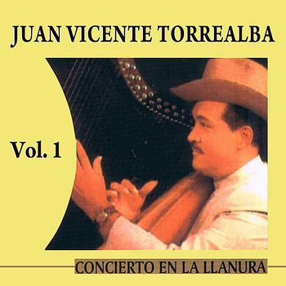
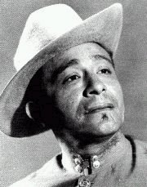
Joropo
Joropo is a music form that originated in the rural plains of Venezuela. It has African and European influences.
This music was developed by creative artists such as Juan Vicente Torrealba and Angel Custodio Loyola.
Joropo is usually accompanied by a dance that resembles the waltz. It’s considered the unofficial national anthem of Venezuela.
Angel Custodio Loyola

Slide 6
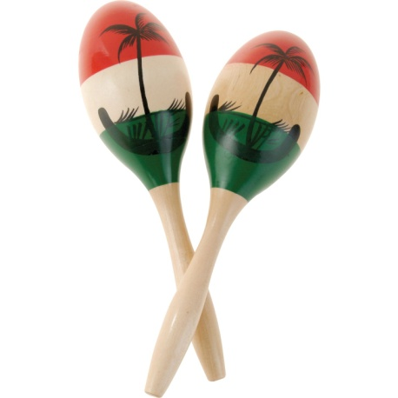
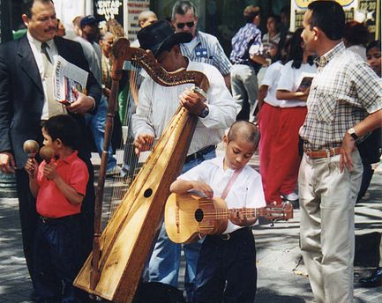
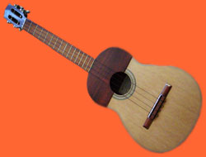
Joropo
In this photo street musicians are playing Joropo on the arpa llanera (plains harp). The harp is usually accompanied by the maracas, the bandola and the cuatro (shown on right) which are slightly smaller versions of the guitar...
Notes:
Called the cuatro because it has at least four strings

Slide 7
Video of Joropo music
http://www.youtube.com/watch?v=p3MVwbSoWcI

Slide 8
Popular Music
Pop and rock music are very popular too. There are many Venezuelan pop musicians such as Ricardo Montaner, Kiara, Karina, José Luis Rodríguez "El Puma", and Franco De Vita.
Mariah Carey is a famous singer here in the U.S and is of Venezuelan descent.

Slide 9

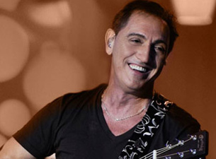
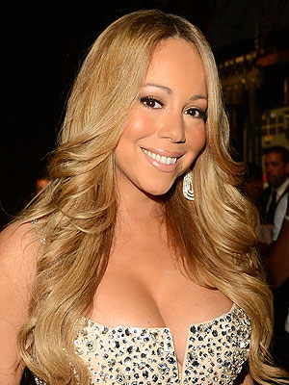
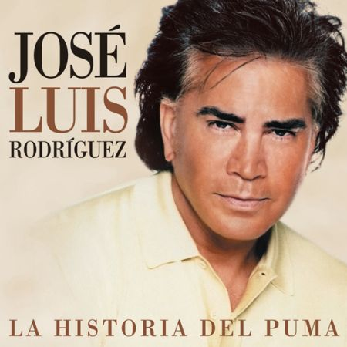
Franco De Vita
Ricardo Montaner
“El Puma”
Mariah Carey

Slide 10
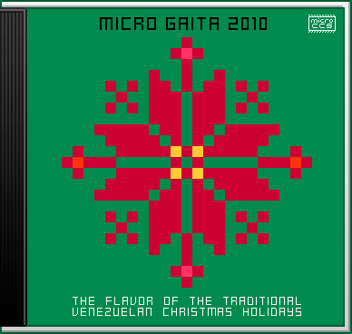
The Gaita
The Gaita is also a popular style of folk music, played generally during Christmas, and is typical of the Zulian region.
It is now known to be a national representation of the Venezuelan Christmas.

Slide 11

Salsa
Venezuela has produced one of the world's leading salsa bands, Oscar D'Leon whose music has become symbolic of salsa's tradition even in Puerto Rico and New York City, the original sources of salsa.
Caracas, Venezuela is where salsa began becoming popular in Venezuela, and is the central hub for music and culture here.
Click here for audio
Oscar D’Leon- El Sonero del Mundo

Slide 12
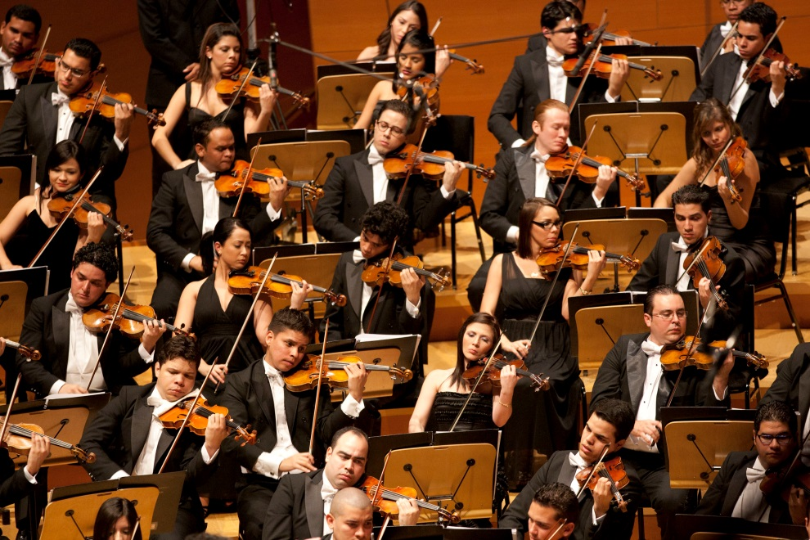
Other Types of Music
The Simón Bolívar Symphony Orchestra of Venezuela is in Caracas, and they still perform there.
The orchesta was founded by José Antonio Abreu and a group of fellow musicians, who were inspired by the ideals of Simón Bolivar, a famous figure in Venezuela.
Jazz and house music have also been popular.

Slide 13
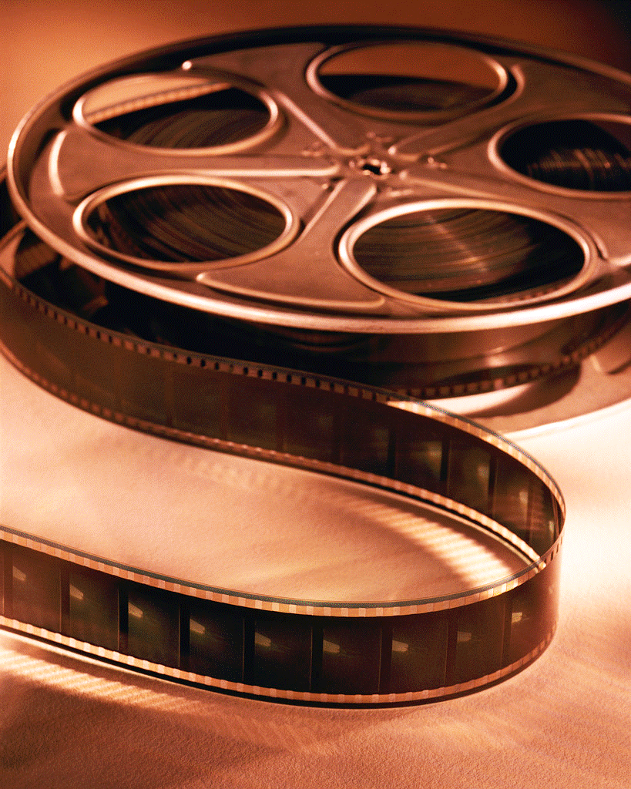
Movies
Venezuela

Slide 14

Movies
In Venezuela, they watch many of the same genres of movies and TV shows that we do. From dramas, action movies, to comedies, and romances.
The two most popular movie genres tend to be dramas and comedies.
Many of the movies and TV shows we watch in America are played in Venezuela, but in Spanish. They watch Glee, C.S.I, The Simpsons, and Indiana Jones to name a few.
Their movies are also nominated at some of the same award ceremonies Americans watch, such as The Oscars.

Slide 15

Popular movies
Hermano- Won an Oscar for Best Foreign Film in 2010
The Voice of the Heart (La Voz de Corazon)
Reverón- Won Best Movie at the Mérida Film Festival.
Secuestro Express- Which was about the safety of Venezuela, was quite successful and was based in the capital city of Caracas.

Slide 16
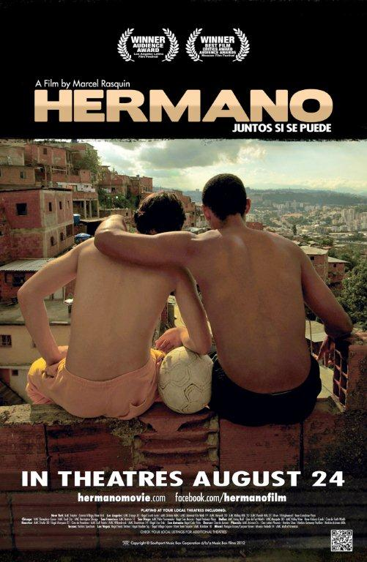
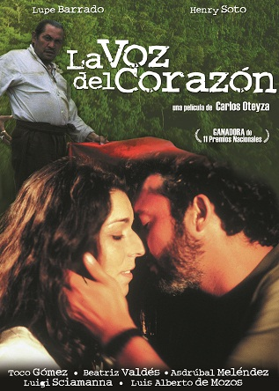
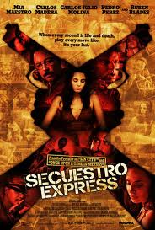

Slide 17
First Person Info on Venezuelan Movies
I got the chance to talk to a girl named Paty from Barquisimeto, Venezuela about their movie stars. In the U.S we tend to idolize our movie stars, but here they are treated like normal people.
Their actors are internationally known, and have had success in the U.S but mostly in Latin America.
Some famous actors from Venezuela are Wilmer Valderrama (Fez from That 70’s Show), Patricia Velásquez (starred in The Mummy Trilogy), and Édgar Ramírez (known for The Bourne Ultimatum, and more recently Zero Dark Thirty).

Slide 18
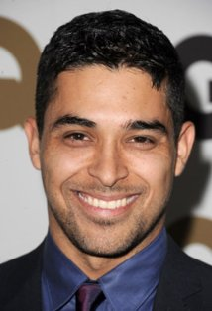
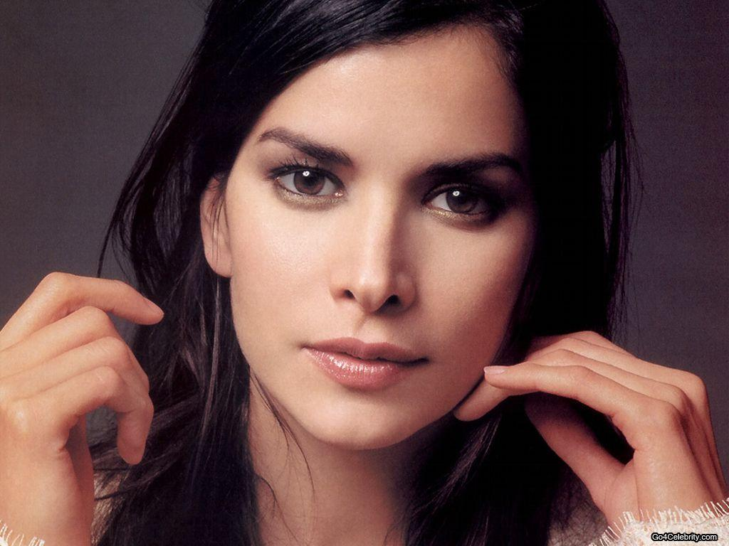
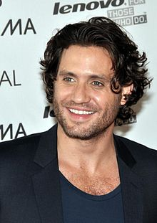
Famous Actors
Wilmer Valderrama
Patricia Velásquez
Edgar Ramírez

Slide 19
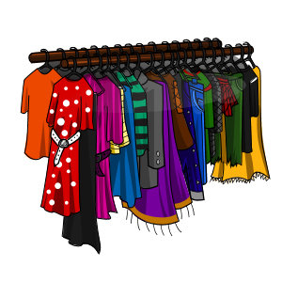
Clothing
Venezuela

Slide 20
Appearance
Venezuelans like to look and dress presentable, appearance is very important to them.
They have nice jewelry, like earrings and necklaces for women, and watches for men.
It is very important for women to “dress to impress” here. Women are very fashion conscious and dress in popular “Western” styles, which is like the clothes women wear here in America.
Venezuelans like to look stylish, fashion is important here and there is great emphasis put on women’s beauty.
Blondes(Catiras) are seen as beautiful, in Venezuela culture as well.

Slide 21
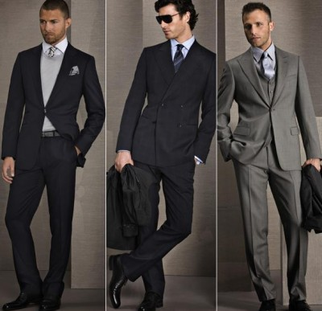
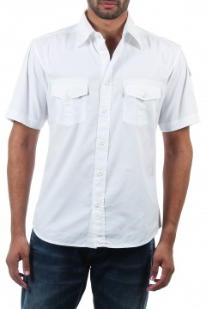
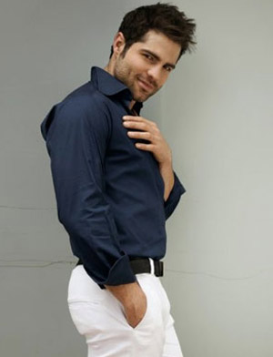
Men’s Clothing
For business wear, men dress in lightweight, dark conservative suits or shirts and trousers.
On casual days men wear lightweight white shirts and pants.

Slide 22
Women’s Clothing
When women want to dress business they wear dresses, skirts and blouses.
I talked to Karmen Kastro on livemocha.com and she said women like to wear nice jeans, a blouse, and high heels when they are hanging out or going dancing.
Women also like to wear popular clothing.
The climate in Venezuela is really warm so everyone mostly wears white shirts and blue jeans.

Slide 23
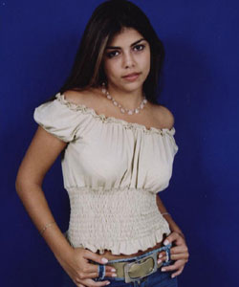
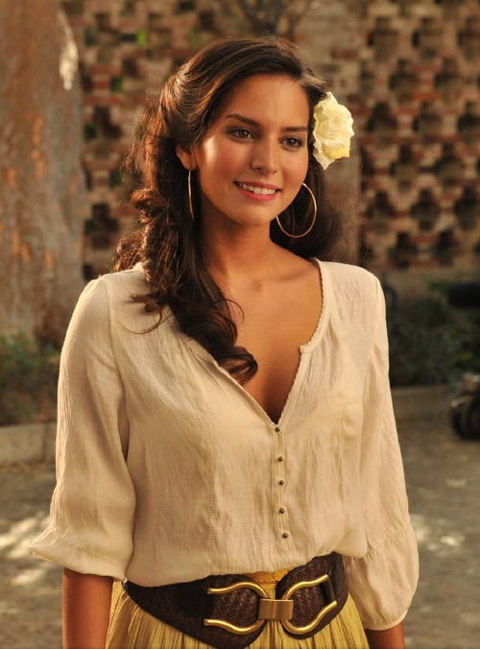
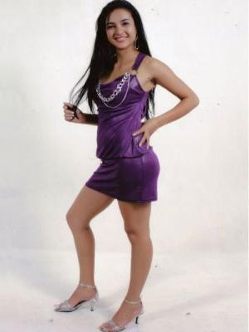
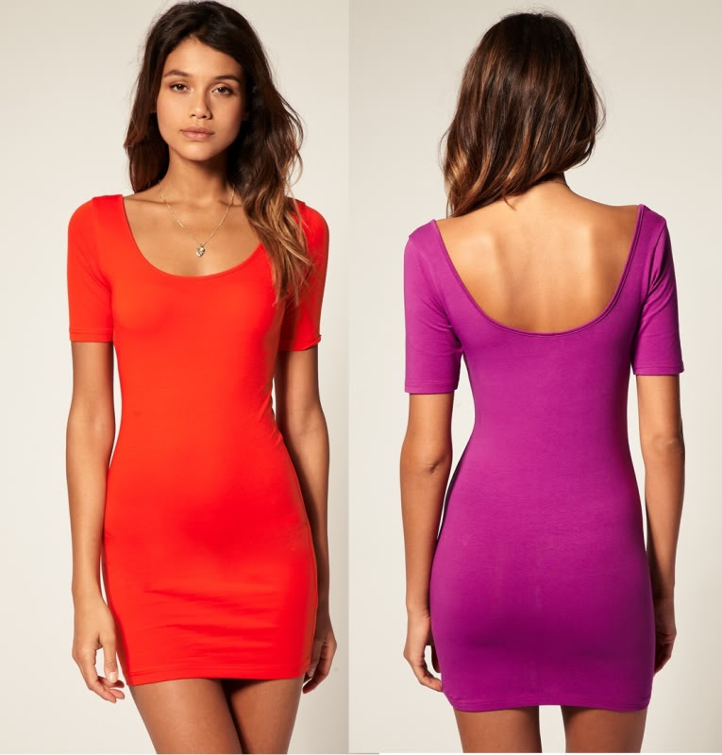
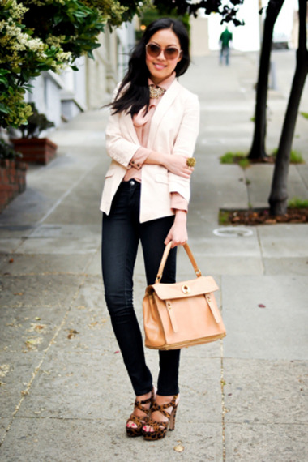
Women’s Clothing

Slide 24
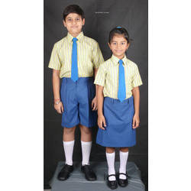

Teen and Children’s Clothing
For children and teenagers that go to school, it is mandatory that they wear school uniforms, so for most of the day that is what they wear.
A boy’s uniform consists of navy blue shorts or pants and a short-sleeved shirt colored accordingly to grade level.
A girl’s uniform usually consists of a navy blue skirt or pants along with the shirt for their grade level.
The uniform also has to have the school logo and the shield of Venezuela.

Slide 25

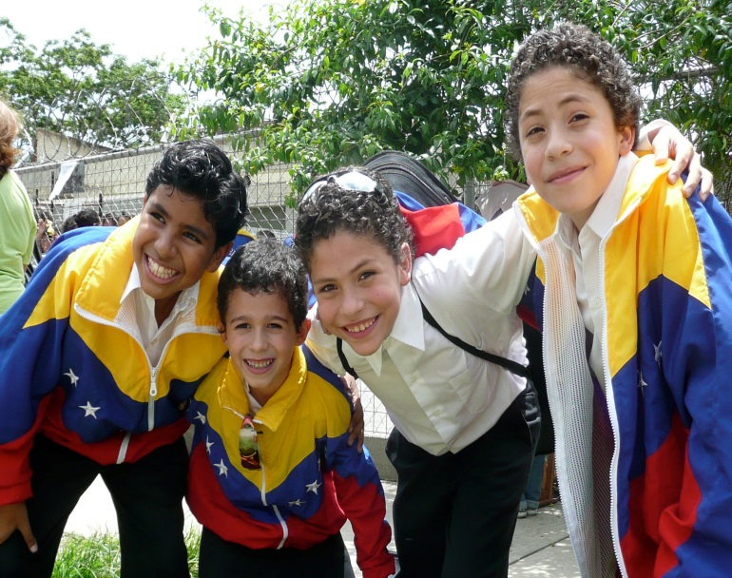

Teen and Children’s Clothing Cont.
When children and teenagers are just hanging out with friends they usually wear what we do, jeans and t-shirts.
Teens in Venezuela like to dress up more, where as here in America most teens dress casually.

Slide 26
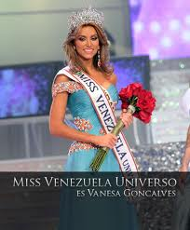
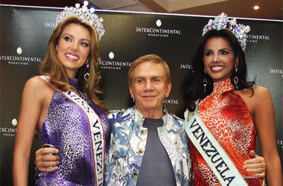
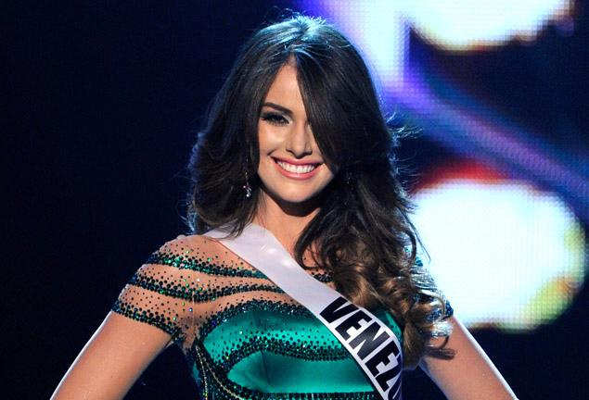
Fun Fact
Did you know that if see a Venezuelan in non-Venezuelan media, chances are that it is a gorgeous woman, probably a beauty queen?
Venezuela has been famous for winning a lot of beauty pageants and they take pride in that fact.
Venezuela has received 6 Miss World, 6 Universe, 6 Miss International, and 1 Miss Earth titles.
Miss Venezuela 2012- Irene Esser

Slide 27
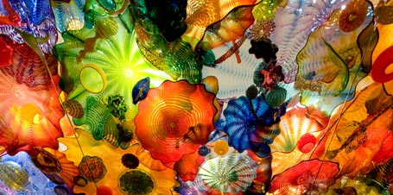
Fine Arts
Of Venezuela

Slide 28
Fine Arts
Venezuela has invested in developing and maintaining a national culture through the arts since the 1920’s.
They publicly financed the Simón Bolivar orchestra that plays not only classical genres but also the more nationalistic genre of Joropo.

Slide 29
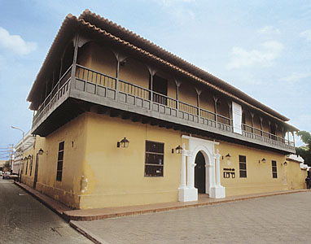
Museum’s
There are several famous museums in Caracas, Venezuela including: the Museum of Fine Arts (which was founded in 1938), the Museum of Colonial Art, the Museum of Natural Sciences (which houses over fifteen thousand exhibits), and the Simon Bolívar Museum.
Museum of Colonial Art

Slide 30
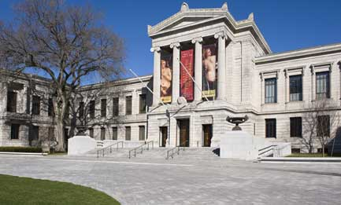
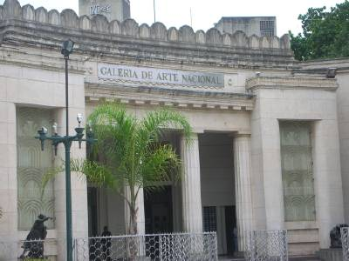
Museum of Fine Arts (Museo de Bellas Artes)
The Museum of Fine Arts, contains a variety of international and Venezuelan art. It connects with the Gallery of National Art (Galeria de Arte Nacional), one of the few museums in South America that show the national cultural identity of the country.
The gallery contains works by more than 40 contemporary and popular-art painters. Oriental ceramics, carvings made out of wood and marble, are also among the exhibits here.

Slide 31
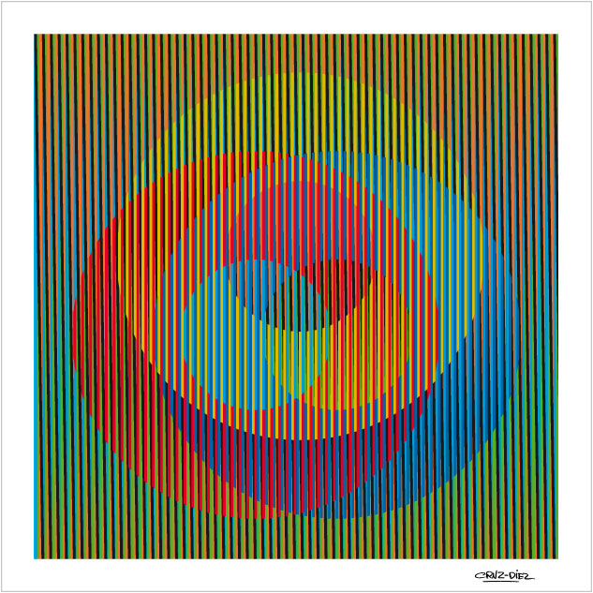
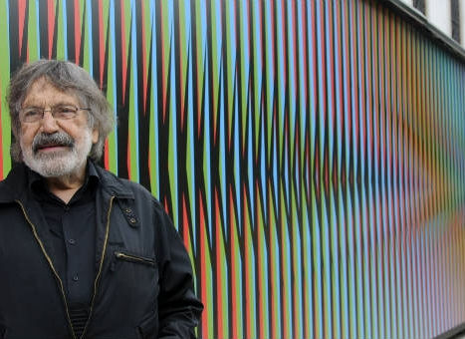
Carlos Cruz-Diez
Karmen from livemocha.com told me about Carlos Cruz-Diez from Caracas, Venezuela. He is a kinetic (art that contains moving parts) and op artist (optical illusions). He has done works in different parts of the country, for example, the floor of International Airport of Maiquetia, has his artwork on it. His style of art is very modern and popular in Venezuela.

Slide 32
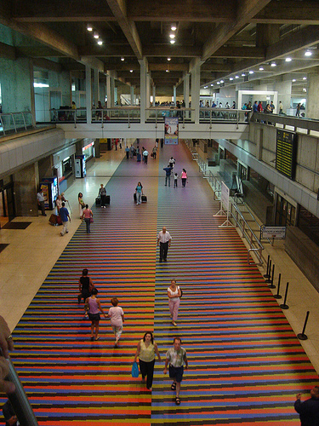
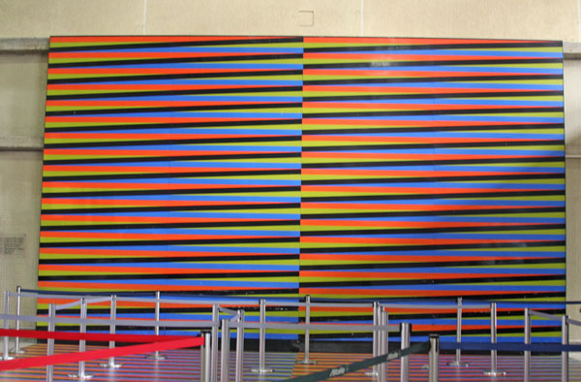
International Airport of Maiquetia

Slide 33
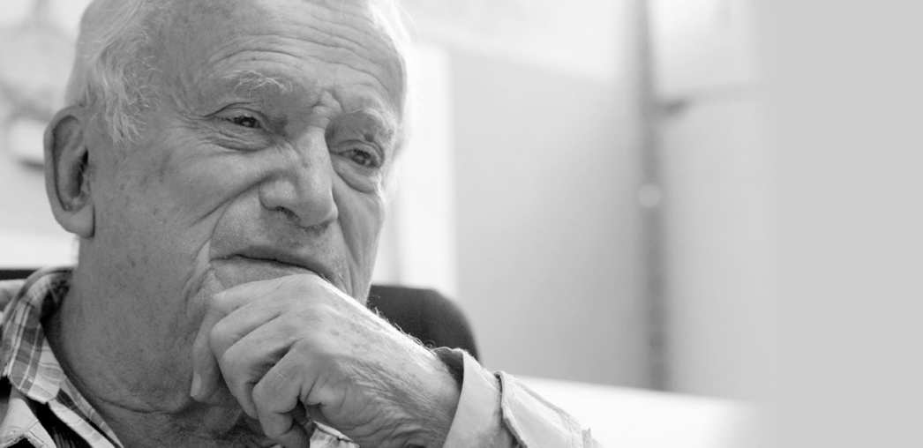
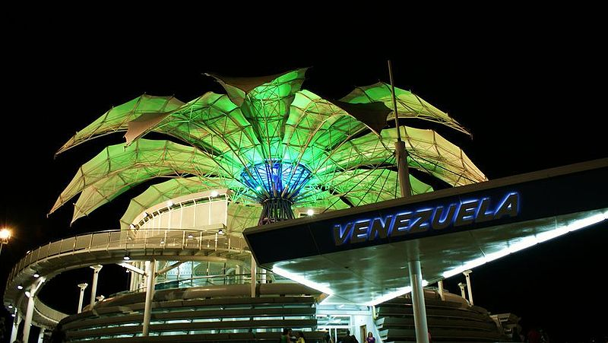
Flor de Venezuela
Karmen also told me about The Flor de Venezuela, an architectural icon for the country created by a famous architect named Fruto Vivas who lives in her hometown Barquisimeto, Venezuela.
It is a very beautiful performing arts center, surrounded by flowers and is used for concerts. It also attracts lots of tourists.

Slide 34
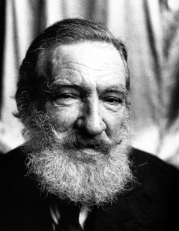
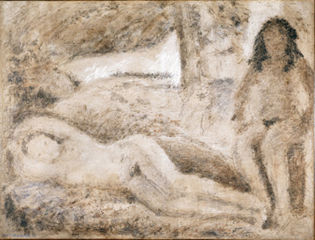
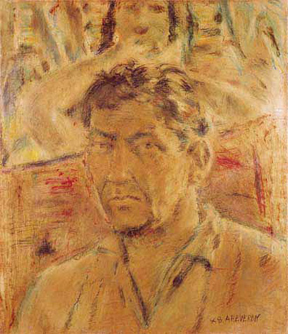
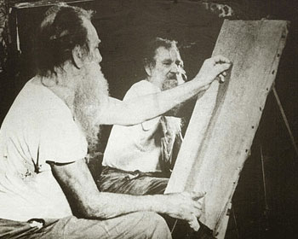
Armando Reveron
Armando Reveron, an impressionist, who has mental health issues but great artistic skill. Not only was he a painter but he was a sculptor as well.

Slide 35
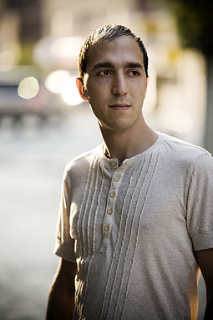
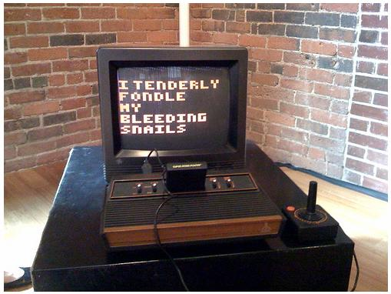
Yucef Merhi
Yucef Merhi is a poet, and artist who pioneered digital art in Venezuela.
Merhi has produced a wide range of works that use electronic circuits, computers, and other devices to present his poetry.
He created a “Poetic Clock”, a machine that converts time into poetry which generates around 86 different poems a day!
Poetic Clock

Slide 36
Conclusion- Venezuelan Popular Culture
Venezuela is full of culture and is thriving. There are many artists, actors, and singers in Venezuela. I had no idea so many famous people came from Venezuela. I enjoyed comparing and contrasting what’s popular in Venezuela versus here in America. Talking to people from Venezuela really gave me first-hand knowledge of what it’s like to live there. Venezuela takes pride in all of their musical and artistic achievements.

Slide 37
Spanish Vocabulary
Spanish | English
La Galería de Arte Nacional | The Gallery of Art
La Flor de Venezuela | The Flower of Venezuela
La impresionista | The impressionist
La poeta | The poet
Ilusión óptica | Optical Illusion
Fine Arts | Las Bellas Artes
La Catiras | Blondes
Los llanos | The plains
Joropo | Genre of music from the rural plains of Venezuela
Gaita | Venezuelan Christmas folk music

Slide 38
Citations for Information
http://en.wikipedia.org/wiki/Venezuela
http://en.wikipedia.org/wiki/Joropo
http://en.wikipedia.org/wiki/Music_of_Venezuela
http://www.everyculture.com/To-Z/Venezuela.html
http://www.youtube.com/watch?v=s6vPkfWmrgE
http://en.wikipedia.org/wiki/List_of_Venezuelan_films
http://www.viki.com/country/ve
http://www.tvguide.com/listings/
http://en.wikipedia.org/wiki/List_of_Venezuelan_films
livemocha.com
http://www.britannica.com/EBchecked/topic/207246/Museum-of-Fine-Arts
http://en.wikipedia.org/wiki/Yucef_Merhi
http://en.wikipedia.org/wiki/Armando_Rever%C3%B3n
http://www.ediplomat.com/np/cultural_etiquette/ce_ve.htm
http://tvtropes.org/pmwiki/pmwiki.php/UsefulNotes/Venezuela
http://en.wikipedia.org/wiki/School_uniform
http://en.wikipedia.org/wiki/Franco_De_Vita
http://carnaval.com/venezuela/music/

Slide 39
Citations for Pictures
http://www.colibrimusic.com/cuatro.jpg
http://chipmusic.org/forums/topic/3042/micro-gaita-2010-compilation-venezuelan-christmas-holidays/
http://www.flagsinformation.com/venezuelan-flag.png
http://www.lifemusic.org.uk/wp-content/uploads/2010/04/Umbrella-Life-Music1.jpg
http://cdn.tradebit.org/usr/mp3-album/pub/9002/493/493229/49322905.jpg
http://media.ticketmaster.com/tm/en-us/dbimages/105895a.jpg
http://img2.timeinc.net/people/i/2012/news/120723/mariah-carey-300.jpg
http://www.rctv.net/wp-content/uploads/2012/09/Ricardo-Montaner-1.jpg
http://static.musiciansfriend.com/derivates/19/001/222/806/DV020_Jpg_Jumbo_440531.162_large.jpg
http://www.askonasholt.co.uk/uploads/images/artists/simn-bolvar-symphony-orchestra-of-venezuela/NOHE5391.jpg
http://iwatchmike.com/wp-content/uploads/2012/08/Hermano-movies1.jpg
http://www.polyvore.com/cgi/img-thing?.out=jpg&size=l&tid=938196
www.teenagerjeans.com
http://gringoadrift.files.wordpress.com/2010/07/p10307661.jpg

Slide 40
Citations for Pictures
http://t0.gstatic.com/images?q=tbn:ANd9GcRQCL2e8OO61mAJTfqkscqXvgehydGw9QGROopWOG8Hro-iq9T
http://www.viki.com/channels/3286-la-voz-del-corazon
http://ia.media-imdb.com/images/M/MV5BMTk3MjQ3MTEyOF5BMl5BanBnXkFtZTcwMDQxMDExNA@@._V1._SX214_CR0,0,214,314_.jpg
http://www.marapets.com/rack.php
http://tvtropes.org/pmwiki/pmwiki.php/UsefulNotes/Venezuela
www.informativovenezuela.com
http://www.theboogaloo.org/2011/07/01/most-prestigious-fashion-brands/
http://www.outletwise.com/uploads/product/front_img/Half-Sleeves-Two-Chest-Pocket-White-Shirt-3.JPG
http://venezuelaladies.com/sitebuildercontent/sitebuilderpictures/a01.jpg
http://25.media.tumblr.com/tumblr_mdzbifzuR61qk6icno1_500.jpg
www.ebay.co.uk
http://3.imimg.com/data3/GQ/XL/MY-6471698/school-uniform-shirting-fabric-250x250.jpg
http://www.vmfa.state.va.us/uploadedImages/VMFA/Exhibitions/2012/Chihuly/04_2749_deYoung_TNR_455.jpg
http://gregcookland.com/journal/uploaded_images/picMFA2009-718946.jpg

Slide 41
Citations for Pictures
http://media-2.web.britannica.com/eb-media/81/20481-004-6C7B5FFF.jpg
http://fashioninsideout.co.uk/wp-content/uploads/2012/11/airport5.jpg
http://farm1.static.flickr.com/113/304400371_31a46c6d2e.jpg?v=0
http://upload.wikimedia.org/wikipedia/commons/thumb/e/e0/Flor_de_venezuela_barquisimeto_lara.jpg/800px-Flor_de_venezuela_barquisimeto_lara.jpg
http://2.bp.blogspot.com/_67LSfsUS06Y/TFeE7ZW_7RI/AAAAAAAAACY/9vF5EPmM91Q/s1600/fruto-vivas.jpg
www.artexpertswebsite.com
http://twi-ny.com/armandoreveron1.jpg
http://mbf.blogs.com/.a/6a00d83451ba1e69e20120a567f14e970c-800wi
http://3.bp.blogspot.com/_Ad8KgPpHLbg/R9m4KiTVLJI/AAAAAAAAACQ/41cHehmrXC8/s400/Loyola.%2BAngel%2BC%5B1%5D.jpg
www.tradebit.com
http://universalmedios.com.ar/sitios/wp-content/uploads/2013/01/jose_luis_rodriguez_el_puma_5264jpg.jpeg

