Slide 1
Amusement in Venezuela
By: Morgan Green

Slide 2
Recreation in Venezuela
There are several famous festivals you can attend in Venezuela.
Carnaval is a yearly nationwide event that lasts for several days and begins just before Ash Wednesday.
On the Holiday of Corpus Christi, there is a dramatic “Dance of the Devils” in the town of San Francisco de Yane, where people parade the streets in costumes and masks.
Venezuelans are very fond of traveling to take part in these festivals.

Slide 3
Recreation
Venezuelans enjoy visiting National Parks. For example, Angel Falls- the tallest waterfall in the world.
In major cities, there are night clubs and discos.
Lots of Venezuelans do crafts for fun, including, pottery, baskets, hammocks, and rugs.

Slide 4
Things to do in Venezuela
Angel Falls
Cable Car-the world’s longest and highest cable car
Caracas
Colonial Tower
Cordillera de Merida
Coro
Cueva del Guacharo
Deep sea fishing
Isla de Margarita
Maracaibo
Merida
Mount Roramia
Mountain Trekking
Parque Nacional Ciengas del Catatumbo

Slide 5
Sports in Venezuela
Soccer is the national passion in Venezuela. It is considered their national sport, but most Venezuelans find their passion in baseball.
In coastal areas, water sports like, swimming, boating, and fishing are very popular.
In the grassy plains, known as Los Llanos, horseback riding is popular.
Fine equestrians take part in colorful rodeos known as toros coleados, in which they compete to bring a bull down by grabbing its tail while riding a horse at top speed.

Slide 6
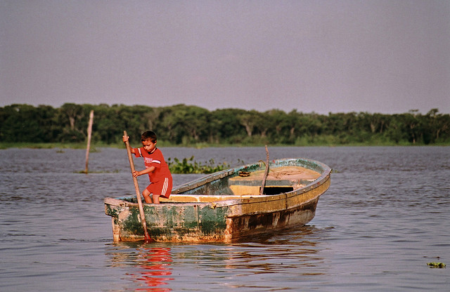
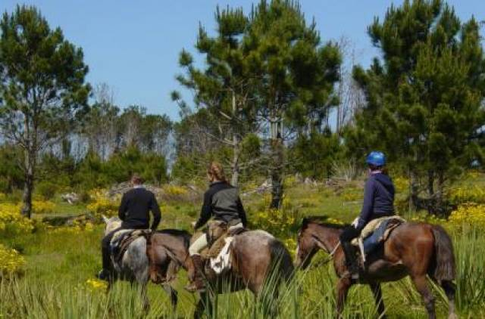
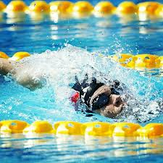
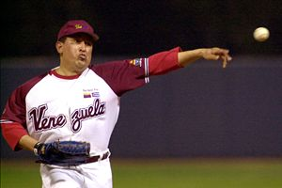
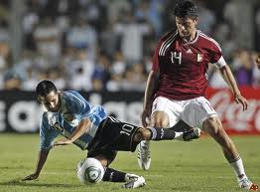
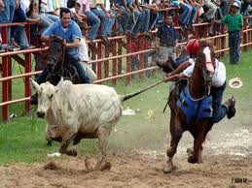
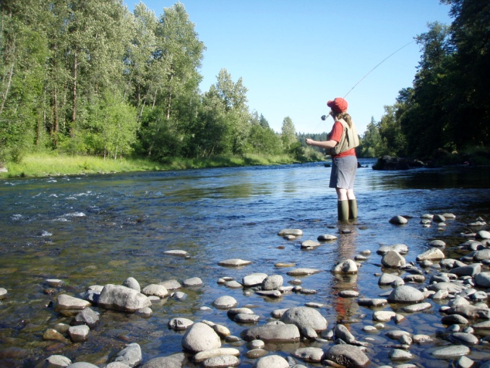

Slide 7
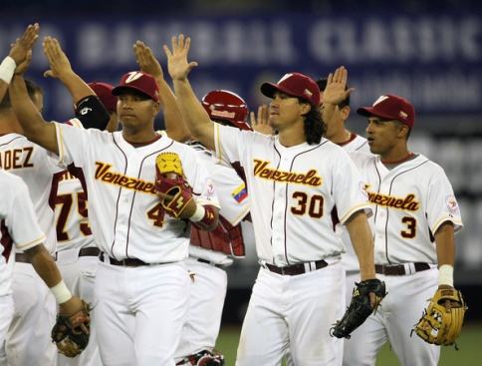
Baseball
The game of baseball was introduced to Venezuela by Venezuelan students who were studying at American Colleges.
The Venezuela national baseball team won the Baseball World Cup several times in the 1940s. Professional baseball began in Venezuela in 1927. The first Venezuelan to play in the Major Leagues was Alejandro Carrasquel, who was a pitcher. He appeared for the Washington Senators on April 23, 1939.

Slide 8
Facts about Baseball in Venezuela
Over 200 Venezuelans have played a part in Major League Baseball. Venezuelan teams have won the Caribbean Series multiple times and they have finished 7th in the Inaugural World Baseball Classic and 3rd in the 2009 event.

Slide 9
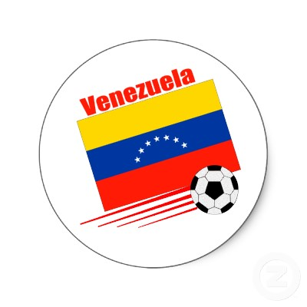
Soccer
Soccer in Venezuela is very popular, but has been slower to develop, because of less interest. Venezuela is the only South American team that has never made it to the World Cup finals.
The Federacion Venezolana de Futbol was established in 1926. Professionalism for the sport wasn’t established until 1957
The Venezuela national soccer team played their first game in 1938. Venezuela didn’t participate in World Cup qualifying until the 1966 qualifiers.

Slide 10
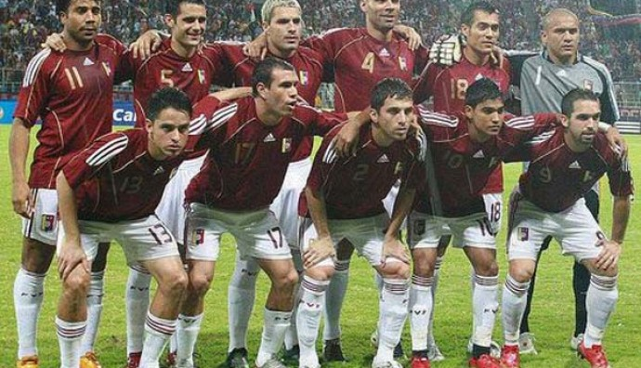
Facts about Soccer
At the beginning of 2010 during qualifying, the team won their first game in the World Cup against Ecuador. Venezuela first participated in Copa America in 1967, and finished 5th.
The overall Copa America record for Venezuela is fairly poor. At the 2011 Copa America Championship, Venezuela reached the semi-finals for the first time.

Slide 11
Popular Vacation Spots
One of the most popular vacation spots is Canaima National Park. This national park is the second largest in the country and is bigger than the state of Maryland. This park features the famous Angel Falls. Another famous vacation hot spot is Margarita Island. Margarita Island is the largest island in Venezuela. Higuerote is one of the most popular spots for vacation in Venezuela. It’s known for its rich history and great nightlife.

Slide 12
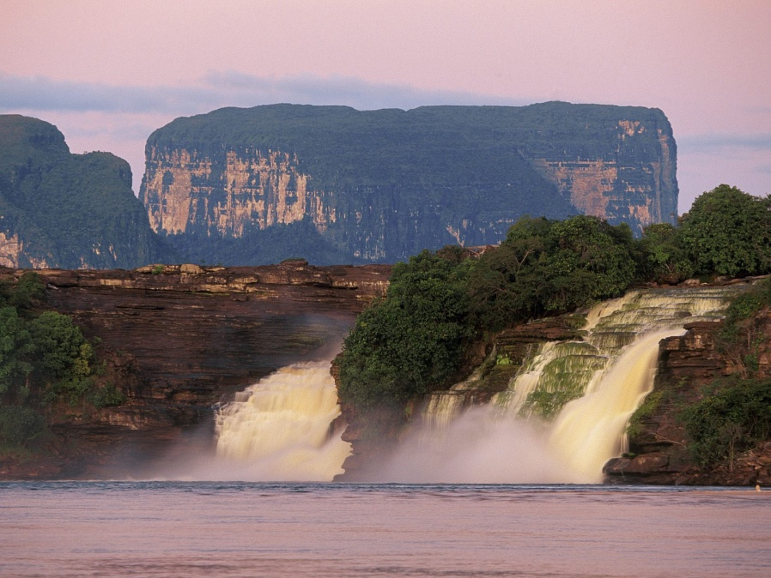
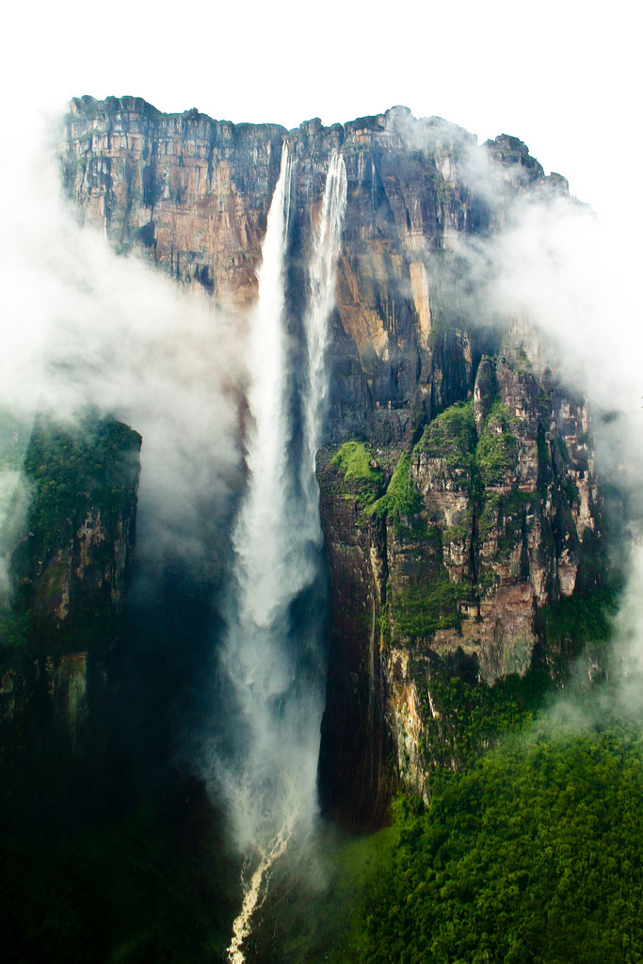
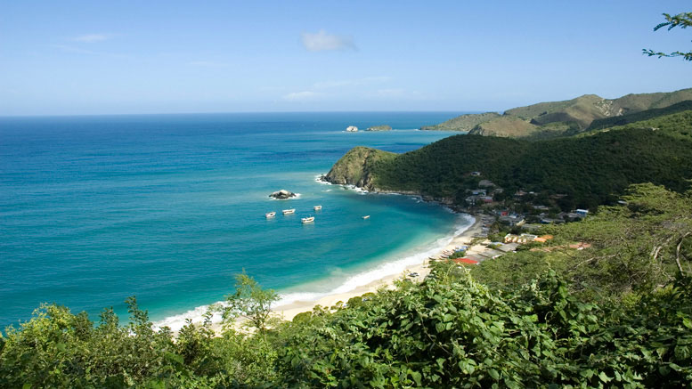
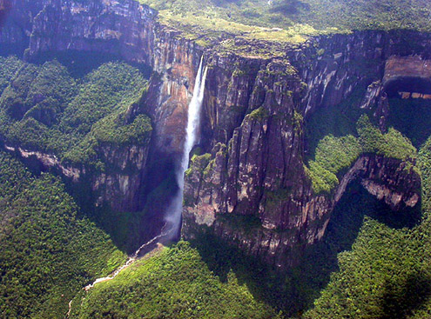
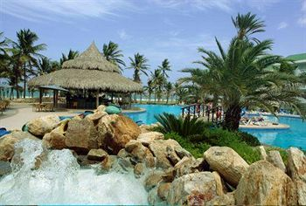
Canaima National Park, Angel Falls, Margarita Island

Slide 13
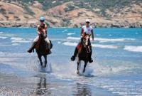
Major Attractions
One major attraction is Caribbean Horseback riding on Margarita Island. You get to discover the beauty of the whole island of Margarita Island on horseback.
Another major attraction in Venezuela is Cave Hiking in Cueva del Guacharo. Cueva del Guacharo was established as Venezuela’s fist national monument in 1949.
Oilbirds or guacharos, which are fruit eating animals that are mainly nocturnal, have been seen here. Lots of people go to the chambers at night to watch the birds leave the caves and search for food.

Slide 14
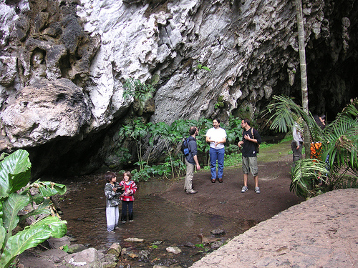
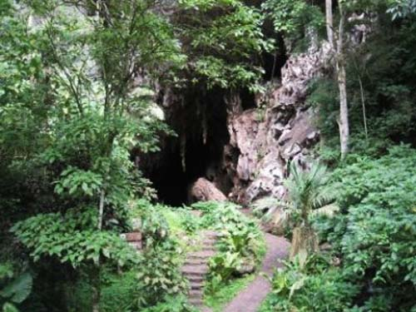
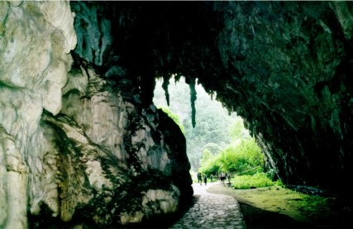
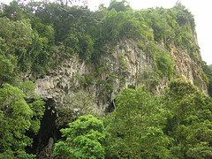
Cave Hiking in Cueva del Guacharo

Slide 15
Major Attractions
You could also do a river trip and sight-seeing at Angel Falls. Angel Falls was discovered in 1933 by Jimmie Angel. It’s the tallest waterfall in the world at 3,212 feet. You can reach Angel Falls by flight from Caracas and from there you take a river trip to the waterfall.
Another thing that is a big attraction is Cable Car riding in Merida. It’s the longest and highest cable car and it’s set over Venezuela’s terrain. The system was first used in the 1950’s for tourists. The track is just less than 8 miles going over the jungles, canyons, rock faces, and waterfalls of Venezuela.

Slide 16
Most popular thing to do in Venezuela
The most popular thing to do in Venezuela is the river expedition on the Orinoco Delta. Boats are used to get as far possible within the delta. When you can’t pass through any farther, you then use dug out canoes. You can see many native animals. Jungle walks are also organized along with boat trips for expeditions at night and piranha fishing.

Slide 17
Stores in Venezuela
Venezuela is home to many stores, markets, and malls. Venezuela is also home to the Centro Comercial Sambil, which is said to be South America’s largest shopping mall. Venezuela stores are just like the stores that we have in the United States. They have bookstores, chocolate shops, retail stores, electronic stores, office equipment and office supplies stores, candy stores, craft shops and grocery stores. I found that even though Wal Mart operates in 14 countries, there are not any Wal Marts in Venezuela. The main grocery stores that are in Venezuela are markets. Some popular grocery stores are Makro, Automercado Plaza, and Central Madeirense.

Slide 18
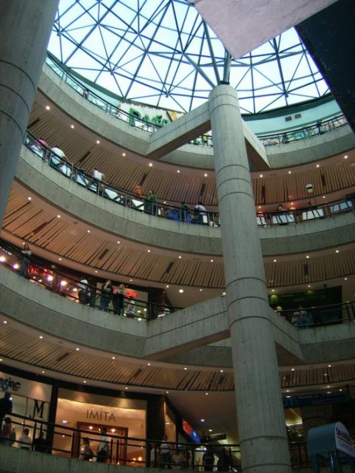
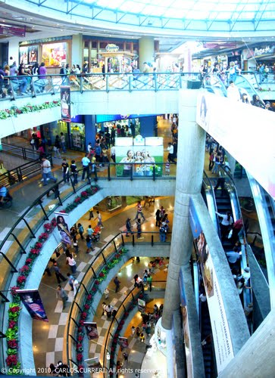
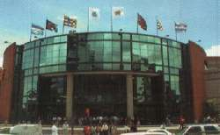
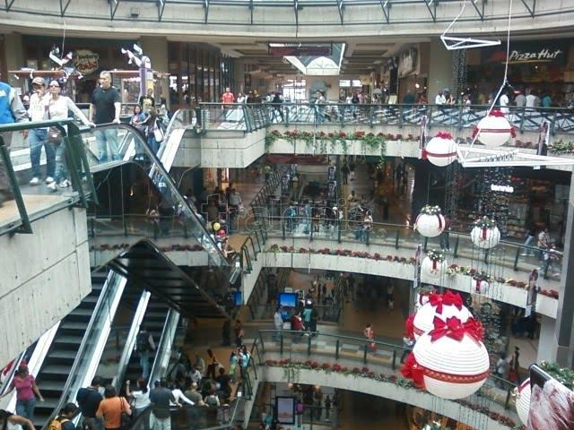
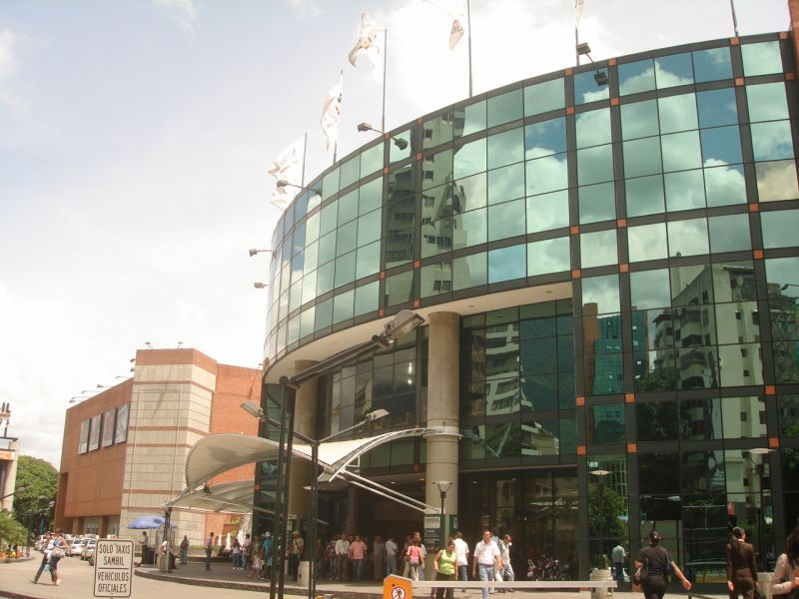
Centro Comercial Sambil

Slide 19
Live Mocha
Shoyree
Paul F.
She says that Venezuelans don’t need much to have fun. But, when they want to have fun they call friends and plan where to go and meet. The favorite spots her and her friends like to hang out are the rivers, beaches, parks, forests or just a friend’s house. Whenever her and her friends get together they have food, music, singing, dancing, and many jokes.
He says that most Venezuelans love to go to all the many beaches that Venezuela has to offer. He said most like to go to Margarita Island or Los Roques. He also said that there are nice national parks and caves to explore, for example: Henri Pittier National Park, Guacharo's Cave, Canaima, The Angel Falls, and Los médanos de coro. He said that his favorite activities are going to the disco at night because most Venezuelans love to party, and he also enjoys going to the Sambil Mall, the biggest mall in Venezuela.

Slide 20
Vocabulary Words
Teleferico –Cable Car
Cuatro- A small guitar from the lute family
Grandes Ligas de Beisbol- Major League Baseball
Copa del Mundo- World Cup
Paseos a Cabello- Horseback riding
Cueva Senderismo-Cave hiking
Expedicion-Expedition
Pirana-Piranha
Guacharos-Oilbirds
Toro Coleados-Colorful rodeos

Slide 21
Citations
http://www.traveladvisortips.com/top-10-venezuela-vacation-spots/
http://www.everyculture.com/wc/Tajikistan-to-Zimbabwe/Venezuelans.html
http://www.worldtravelguide.net/venezuela/things-to-do
http://www.moving2venezuela.net/facts-and-stats/culture.html
http://www.britannica.com/EBchecked/topic/625197/Venezuela/32736/Sports-and-recreation
http://traveltips.usatoday.com/traditions-caracas-venezuela-100375.html
http://venezuela.zeezo.com/clothing.htm
http://www.ask.com/wiki/List_of_supermarket_chains_in_South_America
http://www.baseball-reference.com/bullpen/History_of_baseball_in_Venezuela
http://www.worldsoccer.com/blogs/venezuelan-football-a-brief-history
http://en.wikipedia.org/wiki/Baseball_in_Venezuela
http://en.wikipedia.org/wiki/Football_in_Venezuela
http://en.wikipedia.org/wiki/Venezuela_national_football_team
http://voices.yahoo.com/the-top-five-most-interesting-exciting-things-5702352.html
www.livemocha.com

