Slide 1
Venezuela: Food
By: Courtney Walters

Slide 2
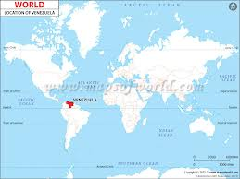
All About Food!
based on French, Italian, Spanish, and African descent

Slide 3
All About Food!
Breakfast
Small pastry/toast
Coffee or tea
Lunch
Biggest meal
Best time to eat out
Dinner
Usually a small snack

Slide 4
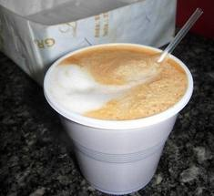
Venezuelan Coffee

Slide 5
All About Food!
cook meals called Arepas
made by flour and filled (usually) with ham, cheese and butter, but you can fill it with whatever you got and of course, sauces.
Patacon.
made with plantains. You crush it and fry two of them. Between both, fill with chicken, meat, vegetable and sauce

Slide 6
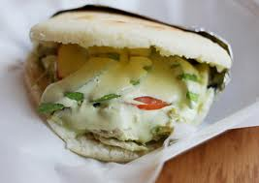
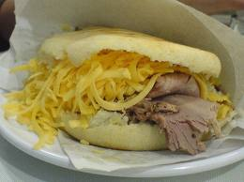
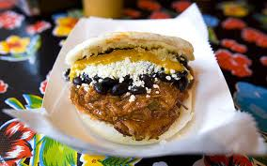

Slide 7
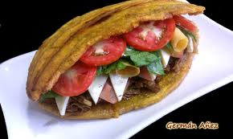
The patacon is referencing the fried plantain located on the outside of the dish.

Slide 8
All About Food!
Breakfast
eggs, bread, arepas, cereal or pastelitos.
Lunch
rice, chicken, meat, plantain, pasta, spaghetti, soup, caldo de pollo
Dinner
arepas, bread, hamburger, pasta, pizza, patacon.

Slide 9
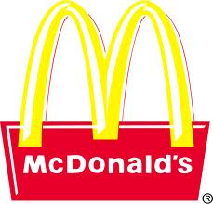
All About Food!
Eat in fast-food restaurants
like McDonald’s, but on the streets or in the mall on weekends.
For special occasions, they don’t cook at home. Instead, they go to luxury restaurants.

Slide 10
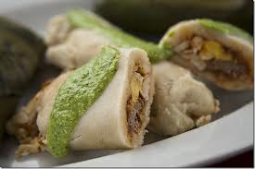
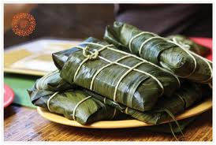
All About Food!
Christmas
hallacas with ham, bread, and some salad
The Hallacas are wrappped in plantain leaves.

Slide 11
All About Food!
They are pretty relaxed about the time that they eat and, as long as they eat lunch together, they eat their meal whenever it pleases them.

Slide 12
Food Staples!
Corn
Rice
Sugar
Plantains
Beans
Yams

Slide 13
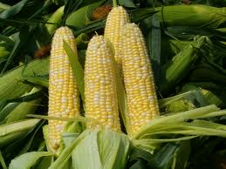
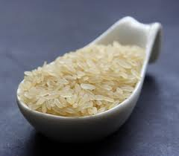
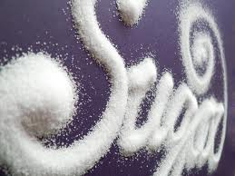
Food Staples!
corn
rice
sugar

Slide 14
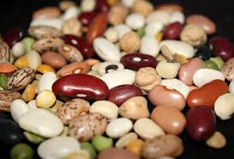
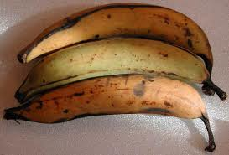
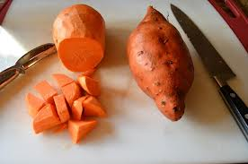
Food Staples!
beans
plantains
yams

Slide 15
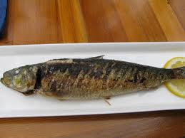
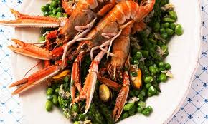
Food Staples!
Fish and Shellfish are traditional foods

Slide 16
Current Day Food!
Lately- food shortages, due to possible hoarding
Troubles finding staples such as corn and sugar
Food being confiscated for being “overpriced
This is because of Chavez and his government policy of “gaining more money for a better society.”

Slide 17
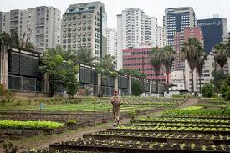
History of Food!
Had lots of sea food so they didn’t rely on cultivated farming, though it was practiced
Europeans brought African slaves- African mix to foods.

Slide 18
History of food!
The arrival of Christopher Columbus brought a Spanish influence to the food, more spices were used because they were used to trade- also the idea of cattle farming was introduced and they began to start using beef in their diet.
Hacienda- cattle farm

Slide 19
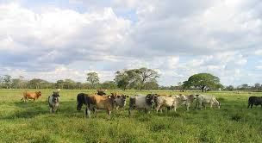
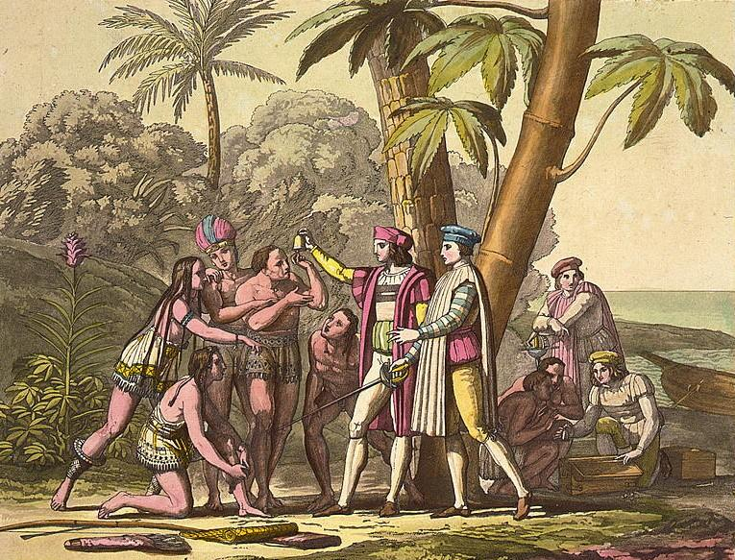

Slide 20
Current Day Food!
Chicken and beef are most everyday foods
only eat pork on holidays.
eat the abundance of locally grown fruit and vegetables and center many meals around it.
largest meal that they eat is eaten between noon and three and they eat a light supper around eight.

Slide 21
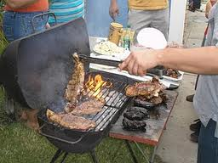
Venezuelan food is mostly fried and baked or grilled.
Most of their food is simple and very well flavored.

Slide 22
Women!
the mother and youngest will cook and prepare the food.
The women very much rely on their daughters to help them with the chores and the process that encompasses making the food.
They rely on the gardens and farms, which the women tend to and harvest.

Slide 23
Images Bibliography
http://environment.nationalgeographic.com/environment/photos/urban-farming/
http://evidencebasedliving.human.cornell.edu/2012/10/the-evidence-on-arsenic-and-rice/
http://www.deliciousobsessions.com/2011/03/sugar-the-secret-killer-part-1-addiction/
http://sekapporchard.com/shop/sweet-corn/
http://www.serenabakessimplyfromscratch.com/2012/06/skinny-mashed-yams.html
http://brghealth.com/national-eat-beans-day/
http://www.all-creatures.org/recipes/i-plantain.html
http://www.hirokoskitchen.com/blog/2011/09/
http://www.guardian.co.uk/lifeandstyle/2012/may/20/queens-diamond-jubilee-seafood-recipes
http://www.whats4eats.com/breads/arepas-recipe
http://vpcollege.blogspot.com/2007/05/grill-with-family-before-leave.html

Slide 24
Images Bibliography Cont.
http://www.annarbor.com/entertainment/marcanos-take-out-review/
http://newyork.metromix.com/restaurants/standard_photo_gallery/savory-latin-pastries-in/1767432/photo/1767640
http://naciendoenholanda.blogspot.com/2011/12/navidad-la-holandesa.html
http://craigsgrapeadventure.blogspot.com/2011/12/hallacas-venezuelan-christmas-tradition.html
http://yumit.com/chefvergatario/yums/14292
http://logoshistory.blogspot.com/2011/05/mcdonalds-history.html
http://venezuelanfoodanddrinks.blogspot.com/2009/05/guayoyo-o-tetero-flaco-venezuelan.html
http://all-history.org/256.html

Slide 25
Bibliography
http://web.li.gatech.edu/~rdrury/500/writing/sp2_04/casa/mexvenfood.htm
http://www.kwintessential.co.uk/resources/global-etiquette/venezuela-country-profile.html
www.livemocha.com
http://www1.broward.edu/~mhillerb/EAP0485/food_culture.htm
http://suite101.com/article/venezuelan-food-and-drink-a28334
http://www.yorkdispatch.com/ci_22375397/venezuela-struggles-sporadic-food-shortages?source=most_viewed
http://www.recipes4us.co.uk/Cooking%20by%20Country/Venezuela.htm
http://ezinearticles.com/?Traditional-Food-in-Venezuela---Amazing-Variety&id=1737948
http://en.wikipedia.org/wiki/Yanomami_women
http://www.southamerica.cl/Venezuela/Food.htm

