Slide 1
Venezuela Education
By Deeanna Welling

Slide 2
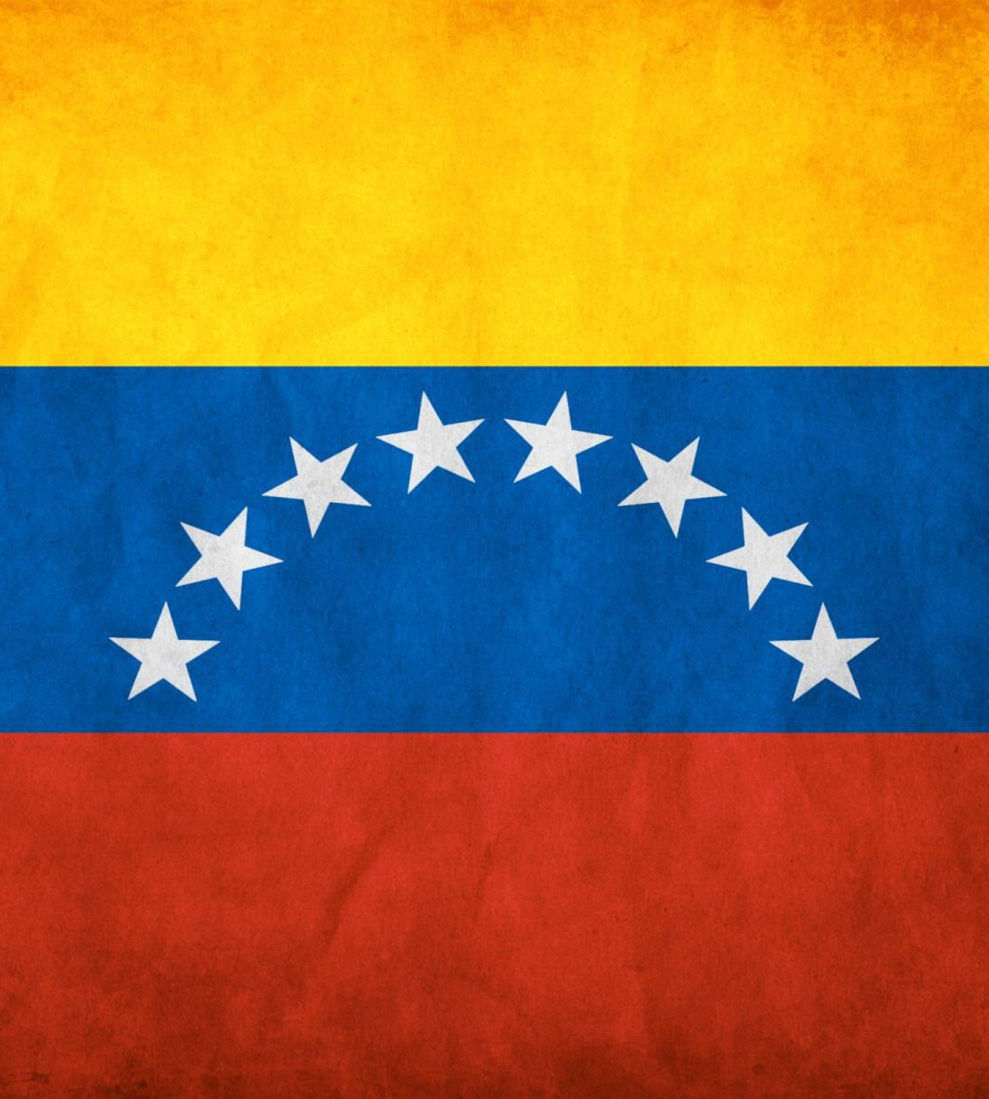
The Venezuelan flag
The standard of education in Venezuela is among the highest in the region.
Although the Venezuelan education system is overextended and underfunded, the Venezuelan government remains committed to the idea that every citizen is entitled to a free education.

Slide 3
Education
Venezuela's education system, as measured by the number of schools, teachers, and size of the enrollment,
Of Venezuelans aged 15 and older, 93.4% can read and write, one of the highest literacy rates in the region.
The literacy rate in 2003 was estimated to be 93.8% for males and 93.1% for females.
Public and private schools are subject to supervision by the Ministry of Education, Culture and Sports.

Slide 4
Education
Basic education consisted of nine years of compulsory schooling for children six to fourteen years of age.
Many children under five attend a preschool.
Children are required to attend school from the age of six.
They attend primary school until they are eleven.
They are then promoted to the second level of basic education, where they stay until they are 14 or 15.
Public school students usually attend classes in shifts.

Slide 5
Education
Nine years of education are compulsory education.
The school year extends from September to June-July.
Some go to school from early in the morning until about 1:30pm and others attend from early afternoon until about 6:00pm.
The student population and the education budget have increased, but many children do not attend school because of poverty.
Although education is mandatory for children, some poor children do not attend school because they must work to support their families.

Slide 6
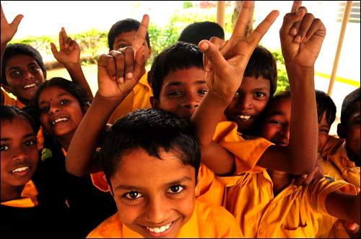
Education
All schoolchildren wear uniforms.
They are forced to wear uniforms, because Venezuelans believe that it will improve academic performance and student attitudes.
Each school in Venezuela has to have a uniform with its respective symbol and flag.
Students who don’t wear the correct uniform are asked to go home and change.

Slide 7
Education
A good example I have found would be that, in kindergarten, kids have to wear a red shirt with blue pants, in middle school they have to wear white shirts with dark blue pants, and in high school, students have to wear dark blue pants with a sky blue shirt or beige shirt.
For those continuing their education, the system offered two years of diversified academic, technical, and vocational study at a senior high school, which could be followed by various types of higher education--junior college, university, or technical institute

Slide 8
Live Mocha
On the website, livemocha.com, I have made a friend named Abel Alejandro, and he has told me all about his the education system in his home town Venezuela.
At first he told me that it was very boring, and he really didn’t like school.
Then he told me that in their first years of schooling, they first go to preschool for four to six years, called a castellano, after that they go to what they call a bachidrato for five years.
Then if they do well in school, and pass all of their classes they can go to college at the age of sixteen, all for free!
My friend Abel Alejandro wanted me to tell everyone that he says hi, and that he is willing to answer any questions you have about his country. ☺

Slide 9
College
The best-known and oldest university was the Central University of Venezuela, in Caracas.
Many of the country's political leaders received their education there, and several of the political parties began as student groups on the Central University of Venezuela's campus.
To the west, Maracaibo was the site of the private Rafael Urdaneta University and the public Zulia University.
The public University of the Andes was located in Mérida. Carabobo University in Valencia, Eastern University (Universidad de Oriente) in Sucre, and Midwestern University (Universidad Centro- Occidental) in Barquisimeto were all public universities.

Slide 10
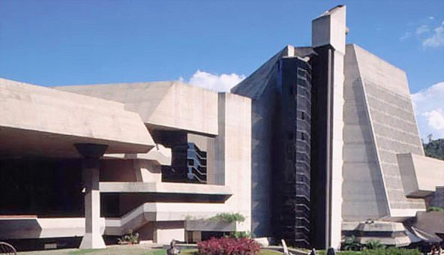
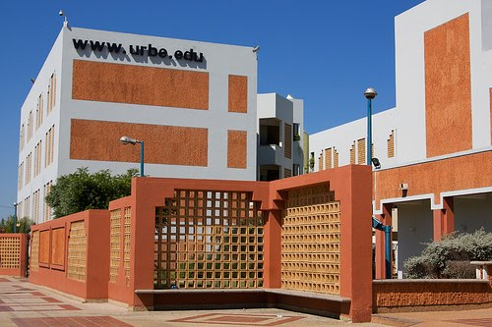
College
Central University of Venezuela
Rafael Urdaneta University

Slide 11
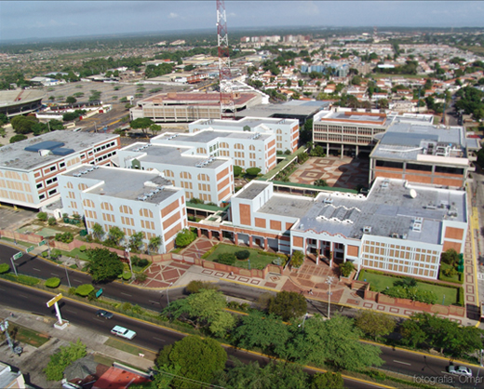
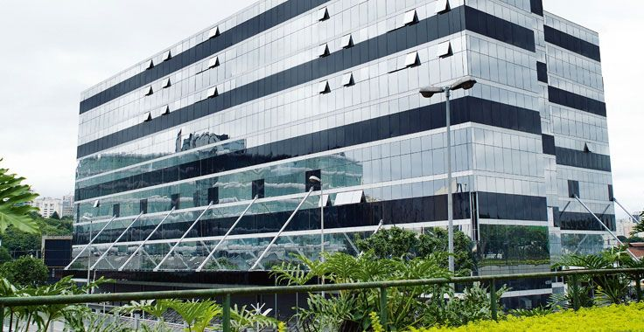
College
Zulia University
University of the Andes

Slide 12
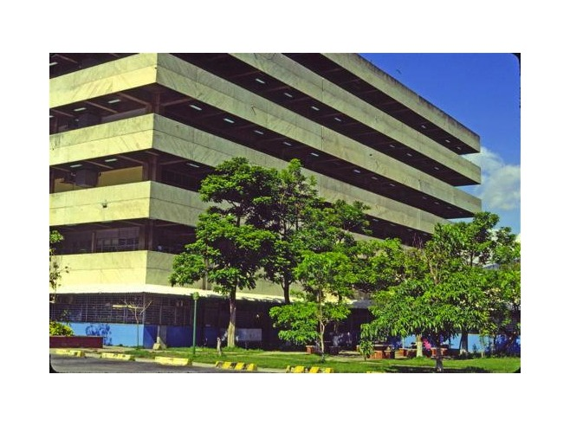
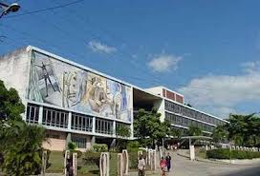
College
Carabobo University in Valencia
Eastern University (Universidad de Oriente)

Slide 13
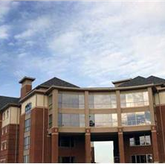
Midwestern University (Universidad Centro- Occidental)

Slide 14
College
These institutions are grouped in two sub-systems: Institutes and University Colleges, mainly for short courses of study (2 1/2 to 3 years) and Universities, mainly for long courses of study (five or six years), leading to the award of the Licenciado or to an equivalent professional title such as Engineer.
Courses of study are Basic Sciences, Engineering and Technology, Agricultural and Marine Sciences, Health Sciences, Social Sciences, Education, Humanities, Art and Letters, and Military Sciences.

Slide 15
College
Students generally take a national test before they are selected to a particular university or career.
Some departments offer independent admission tests beyond the national test, prueba de aptitud académica
The grading system is on a scale from 1 to 20. The minimum passing mark is 10, and the maximum is 20.
Some experimental institutions have a 1 to 5 grading scale, others a 1 to 9 grading scale.

Slide 16
College
Higher education institutions are traditionally divided into Technical Schools and Universities.
Technical schools award the student with the tile of Técnico Superior Universitario or Licenciado after completing a three-year program.
Universities award the student with the title of Ingeniero after completing a five-year program.
Some higher education institutions may award Diplomados but the time necessary to obtain one varies.

Slide 17
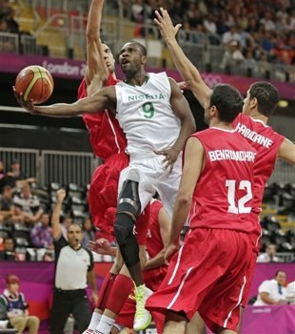
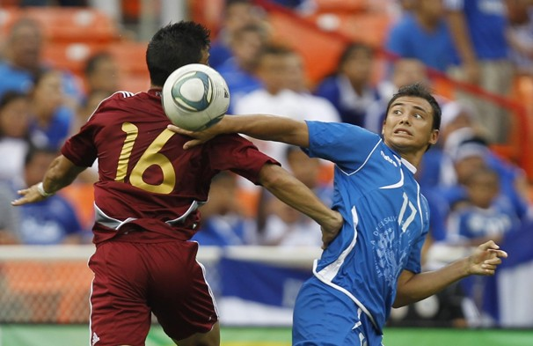
College Sports
College Basketball
College Soccer

Slide 18
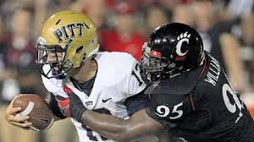

College Sports
College Baseball
College Football

Slide 19
Technology
In 2001-2002 the majority of Venezuelans that own private computers do not have any access to the internet.
In 2004 the government did a survey, and 50.4% said that they rather not have accessibility to the internet, but there is a 28.9% possible future
Internet user, primarily young, educated, and middle-class individuals.

Slide 20
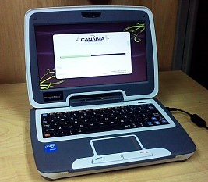
Technology
One of the most successful projects is the announcement that Venezuela is expected to produce 1,200,000 Canaima computers this year.
They placed these computers in primary schools, to help kids learn, help with their homework, continue with their studies, and also to train them with the technological skills they need to know for the 21st century.

Slide 21
Technology
The new satellite will first help bring education, communication and medical services to even the most remote areas of the country.
This process led by President Hugo Chavez, who wants to change Venezuela so it can meet its needs of the poor, and uses the technology to improve the lives of the majority of the population that lives near or below the poverty line.
The more popular technological sovereignty among communities become, the growing number of computer opening throughout the country, called "infocentres", and they offer local residents a collection of technology-based services, including computer training and access to the internet, plus space for residents to use for community purposes.

Slide 22
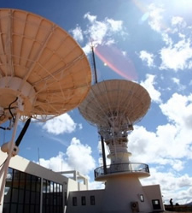
New Satellite!

Slide 23
Vocabulary Words
Satellite- satellite
Computer-computadora
Technology- tecnología
Education- educación
Licenciado - an equivalent professional title such as Engineer.
Castellano- Castilian
Técnico Superior Universitario- University Higher Technician, to distinguish from Technicians of the Sciences
Ingeniero- Engineer
Diplomados- Diploma
Prueba de Aptitud Académica- independent admission tests beyond the national test

Slide 24
Citations
http://www.greenleft.org.au/node/41495
http://venezuelanalysis.com/news/7647
http://en.wikipedia.org/wiki/Internet_in_Venezuela
http://education.stateuniversity.com/pages/1663/Venezuela-EDUCATIONAL-SYSTEM-OVERVIEW.html
http://en.wikipedia.org/wiki/Education_in_Venezuela
http://education.stateuniversity.com/pages/1663/Venezuela-EDUCATIONAL-SYSTEM-OVERVIEW.html

Slide 25
More Citations
http://en.wikipedia.org/wiki/Sport_in_Venezuela
http://venezuela-us.org/2011/02/23/science-and-technology-used-to-satisfy-social-needs-in-venezuela/
http://countrystudies.us/venezuela/19.htm
http://socyberty.com/education/school-education-in-venezuela-compared-to-the-us/
http://axisoflogic.com/artman/publish/Article_26257.shtml
Livemocha.com
Google Images

Slide 26
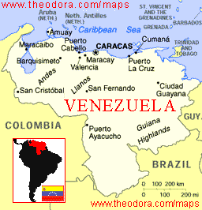
The End ☺

