Slide 1
Platos especiales del los paises hispanohablantes

Slide 2
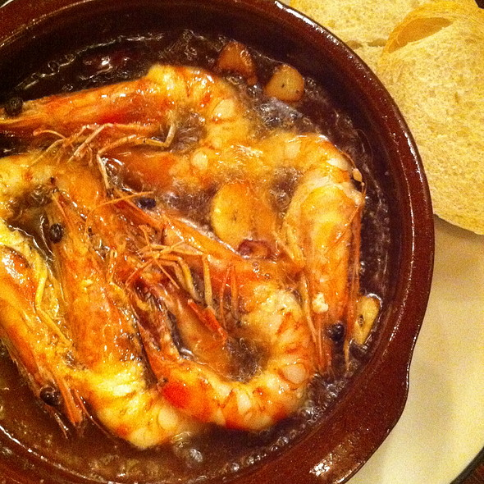
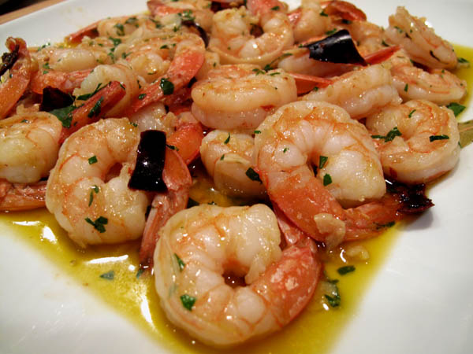
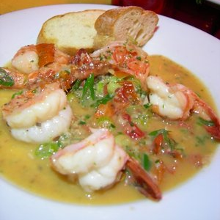
Camarones al ajillo
shrimp in garlic olive oil (similar to “scampi”)

Slide 3
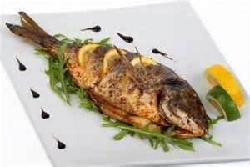
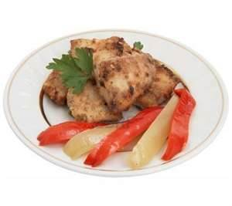
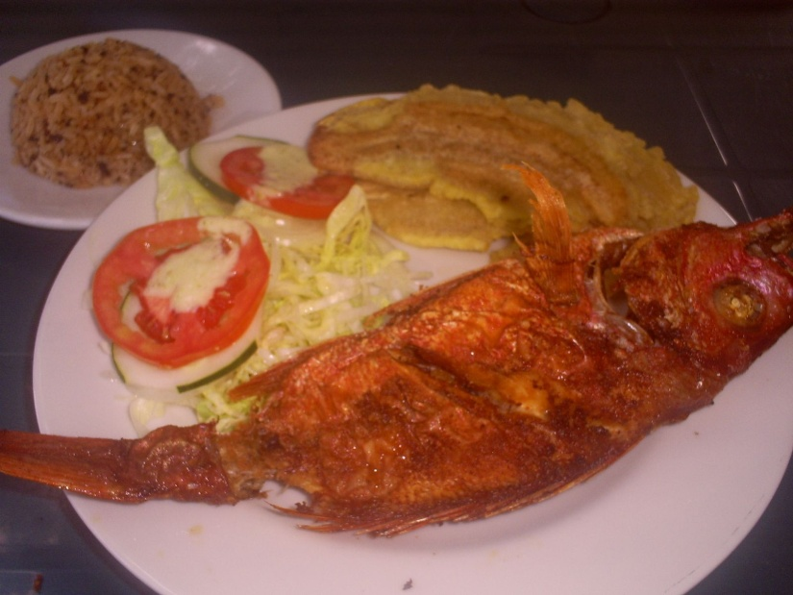
Pescado frito
fried fish (more likely sauted than deep fried
could be battered or breaded, but not always, and may be served with head and scales)

Slide 4
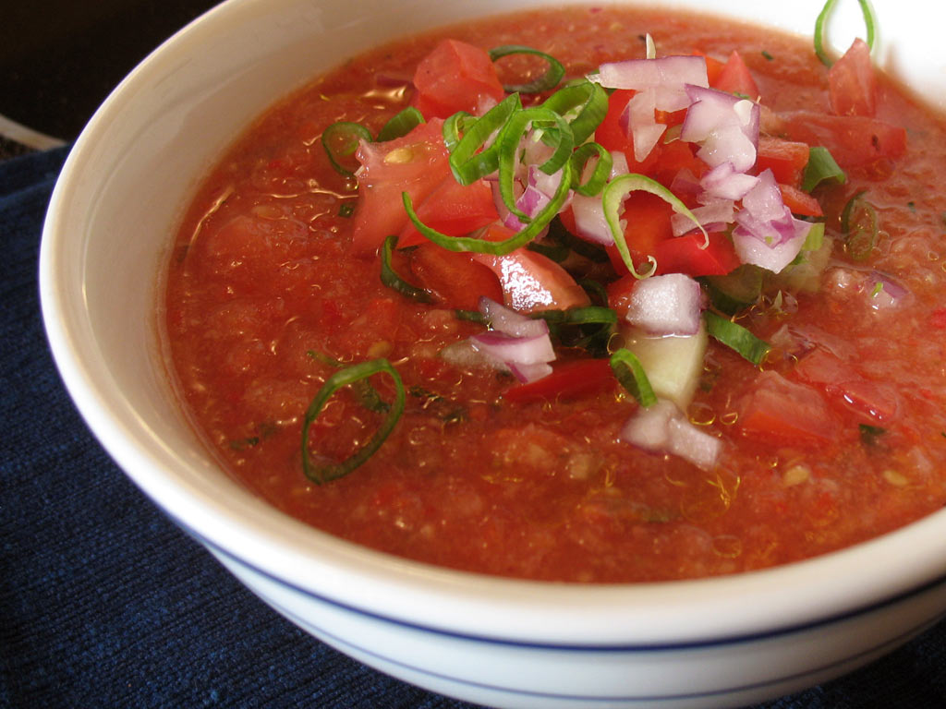
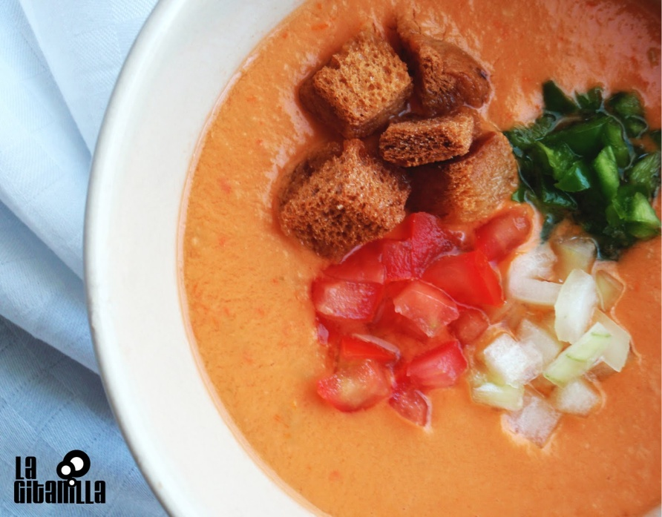
gazpacho
cold tomato soup with fresh vegetables, (usually chunky like salsa) [Spain]

Slide 5
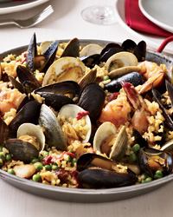
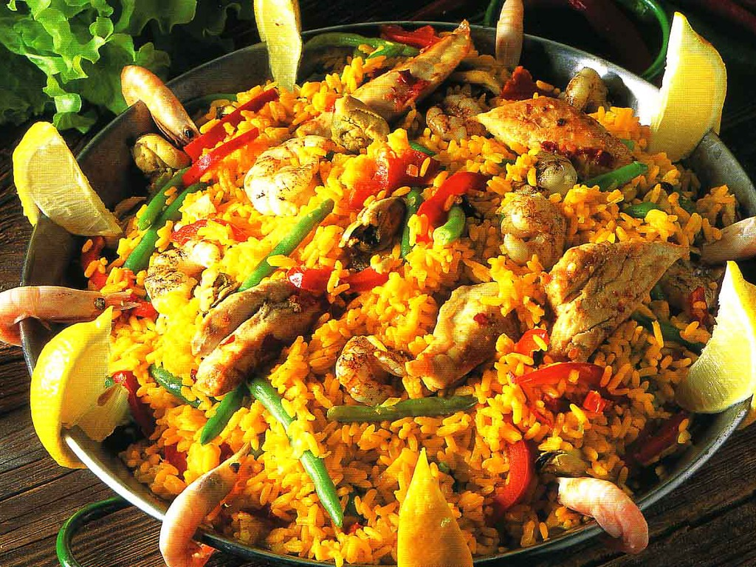
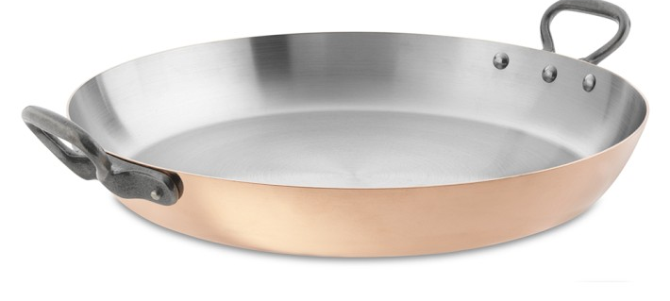
paella
Link to video
“casserole” made of garlic, olive oil, saffron, seafood and rice, made in large “special” frying pan (regional varieties include other meats and vegetables) [Spain]

Slide 6
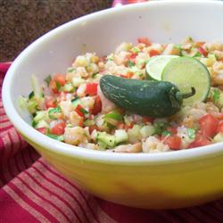
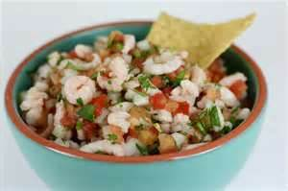
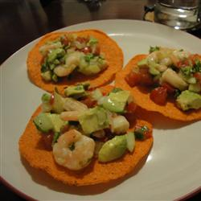
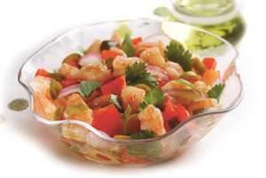
Ceviche
fish/seafood dish “cooked” by acid from lemon or lime juice; usually served as appetizer

Slide 7
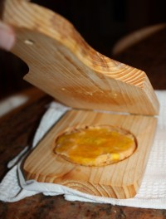
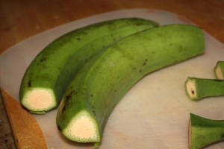
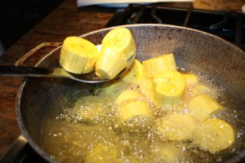
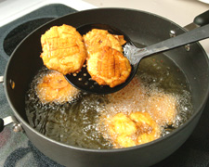
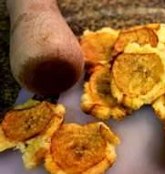
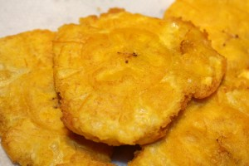
tostones
fried bananas – green plantains, not sweet , starchy a little like fried potatoes; made by frying, squishy and frying again; served as side dish or appetizer [Puerto Rico]
Can be served with garlic mojito sauce or
mayo-ketchup sauce

Slide 8
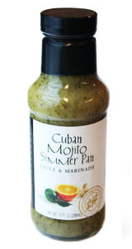
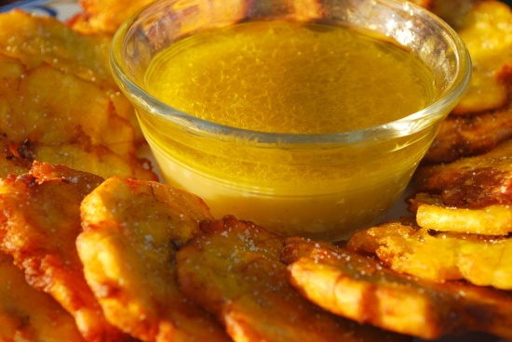
mojito
garlic and olive oil sauce
Ingredients:
1 cup olive oil, warmed
1 head of garlic peeled, crushed
&f inely chopped
1 small onion, finely diced
3 tablespoons cilantro, finely chopped
juice of 1 lemon
juice of 1 lime
salt to taste
Preparation:
Blend all the ingredients together in a nonreactive bowl. (A nonreactive bowl is one made of material that does not react chemically to the citrus acids
Tip: Use a blender or food processor to mix the ingredients..

Slide 9
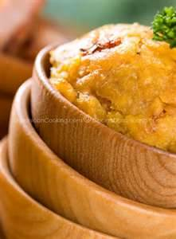
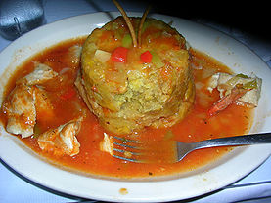
mofongo
fried green plantains mashed together in a pilón (which is a wooden mortar and pestle), with broth, garlic, olive oil, and pork cracklings or bits of bacon. It is often filled with vegetables, chicken, crab, shrimp, or beef and is often served with fried meat ; can be served in the pilon [Puerto Rico]

Slide 10
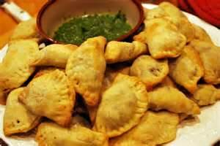
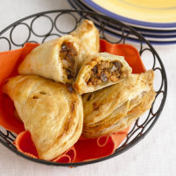
empanadas
pastry filled with meats, spices and fruit; like “turn-overs”

Slide 11
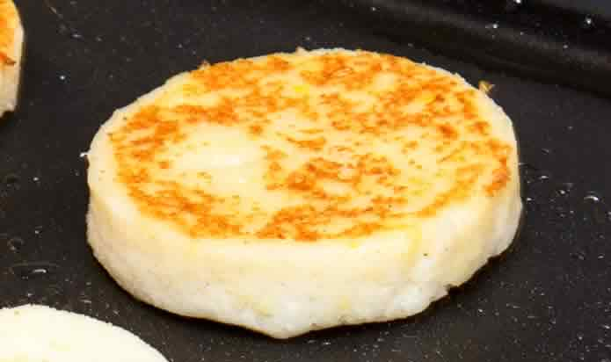
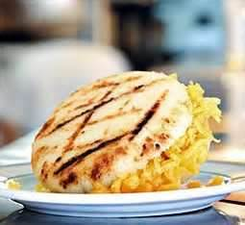
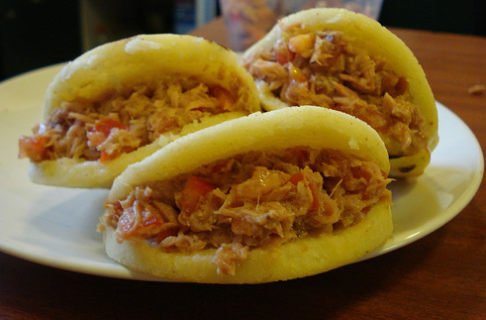
arepas
tortilla pancake made of corn meal (like corn bread), served with filling [Venezuela]

Slide 12
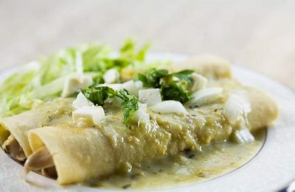
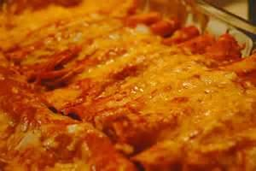
enchiladas
soft tortillas filled with meat, beans, cheese, vegetables; tortillas are wrapped, and covered with sauce; often baked [Mexico]

Slide 13
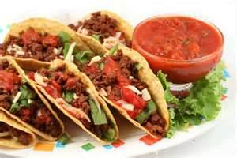
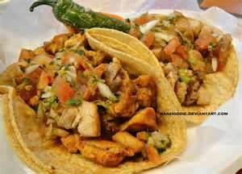
tacos
tortillas, soft or fried, served filled with meat or beans or seafood, fresh vegetables, salsa, cheese, sour cream [Mexico]

Slide 14
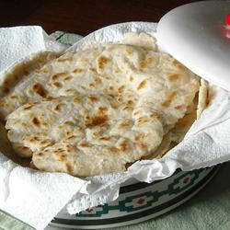
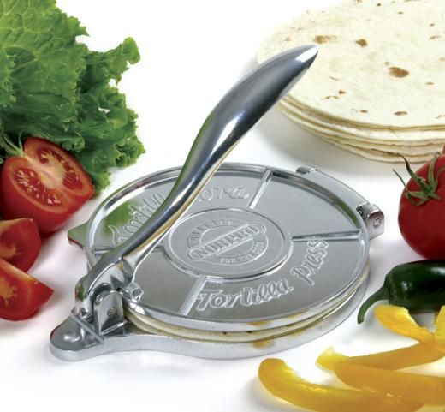
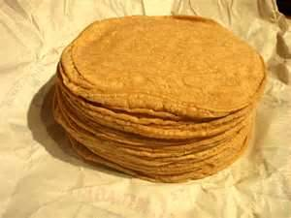
tortillas
soft, round, thin, flat bread; can be made of flour (wheat) or corn meal [Mexico and South America]

Slide 15
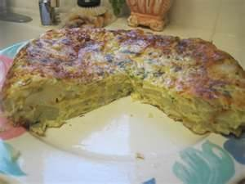
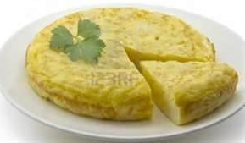
Tortilla espaŇola
prepared in pan with eggs, potatoes, onions, and peppers; cooked gently over flame like an omelet, but filling is incorporated into eggs and it is not folded over to be served; inverted on serving dish, cut in wedges, and served as light meal or appetizer [Spain]

Slide 16
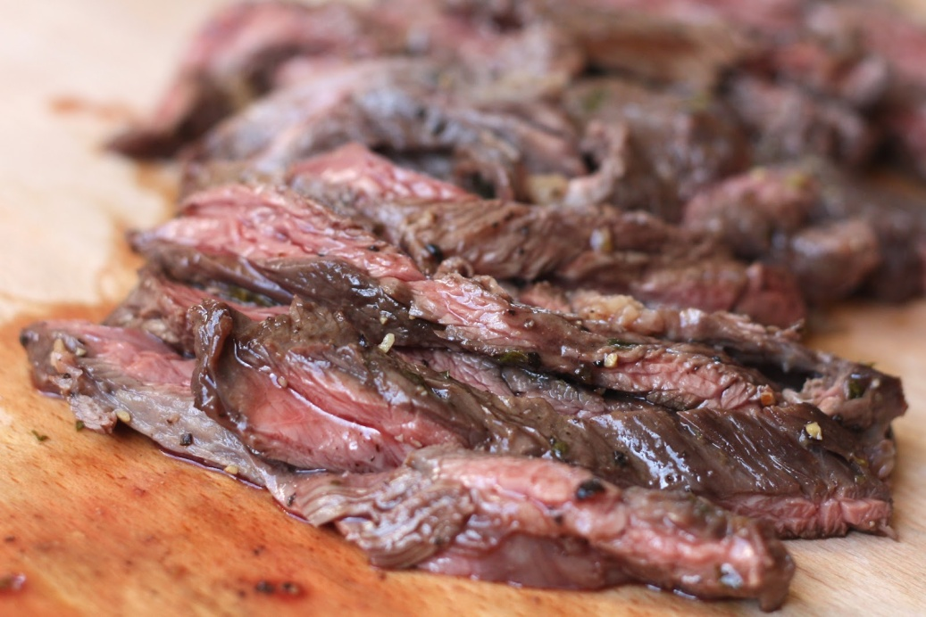
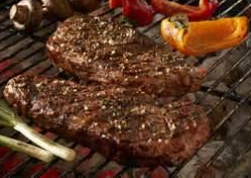
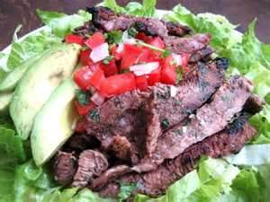
Carne asada
roasted meat, usually thin beef steak, flavored with “certain” spices; served in various ways

Slide 17
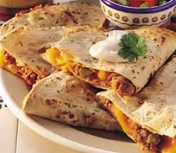
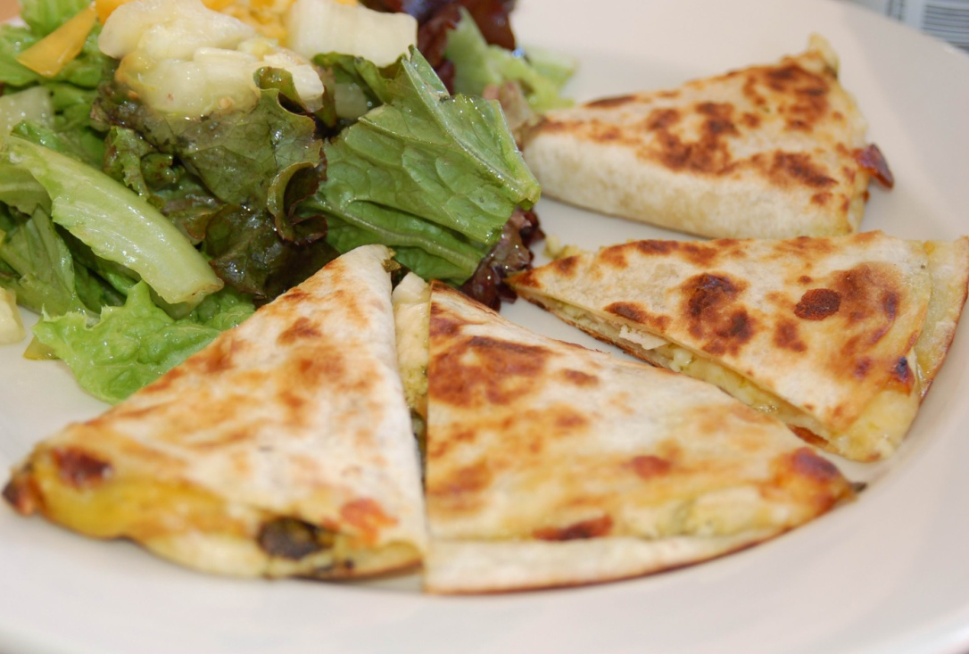
quesadillas
2 tortillas (or single tortilla) filled with cheese (and maybe meat or beans or vegetables) and fried on both sides; served folded over or cut in wedges with salsa, sour cream,or pico de gallo

Slide 18
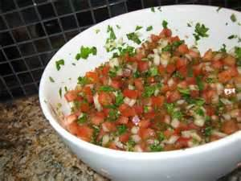
pico de gallo
fresh salsa made of tomatoes, onions, and other vegetables

